Slide 1

NGOC LAM PRIMARY SCHOOL
Unit 6
DESCRIBING PEOPLE
REVIEW & PRACTICE 1
PAGE 90

Slide 2
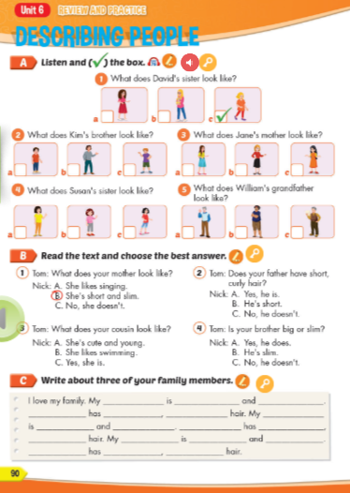
Lesson Outline
Warm-up
Listening
Reading
Consolidation
Wrap-up

Slide 3
Objectives
By the end of this lesson, students will be able to review Unit 6.
Vocabulary: Handsome, pretty, slim, blond, curly, straight
Structure:
What does he look like?
He is slim and tall.
Is she tall or short?
She is tall.

Slide 4

WARM UP

Slide 5



LISTEN AND CHOOSE
LET’S PLAY!

Slide 6

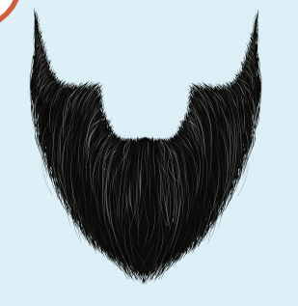
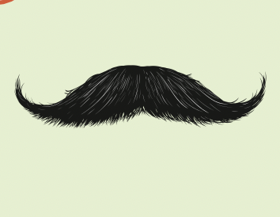

Slide 7

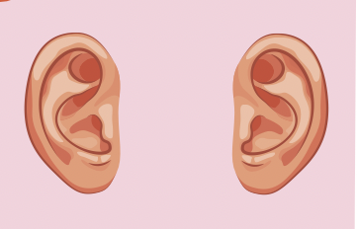

Slide 8
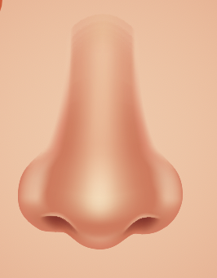
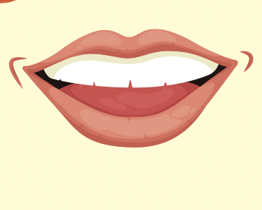

Slide 10
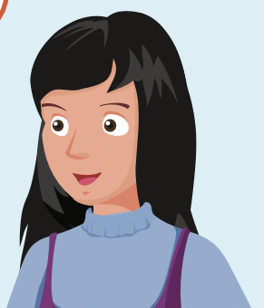
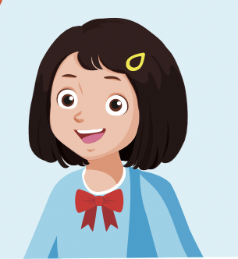

Slide 11
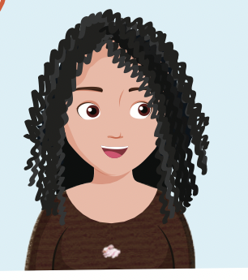
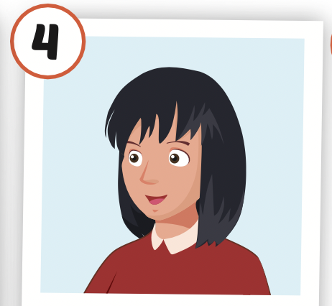

Slide 12
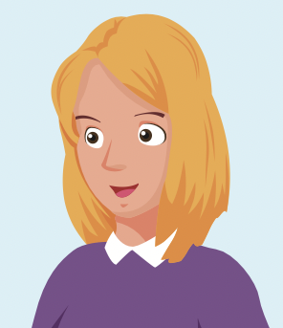

Slide 13

It’s time to learn …

Slide 14

Listening

Slide 15

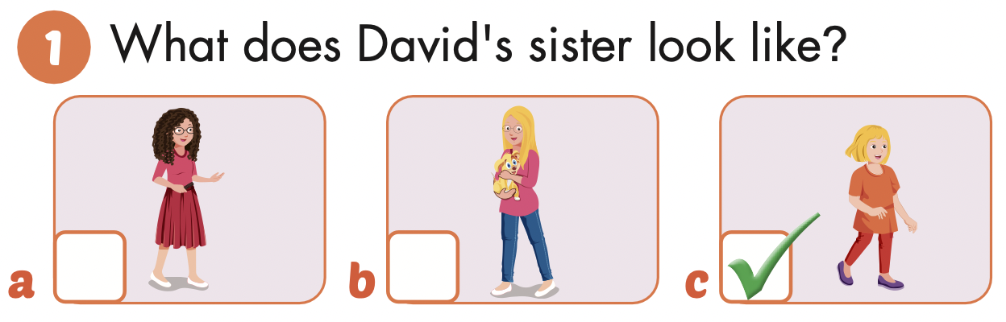

Slide 16
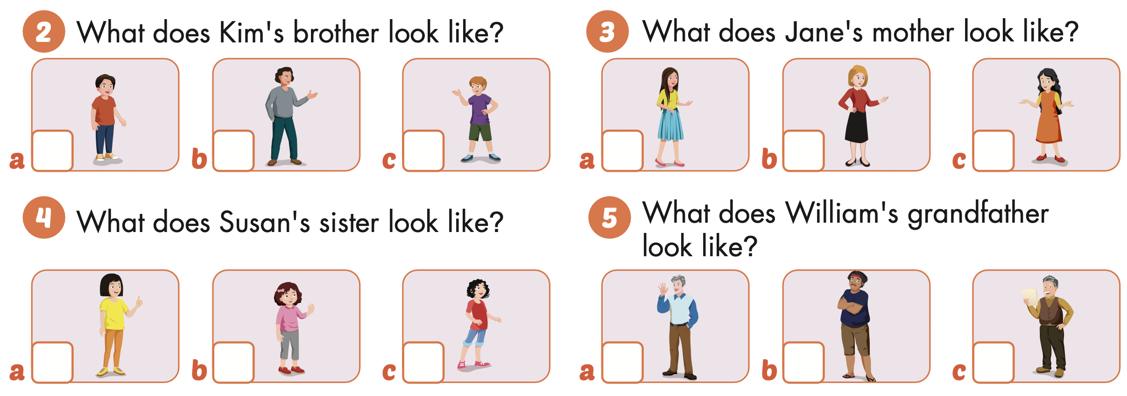




Slide 17
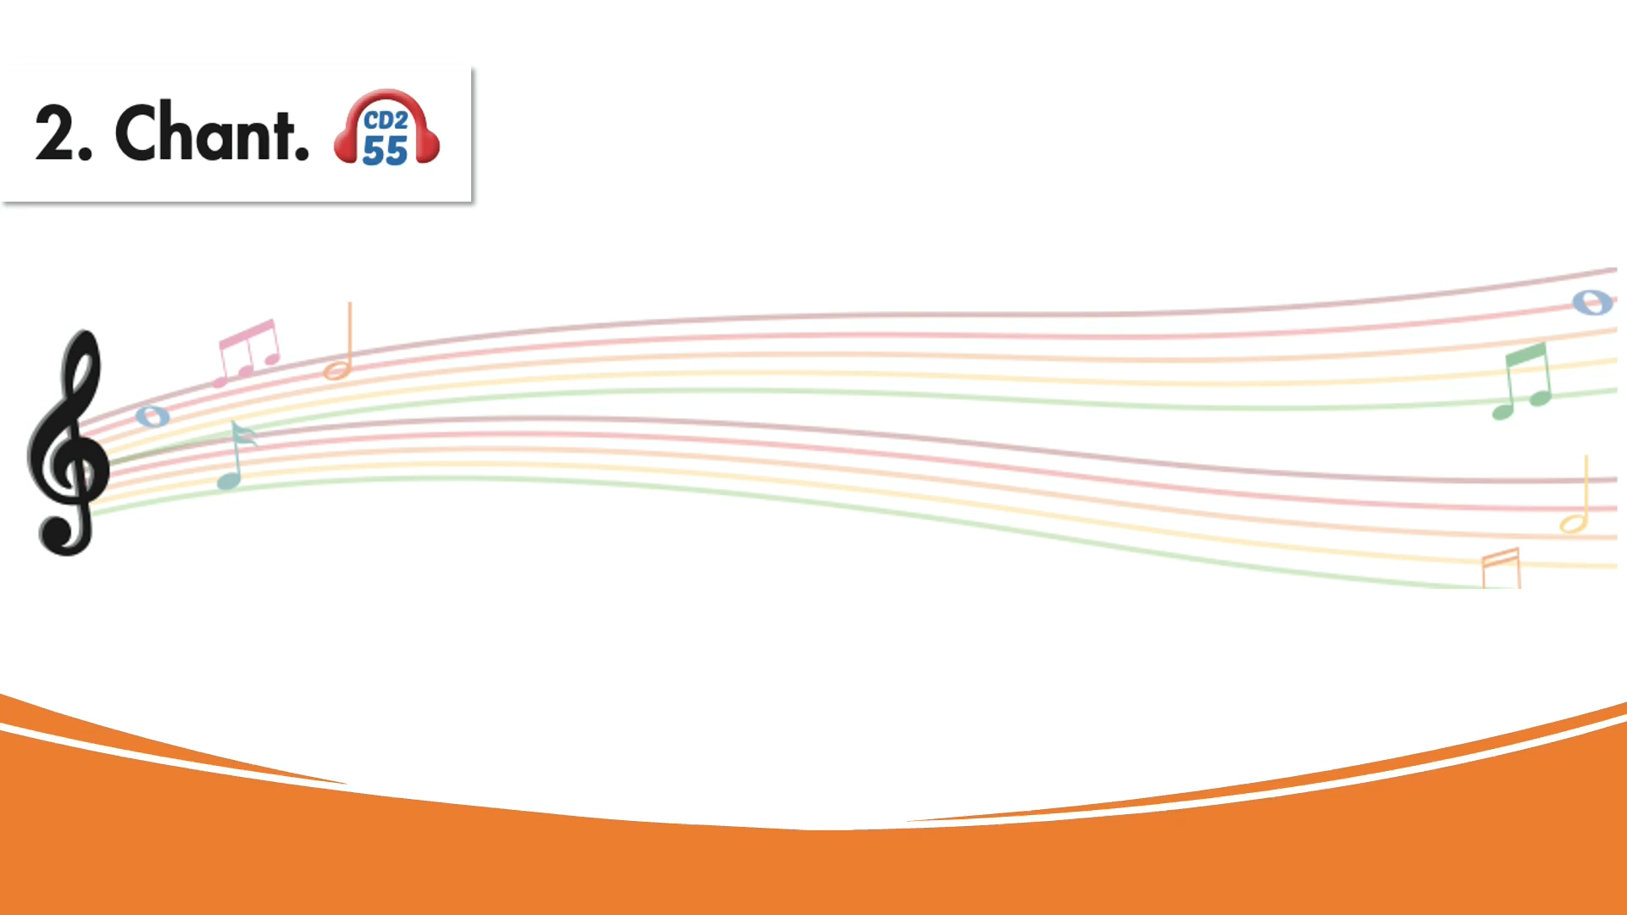

Slide 18

Reading

Slide 19
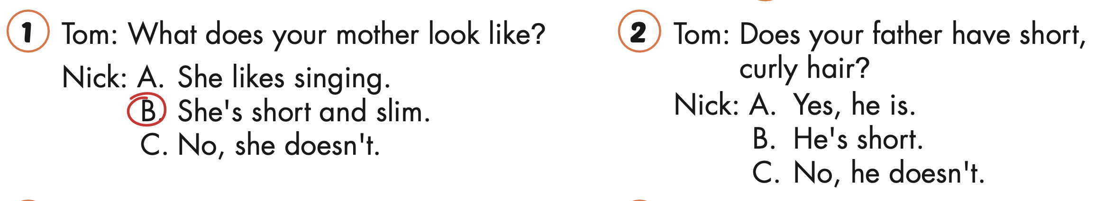

Slide 21
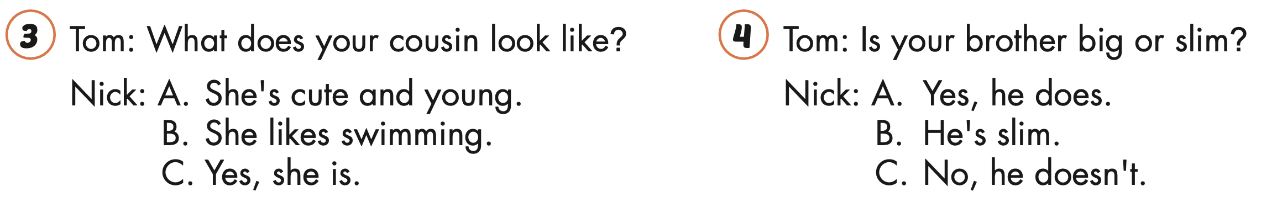

Slide 23

Writing

Slide 24
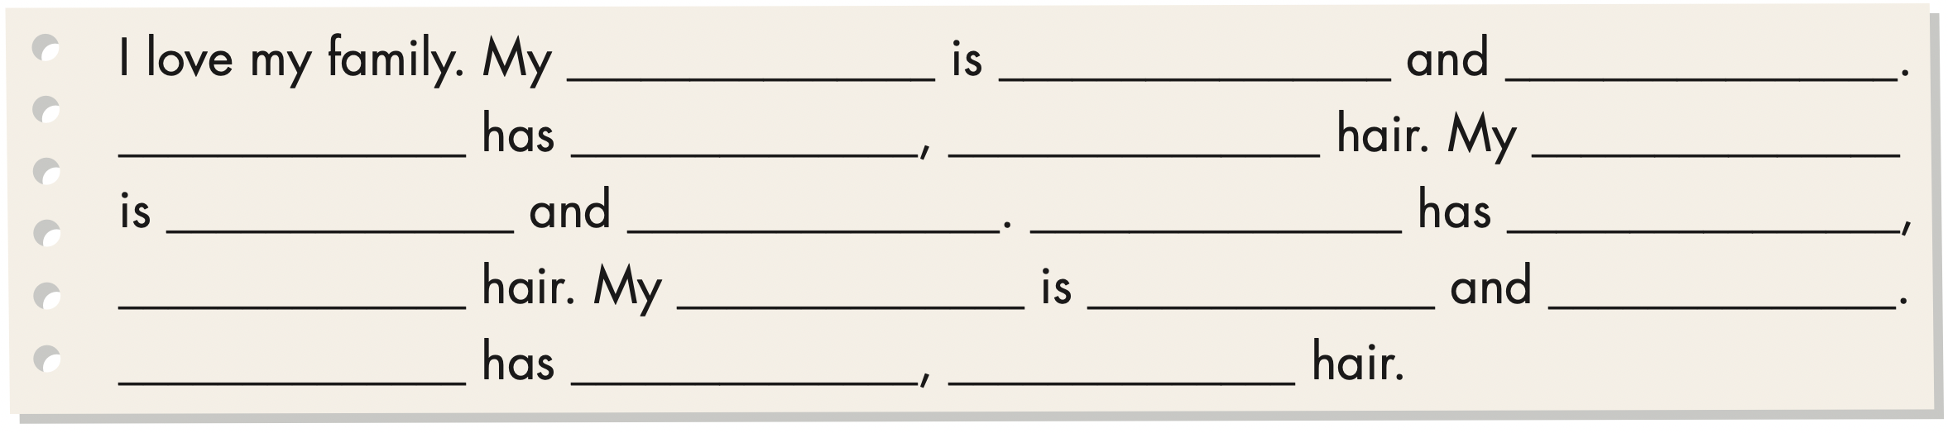

Slide 25

Speaking

Slide 26
TELL YOUR FRIENDS ABOUT YOUR FAMILY MEMBERS

Slide 27

CONSOLIDATION

Slide 28

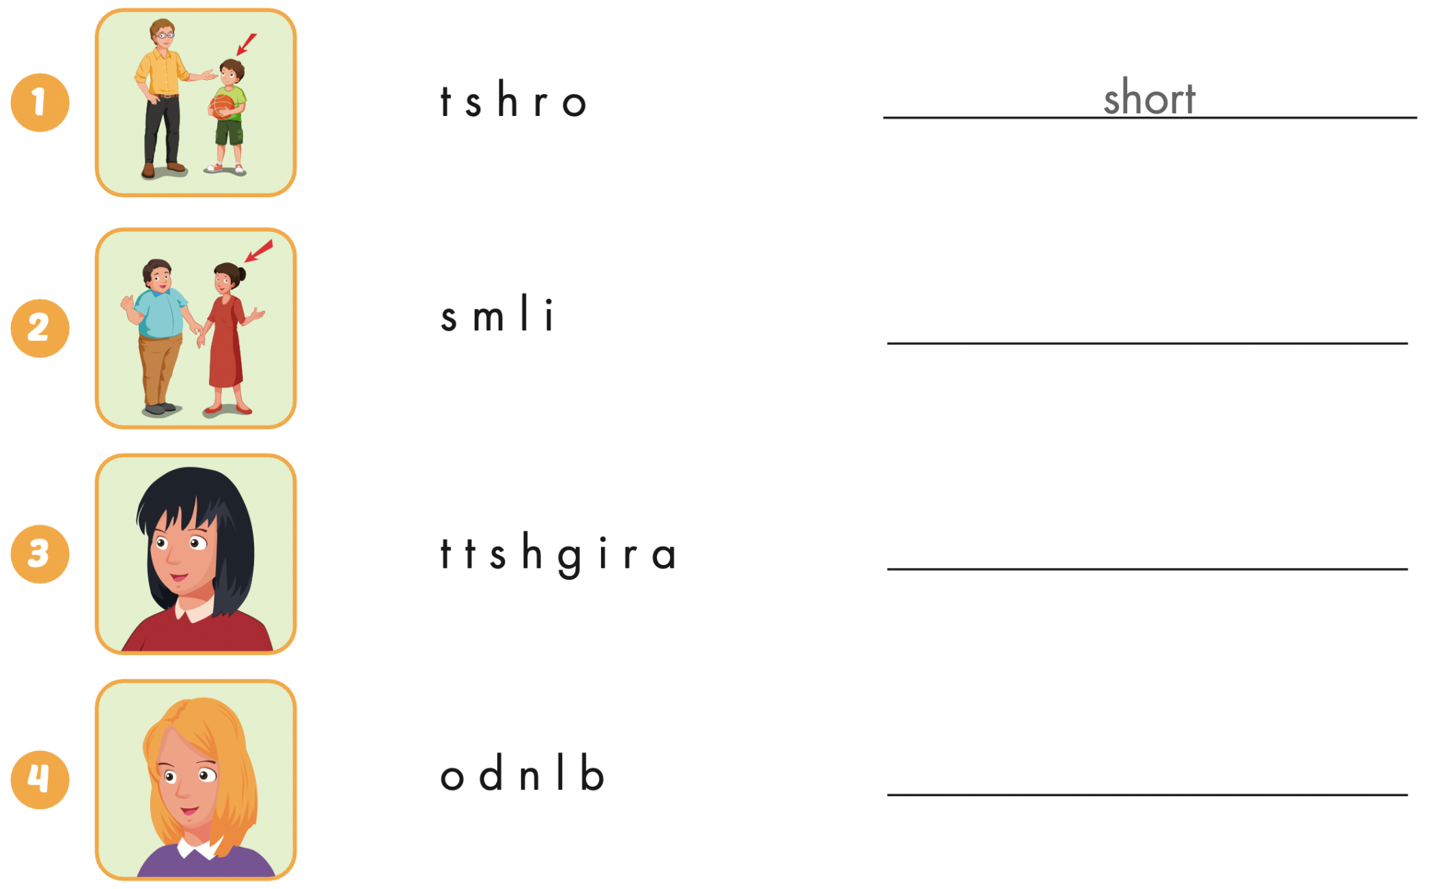
Extra Practice
WB, page 60
slim
straight
blond

Slide 29
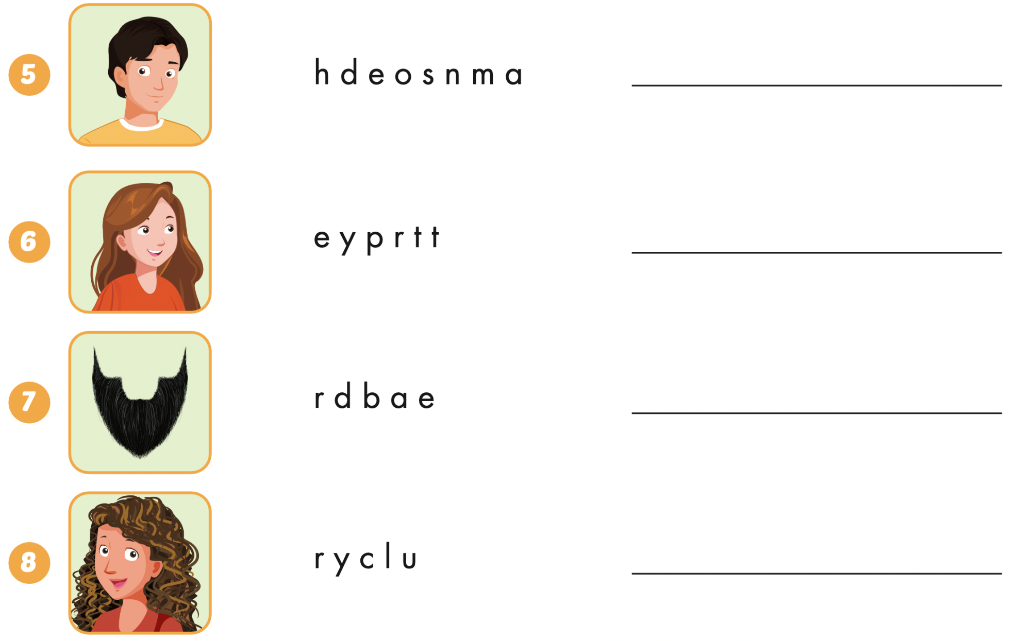
Extra Practice
WB, page 60
handsome
pretty
beard
curly

Slide 30

WRAP-UP

Slide 31
Today’s lesson
Vocabularies
Handsome,
Pretty,
Slim,
Blond,
Curly,
Straight
Structures/ Sentence patterns
What does he look like?
He is slim and tall.
Is she tall or short?
She is tall.

Slide 32
Homework
Practice the vocabularies and structure, and make sentences using them.
Do the exercises in Tiếng Anh 4 i-Learn Smart Start WB (page 60).
Do the exercises in Tiếng Anh 4 i-Learn Smart Start Notebook (Page 38).
Prepare the next lesson (page 91 SB).
Play the consolidation games in Tiếng Anh 4 i-Learn Smart Start DHA App on www.eduhome.com.vn

Slide 33

Enjoy your day!

