Slide 1

NGOC LAM PRIMARY SCHOOL
Unit 6
DESCRIBING PEOPLE
ART LESSON 2
PAGE 88

Slide 2
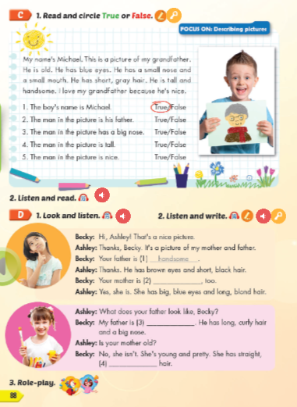
Lesson Outline
Warm-up
Reading
Listening
Consolidation
Wrap-up

Slide 3
Objectives
By the end of this lesson, students will be able to describe pictures.
Vocabulary: handsome, pretty, cute, young, old.
Structure: What does your brother look like?
He's young and handsome.

Slide 4

WARM UP

Slide 5

Speaking

Slide 6


Look, ask and answer

Slide 7
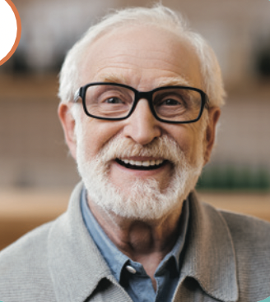
grandfather
What does your grandfather look like?
He is old.

Slide 8

Mother
What does your mother look like?
She is pretty.

Slide 9

sister
What does your sister look like?
She is cute.

Slide 10
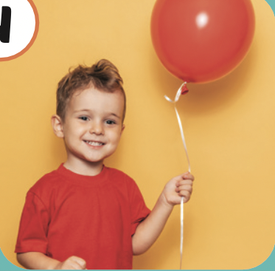
brother
What does your brother look like?
He is young.

Slide 11
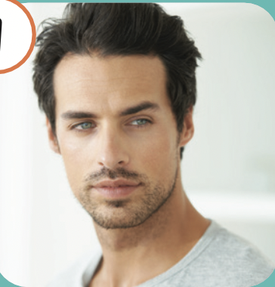
uncle
What does your uncle look like?
He is handsome.

Slide 12

It’s time to learn …

Slide 13
Reading

Slide 14

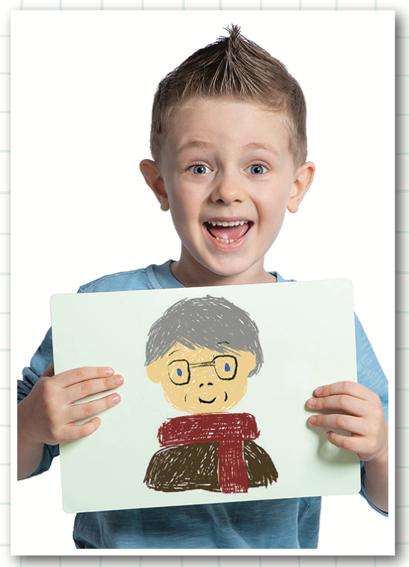
Look and guess:
Who is he drawing?
What does he look like?

Slide 15

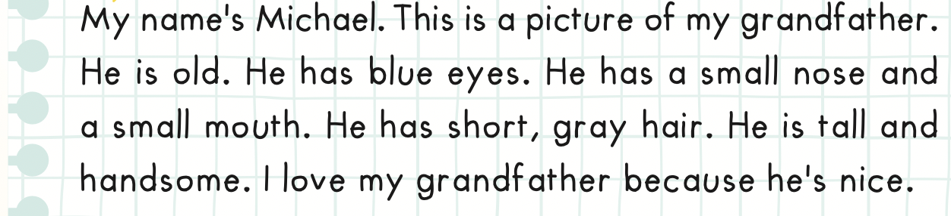
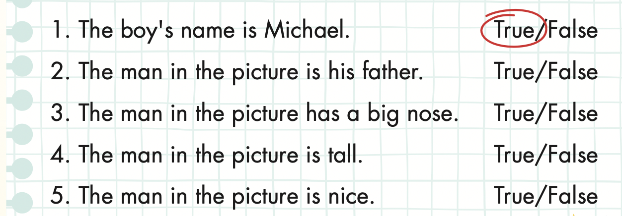

Slide 16

False
True
YES or NO
START

Slide 17
True
The boy’s name is Michael.
False

Slide 18
True
The man in the picture is his father.
False

Slide 19
True
The man in the picture has a big nose.
False

Slide 20
True
The man in the picture is tall.
False

Slide 21
True
The man in the picture is nice.
False

Slide 22

Listening

Slide 23



Slide 24

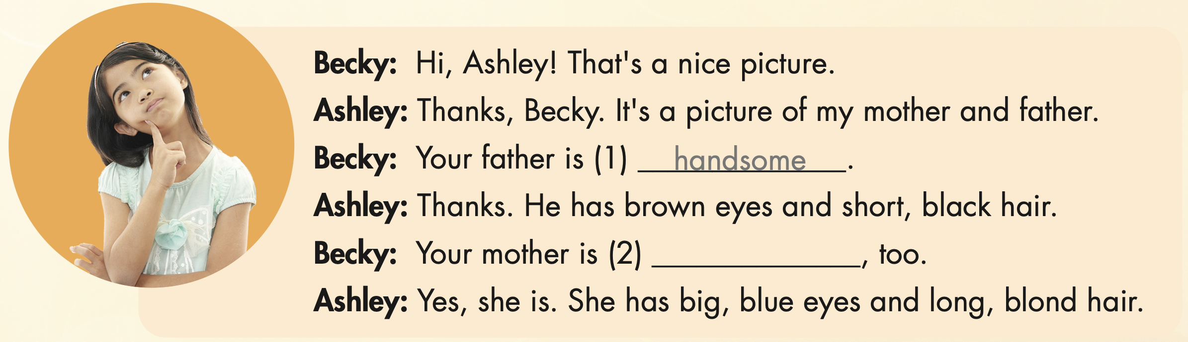
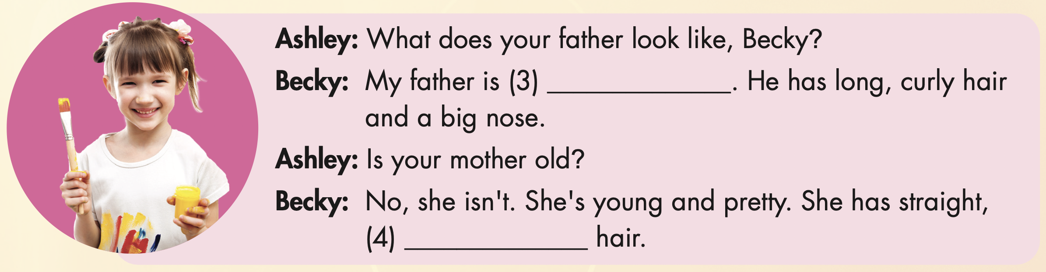

Slide 25

pretty

Slide 26
old
black

Slide 27

Writing

Slide 28

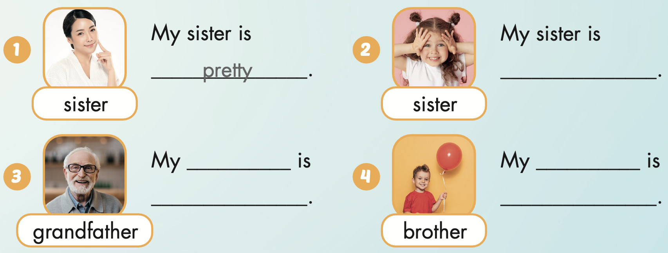
Extra Practice
WB, page 18
cute
grandfather
brother
old
young

Slide 29

CONSOLIDATION

Slide 30

WRAP-UP

Slide 31
Today’s lesson
Vocabularies
handsome,
pretty,
cute,
young,
old.
Structures/ Sentence patterns
What does your brother look like?
He's young and handsome.

Slide 32
Homework
Practice the vocabularies and structure, and make sentences using them.
Do the exercises in Tiếng Anh 4 i-Learn Smart Start WB (page 59).
Do the exercises in Tiếng Anh 4 i-Learn Smart Start Notebook (page 37).
Prepare the next lesson (page 89 SB).
Play the consolidation games in Tiếng Anh 4 i-Learn Smart Start DHA App on www.eduhome.com.vn

Slide 33
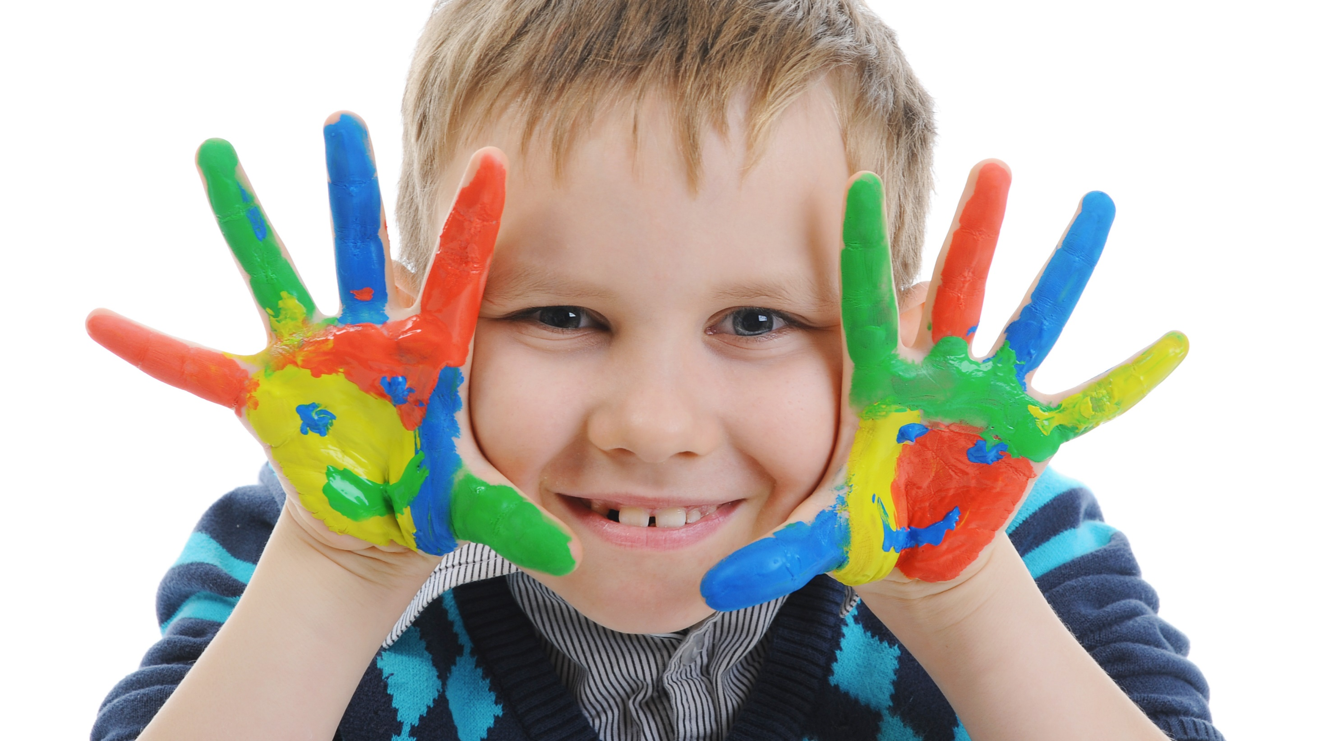
Enjoy your day!

