Slide 1

Unit 6: Clothes
Lesson 3.3
Page 90

Slide 2
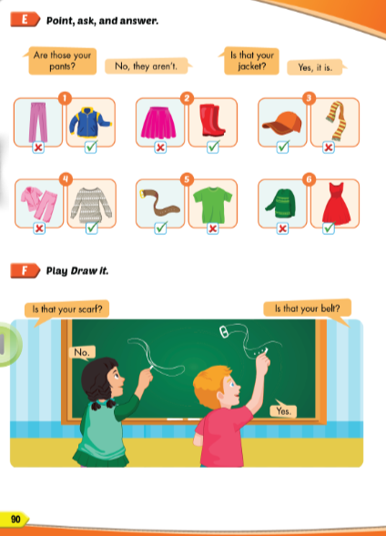
Lesson Outline
Warm-up
Practice
Speaking
Consolidation
Wrap-up

Slide 3
Objectives
By the end of this lesson, students will be able to ask and answer about their clothes.
Vocabulary:
Revision (belt, scarf, sweater, pajamas, skiing).
Structure: Are those your pants?
No, they aren’t.
Is that your jacket?
Yes, it is.

Slide 4

WARM UP

Slide 5
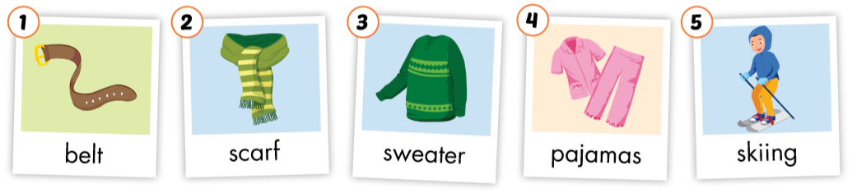

Slide 6
Let’s play!
Pictionary

Slide 7
How to play
Pictionary
Put the words in a bag.
Divide the class into 2 teams and draw a line down the middle of the board.
Ask one member from each team to choose a word from the bag.
Tell the students to draw the word as a picture on the board and encourage their team to guess the word.
The first team to shout the correct answer gets a point.

Slide 8

Practice

Slide 9

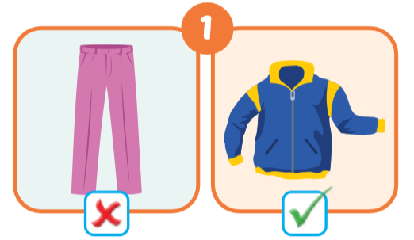
Are those your pants?
No, they aren’t.
Is that your jacket?
Yes, it is.

Slide 10
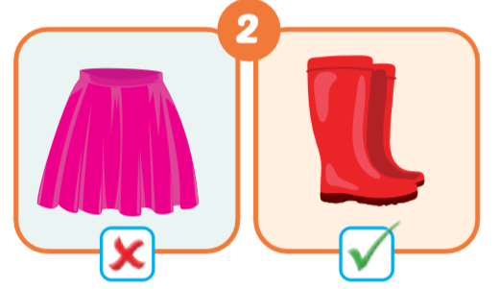
Is that your skirt?
No, it isn’t.
Are those your boots?
Yes, they are.

Slide 11
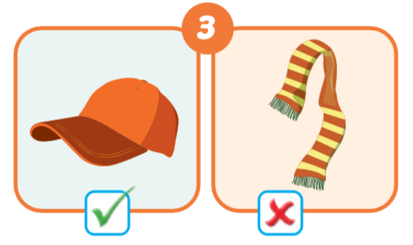
Is that your hat?
Yes, it is.
Is that your scarf?
No, it is’nt.

Slide 12
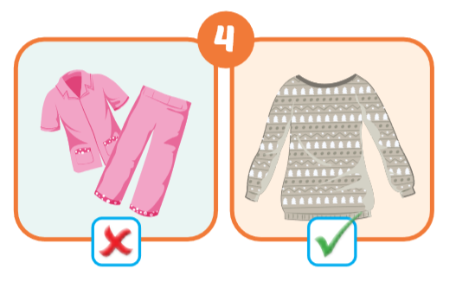
Are those your pajamas?
No, they aren’t.
Is that your sweater?
Yes, it is.

Slide 13
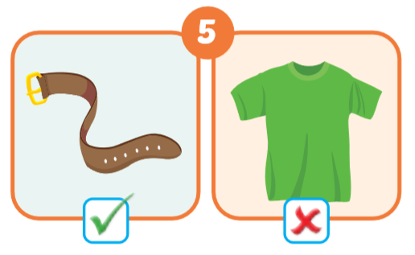
Is that your belt?
Yes, it is.
Is that your T-shirt?
No, it is’nt.

Slide 14
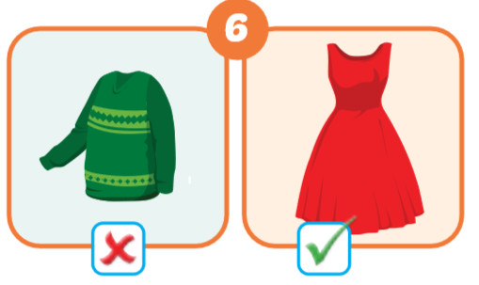
Is that your sweater?
No, it is’nt.
Is that your dress?
Yes, it is.

Slide 15



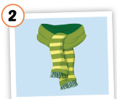
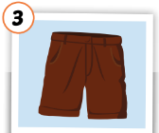
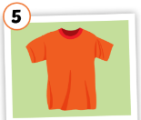
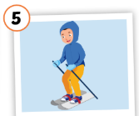
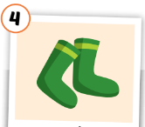
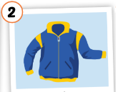
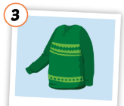

Put the pictures in the right group.
◆
❖
summer
winter

Slide 16

Speaking

Slide 17



What is behind the question marks?
s
c
a
r
f

Slide 18
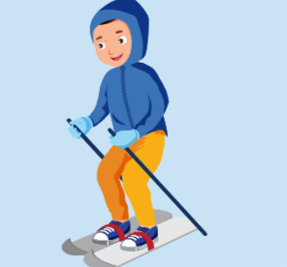
What is behind the question marks?
s
k
i
i
n
g

Slide 19
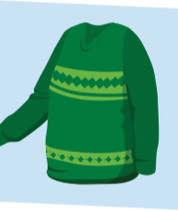
What is behind the question marks?
s
w
e
a
t
e
r

Slide 20

What is behind the question marks?
p
a
j
a
m
a
s

Slide 21

What is behind the question marks?
b
e
l
t

Slide 22

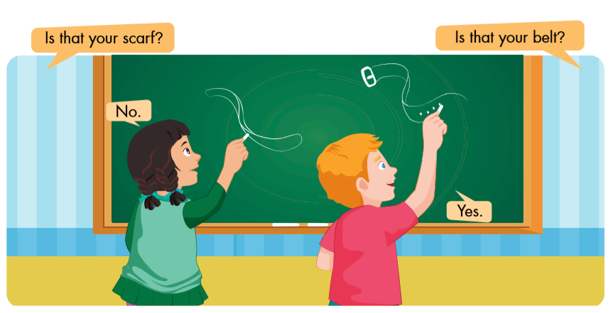

Slide 23

CONSOLIDATION

Slide 24
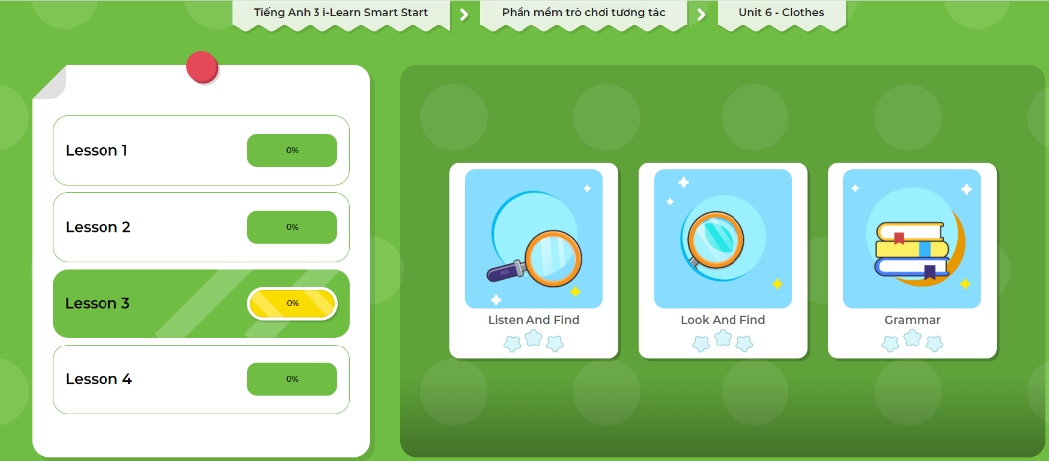
Click here to play the games!

Slide 25

WRAP-UP

Slide 26
Today’s lesson
Structures/ Sentence patterns
Are those your pants?
No, they aren’t.
Is that your jacket?
Yes, it is.

Slide 27
Homework
Practice the vocabularies and structure; and make sentences using them.
Do the exercises in Tiếng Anh 3 i-Learn Smart Start Workbook (page 63).
Prepare the next lesson (page 91 SB).
Play the consolidation games in Tiếng Anh 3 i-Learn Smart Start DHA App on www.eduhome.com.vn
Do the exercise in Tiếng Anh 3 i-Learn Smart Start Notebook (page 42).

Slide 28

Enjoy your day!

