Slide 1

Unit 6: Clothes
Lesson 3.2
Page 89

Slide 2
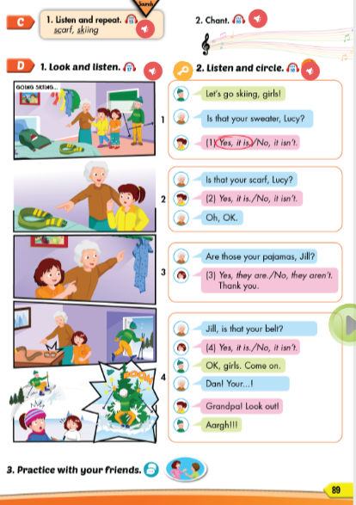
Lesson Outline
Warm-up
Listening
Consolidation
Wrap-up

Slide 3
Objectives
By the end of this lesson, students will be able to ask and answer about their clothes.
Vocabulary: scarf , skiing
Structure: Is that your belt?
Yes, it is./No, it isn’t
Are those your pajamas?
Yes, they are./No, they aren’t.

Slide 4

WARM UP

Slide 5
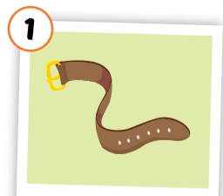
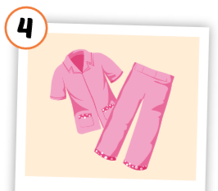
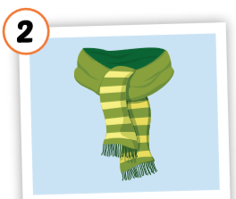
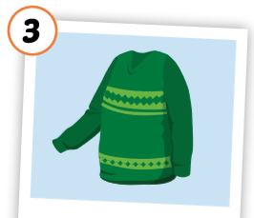
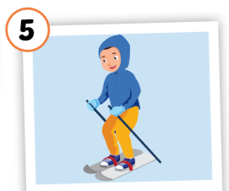
1
4
2
1
2
SPIN
5
2
3
4
3
5

Slide 6
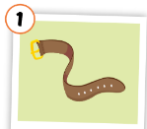
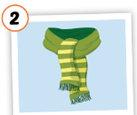



sweater
pajama
belt
skiing
scarf

Slide 7

It’s time to learn …

Slide 8

Listening

Slide 9


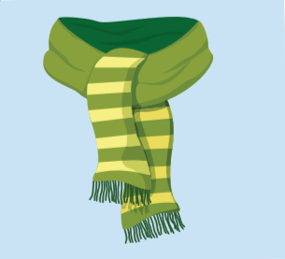
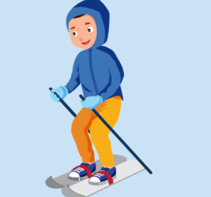
C. 1.Listen and repeat.
scarf
skiing
Click each English word to hear the sound.
Notes:
GV giới thiệu từ vựng, CCQ

Slide 10


Click the earphone to hear the sound.
/sk/, /sk/, /sk/
scarf skiing
/sk/, /sk/, /sk/
/sk/, /sk/, /sk/
/sk/, /sk/, /sk/

Slide 11

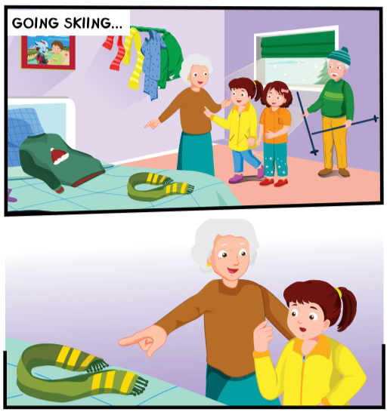
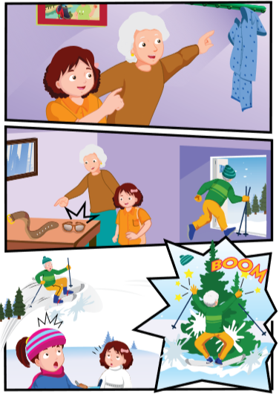
Click the earphone to hear the sound.

Slide 12




Let’s go skiing, girls!
Is that your sweater, Lucy?
(1) Yes, it is./No, it isn’t.
Click the earphone to hear the sound.

Slide 13
Is that your scarf, Lucy?
(2) Yes, it is./No, it isn’t.
Oh, OK.
Click the earphone to hear the sound.

Slide 14

Are those your pajamas, Jill?
Yes, they are./
No, they aren’t. Thank you.
Click the earphone to hear the sound.

Slide 15






Click the earphone to hear the sound.
Jill, is that your belt?
(4) Yes, it is./No, it isn’t.
OK, girls. Come on.
Dan! Your...!
Grandpa! Look out!
Aargh!!!

Slide 16
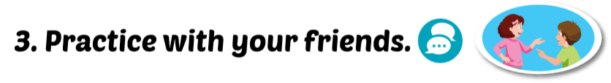
Grandpa: Let’s go skiing, girls!
Grandma: Is that your sweater, Lucy?
Lucy : Yes, it is.

Slide 17
Grandma: Is thta your srcaf, Lucy?
Lucy : No, it isn’t.
Grandma: Oh, OK.

Slide 18
Grandma: Are those your pajamas, Jill?
Jill : Yes, they are. Thank you.

Slide 19
Grandma: Jill, is that your belt?
Jill : Yes, it is.
Grandpa: OK, girls. Come on!
Grandma: Dan! Your...!
Lucy : Grandpa! Look out!
Grandpa: Aargh!!!

Slide 20

Workbook
p. 61

Slide 21

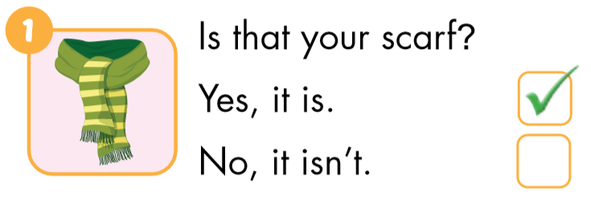
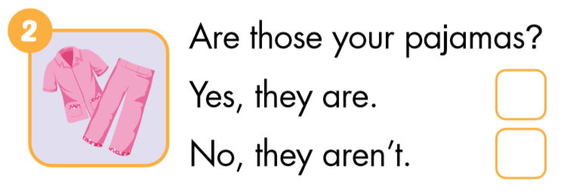

Click the earphone to hear the sound.

Slide 22
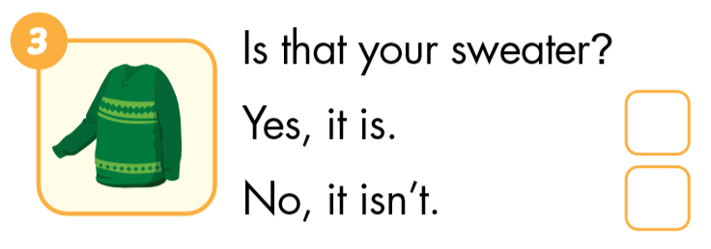
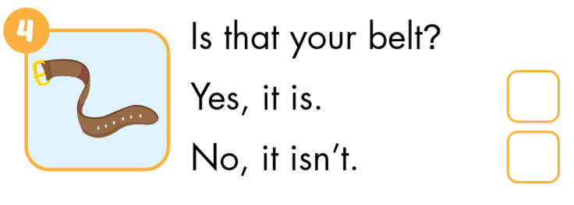
Click the earphone to hear the sound.

Slide 23

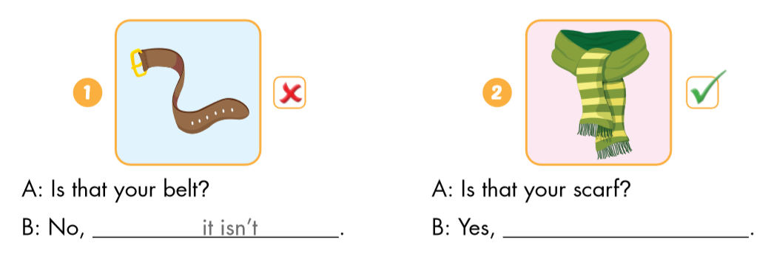
it isn’t
it is

Slide 24
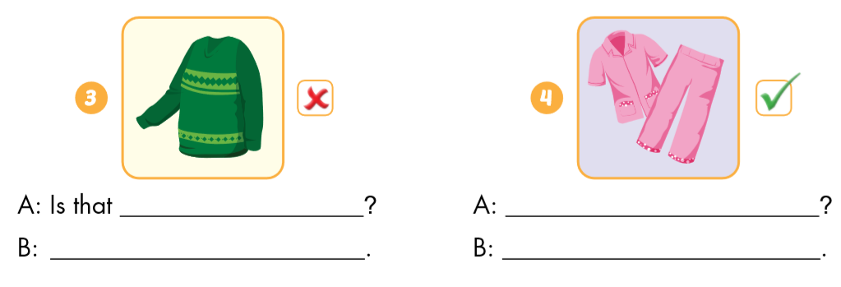
your sweater
Are those your pajamas?
No, it isn’t
Yes, they are

Slide 25

CONSOLIDATION

Slide 26
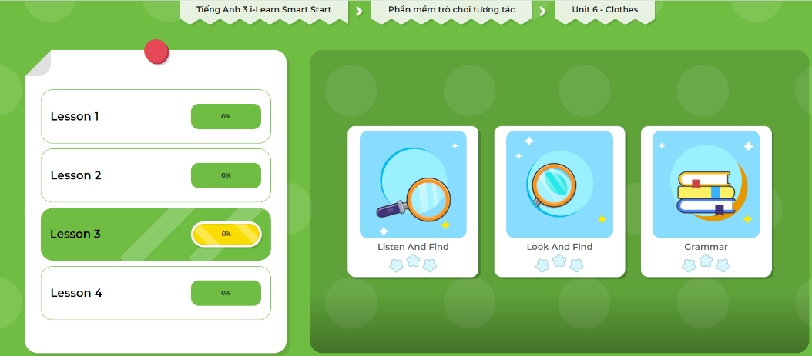
Click here to play the games!

Slide 27
scarf
SHOW

Slide 28
skiing
SHOW

Slide 29

WRAP-UP

Slide 30
Today’s lesson
Vocabularies
scarf , skiing
Phonics
/sk/
Structures/ Sentence patterns
Is that your belt?
Yes, it is./No, it isn’t
Are those your pajamas?
Yes, they are./No, they aren’t.

Slide 31
Homework
Practice the vocabularies and structure; and make sentences using them.
Do the exercises in Tiếng Anh 3 i-Learn Smart Start Workbook (page 63).
Prepare the next lesson (page 90 SB).
Play the consolidation games in Tiếng Anh 3 i-Learn Smart Start DHA App on www.eduhome.com.vn

Slide 32

Enjoy your day!

