Slide 1

Unit 6: Clothes
Lesson 2.2
Page 86

Slide 2
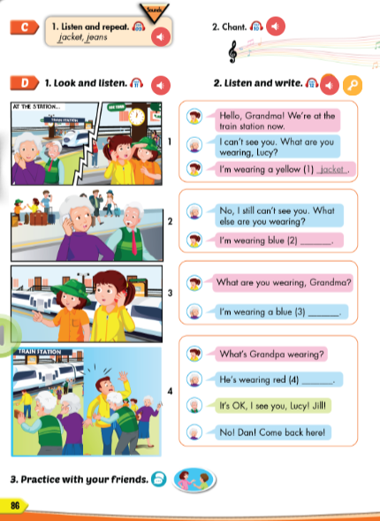
Lesson Outline
Warm-up
Listening
Consolidation
Wrap-up

Slide 3
Objectives
By the end of this lesson, students will be able to to pronounce the sound /dʒ/ and talk about what they are wearing.
Vocabulary: jacket, jeans.
Structure: What are you wearing?
I’m wearing blue jeans/ I’m wearing a red jacket.

Slide 4

WARM UP

Slide 5
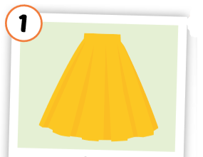
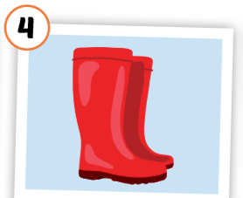
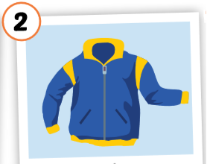
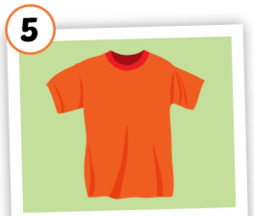
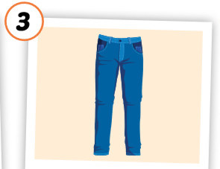
1
4
2
1
2
SPIN
5
2
3
4
3
5

Slide 6





1
2
3
4
5
6
7
8
9
10

Slide 7
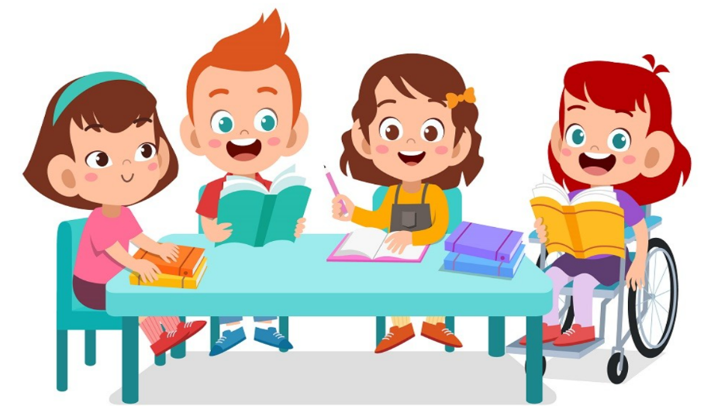
It’s time to learn …

Slide 8

Listening

Slide 9


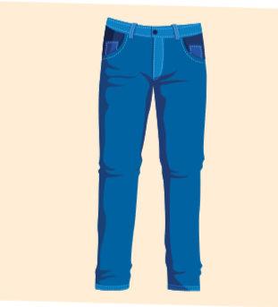
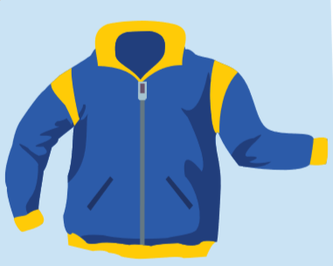
C. 1.Listen and repeat.
jacket
jeans
Click each English word to hear the sound.
Notes:
GV giới thiệu từ vựng, CCQ

Slide 10

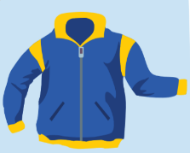


Click the earphone to hear the sound.
/dʒ/, /dʒ/, /dʒ/
jacket jeans
/dʒ/, /dʒ/, /dʒ/
/dʒ/, /dʒ/, /dʒ/
/dʒ/, /dʒ/, /dʒ/

Slide 11

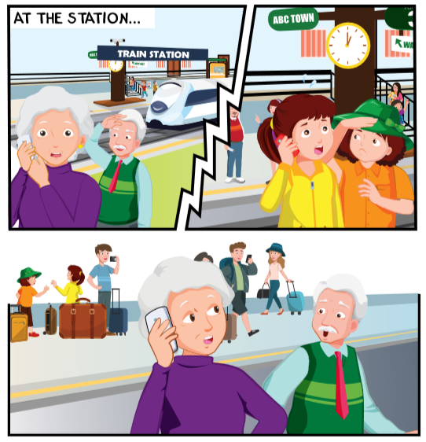
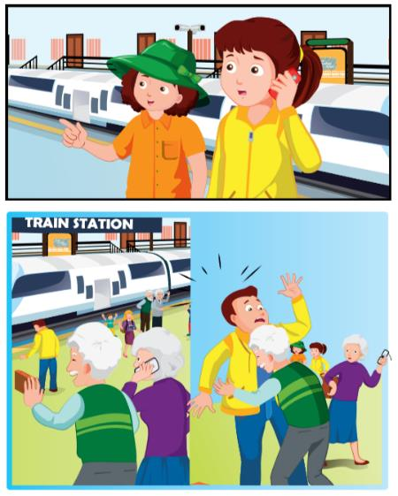
Click the earphone to hear the sound.

Slide 12

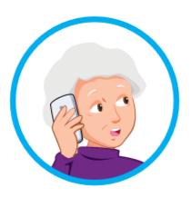

Click the earphone to hear the sound.
Hello, Grandma! We’re at the train station now.
I can’t see you. What are you wearing, Lucy
I’m wearing a yellow
(1) _______.
jacket

Slide 13
Click the earphone to hear the sound.
No, I still can’t see you. What else are you wearing?
I’m wearing blue (2) _______.
jeans

Slide 14
Click the earphone to hear the sound.
What are you wearing, Grandma?
I’m wearing a blue
(3) _______.
skirt

Slide 15
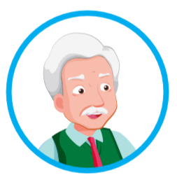
Click the earphone to hear the sound.
What’s Grandpa wearing?
He’s wearing red (4) _______.
boots
It’s OK, I see you, Lucy! Jill!
No! Dan! Come back here!

Slide 16
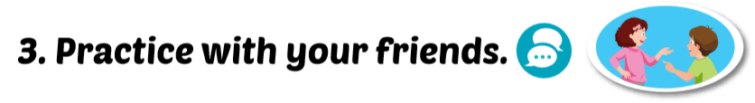
Lucy: Hello, Grandma!
We’re at the train station now.
Grandma: I can’t see you.
What are you wearing, Lucy?
Lucy: I’m wearing a yellow jacket.

Slide 17
Grandma: No, I sillt can’t see yuo. Waht else aer you weingar?
Lucy: I’m weinarg bleu jesan.

Slide 18
Grandma: I’m wearing a blue skirt.
Lucy: What are you wearing, Grandma?

Slide 19
Lucy: Whta’s Grandpa weriang?
Grandma: He’s rinweag red botos.
Grandpa: It’s OK, I see you, Lucy! Jill!
Grandma: No! Dan! Cemo back here!

Slide 20

Workbook
p. 61

Slide 21

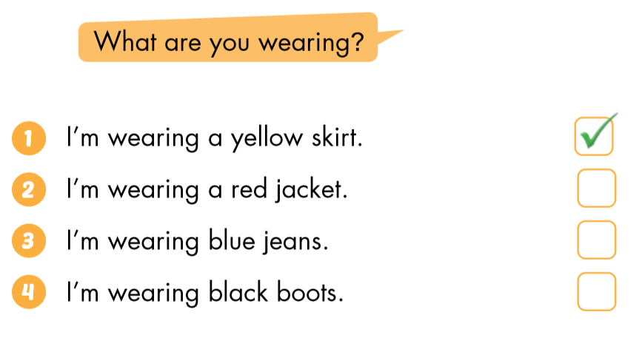



Slide 22

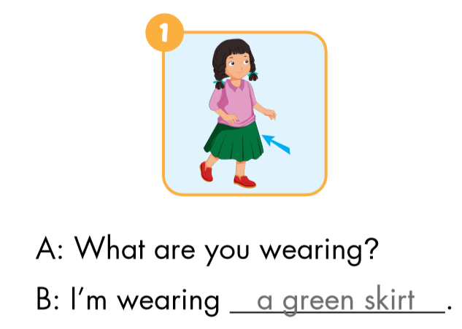
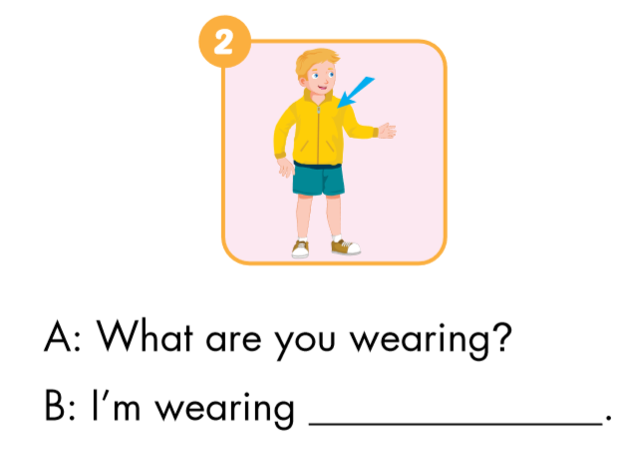
a green skirt
a yellow jacket

Slide 23
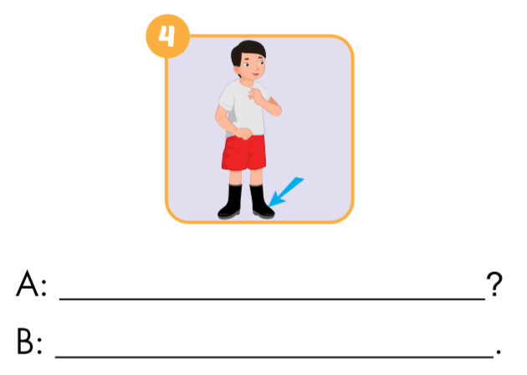
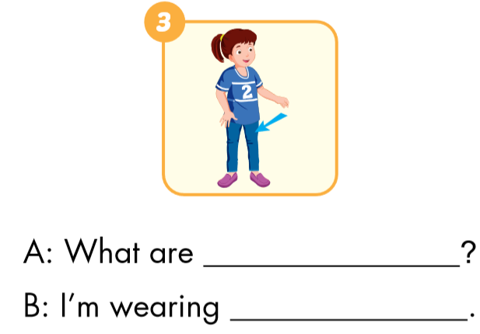
you wearing
What are you wearing
blue jeans
I’m wearing black boots

Slide 24

CONSOLIDATION

Slide 25

Chain Spelling Activity
The students stand up and you say a word (Jacket).
Students have to spell it out, letter by letter.
If someone misses a letter, they sit down and are out of the game.
The last person left standing is the winner.

Slide 26
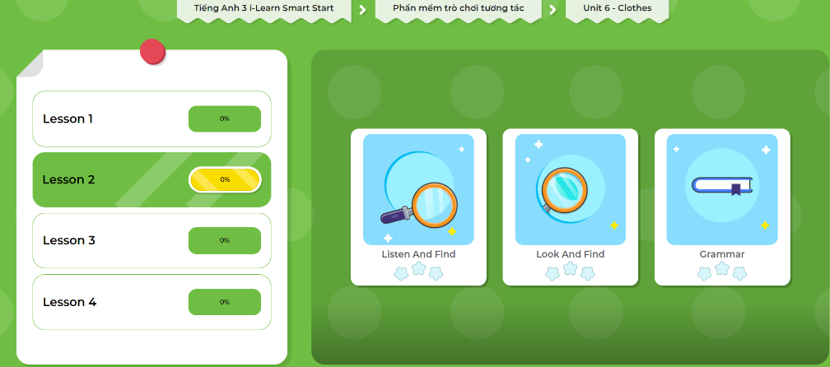
Click here to play the games!

Slide 27

WRAP-UP

Slide 28
Today’s lesson
Vocabularies
jacket, jeans.
Phonics
/dʒ/
Structures/ Sentence patterns
What are you wearing?
I’m wearing blue jeans.
What are you wearing?
I’m wearing a red jacket.

Slide 29
Homework
Practice the vocabularies and structure; and make sentences using them.
Do the exercises in Tiếng Anh 3 i-Learn Smart Start Workbook (page 61).
Prepare the next lesson (page 87 SB).
Play the consolidation games in Tiếng Anh 3 i-Learn Smart Start DHA App on www.eduhome.com.vn

Slide 30

Enjoy your day!

