Slide 1

Unit 6: Clothes
Lesson 1.2
Page 83

Slide 2
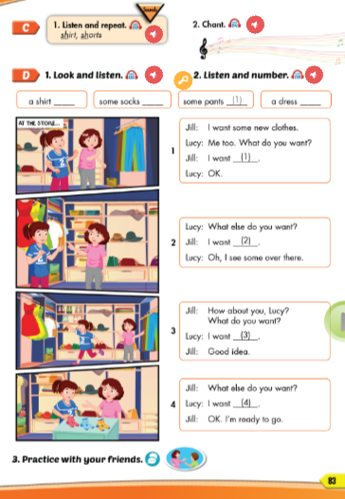
Lesson Outline
Warm-up
Listening
Consolidation
Wrap-up

Slide 3
Objectives
By the end of this lesson, students will be able to pronounce the sound /ʃ/ and ask and answer about what clothes they want.
Vocabulary: shirt, shorts.
Structure: - What do you want?
- I want a dress/I want some socks.

Slide 4

WARM UP

Slide 5
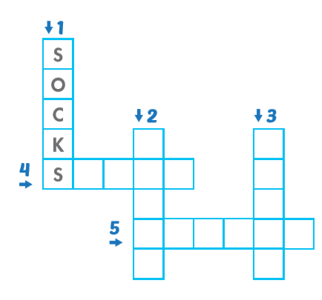
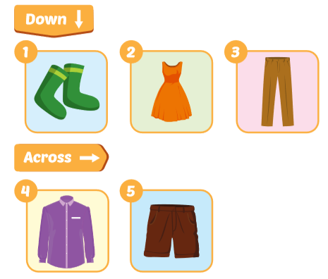
Look and write
Click on each picture to see the answer.
D
R
E
S
S
P
A
N
T
S
H I T
H O R S

Slide 6



Click on the picture to get the answer.
socks
Click here to return to the game.

Slide 7
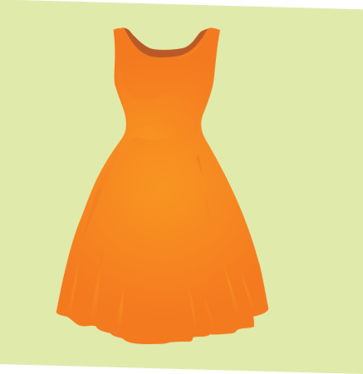
Click on the picture to get the answer.
dress
Click here to return to the game.

Slide 8
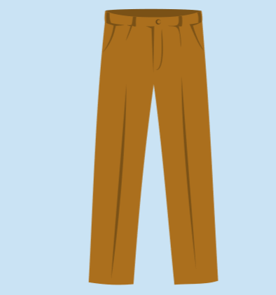
Click on the picture to get the answer.
pants
Click here to return to the game.

Slide 9
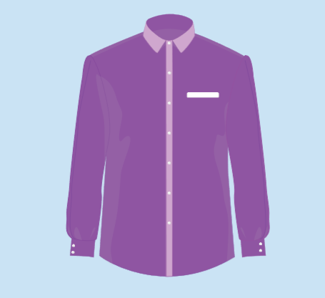
Click on the picture to get the answer.
shirt
Click here to return to the game.

Slide 10
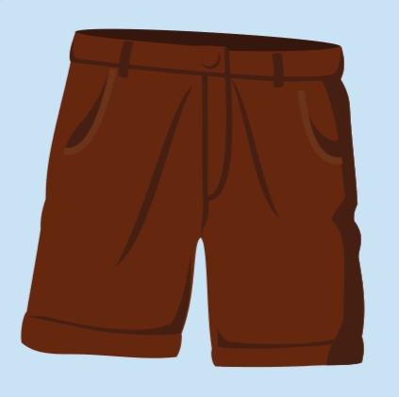
Click on the picture to get the answer.
shorts
Click here to return to the game.

Slide 11

It’s time to learn …

Slide 12

Listening

Slide 13



C. 1.Listen and repeat.
shirt
shorts
Click each English word to hear the sound.
Notes:
GV giới thiệu từ vựng, CCQ

Slide 14




Click the earphone to hear the sound.
/ʃ/ /ʃ/ /ʃ/
shirt shorts
/ʃ/ /ʃ/ /ʃ/
/ʃ/ /ʃ/ /ʃ/
/ʃ/ /ʃ/ /ʃ/

Slide 15

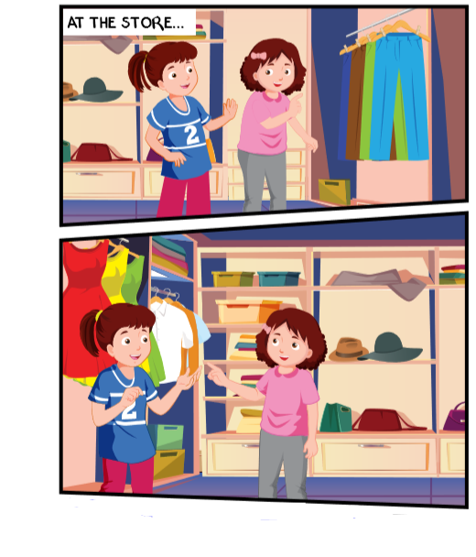
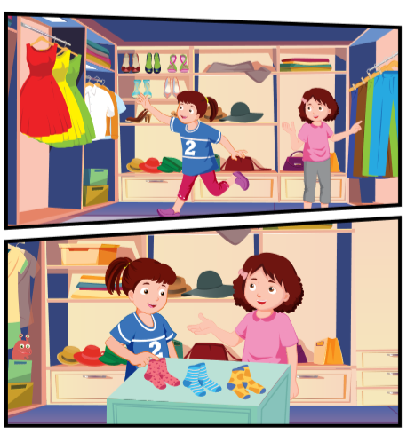
Click the earphone to hear the sound.

Slide 16


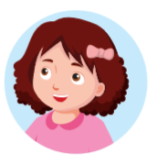
Click the earphone to hear the sound.
I want some new clothes.
Me too. What do you want?
I want
(1) some pants.
OK.

Slide 17
Click the earphone to hear the sound.
What else do you want?
I want
(2) a shirt.
Oh, I see some over there.

Slide 18
Click the earphone to hear the sound.
How about you, Lucy? What do you want?
I want
(3) a dress.
Good idea.

Slide 19
Click the earphone to hear the sound.
What else do you want?
I want
(4) some socks.
OK. I’m ready to go.

Slide 20

Jill: I want some new clothes.
Lucy: Me too. What do you want?
Jill: I want some pants.
Lucy: OK.

Slide 21
Lucy: What else do you want?
Jill: I want.
Lucy: Oh, I see some over there

Slide 22
Jill: How about you, Lucy? What do you want?
Lucy: I want a drees.
Jill: Good idea.

Slide 23
Jill: What else do you want?
Lucy: I want some socks.
Jill: OK. I’m ready to go.

Slide 24

Workbook
p. 59

Slide 25

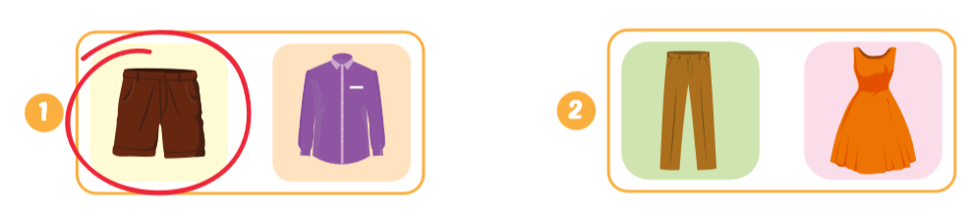
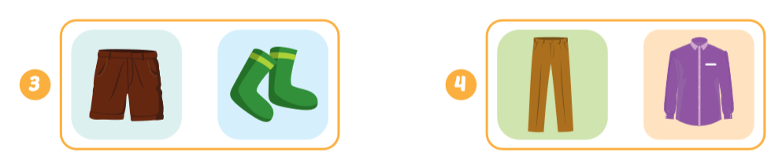
Click the earphone to hear the sound.

Slide 26

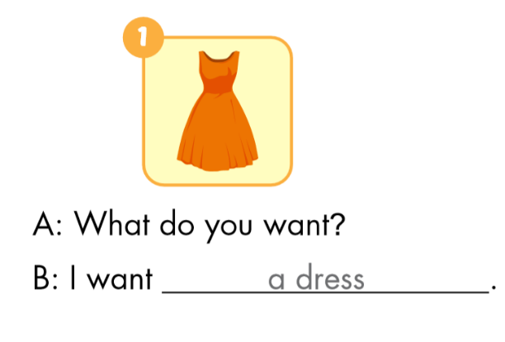
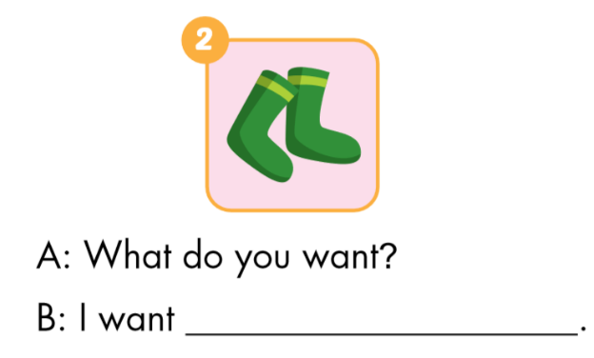
a dress
some socks

Slide 27
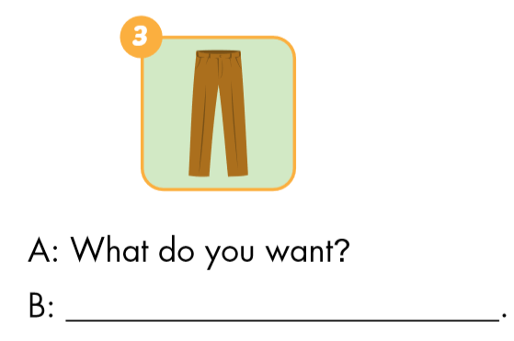
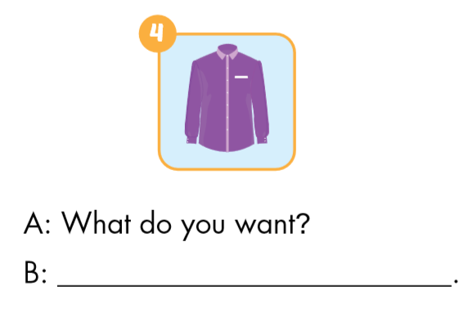
I want some pants
I want a shirt

Slide 28

CONSOLIDATION

Slide 29


What do you want?
What do you want?
I want a shirt.
I want some shorts.

Slide 30

WRAP-UP

Slide 31
Today’s lesson
Vocabularies
shirt
shorts
Structures/ Sentence patterns
What do you want?
I want a dress.
What do you want?
I want some shorts.

Slide 32
Homework
Practice the vocabularies and structure; and make sentences using them.
Do the exercises in Tiếng Anh 3 i-Learn Smart Start Workbook (page 59)
Do the exercises in Tiếng Anh 3 i-Learn Smart Start Notebook (page 40)
Prepare the next lesson (page 84 SB)
Play the consolidation games in Tiếng Anh 3 i-Learn Smart Start DHA App on www.eduhome.com.vn

Slide 33

Enjoy your day!

