Slide 1

Unit 5: Sports and hobbies
Lesson 1.2
Page 69

Slide 2
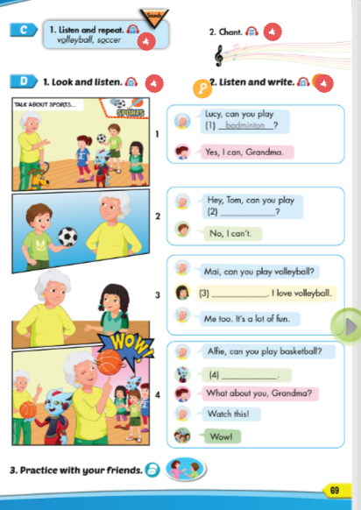
Lesson Outline
Warm-up
Listening
Consolidation
Wrap-up

Slide 3
Objectives
By the end of this lesson, students will be able to…
Vocabulary: badminton, tennis, volleyball, basketball, soccer
Structure: Can you play soccer?
- Yes, I can./No, I can't.

Slide 4

WARM UP

Slide 5
Vocabulary Review

Slide 6
iodmbntan
b | a | d | m | i | n | t | o | n

Slide 7
cosrec
s | o | c | c | e | r

Slide 8
tsnnie
t | e | n | n | i | s

Slide 9
ovlblylale
v | o | l | l | e | y | b | a | l | l

Slide 10
absletbakl
b | a | s | k | e | t | b | a | l | l

Slide 11

It’s time to learn …

Slide 12

Listening

Slide 13
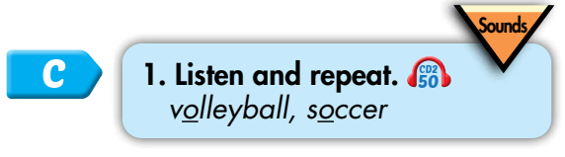

/ɑː/
volleyball
soccer
Click on each word to hear the sound.

Slide 14



/ɑː/, /ɑː/, /ɑː/, /ɑː/, /ɑː/, /ɑː/, volleyball, soccer, /ɑː/, /ɑː/, /ɑː/.
/ɑː/, /ɑː/, /ɑː/,
/ɑː/, /ɑː/, /ɑː/,
volleyball, soccer,
/ɑː/, /ɑː/, /ɑː/.
Click to follow the lyrics.

Slide 15
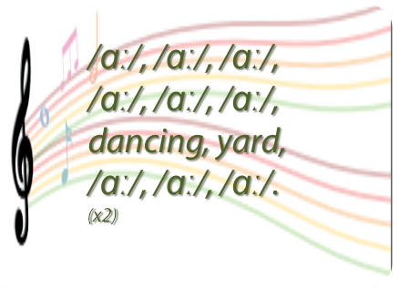
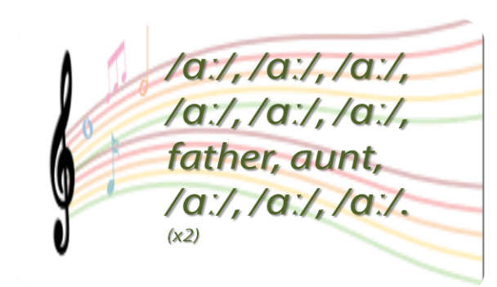
Do a similar chant. 🎤
Click on the circle to open the chant
/ɑː/
🎤
🎤

Slide 16
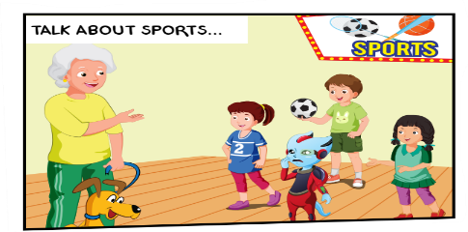

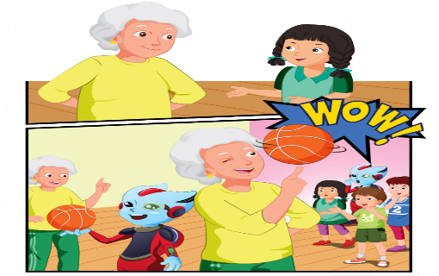
1
Who is she?
2
Are they talking about soccer?
3
What are they talking about?
4
What is Grandma doing ?

Slide 17
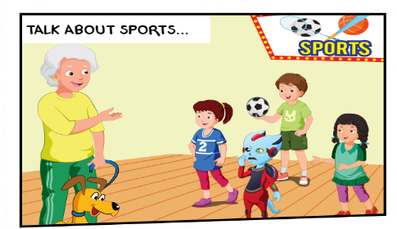




2
1
3
1. Grandma: Lucy, can you play badminton? Lucy: Yes, I can, Grandma.
2. Grandma: Hey, Tom, can you play tennis? Tom: No, I can't
3. Grandma: Mai, can you play volleyball? Mai: Yes, I can. I love volleyball. Grandma: Me too. It's a lot of fun.
4. Grandma: Alfie, can you play basketball? Alfie: No, I can't. Lucy: What about you, Grandma? Grandma: Watch this! Children: Wow!
4

Slide 18

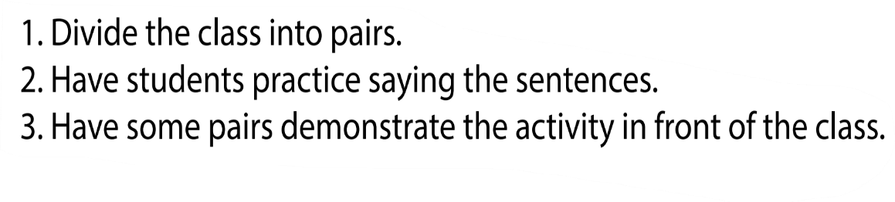


Can you play soccer?
Yes, I can.
/No, I can't.

Slide 19

Practice

Slide 20

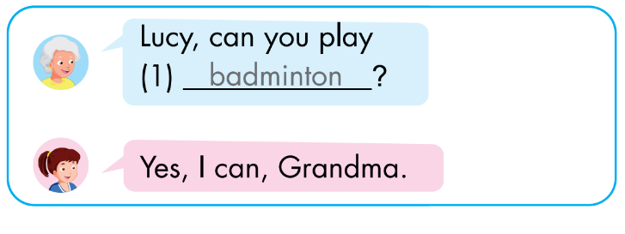
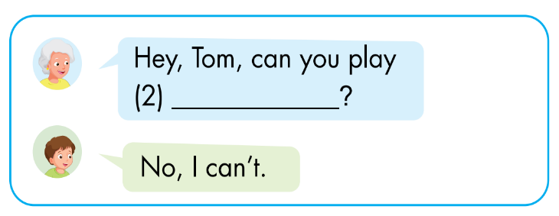
Click on each box to hear the sound.
tennis

Slide 21
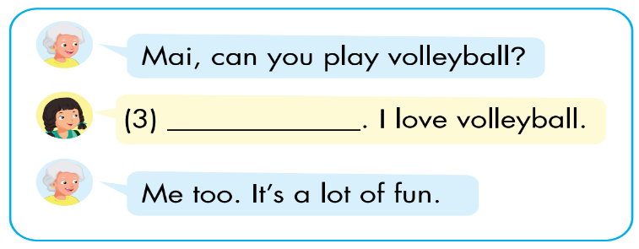
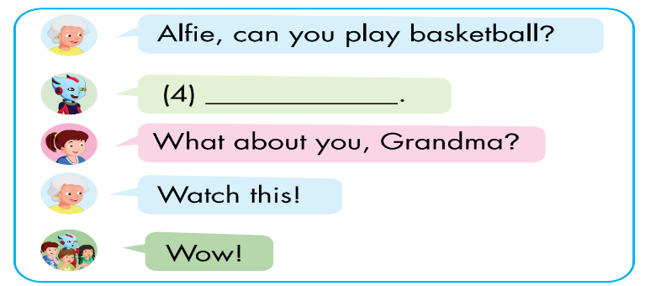
Click on each box to hear the sound.
Yes, I can
No, I can’t.

Slide 22

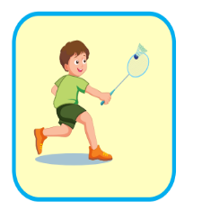
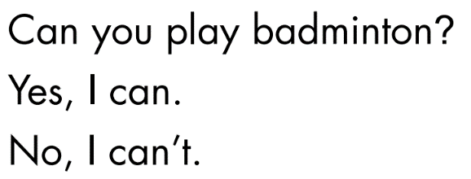


Extra Practice
WB, page 49.
1
✓
✓
2
Click on the number to hear the sound.

Slide 23
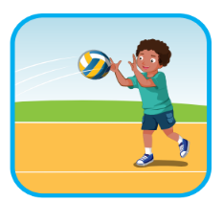

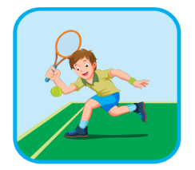
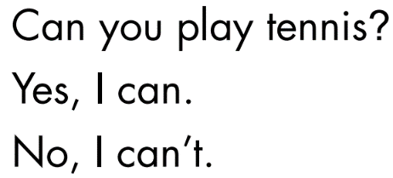
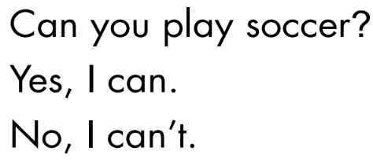

3
✓
✓
4
5
✓
Click on the number to hear the sound.

Slide 24

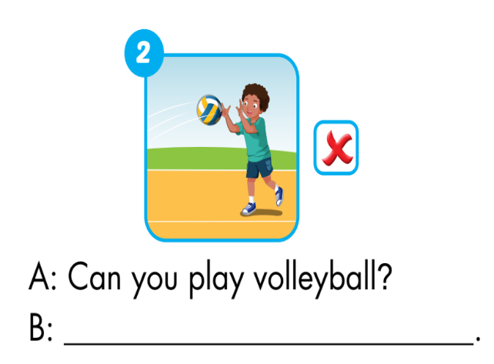
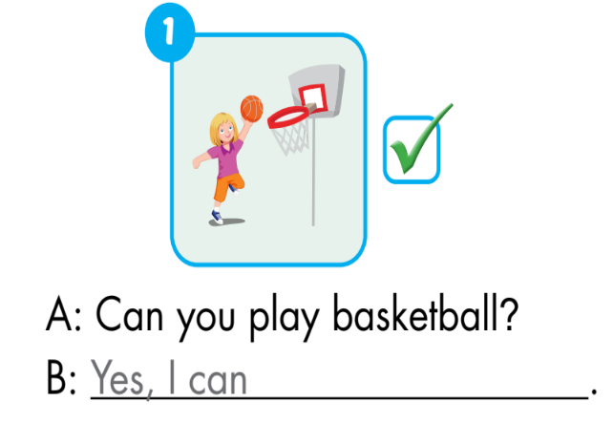
Extra Practice
WB, page 49.
No, I can’t

Slide 25
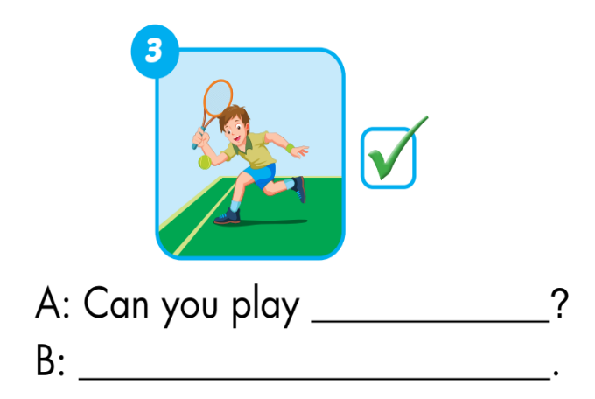
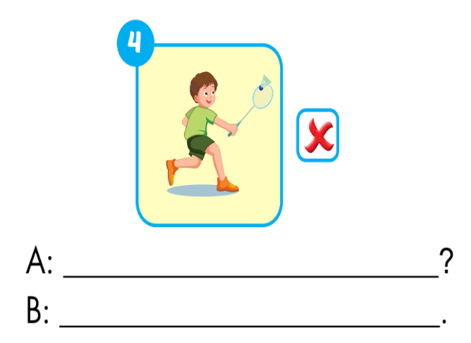
tennis
Can you play badminton
Yes, I can
No, I can’t.

Slide 26

CONSOLIDATION

Slide 27
Early Production

Slide 28
FIND SOMEONE WHO

Slide 29

Students draw the following chart in notebooks.
SPORTS | NAME
badminton
tennis
volleyball
basketball
soccer
Mai

Slide 30
Students ask Yes/No questions for the suggested words.
(Ex: Can you play tennis?).
Model with a student. Ask any question from the table. If the student's answer is "Yes", enter the student's name in the "Name" column (different names).
Students to stand up and walk around the class and ask their friends. The student who fills in all the names in the “Name” column first is the winner.

Slide 31

WRAP-UP

Slide 32









Click on the number

Slide 33


Can you play
badminton?

Slide 34
Can you play
tennis?

Slide 35
Can you play
volleyball?

Slide 36
Today’s lesson
Vocabularies
badminton
tennis
volleyball
basketball
soccer
Structures/ Sentence patterns
Can you play soccer?
- Yes, I can./No, I can't.

Slide 37
Lesson 3
Homework
Practice vocabularies and structure. Make sentences using them.
Do the exercises in Tiếng Anh 3 i-Learn Smart Start Workbook (page 49)
Do the exercises in Tiếng Anh 3 i-Learn Smart Start Notebook (page 34)
Play the consolidation games in Tiếng Anh 3 i-Learn Smart Start DHA App on www.eduhome.com.vn
Prepare the next lesson (page 70)

Slide 38

Have a nice day!

