Slide 1

Ngoc Lam
Primary School
Unit 4: Travel
Lesson 3.3
Page 56

Slide 2
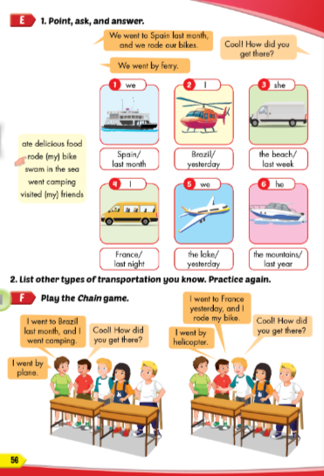
Lesson Outline
Warm-up
Practice
Speaking
Consolidation
Wrap-up

Slide 3
Objectives
By the end of this lesson, students will be able to…
Vocabulary: Pronounce and use the words related to the topic properly: ferry, minibus, plane, helicopter, van, speedboat
Structure: How did you get there? - We went by helicopter.

Slide 4

WARM-UP

Slide 5



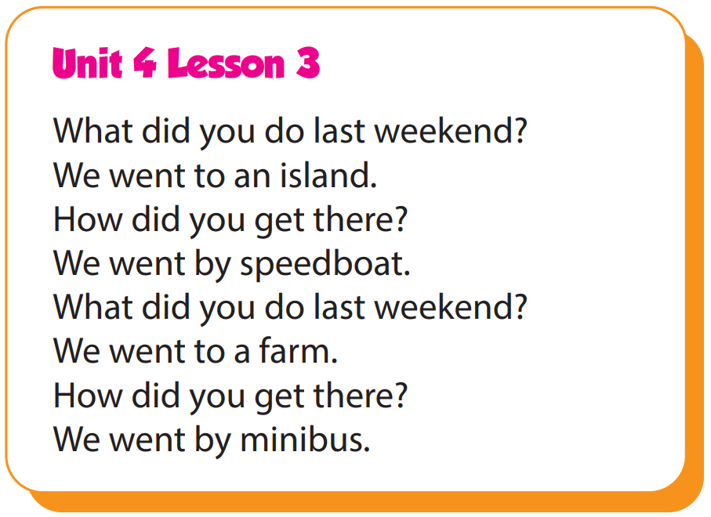

Slide 6

It’s time to learn …

Slide 7

Practice

Slide 8

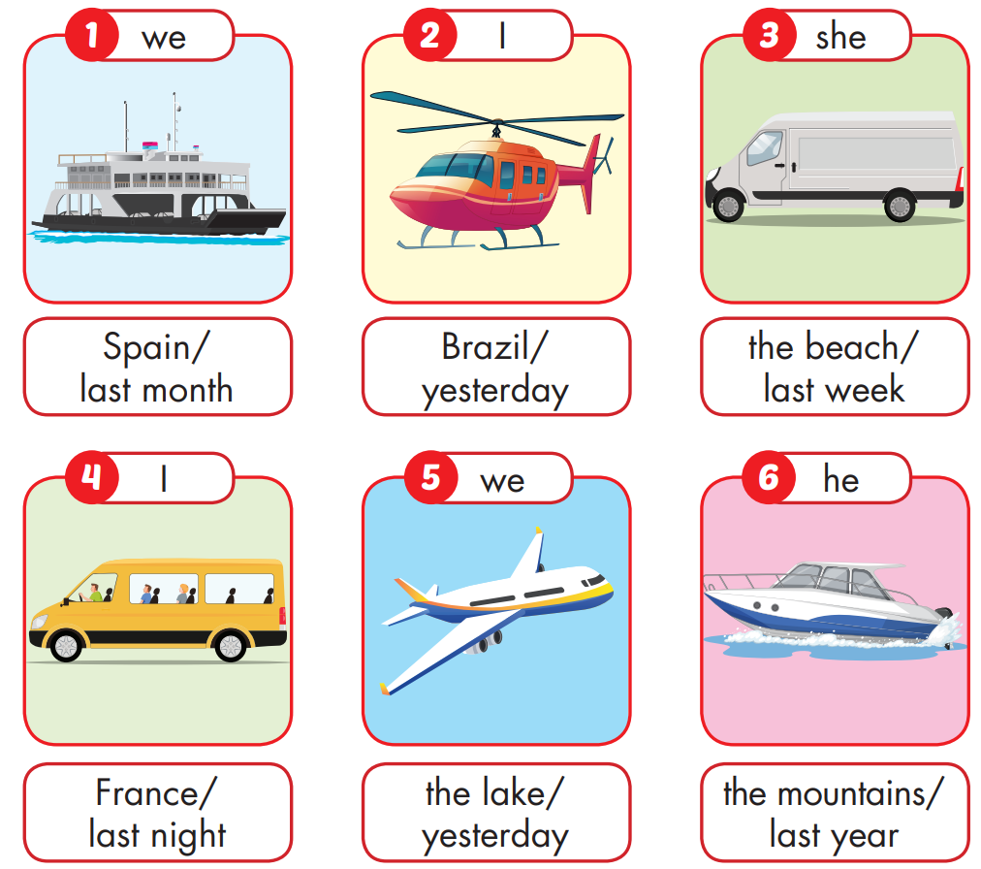



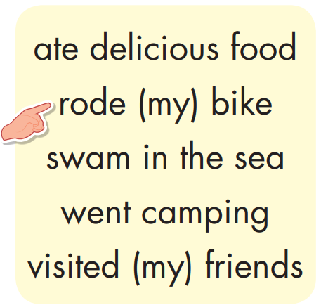

Slide 9
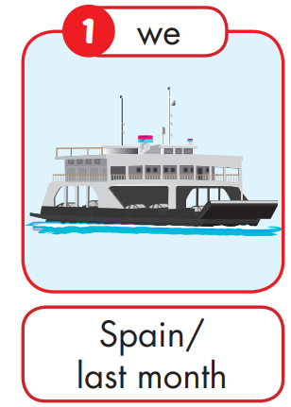

We went to Spain last month,
and we rode our bikes.
We went by ferry.
Cool! How did you get there?

Slide 10
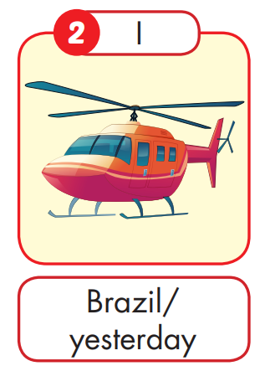
I went to Brazil yesterday,
and I vistited my friends.
I went by helicopter.
Cool! How did you get there?

Slide 11
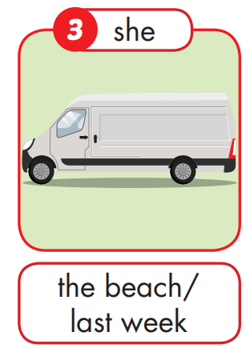
She went to the beach last week,
and she swam in the sea.
She went by van.
Cool! How did she get there?

Slide 12
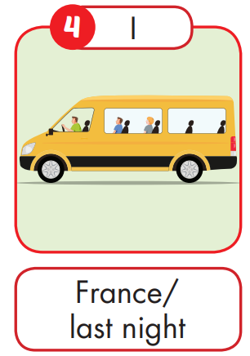
I went to France last night,
and I went camping.
I went by minibus.
Cool! How did you get there?

Slide 13
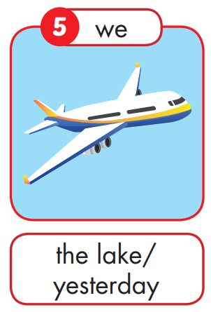
We went to the lake yesterday,
and we went camping.
We went by plane.
Cool! How did you get there?

Slide 14
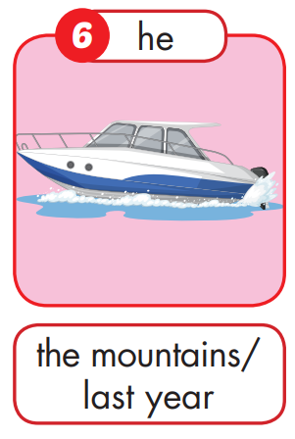
He went to the mountains,
and He ate delicious food.
He went by speedboat.
Cool! How did he get there?

Slide 16

Production

Slide 17

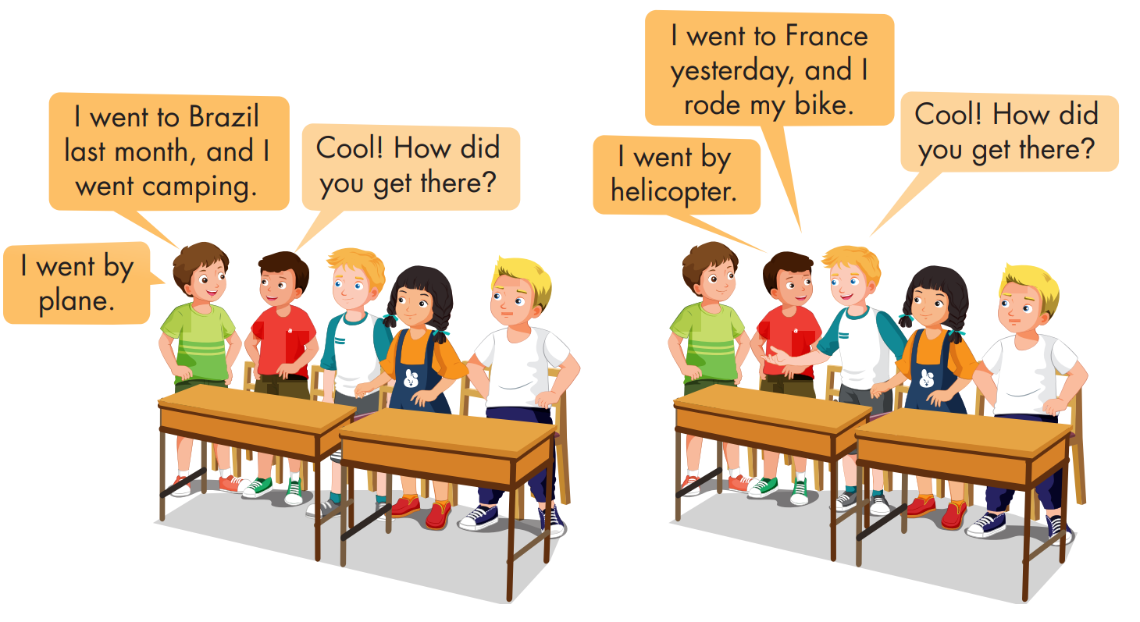

Slide 18

CONSOLIDATION

Slide 19
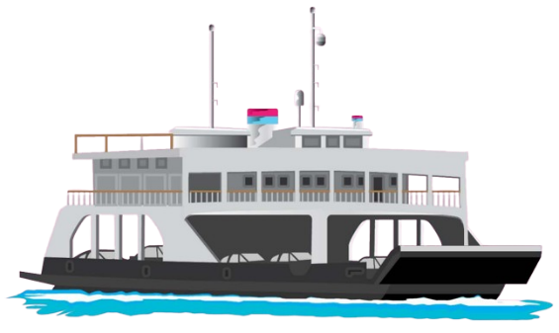
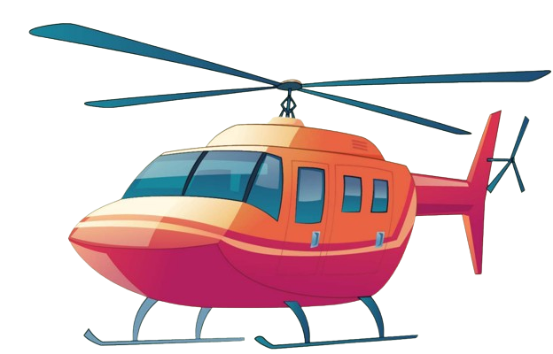
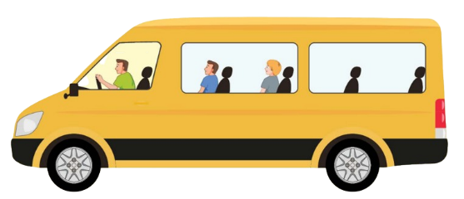



How did you get there?
a
b
c
I went by ferry.

Slide 20


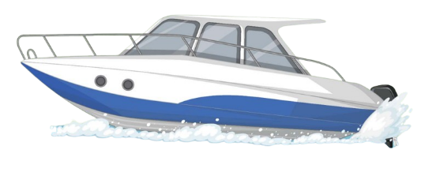
How did you get there?
a
b
c
I went by speedboat.

Slide 21


How did you get there?
a
b
c
I went by minibus.

Slide 22



How did you get there?
a
b
c
I went by helicopter.

Slide 23


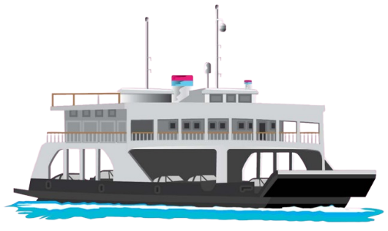
How did you get there?
a
b
c
I went by plane.

Slide 24



How did you get there?
a
b
c
I went by van.

Slide 25

WRAP-UP

Slide 26
Today’s lesson
Vocabularies
ferry, minibus, plane, helicopter, van, speedboat
Structures/ Sentence patterns
How did you get there?
- We went by helicopter.

Slide 27
Homework
Practice the vocabularies and structure, and make sentences using them.
Do the exercises in Tiếng Anh 5 i-Learn Smart Start WB (page 35)
Do the exercises in Tiếng Anh 5 i-Learn Smart Start Notebook (page 24)
Prepare the next lesson (page 57 SB)
Play the consolidation games in Tiếng Anh 5 i-Learn Smart Start DHA App on www.eduhome.com.vn

Slide 28

Enjoy your day!

Slide 29

Lesson 3
Stay positive and have a nice day!

