Slide 1

Ngoc Lam
Primary School
Unit 2
WHAT I CAN DO
LESSON 2. 1 - PAGE 23

Slide 2
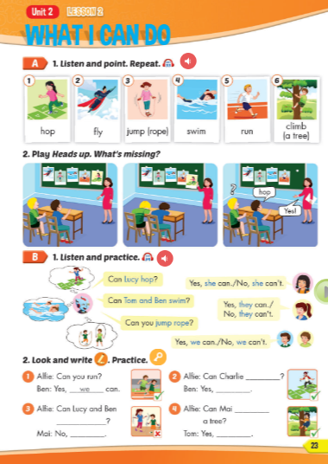
Lesson Outline
Warm-up
Vocabulary
Structure
Consolidation
Wrap-up

Slide 3
Objectives
By the end of this lesson, students will be able to ask about what others can or can't do.
Vocabulary: hop, fly, jump (rope), swim, run, climb (a tree)
Structure: Can Lucy hop?
- Yes, she can. / No, she can't.
Can Tom and Ben swim?
- Yes, they can. / No, they can't.
Can you jump rope?
- Yes, we can. / No, we can't.

Slide 4

WARM UP

Slide 5
LET’S PLAY!
WHAT’S MISSING?

Slide 6
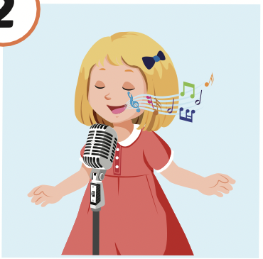
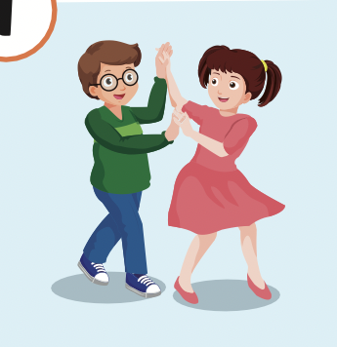
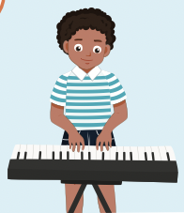

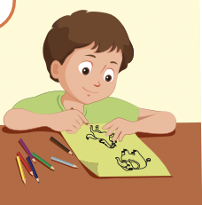
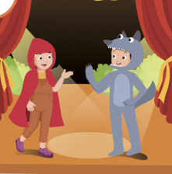

Slide 12

It’s time to learn …

Slide 13

New words
hop,
fly,
jump (rope),
swim,
run,
climb (a tree)

Slide 14

Presentation

Slide 15


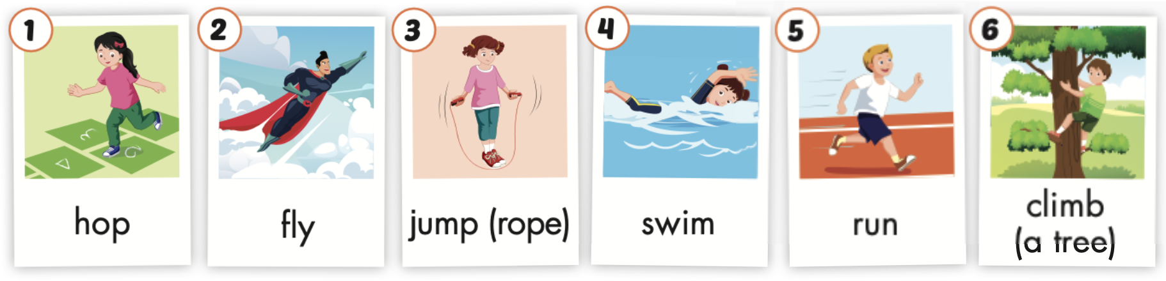
Click the icon to hear the sound.

Slide 16

Click the picture to hear the sound.
hop
/hɑːp/
nhảy lò cò

Slide 17
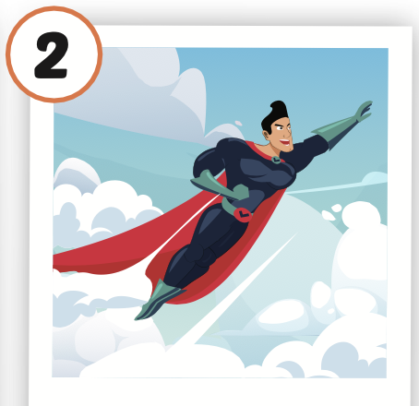
Click the picture to hear the sound.
fly
/flaɪ/
bay

Slide 18
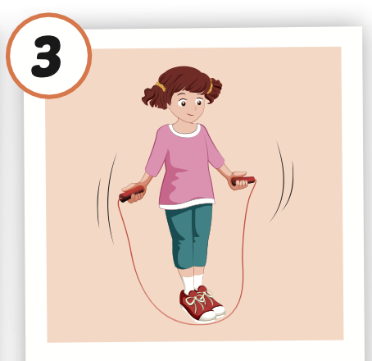
Click the picture to hear the sound.
jump (rope)
/dʒʌmp roʊp/
nhảy (dây)

Slide 19
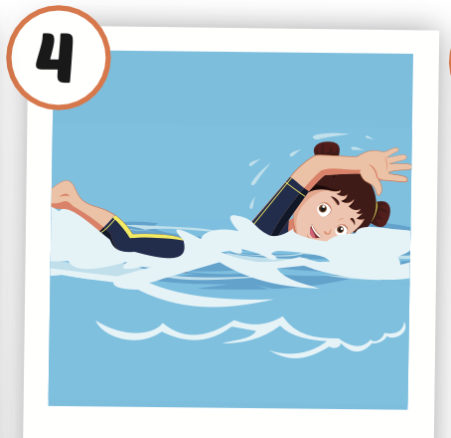
Click the picture to hear the sound.
swim
/swɪm/
bơi

Slide 20
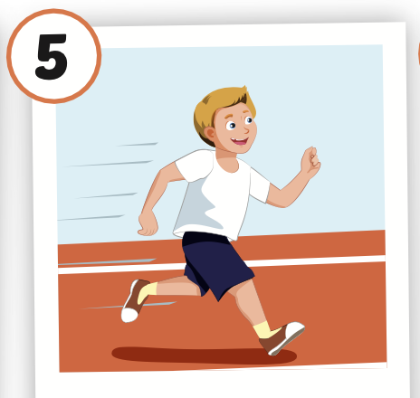
Click the picture to hear the sound.
run
/rʌn/
chạy

Slide 21

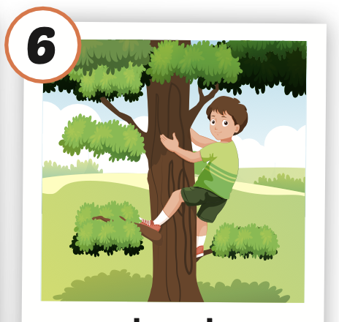
Click the picture to hear the sound.
climb (a tree)
/klaɪm ə triː/
leo, trèo (cây)

Slide 22

Practice

Slide 23



LISTEN AND CHOOSE
LET’S PLAY!

Slide 28
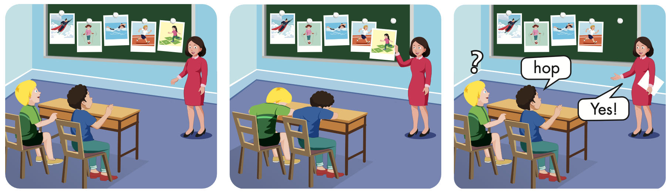

Slide 29
Structures
Can Lucy hop?
- Yes, she can. / No, she can’t.
Can Tom and Ben swim?
- Yes, they can. / No, they can't.
Can you jump rope?
- Yes, we can. / No, we can't.

Slide 30
Presentation

Slide 31

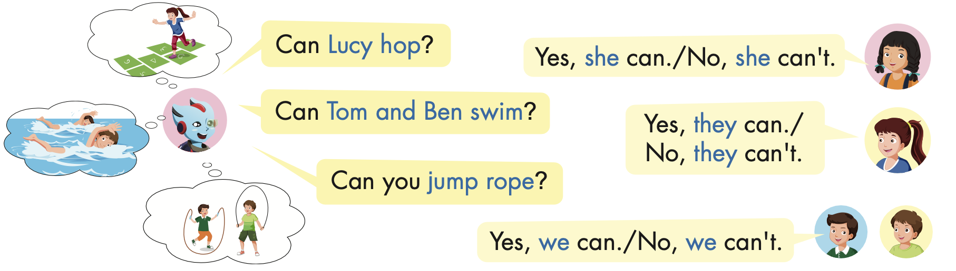

Slide 32
Practice

Slide 33
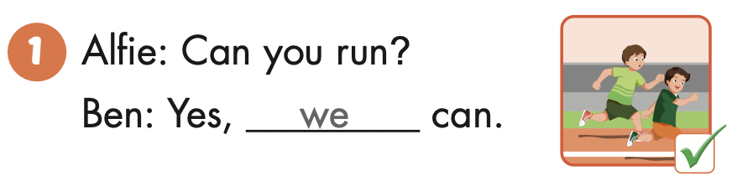
Can you run?
Yes, we can.

Slide 34
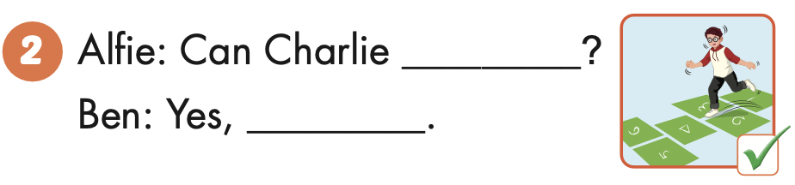
Can Charlie hop?
Yes, he can.
Charlie

Slide 35
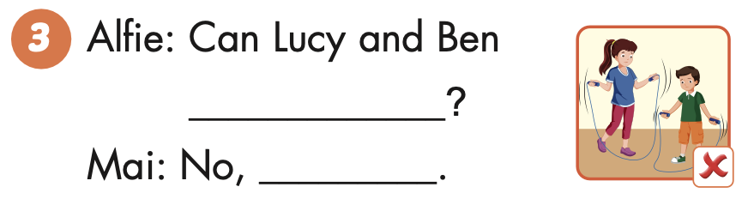
Can Lucy and Ben jump rope?
No, they can’t.
Lucy and Ben

Slide 36

Writing

Slide 37


Slide 38
hop
he can

Slide 39
jump ropes
the can’t

Slide 40
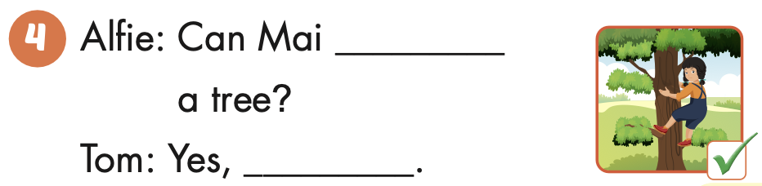
climb
she can

Slide 41

Production

Slide 42



Slide 43












> Someone has deleted some words.
> Guess the deleted word within the time limit (12 seconds).

Slide 44

Can he run?
CHECK
Notes:
44

Slide 45
Can she hop?
CHECK
Notes:
45

Slide 46

Y
Can he climb a tree?
Yes, he can.
CHECK
Notes:
46

Slide 47
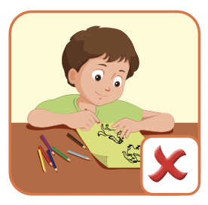
Can Tom draw?
No, he can’t.
CHECK
Notes:
47

Slide 48

CONSOLIDATION

Slide 49

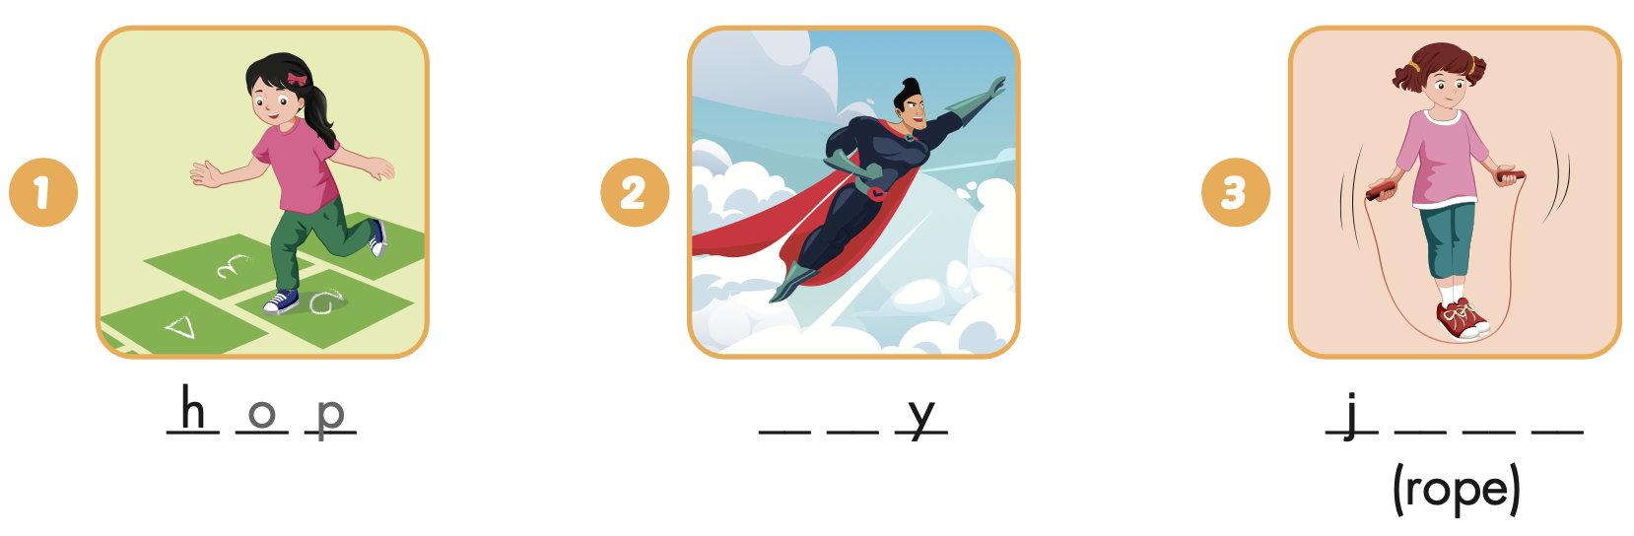
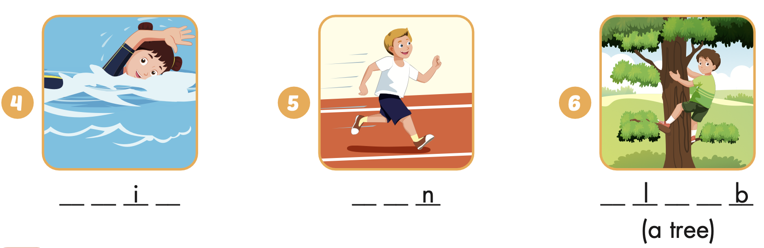
Extra Practice
WB, page 14
f l
u m p
s w m
r u
c i m

Slide 50

WRAP-UP

Slide 51
Today’s lesson
Structures/ Sentence patterns
Can Lucy hop?
- Yes, she can. / No, she can’t.
Can Tom and Ben swim?
- Yes, they can. / No, they can't.
Can you jump rope?
- Yes, we can. / No, we can't.
Vocabularies
hop, fly, jump (rope), swim, run, climb (a tree)

Slide 52
Homework
Practice the vocabularies and structure; and make sentences using them.
Do the exercises in Tiếng Anh 4 i-Learn Smart Start WB (page 14)
Do the exercises in Tiếng Anh 4 i-Learn Smart Start Notebook ( page 11)
Prepare the next lesson (page 24 SB) Play the consolidation games in Tiếng Anh 4 i-Learn Smart Start DHA App on www.eduhome.com.vn

Slide 53

Enjoy your day!

