Slide 1








TIẾNG ANH 4
WELCOME!
to our lesson
Unit 3: Weather-L3.1

Slide 2



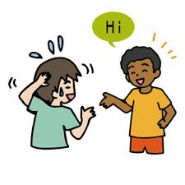



Classroom rules
1.Listen
2.Speak English
3.Be quiet
4.Raise your hand
5.Sit nicely
Notes:
Teacher speak slowly for Students to the classroom rules.

Slide 3


CONTENT
01 Warm Up 02 New Vocabulary
03 Structure
04 Practice
05 Wrap up

Slide 4



WARM UP
Are you ready?
Let’s play and find!

Slide 5


Slide 6





Unit 3
WEATHER
Lesson 1

Slide 7



MsPham
0936082789
Vocabulary

Slide 8








A
1. Listen and point. Repeat.
1
2
3
4
5
6
MsPham
0936082789
sunny
rainy
snowy
cloudy
windy
foggy

Slide 9




Flying kite
PLAY

Slide 10

rainy
Flying
Next
Check

Slide 11

windy
Flying
Next
Check

Slide 12

sunny
Flying
Next
Check

Slide 13

foggy
Flying
Next
Check

Slide 14

cloudy
Flying
Next
Check

Slide 15

snowy
Flying
Next
Check

Slide 16
Welldone!
Next

Slide 17







Vocabulary
sunny
: Có nắng
MsPham
0936082789
rainy
: Có mưa
snowy
: Có tuyết
cloudy
: Có nhiều mây
windy
: Có gió
foggy
: Có sương mù

Slide 18

Structure

Slide 19
What's the weather like today?
It’s _______.
sunny
foggy
rainy
windy
snowy
cloudy

Slide 20



B
1. Listen and practice.

Slide 21
Practice

Slide 22
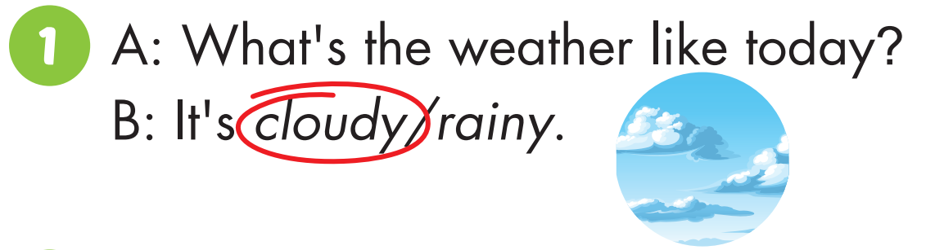
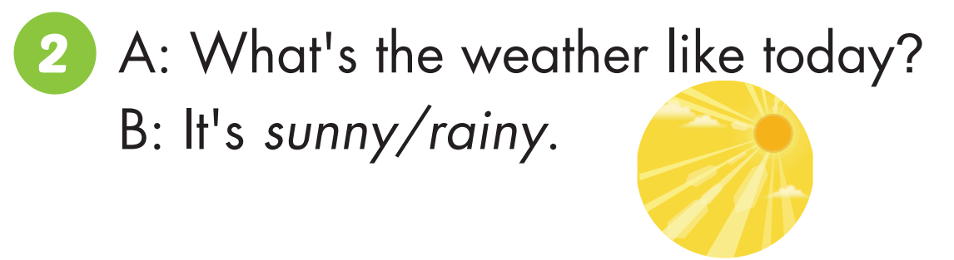

Slide 23
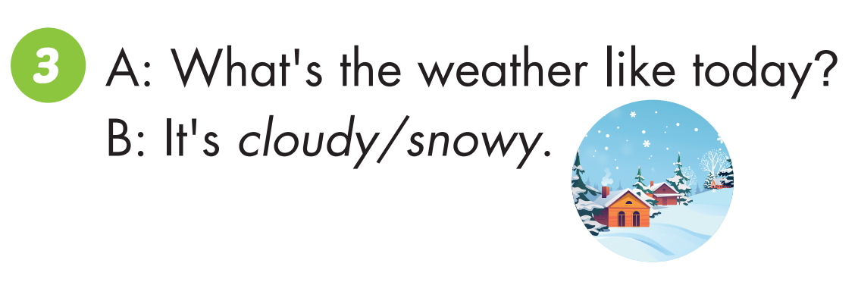
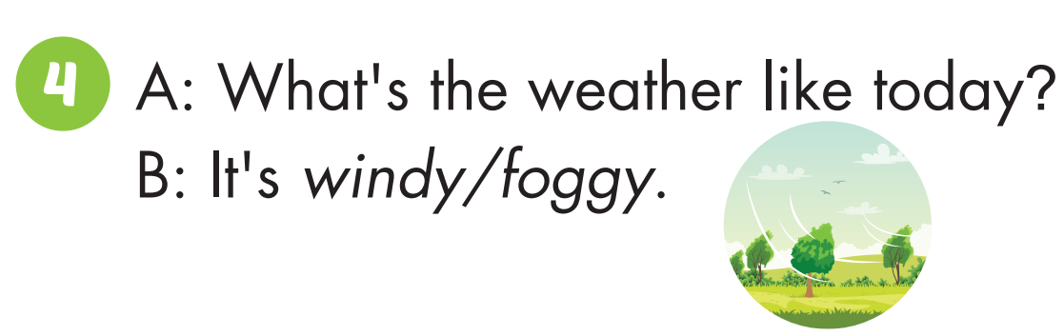

Slide 24
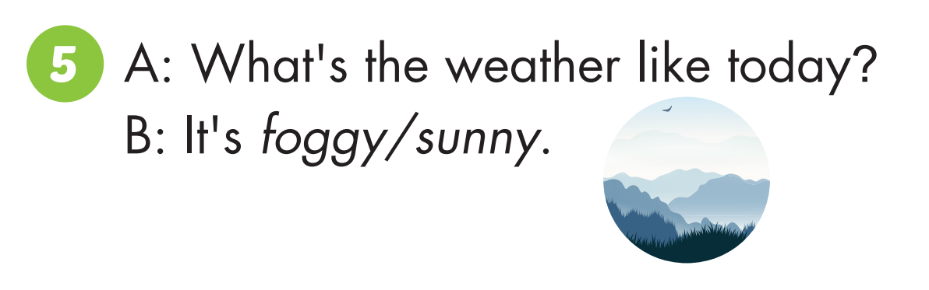
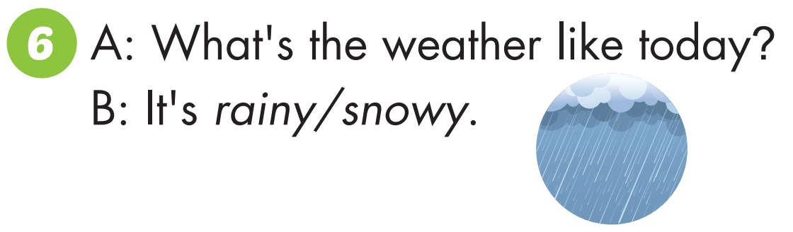

Slide 25
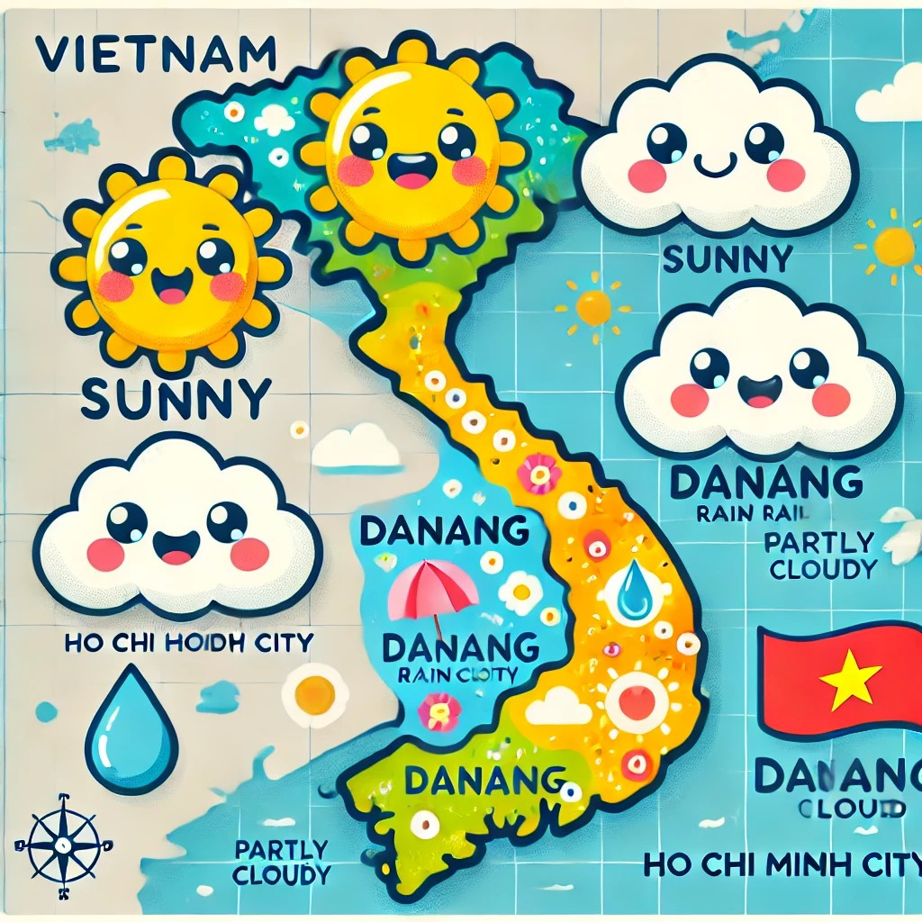

Slide 26



WRAP-UP!

Slide 27

Vocabulary:
Sunny, Rainy, Cloudy, Snowy, Cloudy, Foggy.
Structures:
What’s the weather like today?
It’s Sunny/ Rainy…

Slide 28


Thank you !

