Slide 1

Ngoc Lam
Primary School
Unit 3: MY FRIENDS AND I
Culture - Lesson 2
Page 44

Slide 2
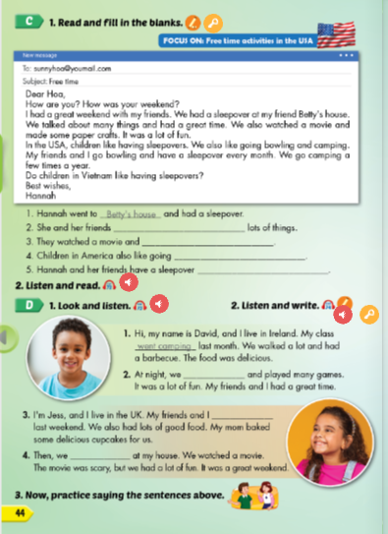
Lesson Outline
Warm-up
Reading
Listening
Speaking
Consolidation
Wrap-up

Slide 3
Objectives
By the end of this lesson, students will familiarize themselves with aspects of USA, UK, Ireland and Vietnamese culture. Then students will be able to talk about what they and their friends did.
Vocabulary: have a sleepover, go camping, have a barbecue, sing karaoke, go bowling, make paper crafts.
Structure: I went camping last week.

Slide 4

WARM-UP

Slide 5

New words
have a sleepover,
go camping,
have a barbecue,
sing karaoke,
go bowling,
make paper crafts.

Slide 6
Listen and choose.
Then say.

Slide 7
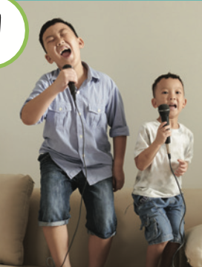
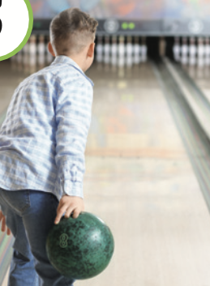
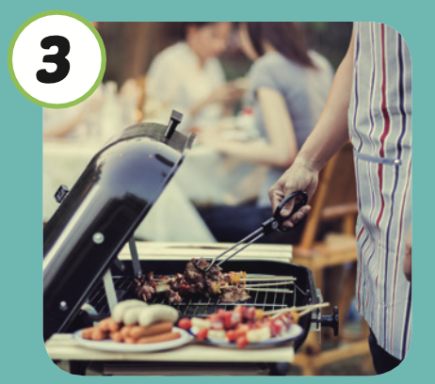


Listen and choose
A
B
C

Slide 8

Listen and choose
A
B
C

Slide 9
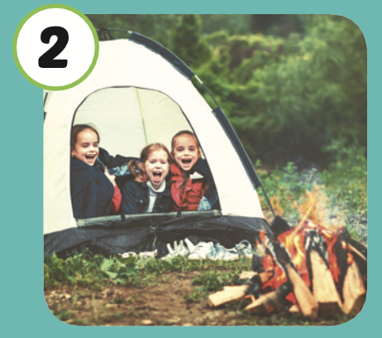
Listen and choose
A
B
C

Slide 10
Listen and choose
A
B
C

Slide 11

It’s time to learn …

Slide 12
Structure
I went camping last week.

Slide 13

Lead-in

Slide 14

WHAT COUNTRY IS IT?
The U.S.A.
Its capital is Washington, D.C.
It is the world’s third largest country in size.

Slide 15
Practice

Slide 16

Reading

Slide 17



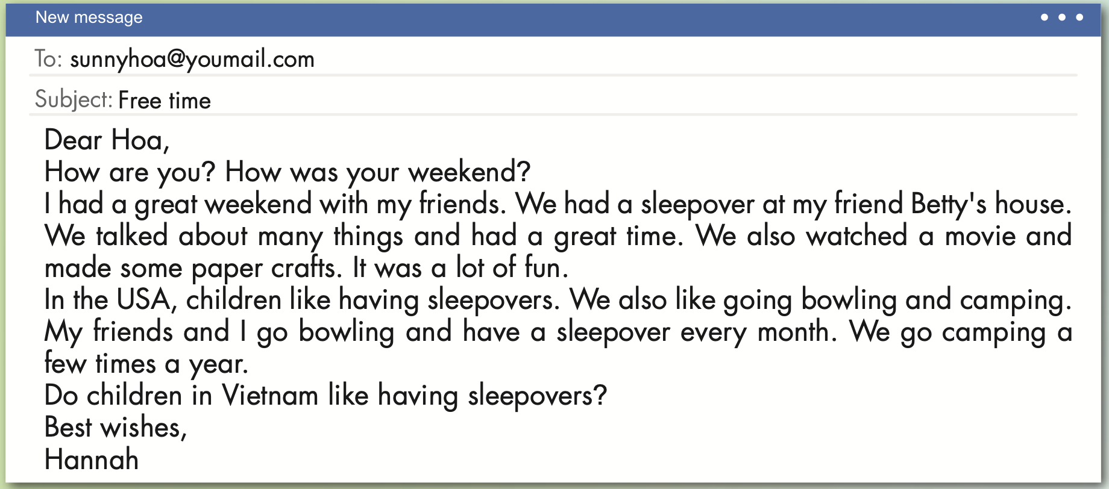

Slide 18
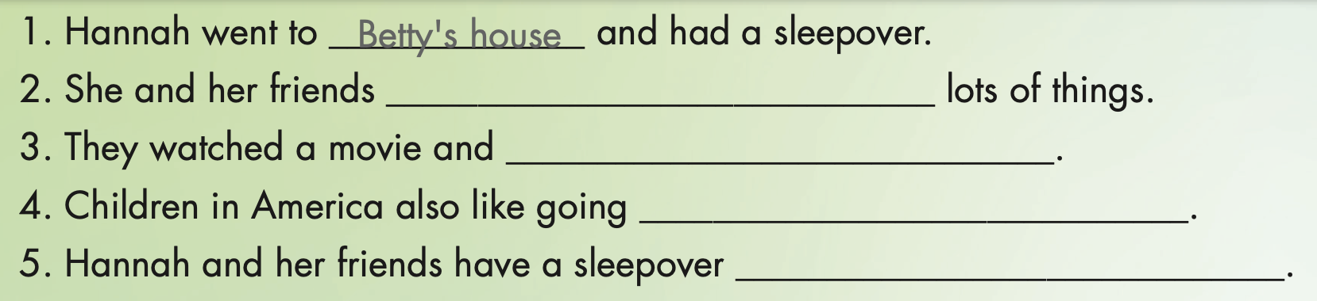
talked about
made some paper crafts
bowling and camping
every month

Slide 19

NO
YES or NO
YES
START

Slide 20
Hoa had a sleepover at her friend Betty’s house.
NO
YES

Slide 21
Hannah had a great weekend with her feiends.
NO
YES

Slide 22
Hannah lives in the USA.
NO
YES

Slide 23
In the USA, children don’t like going camping.
NO
YES

Slide 24

Listening

Slide 25

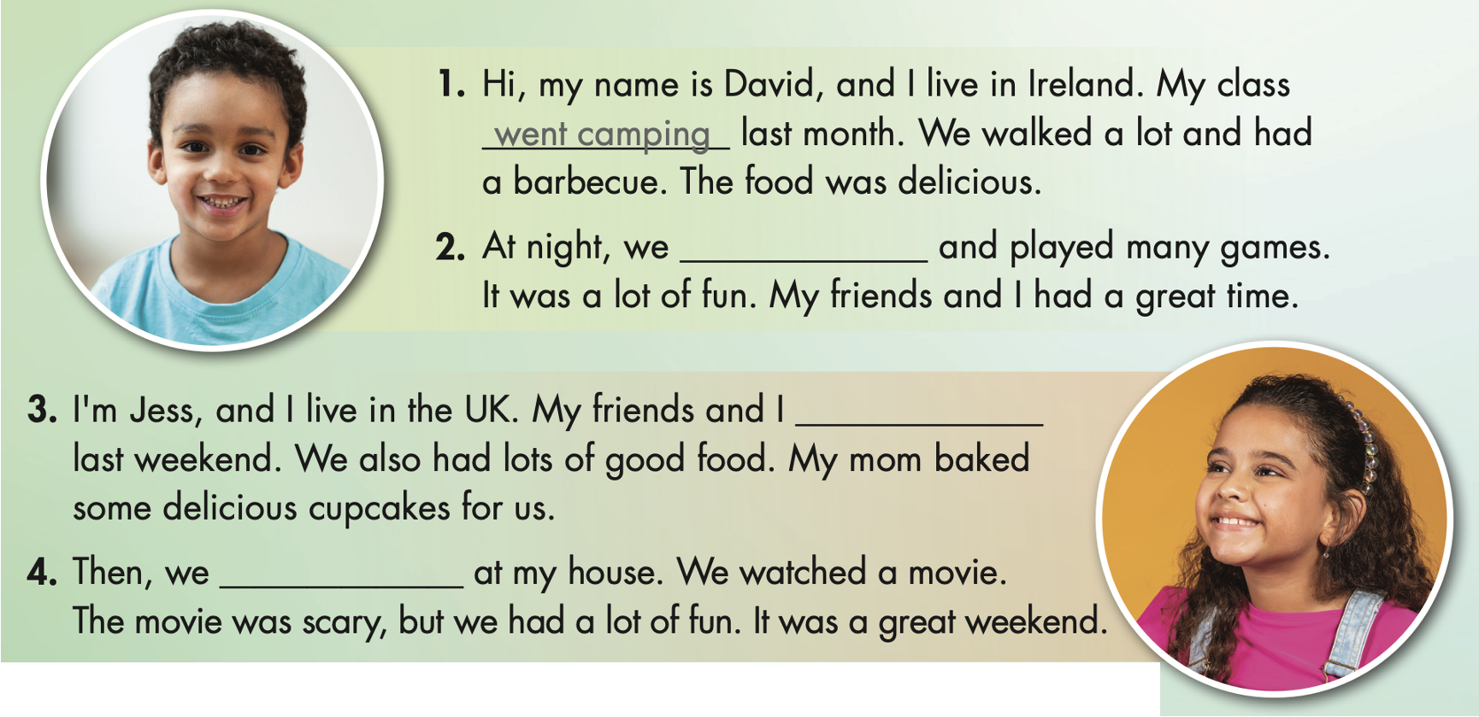

Slide 26

sang many songs
went bowling
had a sleepover

Slide 27

Production

Slide 28


Slide 29

CONSOLIDATION

Slide 30

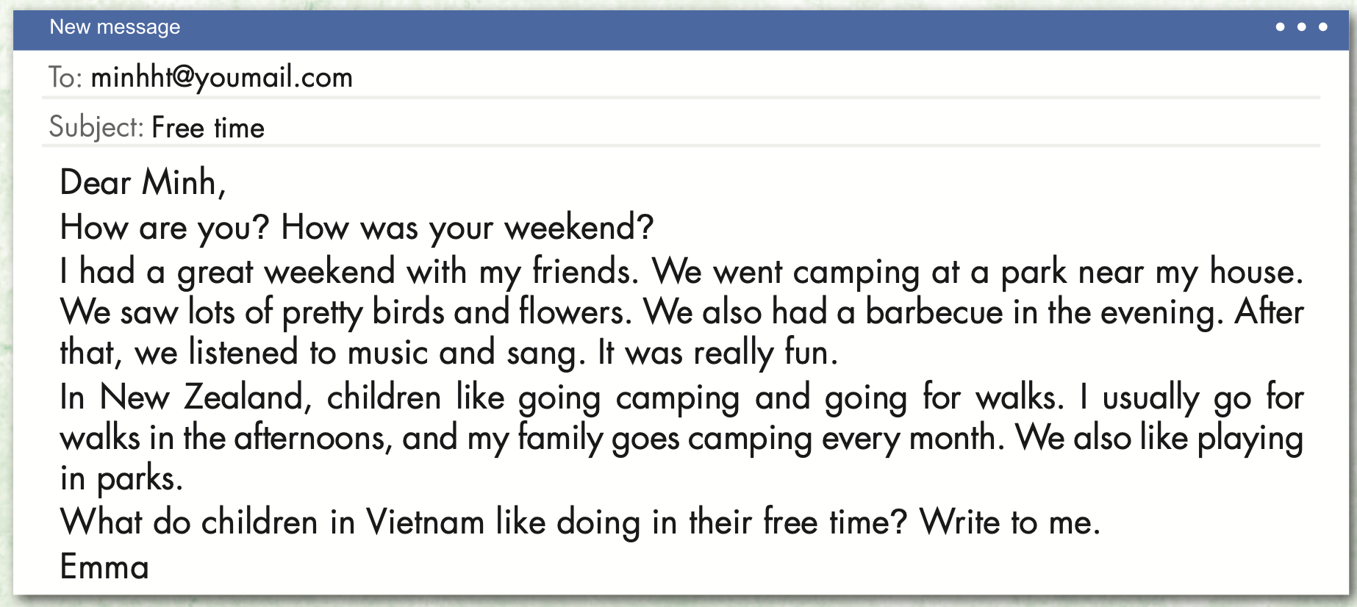
Extra Practice
WB, page 28

Slide 31
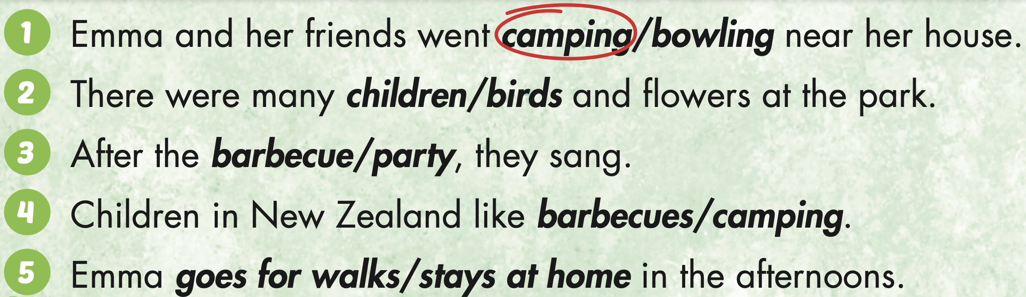
Extra Practice
WB, page 28

Slide 32

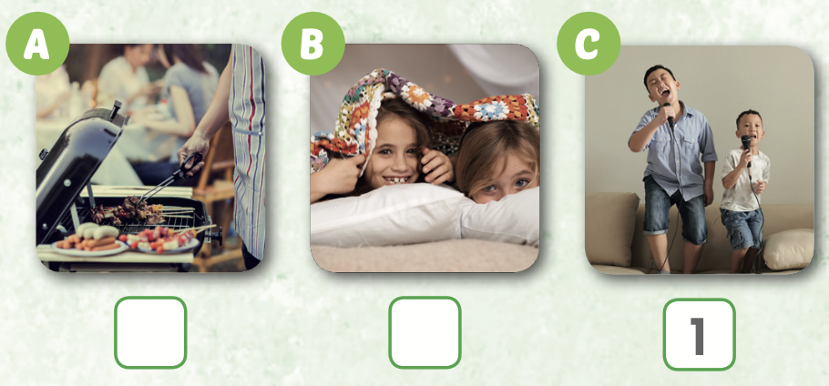
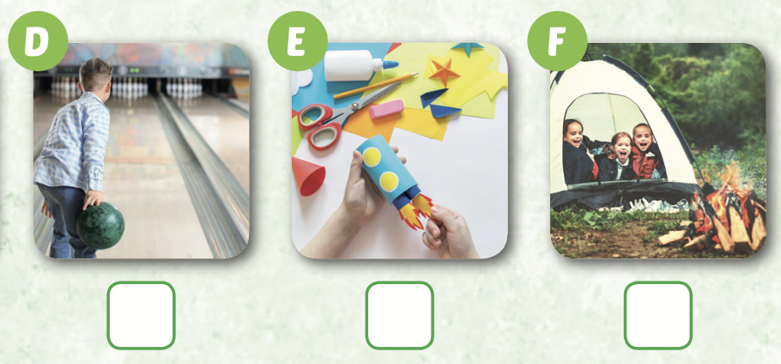
Extra Practice
WB, page 9
6
4
3
2
5

Slide 33

WRAP-UP

Slide 34
Today’s lesson
Vocabularies
have a sleepover,
go camping,
have a barbecue,
sing karaoke,
go bowling,
make paper crafts.
Structures/ Sentence patterns
I went camping last week.

Slide 35
Homework
Practice the vocabularies and structure, and make sentences using them.
Do the exercises in Tiếng Anh 5 i-Learn Smart Start WB (page 29).
Do the exercises in Tiếng Anh 5 i-Learn Smart Start Notebook.
Prepare the next lesson (page 45 SB).
Play the consolidation games in Tiếng Anh 5 i-Learn Smart Start DHA App on www.eduhome.com.vn

Slide 36

Enjoy your day!

Slide 37

Lesson 3
Stay positive and have a nice day!

