Slide 1

Ngoc Lam
Primary School
Unit 3: WEATHER
Lesson 4.1
Page 43

Slide 2
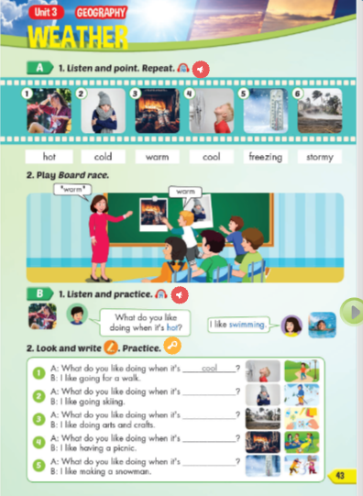
Lesson Outline
Warm-up
Vocabulary
Structure
Consolidation
Wrap-up

Slide 3
Objectives
By the end of this lesson, students will be able to the weather like today.
Vocabulary: Cold, Hot, Warm, Freezing, Cool, Stormy
Structure: What do you like doing when it's hot?
I like swimming.

Slide 4

WARM UP

Slide 5




What is this?
Coat
Gloves
Sunglasses

Slide 6

What is this?
Umbrella
Coat
Cap

Slide 7

What is this?
Cap
Raincoat
Gloves

Slide 8

What is this?
Sunglasses
Raincoat
Umbrella

Slide 9

What is this?
Coat
Umbrella
Cap

Slide 10

What is this?
Raincoat
Cap
Gloves

Slide 11

Vocabulary

Slide 12

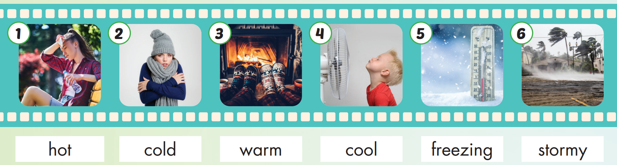

Slide 13
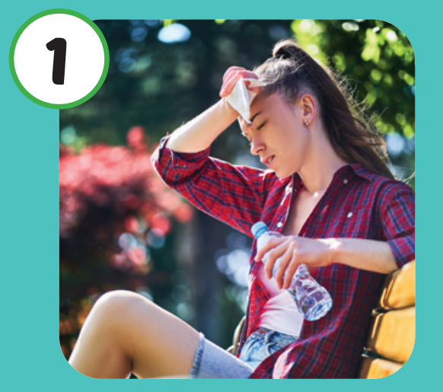
Listen and repeat.
Click each picture to hear the sound.
Hot
/hɑːt/
Nóng

Slide 14

Listen and repeat.
Click each picture to hear the sound.
Cold
/koʊld/
Lạnh

Slide 15


Listen and repeat.
Click each picture to hear the sound.
Warm
/wɔːrm/
Ấm áp

Slide 16
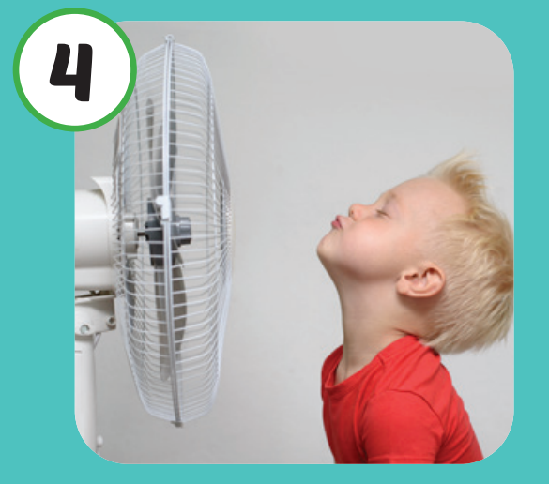
Listen and repeat.
Click each picture to hear the sound.
Cool
/kuːl/
Mát mẻ

Slide 17
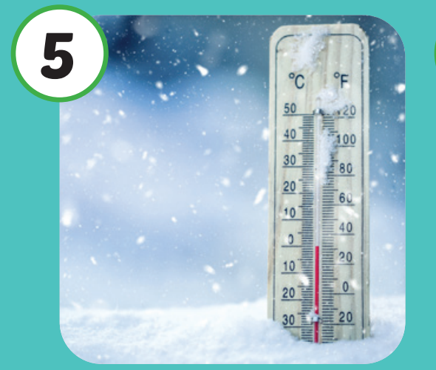
Listen and repeat.
Click each picture to hear the sound.
Freezing
/ˈfriːzɪŋ/
Lạnh cóng

Slide 18

Listen and repeat.
Click each picture to hear the sound.
Stormy
/ˈstɔːrmi/
Có bão

Slide 19

Practice

Slide 20

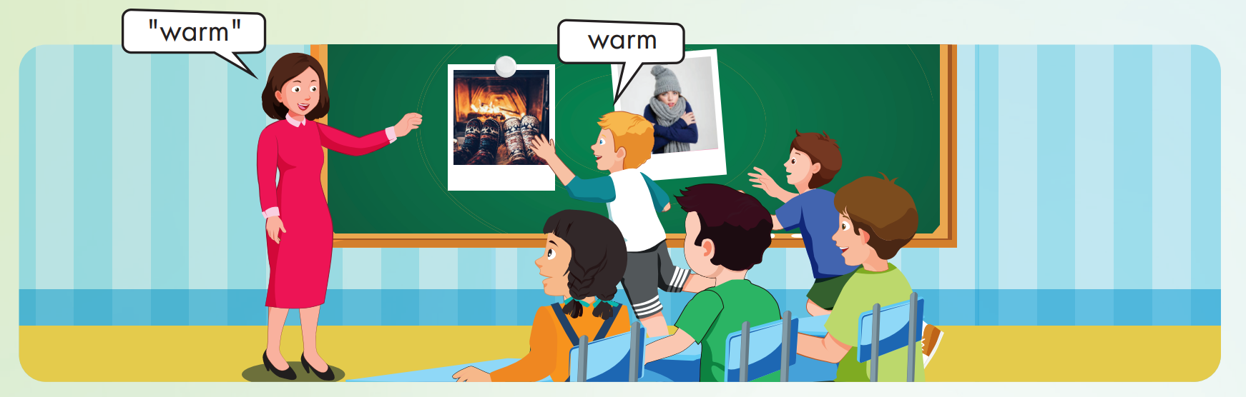

Slide 21


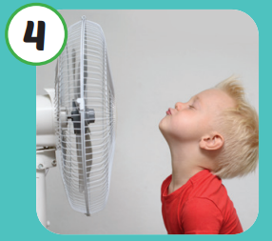

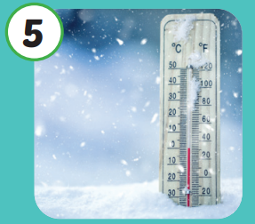

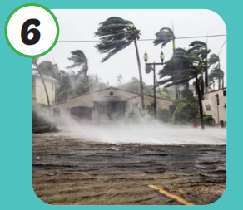
Hot
Cool
Cold
Freezing
Warm
Stormy

Slide 22

Structure

Slide 23

Structures
What do you like
doing when it's hot?
I like swimming.

Slide 24




What do you like doing when it's hot?
I like swimming.

Slide 25

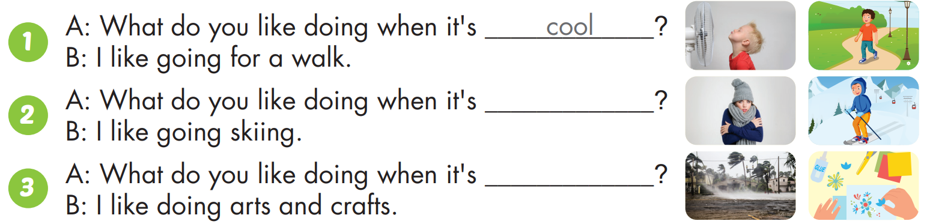
cold
stormy

Slide 26
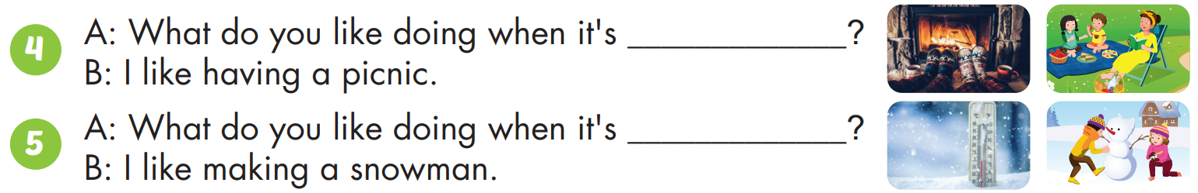
warm
freezing

Slide 27

CONSOLIDATION

Slide 28



Slide 29

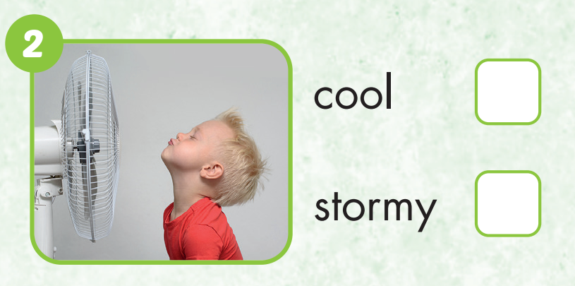

Slide 30
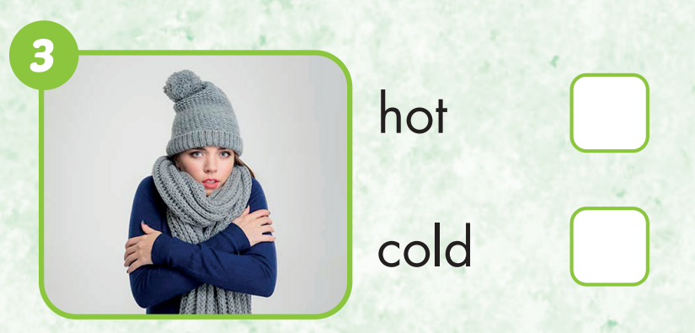

Slide 31
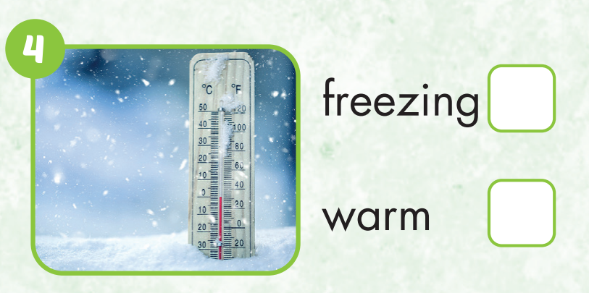

Slide 32
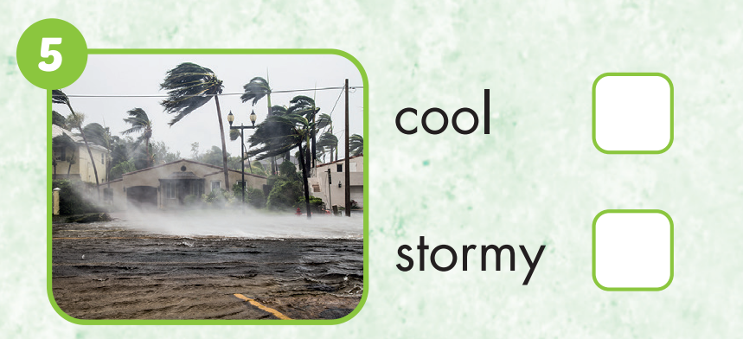

Slide 33
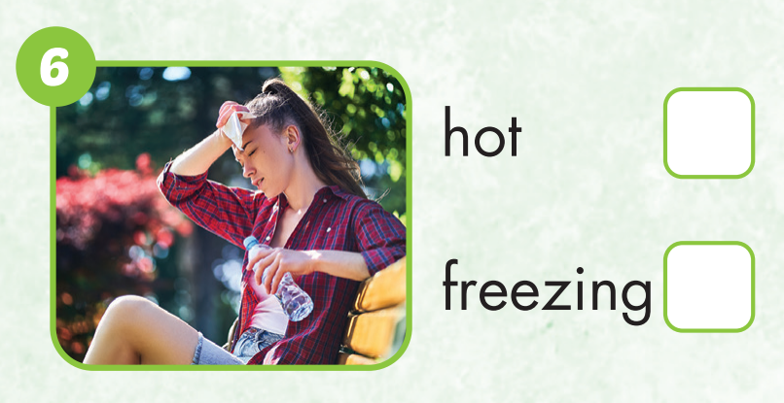

Slide 34

WRAP-UP

Slide 35
Lesson 3
Today’s lesson
Vocabularies
Hot
Cold
Warm
Cool
Freezing
Stormy
Structures/ Sentence patterns
What do you like doing when it's hot?
I like swimming.

Slide 36
Homework
Practice the vocabularies and structure; and make sentences using them.
Do the exercises in Tiếng Anh 4 i-Learn Smart Start WB (page 28).
Do the exercises in Tiếng Anh 4 i-Learn Smart Start Notebook (page 19).
Prepare the next lesson (page 44 SB).
Play the consolidation games in Tiếng Anh 4 i-Learn Smart Start DHA App on www.eduhome.com.vn

Slide 37

Have a nice day!

