Slide 1

Ngoc Lam
Primary School
Unit 1: SCHOOL
Review 1
Page 18

Slide 2
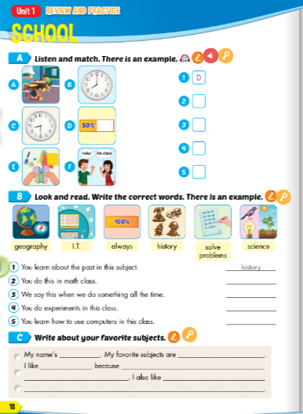
Lesson Outline
Warm-up
Listening
Reading
Writing
Wrap-up

Slide 3
Objectives
By the end of this lesson, students will be able to review the target language presented in unit 1 and practice Listening, Reading and Writing.
Vocabulary: unit 1
Structure: unit 1

Slide 4

WARM-UP

Slide 5
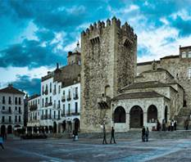
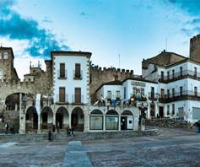
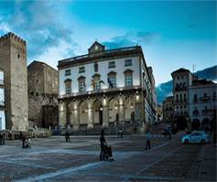

WHAT IS IT?
PHOTO PUZZLE

Slide 6

WHAT IS IT?
Turn around as many colored boxes as you can within the time limit (5 seconds) and say what it is in the picture.

Slide 7

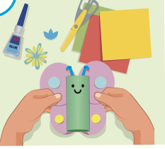
What is it?
making things
T
I
M
E
I
S
U
P
CHECK
NEXT
Click on the colored boxes to turn them around

Slide 8

What is it?
learning languages
T
I
M
E
I
S
U
P
CHECK
NEXT
Click on the coloured boxes to turn them around

Slide 9
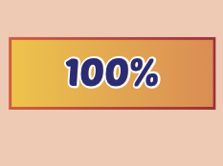
What is it?
always
T
I
M
E
I
S
U
P
CHECK
NEXT
Click on the colored boxes to turn them around

Slide 10
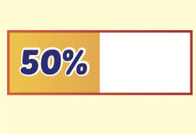
What is it?
making things
T
I
M
E
I
S
U
P
CHECK
NEXT
Click on the colored boxes to turn them around

Slide 11
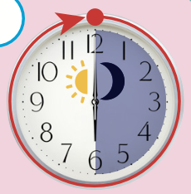
What is it?
a.m.
T
I
M
E
I
S
U
P
CHECK
NEXT
Click on the colored boxes to turn them around

Slide 12
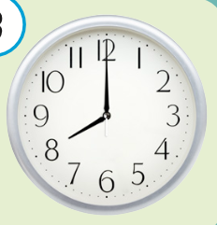
Eight o’clock
What time is it?
T
I
M
E
I
S
U
P
CHECK
END
Click on the colored boxes to turn them around

Slide 13

It’s time to learn …

Slide 14

Presentation

Slide 15
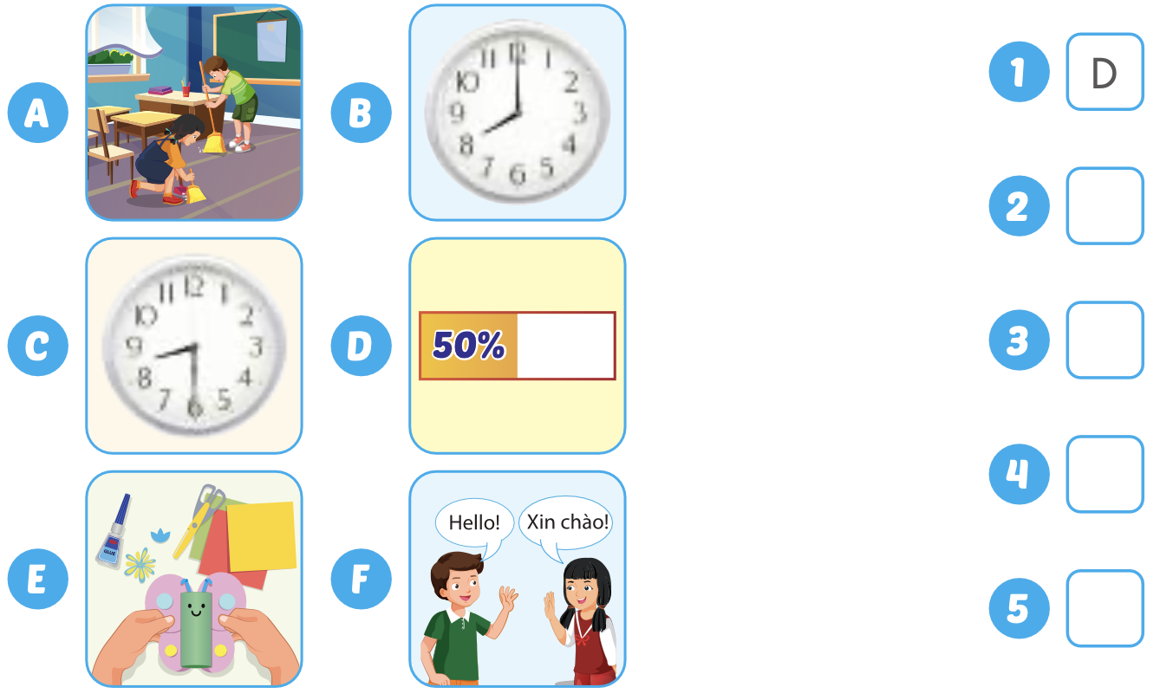
Point and say.

Slide 16
Practice

Slide 17

Listening

Slide 18

Click on the picture to hear the sound.
B
A
E
F

Slide 19
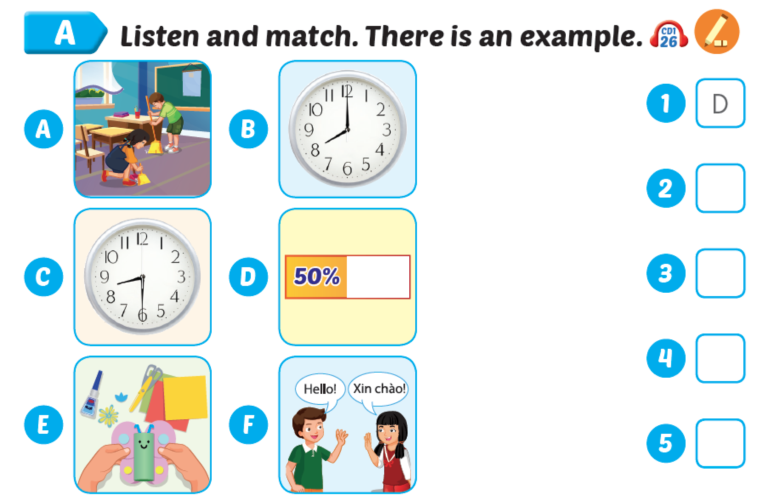
B
A
E
F

Slide 20

Reading

Slide 21
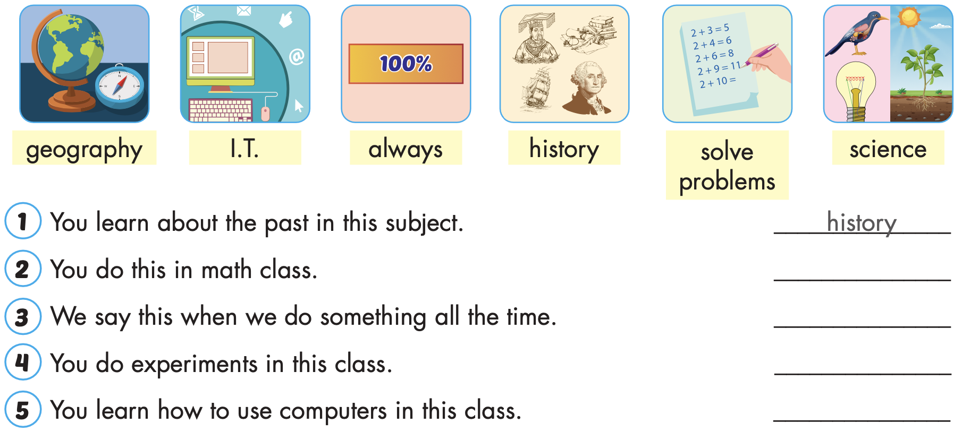
solve problems
always
science
I.T.

Slide 22



Slide 23
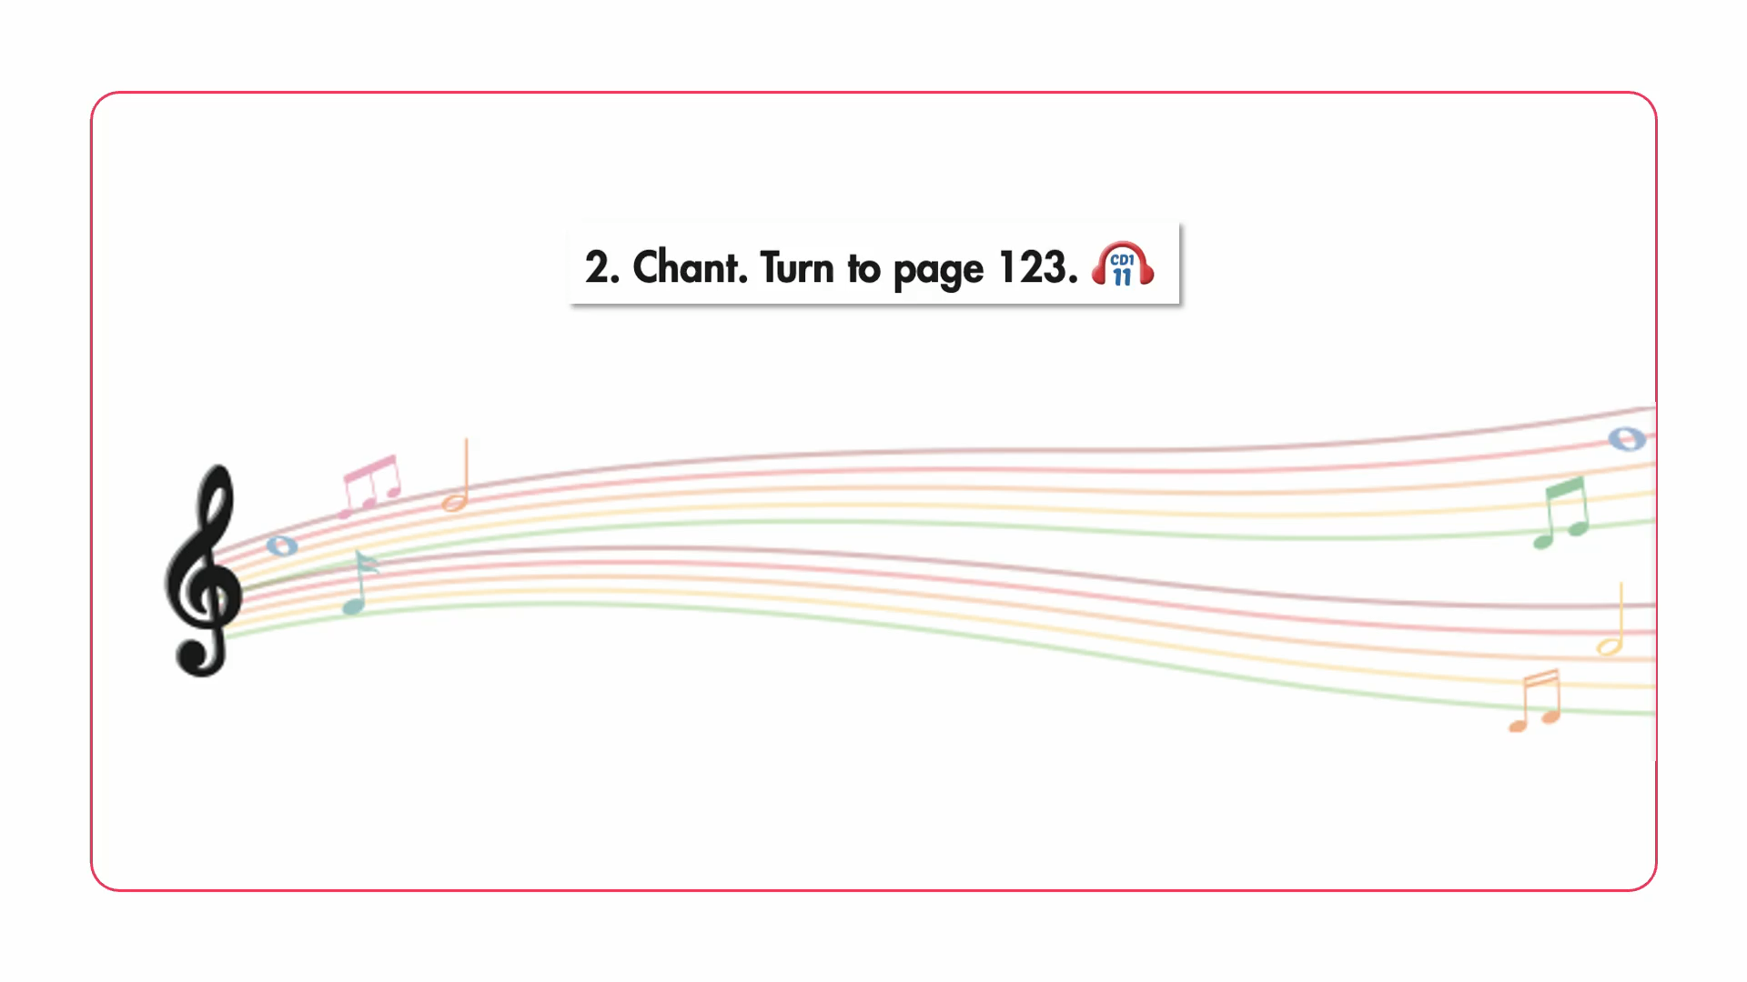

Slide 24

Writing

Slide 25
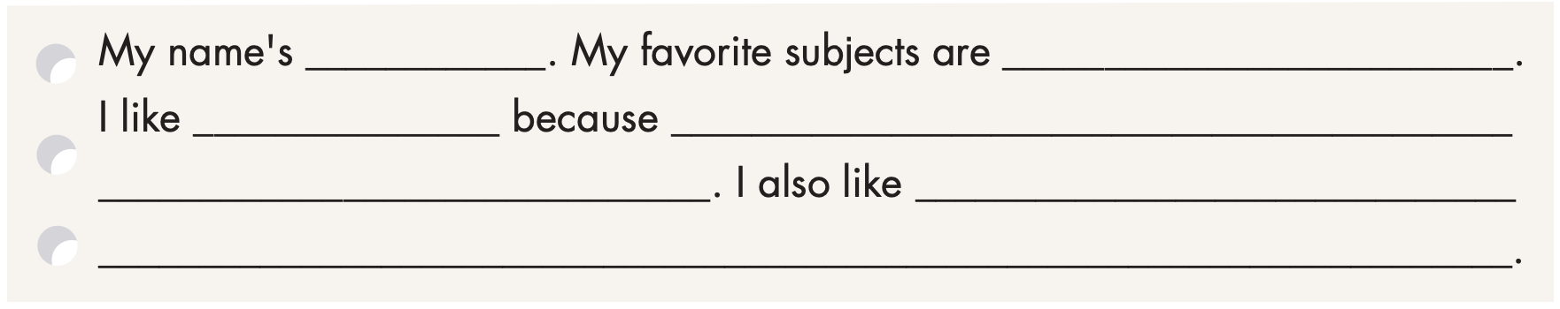
Examples:
Lan
English and history
English
I like learning languages. I always
learn new words in English
history because I like
learning about the past. I sometimes read stories in history

Slide 26

Production

Slide 27

Speaking

Slide 28
Talk about your favorite subjects.

Slide 29

CONSOLIDATION

Slide 30
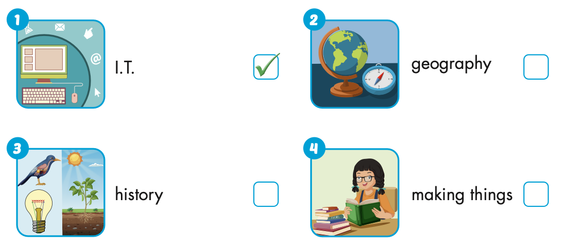


Extra Practice
WB, page 10

Slide 31
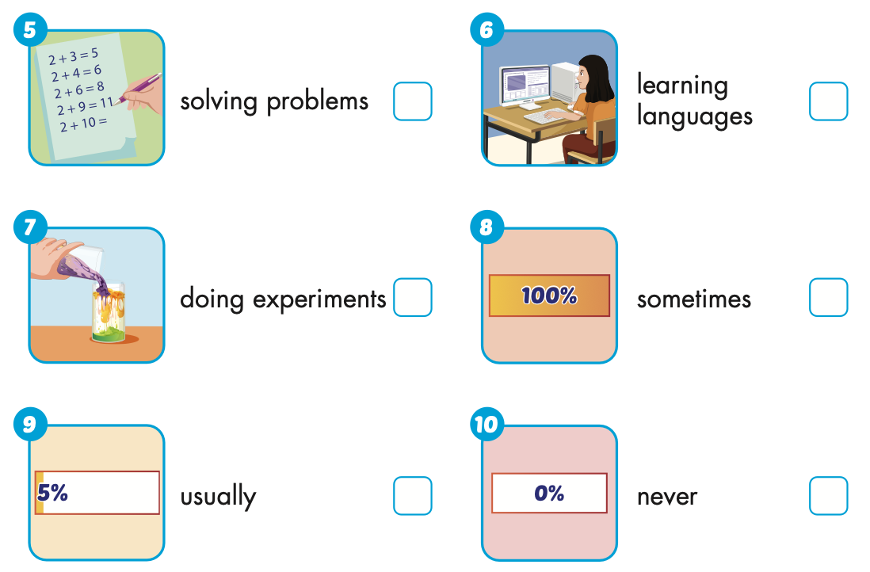



Extra Practice
WB, page 10

Slide 32

WRAP-UP

Slide 33
Today’s lesson
Vocabularies
Unit 1
Structures/ Sentence patterns
Unit 1

Slide 34
Homework
Practice the vocabularies and structure, and make sentences using them.
Do the exercises in Tiếng Anh 5 i-Learn Smart Start WB (page 10).
Do the exercises in Tiếng Anh 5 i-Learn Smart Start Notebook.
Prepare the next lesson (page 19 SB).
Play the consolidation games in Tiếng Anh 5 i-Learn Smart Start DHA App on www.eduhome.com.vn

Slide 35

Enjoy your day!

Slide 36

Lesson 3
Stay positive and have a nice day!

