Slide 1

Teacher: Le Thi Hau
Unit 1: Animals
Review and Practice 2
Page 19

Slide 2
Lesson Outline
Warm-up
Speaking
Consolidation
Wrap-up

Slide 3
Objectives
By the end of this lesson, students will be able to…
Vocabulary: Review: " snake, monkey, horse, camel, hippo, rhino, panda, giraffe, lion, dolphin, tiger, zebra, crocodile, bat, shark, penguin, kangaroo, elephant."
Structure: Review: "This is a monkey. - These are monkeys. That's a snake. - Those are snakes, What's this? It's a panda. What's that? It's a dolphin, What are these? They're penguins. What are those? They're bats."

Slide 4

WARM UP

Slide 5
CHECK
YOUR MEMORY

Slide 6





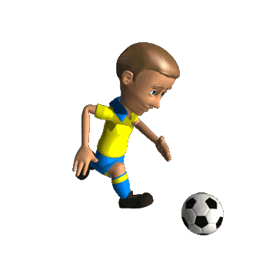

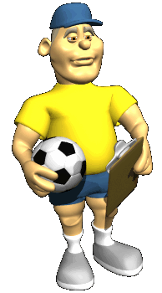

NEXT
monkey
horse

Slide 7

Choose the correct answer.
NEXT
panda
shark

Slide 8

Choose the correct answer.
NEXT
tiger
lion

Slide 9

Choose the correct answer.
NEXT
dolphin
crocodile

Slide 10

Choose the correct answer.
NEXT
dolphin
zebra

Slide 11

It’s time to learn …

Slide 12

Speaking

Slide 13
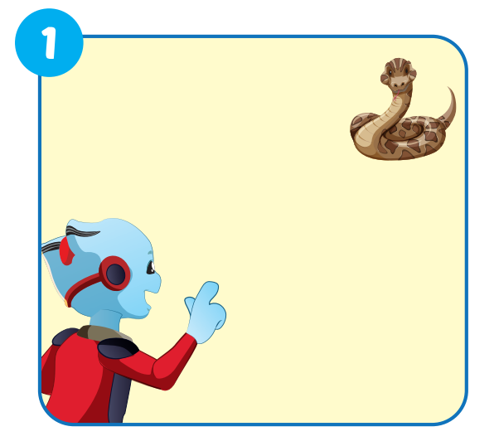

PRE-SPEAKING
That's a snake.

Slide 14
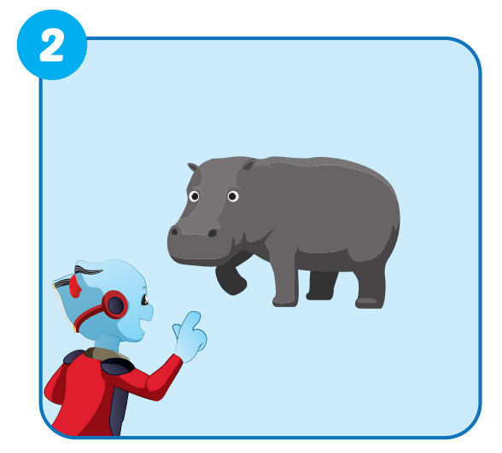
PRE-SPEAKING
This is a hippo.

Slide 15
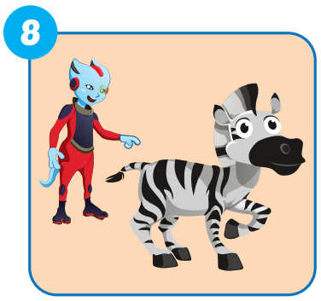


PRE-SPEAKING
What's this?
It's a zebra.

Slide 16
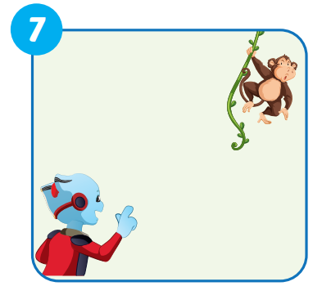
PRE-SPEAKING
What's that?
It's a monkey.

Slide 17
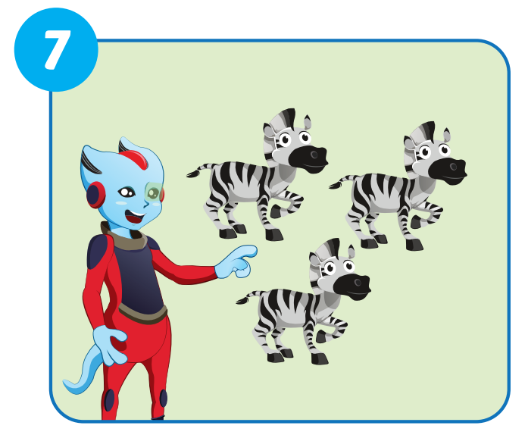
PRE-SPEAKING
What are these?
They're zebras.

Slide 18
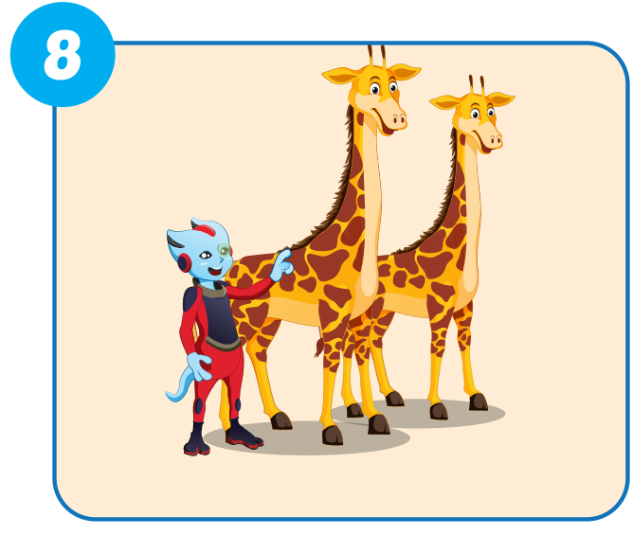
PRE-SPEAKING
They are giraffes.
What's are these?

Slide 19

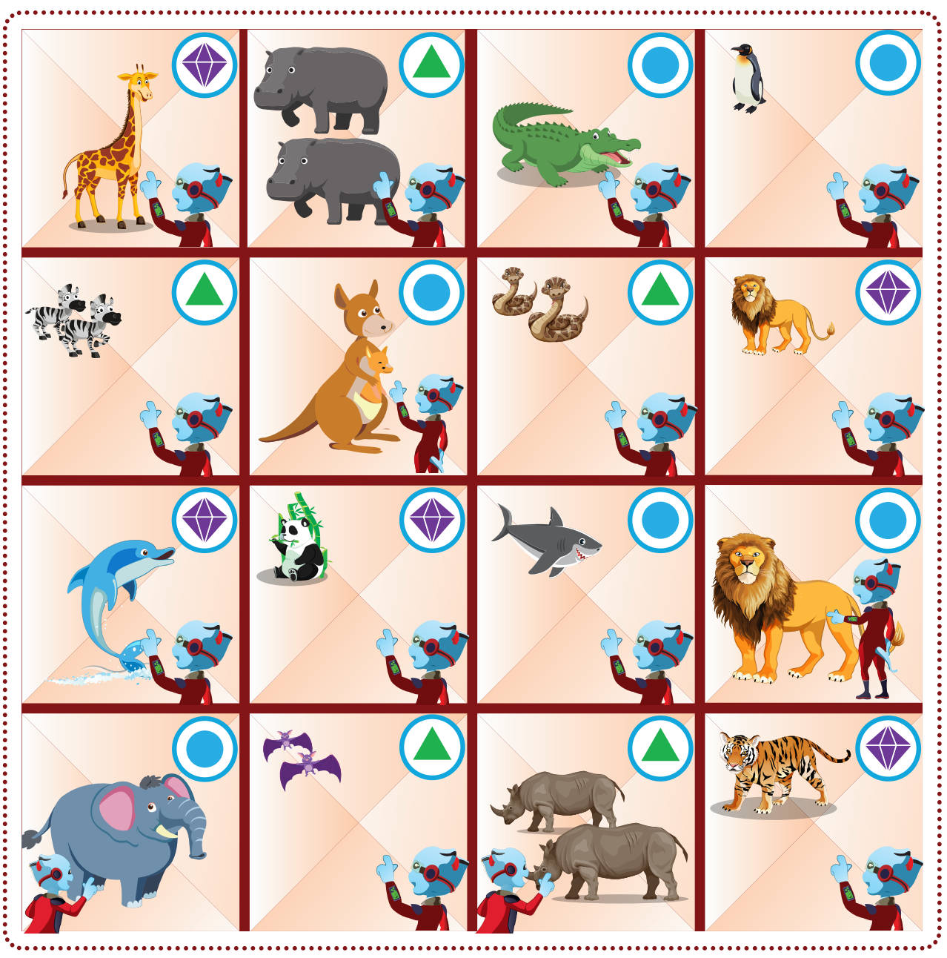
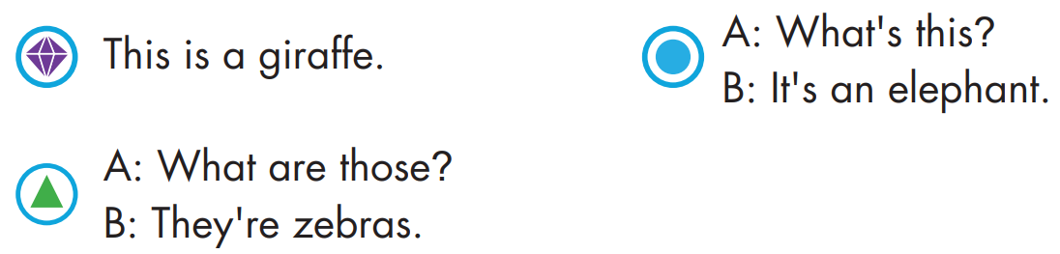
WHILE-SPEAKING

Slide 20
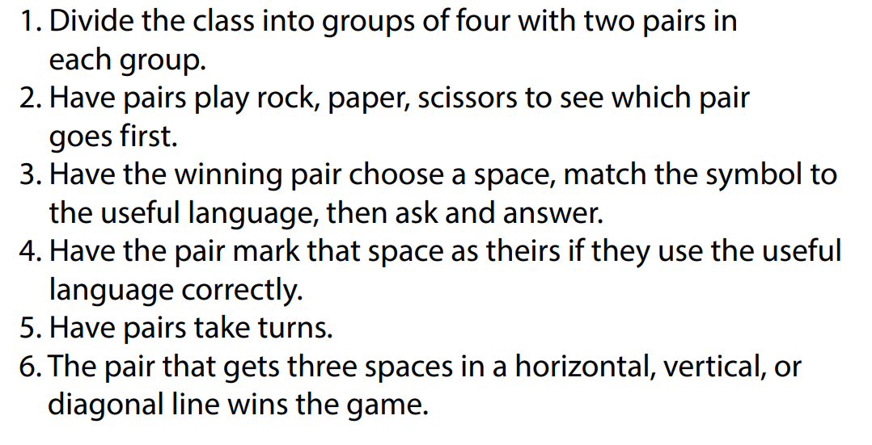
HOW TO PLAY?

Slide 21

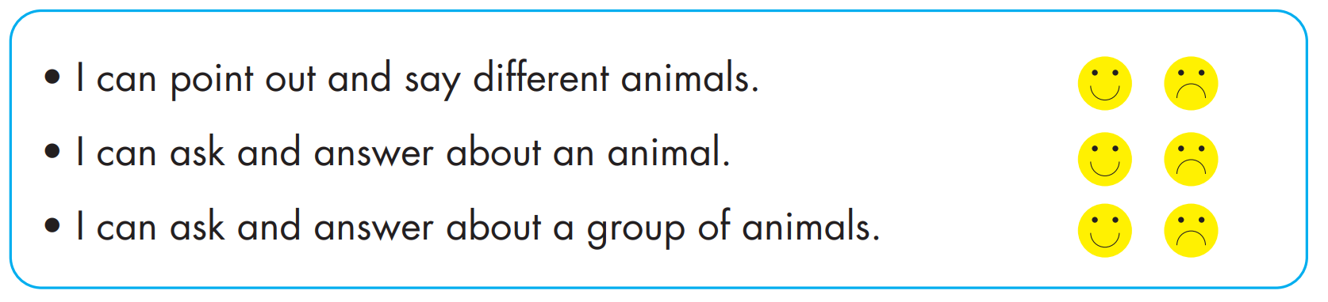

Slide 22



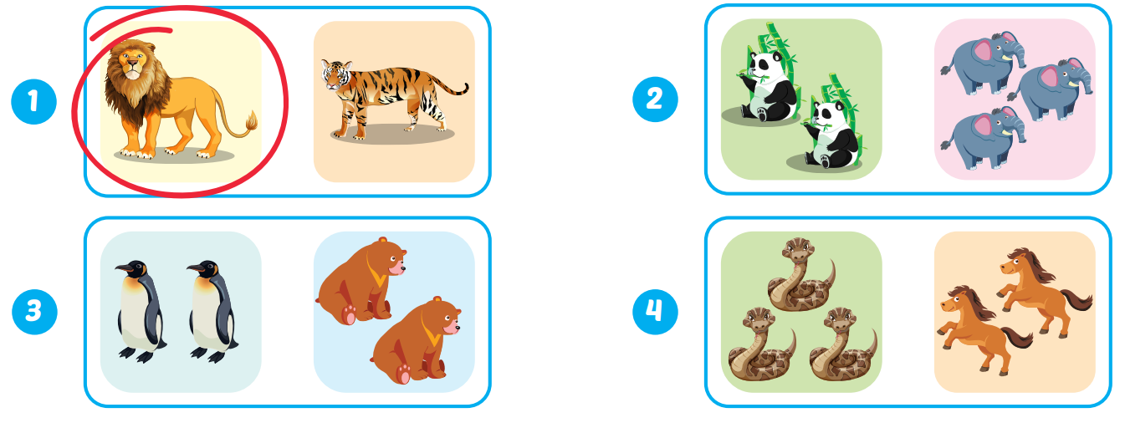
Extra Practice
WB, page 11

Slide 23
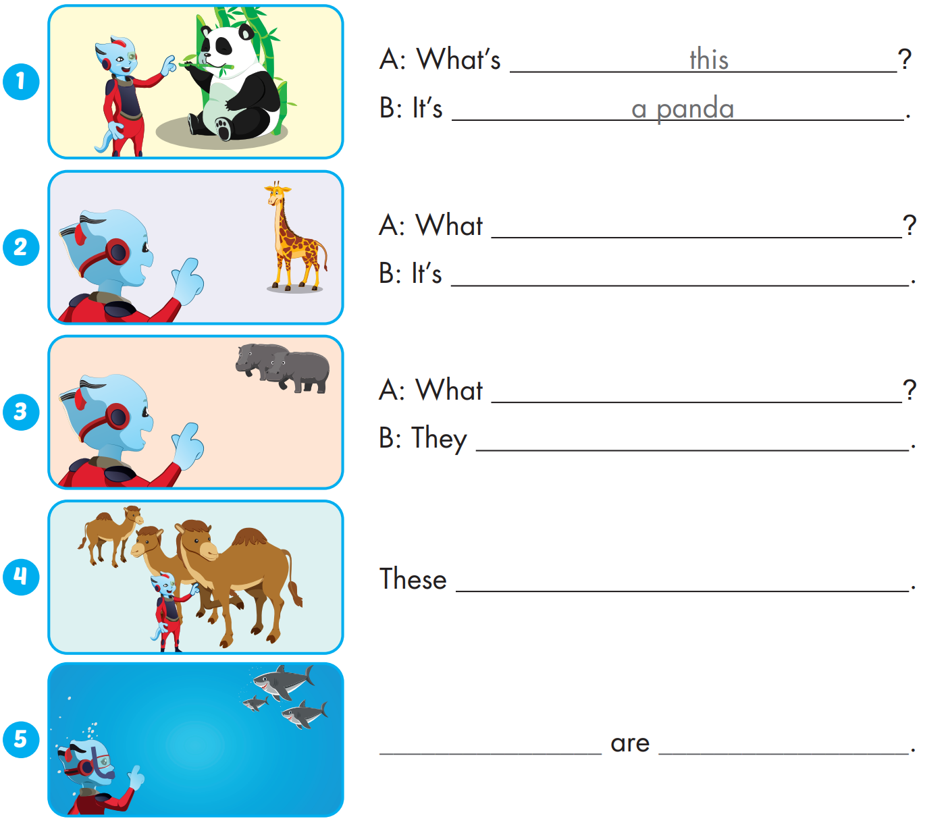

Extra Practice
WB, page 11
is that
a giraffe
are those
are hippos
are camels
Those sharks

Slide 24

WRAP-UP

Slide 25
Today’s lesson
Vocabularies
Vocabulary: Review: " snake, monkey, horse, camel, hippo, rhino, panda, giraffe, lion, dolphin, tiger, zebra, crocodile, bat, shark, penguin, kangaroo, elephant."
Structures/ Sentence patterns
Review: "This is a monkey.
- These are monkeys.
That's a snake.
- Those are snakes,
What's this? It's a panda.
What's that? It's a dolphin,
What are these? They're penguins.
What are those? They're bats."

Slide 26
Homework
Practice the vocabularies and structure; and make sentences using them.
Do the exercises in Tiếng Anh 4 i-Learn Smart Start WB (page 11)
Do the exercises in Tiếng Anh 4 i-Learn Smart Start Notebook (page 9)
Prepare the next lesson (page 20 SB)
Play the consolidation games in Tiếng Anh 4 i-Learn Smart Start DHA App on www.eduhome.com.vn

Slide 27

Enjoy your day!

