Slide 1
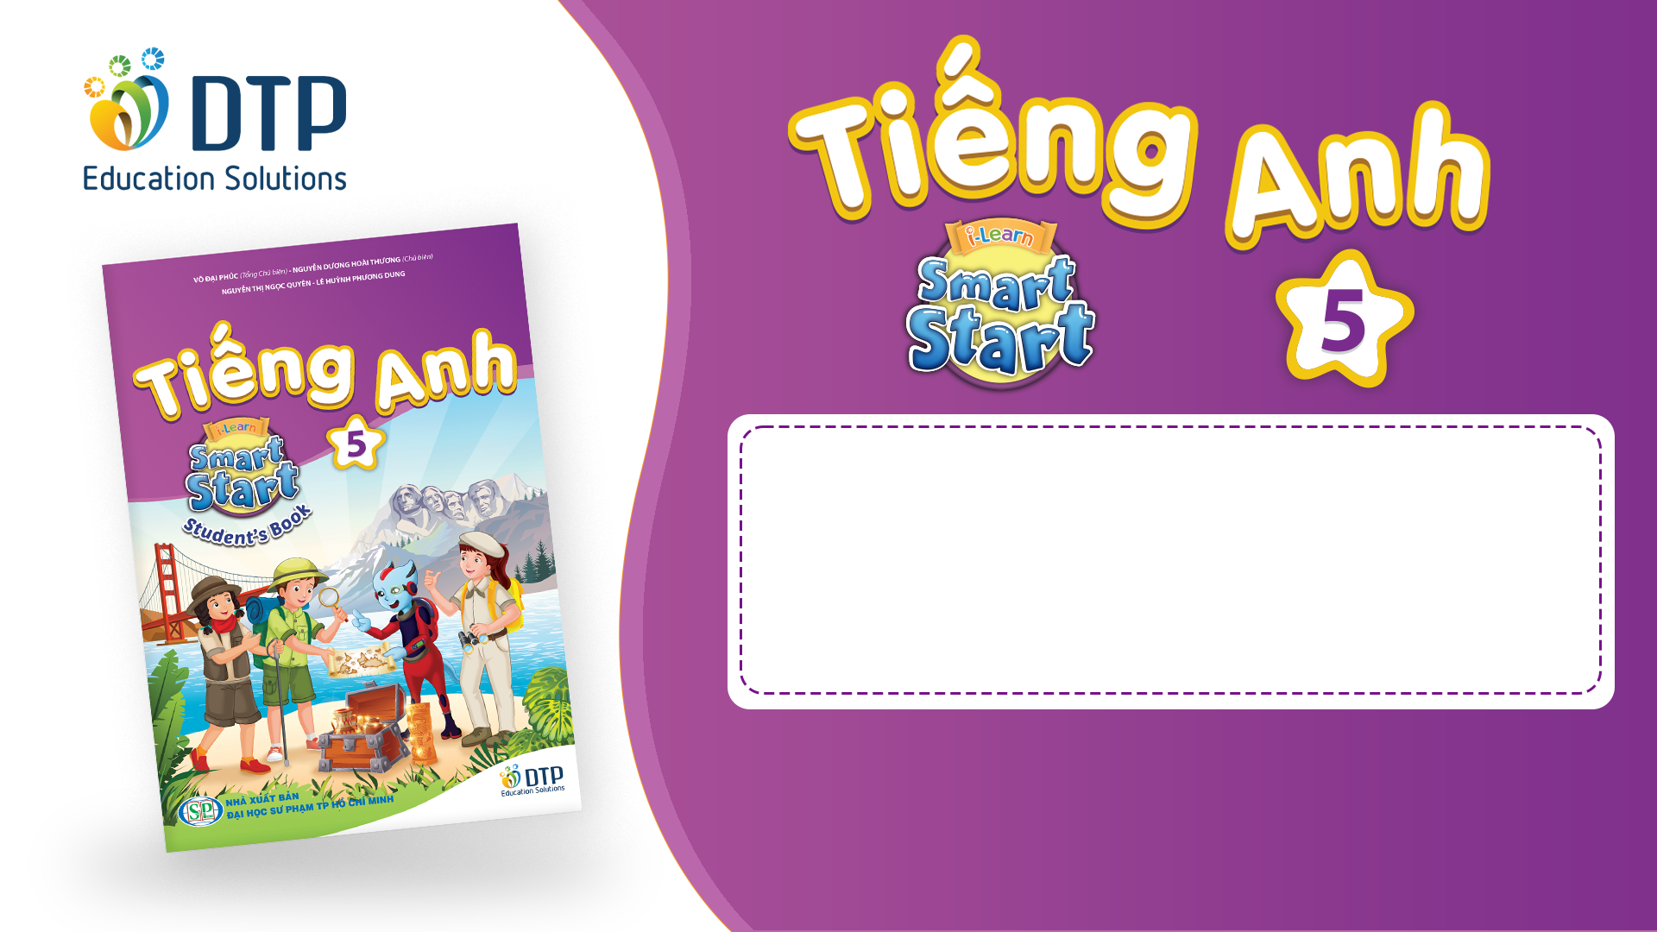
Ngoc Lam
Primary School
Unit 2: Holidays
Lesson 4.1
Page 29

Slide 2
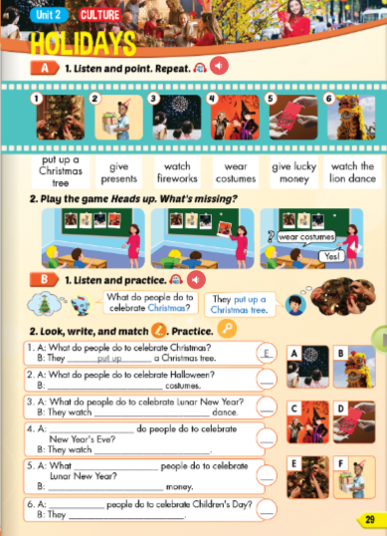
Lesson Outline
Warm-up
Vocabulary
Structure
Consolidation
Wrap-up

Slide 3
Objectives
By the end of this lesson, students will be able to…
Vocabulary: Pronounce and use the words related to the topic properly: put up a Christmas tree, give presents, watch fireworks, wear costumes, give lucky money, watch the lion dance
Structure: What do people do to celebrate Christmas?
- They put up a Christmas tree.

Slide 4

WARM-UP

Slide 5


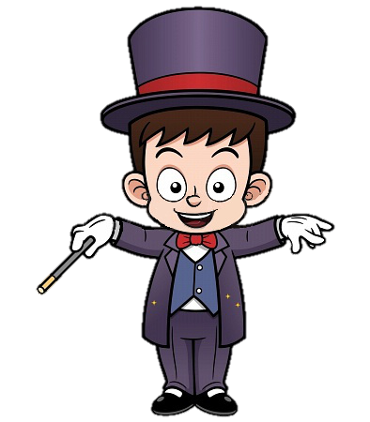

Slide 6


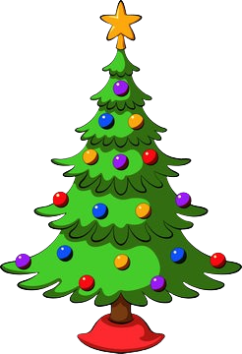

Christmas tree
NEXT

Slide 7

fireworks
NEXT

Slide 8
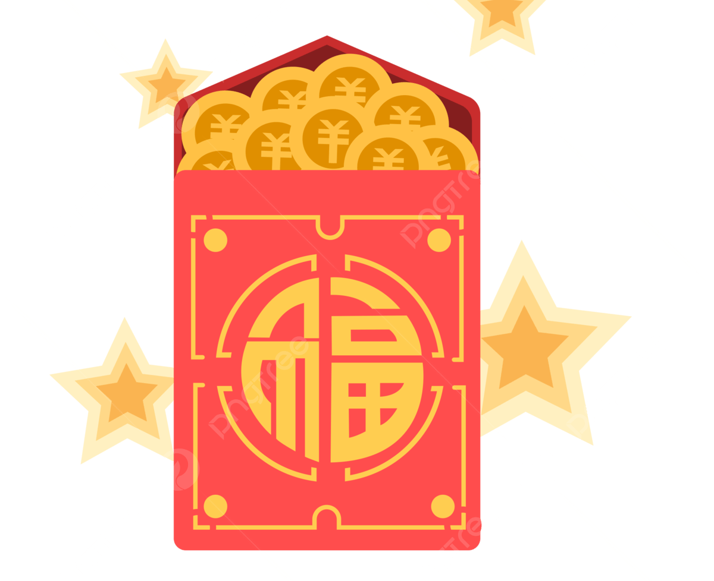
lucky money
NEXT

Slide 9
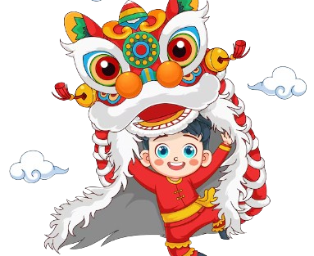
lion dance
NEXT

Slide 10
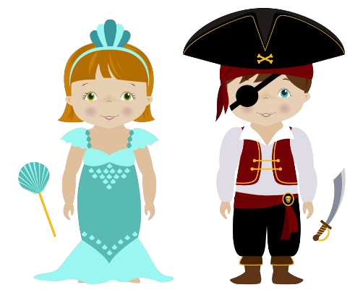
customes
NEXT

Slide 11
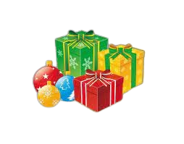
presents
NEXT

Slide 12

It’s time to learn …

Slide 13

New words
put up a Christmas tree,
give presents,
watch fireworks,
wear costumes,
give lucky money,
watch the lion dance

Slide 14

Presentation

Slide 15


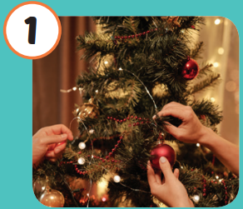
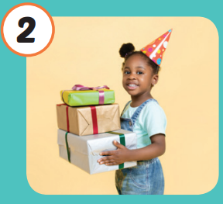
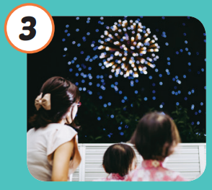
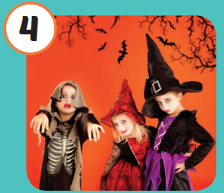
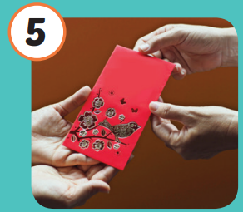
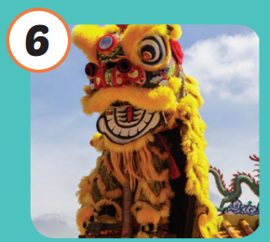
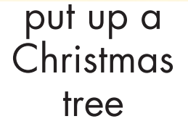
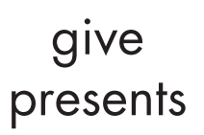
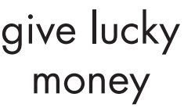


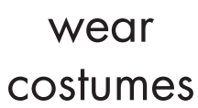
/pʊt ʌp ə ˈ
krɪsməs tri/
trang trí
cây thông Noel
/ɡɪv ˈprezənts/
tặng quà
/wɑtʃ ˈfaɪərwɜrks/
xem pháo hoa
/weər ˈkɑːstuːmz/
mặc trang phục cải trang
/ɡɪv ˈlʌki ˈmʌni/
lì xì
/wɑtʃ ðə ˈ
laɪən dæns/
xem múa lân/múa sư tử
Notes:
Click vào hình A. 1. Listen and point. Repeat để cho cả audio full chạy

Slide 16
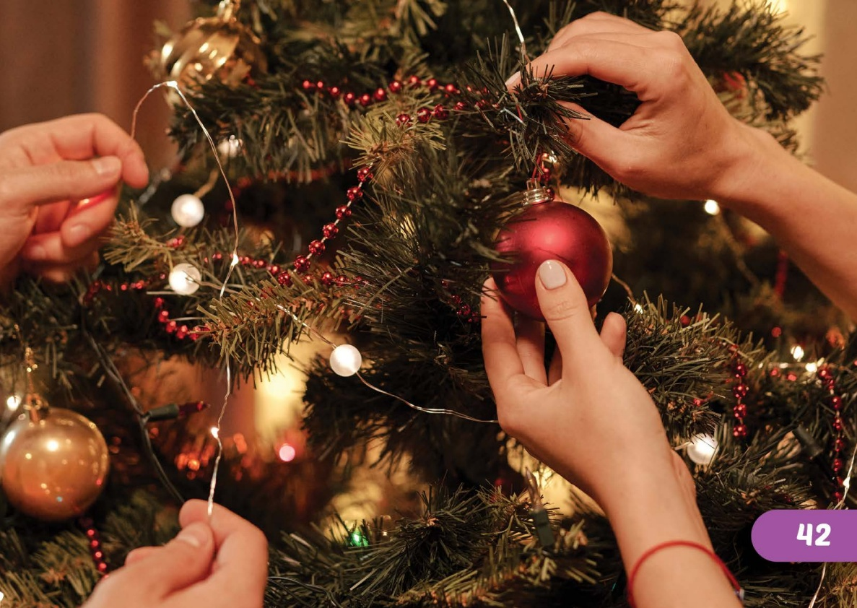

/pʊt ʌp ə ˈ
krɪsməs tri/
trang trí
cây thông Noel

Slide 17
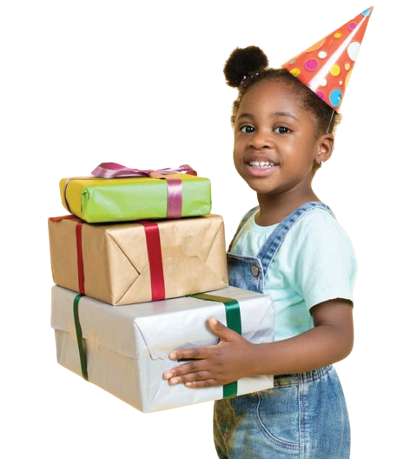

/ɡɪv ˈprezənts/
tặng quà

Slide 18
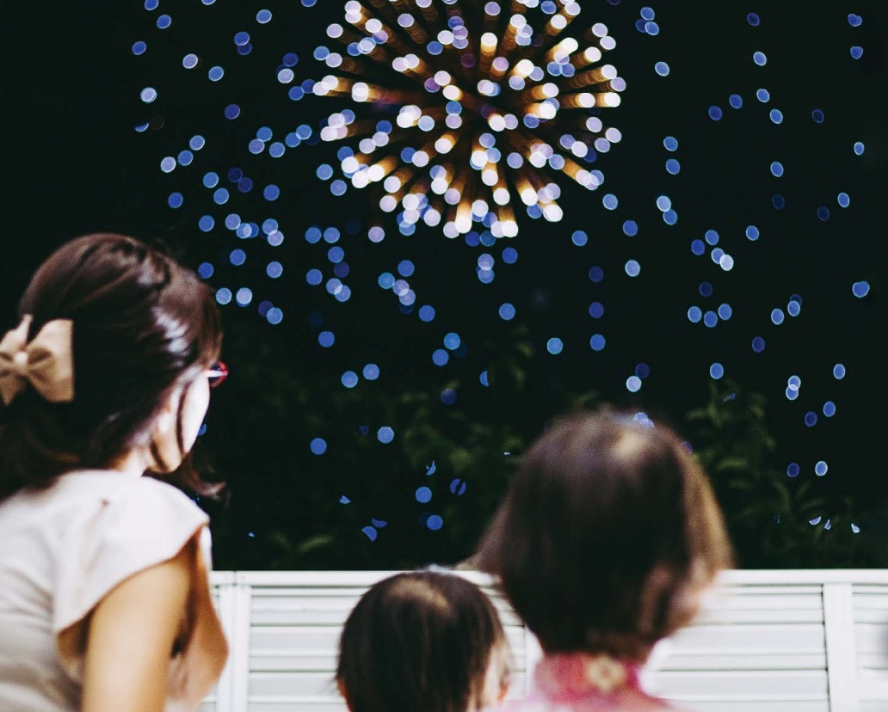

/wɑtʃ ˈfaɪərwɜrks/
xem pháo hoa

Slide 19
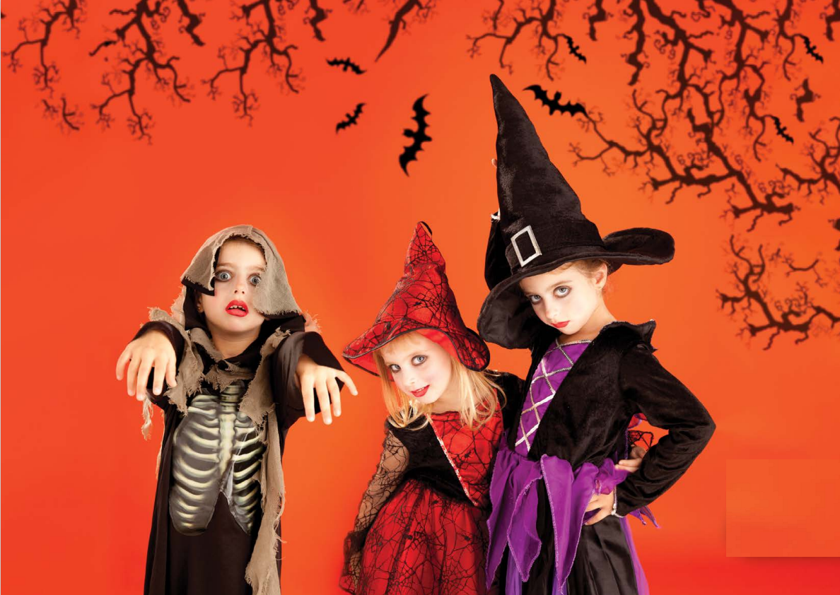

/weər ˈkɑːstuːmz/
mặc trang phục cải trang

Slide 20
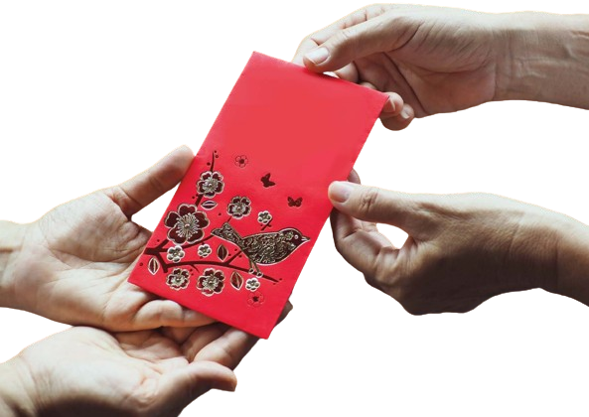

/ɡɪv ˈlʌki ˈmʌni/
lì xì

Slide 21

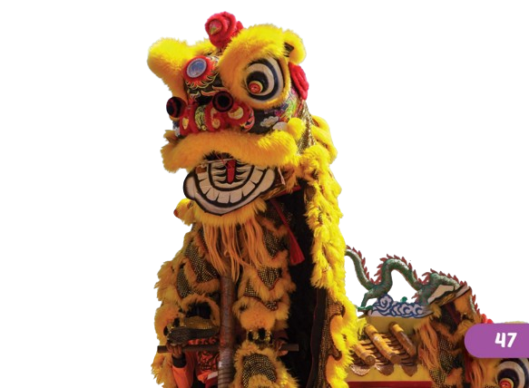
/wɑtʃ ðə ˈ
laɪən dæns/
xem múa lân/múa sư tử

Slide 22
Practice

Slide 23
Check your memory

Slide 24


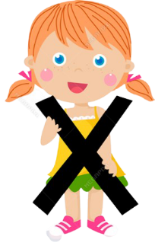





Listen and choose
A
C
B

Slide 25


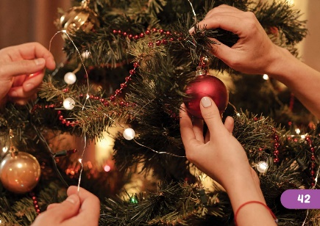
Listen and choose
A
C
B

Slide 26

Listen and choose
A
B
B

Slide 27


Listen and choose
A
C
B

Slide 28


Listen and choose
A
C
B

Slide 29


Listen and choose
A
B
B

Slide 30
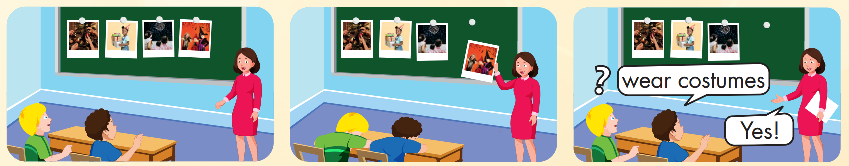

Slide 31
Structure
What do people do to celebrate Christmas?
- They put up a Christmas tree.

Slide 32
Presentation

Slide 33
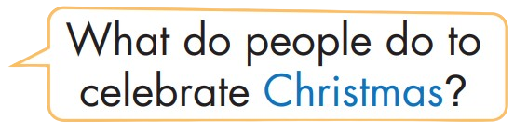
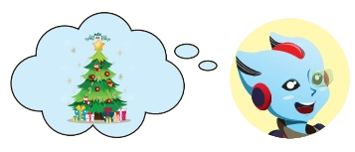
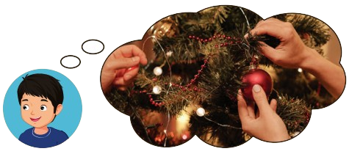
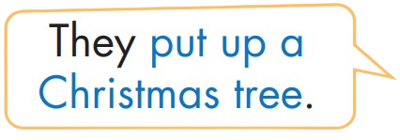
Structure

Slide 34
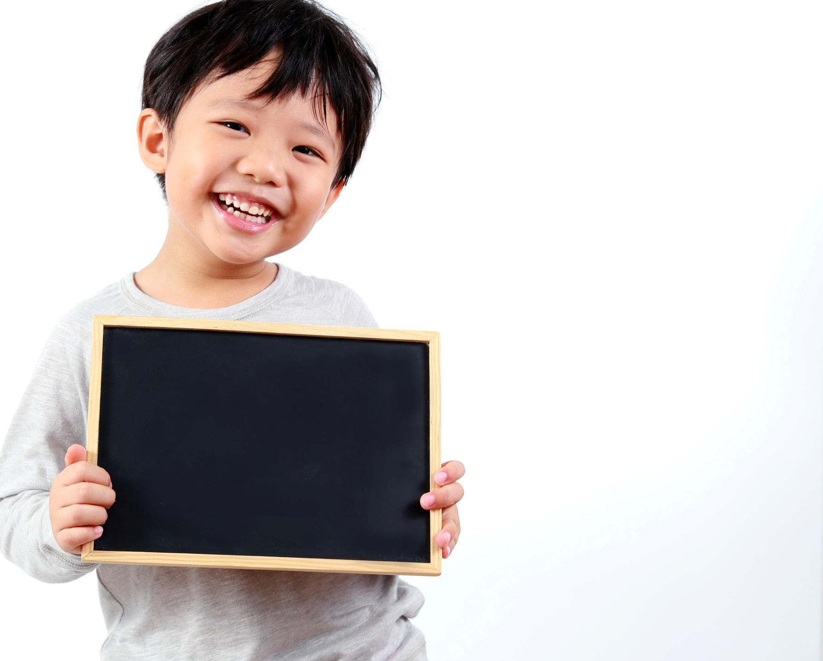
Practice

Slide 35


Slide 36
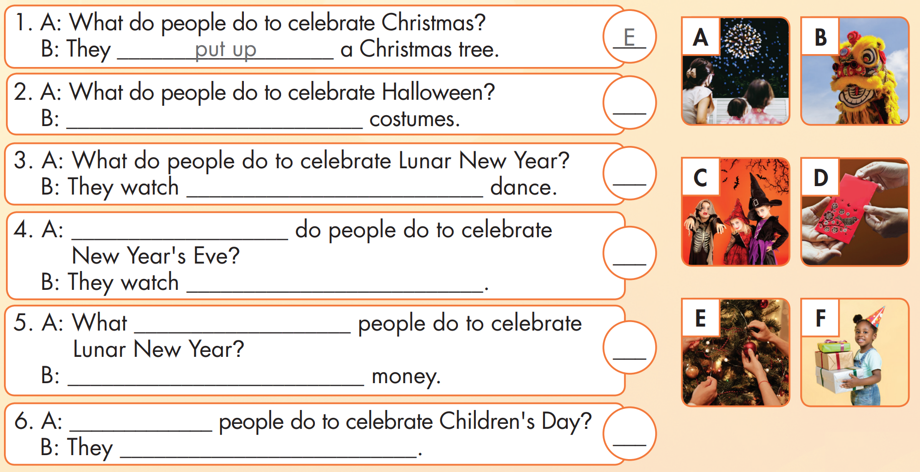
C
They wear
B
the lions
What
A
fireworks
do
D
They give lucky
What
F
give presents

Slide 37

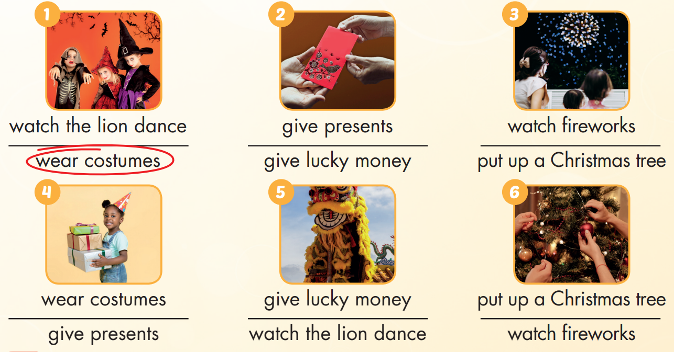

Extra Practice
WB, page 18

Slide 38

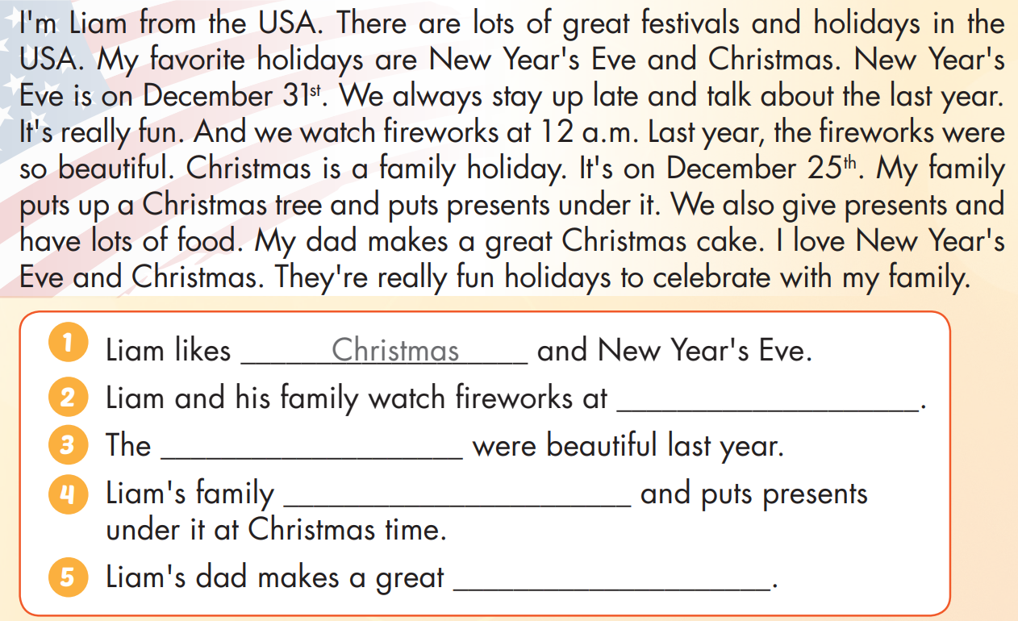
Extra Practice
WB, page 18

Slide 39
Extra Practice
WB, page 18
12 a.m
fireworks
puts up a Christmas tree
Christmas cake

Slide 40

Production

Slide 41

CONSOLIDATION

Slide 42
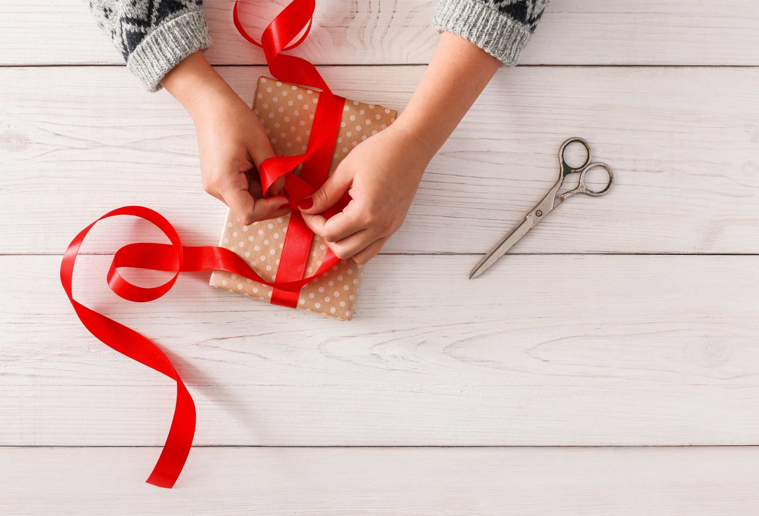
WRAP-UP

Slide 43
Today’s lesson
Vocabularies
put up a Christmas tree, give presents, watch fireworks, wear costumes, give lucky money, watch the lion dance
Structures/ Sentence patterns
What do people do to celebrate Christmas?
- They put up a Christmas tree.

Slide 44
Homework
Practice the vocabularies and structure, and make sentences using them.
Do the exercises in Tiếng Anh 5 i-Learn Smart Start WB (page 17)
Do the exercises in Tiếng Anh 5 i-Learn Smart Start Notebook (page 13)
Prepare the next lesson (page 30 SB)
Play the consolidation games in Tiếng Anh 5 i-Learn Smart Start DHA App on www.eduhome.com.vn

Slide 45

Enjoy your day!

Slide 46

Lesson 3
Stay positive and have a nice day!

