Slide 1
UNIT 2: HOLIDAYS
Period 9 – Lesson 3
- Grade 5 -
Welcome to our lesson today!

Slide 2
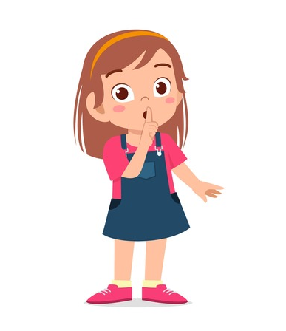


Slide 3



Slide 4


Slide 5



Slide 6



Slide 7
The rules in class

Slide 8

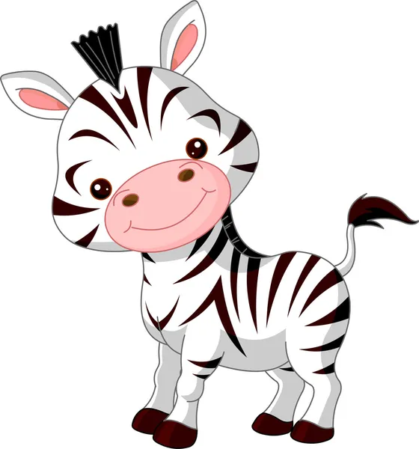
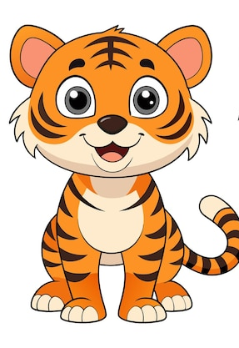
The class will be divided into 4 teams
TEAM 1
TEAM 2
TEAM 3
TEAM 4

Slide 9
Warm-up!
Let’s sing a song together!

Slide 10
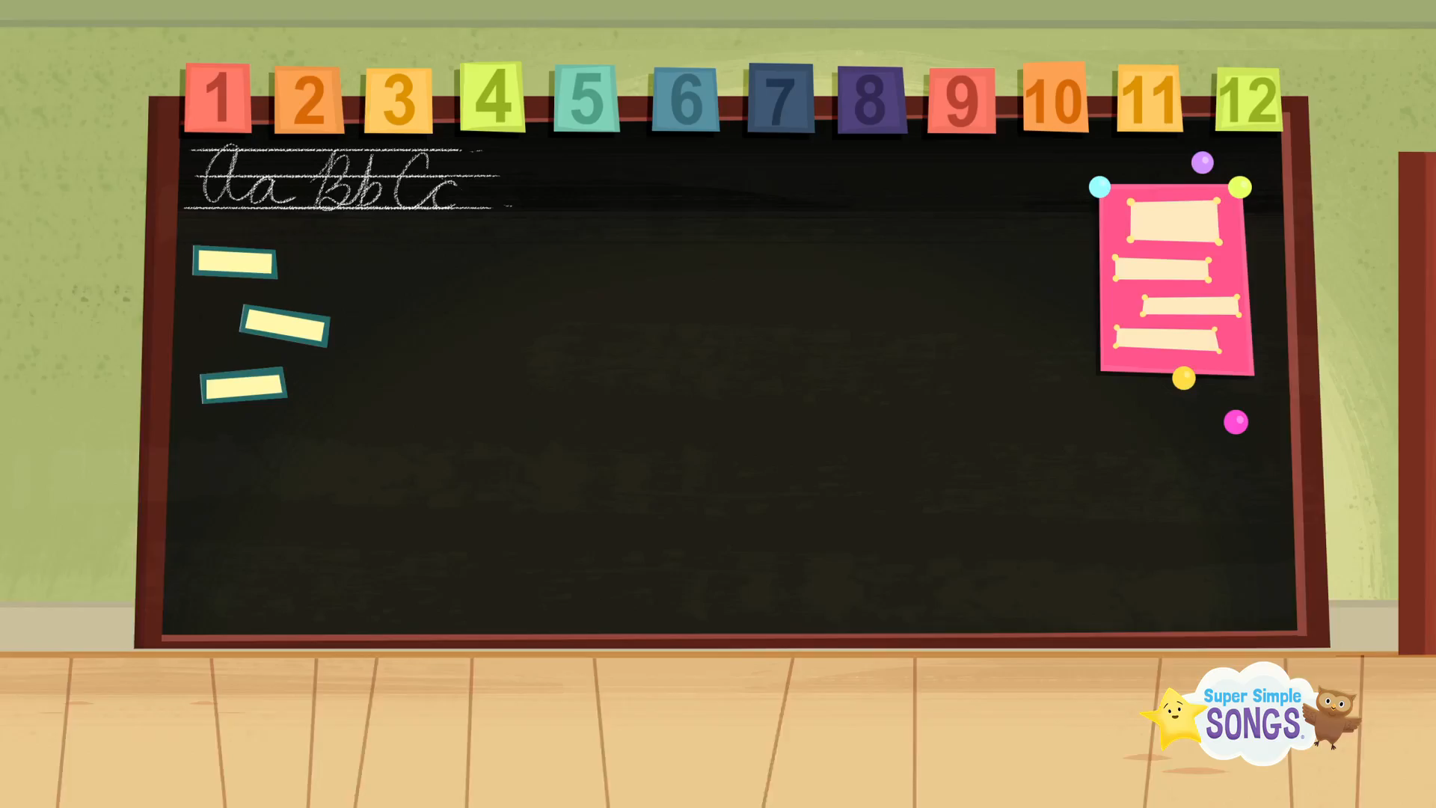

Slide 11
REVIEW OLD LESSON!
“SLAP THE BOARD”

Slide 12
What are the missing letters?
A
I
H _ L _ D _ YS
O

Slide 13
UNIT 2: HOLIDAYS
Period 9 – Lesson 3
- Grade 5 -

Slide 14
Table of contents
01
02
Review Words
Worksheet
03
04
Mini-Game
Wrap-up

Slide 15
01
Review Words

Slide 16
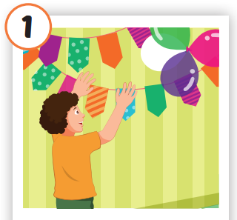
PUT UP COLORED PAPER

Slide 17
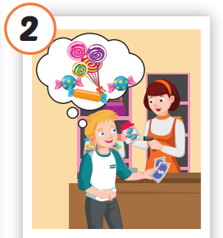
BUY CANDY

Slide 18
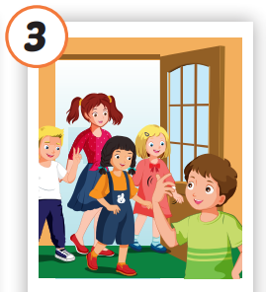
INVITE FRIENDS

Slide 19
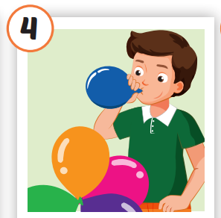
➢BLOW UP THE BALLOONS

Slide 20
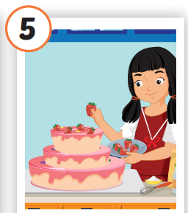
➢➢MAKE A CAKE

Slide 21
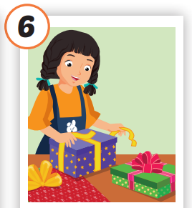
➢WRAP THE PRESENTS

Slide 22

Listen and repeat!
Put Up Colored Paper
Buy Candy
Invite Friends
Blow up the balloons
Make A Cake
Wrap The Presents

Slide 23
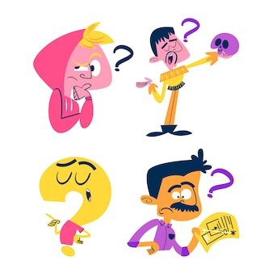
Activity 1:
“Can you guess it?”
The teacher will randomly choose a student, and that student will come to the front of the class.
The teacher shows the flashcard to the student, who must act out the phrase. Another student will try to guess the phrase. If it’s correct, the student’s team earns one star.
This continues with the other students.

Slide 24
02
Worksheet

Slide 25
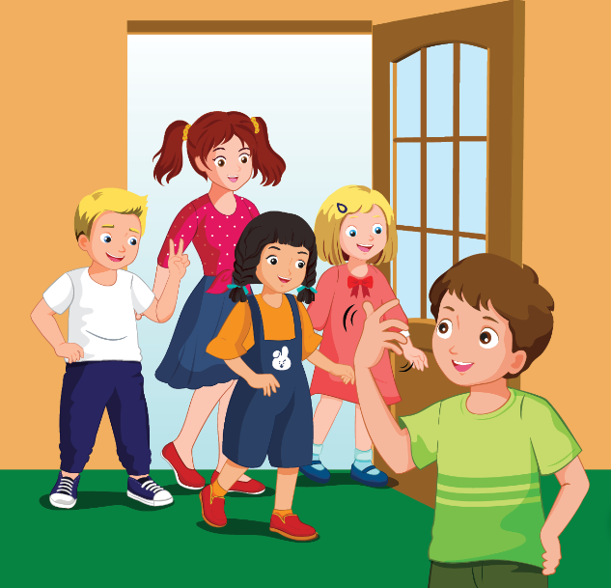
A. Listen and fill in the blank with ONE word.
*Example
Tom: "Hi, Anna. Could you help invite friends to the party?“
Anna: "Yes, sure!”

Slide 26
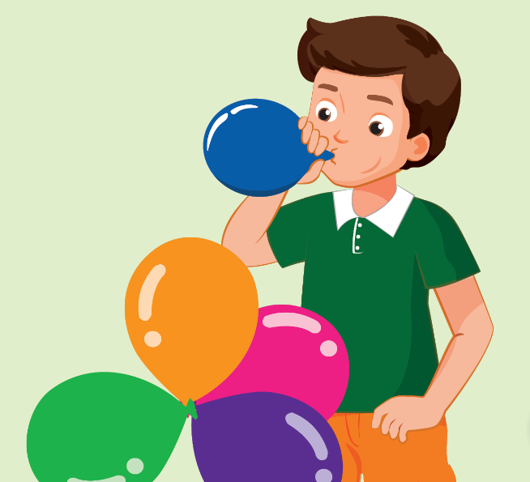
A. Listen and fill in the blank with ONE word.
Part 1:
Anna: "Hey Tom, could you ________ up the balloons for the party?"
Tom: "Yes, sure! How many ________ do we need?"
Anna: "We need about 20."
Tom: "Yes, no problem."
blow
balloons

Slide 27
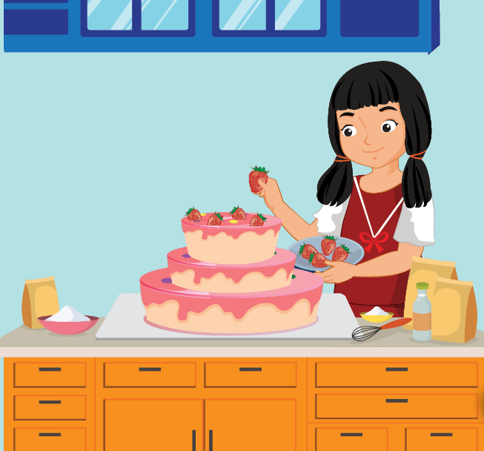
A. Listen and fill in the blank with ONE word.
Part 2:
Tom: "Hey Anna, could you ________ a ________ for the party?"
Anna: "No, sorry. I’m not very good at baking."
Tom: "That’s okay. We can buy one."
make
cake

Slide 28
03
Mini-Game

Slide 29
Baamboozle game!

Slide 30
04
Wrap-up

Slide 31
Time to write!
Put Up Colored Paper
Buy Candy
Invite Friends
Blow up the balloons
Make A Cake
Wrap The Presents

Slide 32
Today’s lesson:
*Review words:
put up colored paper
buy candy
invite friends
blow up the balloons
make a cake
wrap the presents.

Slide 33
Homelink:
- Practice the vocabulary, and make sentences using them.
- Complete the notebook if you have not completed it in class.

Slide 34
THANKS!

