Slide 1





















Review 6
Part 4

Slide 2






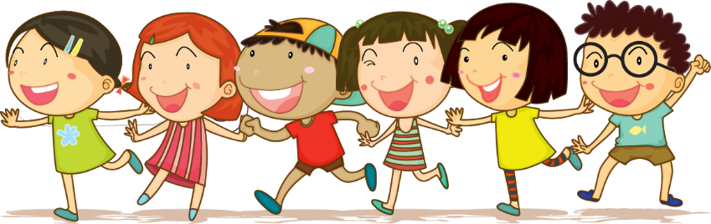



1.Warm-up

Slide 3


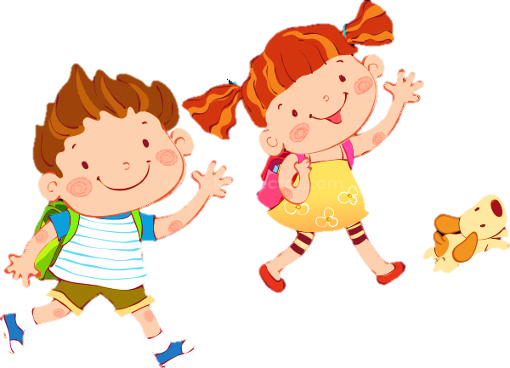
01
s u m m e r
3 stars

Slide 4
02
s p r i n g
4 stars

Slide 5
03
a u t u m n
5 stars

Slide 6
04
w i n t e r
4 stars

Slide 7
05
s u n n y
5 stars

Slide 8
06
r a i n y
3 stars

Slide 9

07
h o t
4 stars

Slide 10
08
w e t
3 stars

Slide 11
2.Review

Slide 12



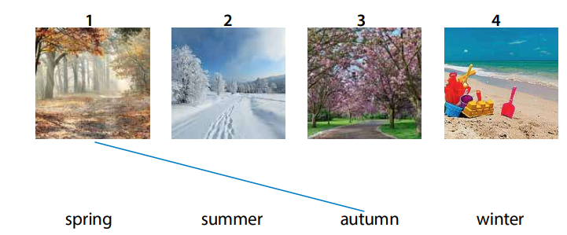
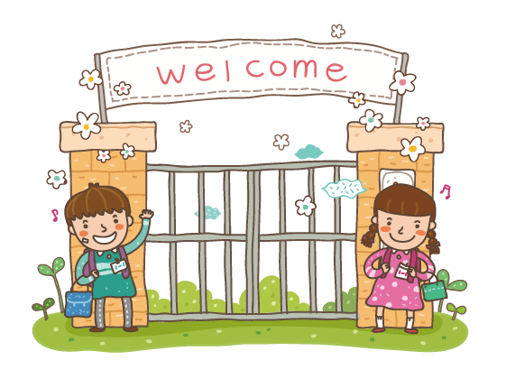
Task 1 : Match
在此输入文字
在此输入文字
在此输入文
在此输入文字

Slide 13


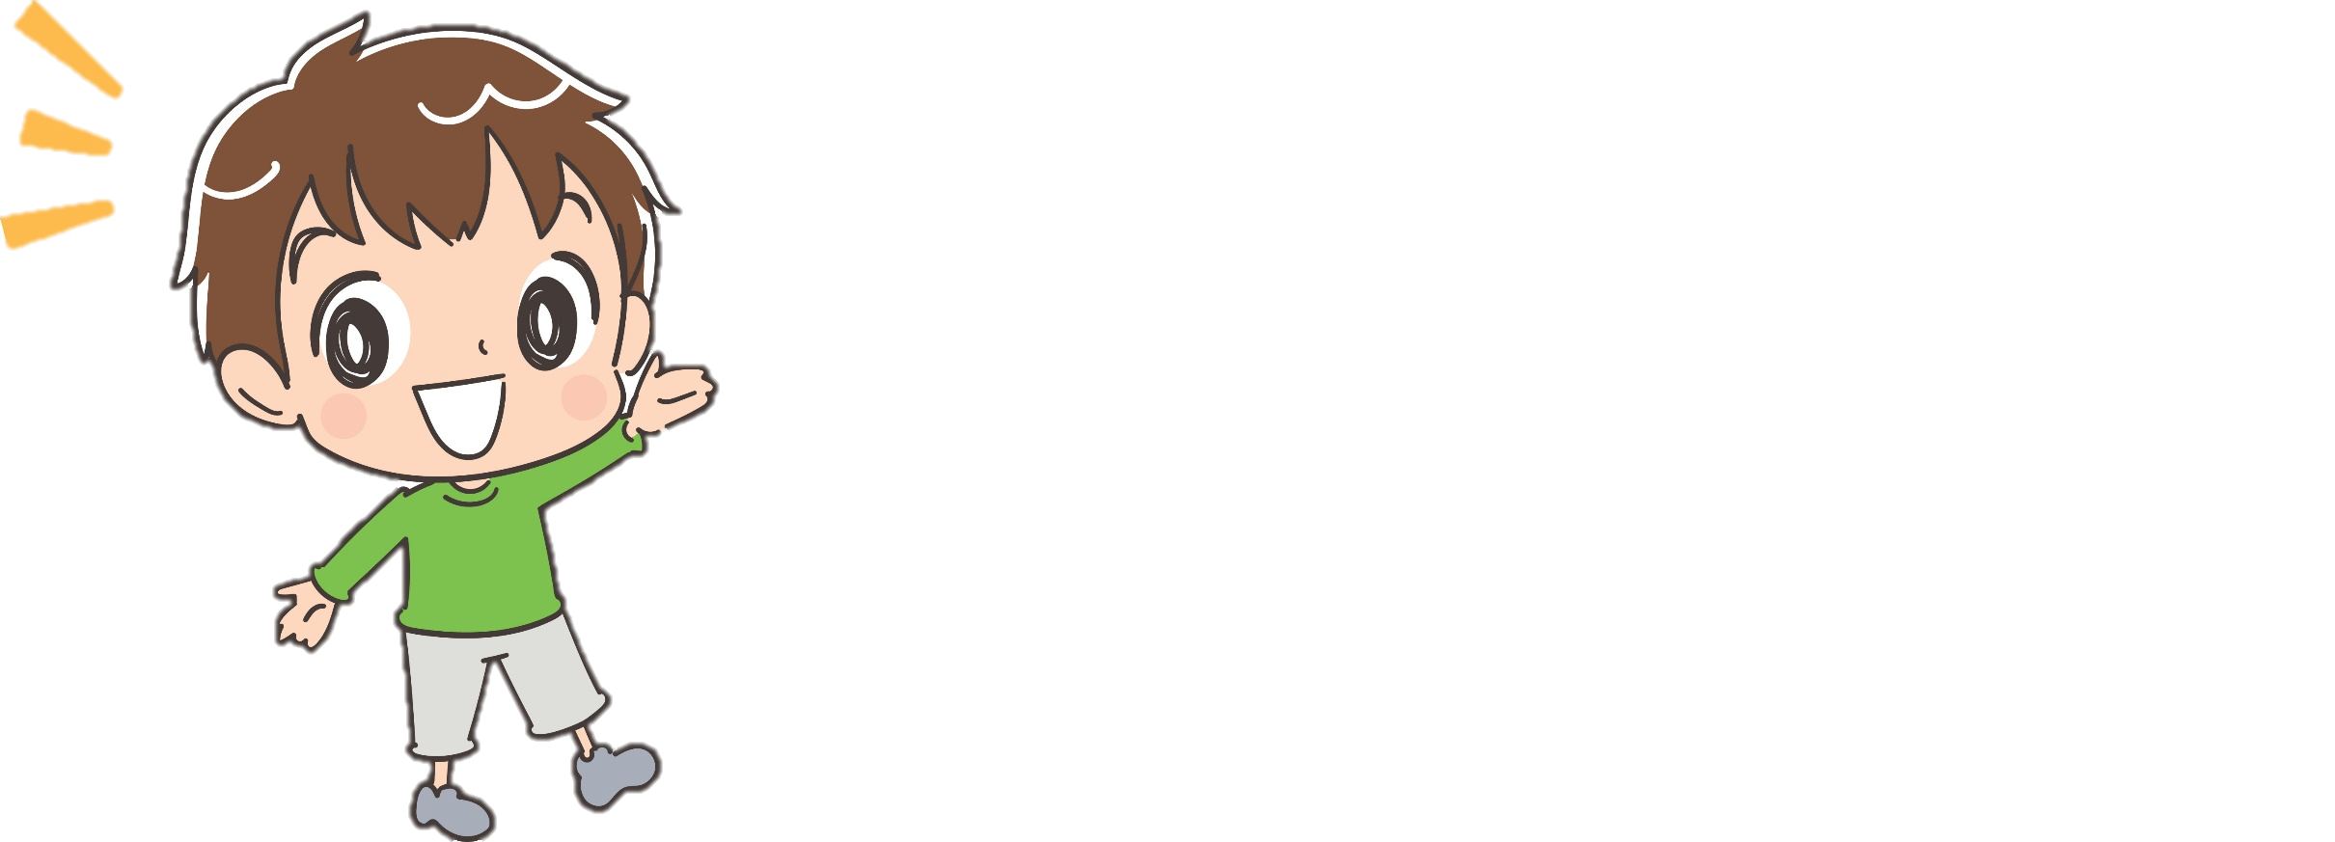

Answer to get stars!!!
1
2
3
4
5
6
7
8

Slide 14
Back
Star
You get 3 stars!
Answer the question
Do you go to school in the winter?
Yes, I do./No I don’t.

Slide 15
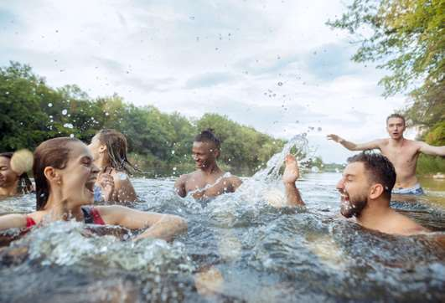
Back
Star
You get 2 stars!
Choose the best answer
Do they like swimming in the river?
A.Yes, they do.
B.No, they don’t.

Slide 16
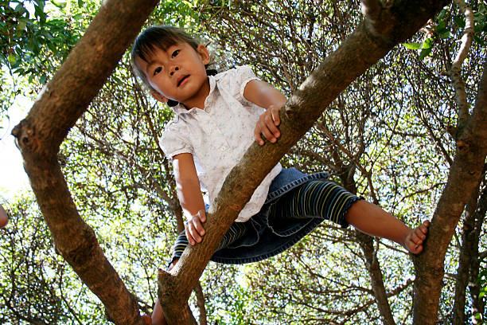
Back
Star
You get 3 stars!
Circle the correct answer
Does she climb the tree with her friends?
A.Yes, she does.
B.No, she doesn’t.

Slide 17
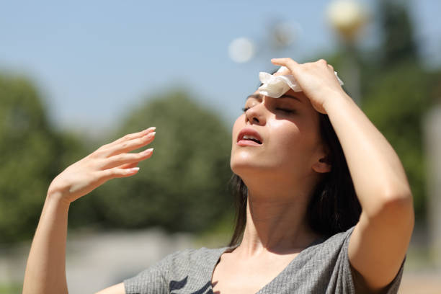
Back
Star
You get 9 stars!
Choose the best answer
It’s ……in summer?
A. hot
B. cold
C. winter

Slide 18
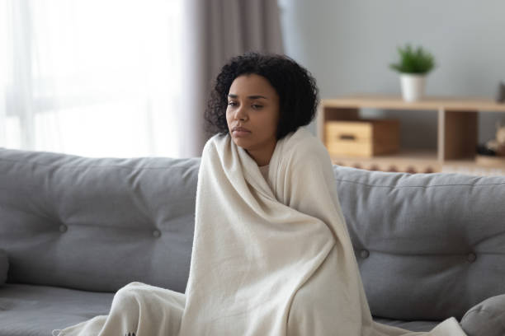
Back
Star
You get 2 stars!
Choose the best answer
It’s ……in winter?
A. wet
B. cold
C. warm

Slide 19
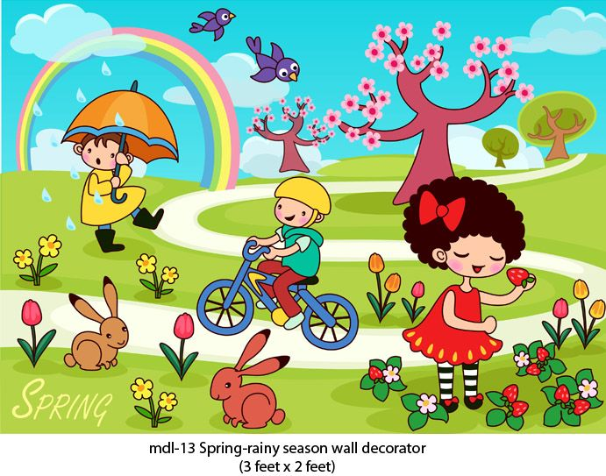
Back
Star
You get 7 stars!
Choose the best answer
It’s ……in spring.
A. wet
B. hot
C. warm

Slide 20
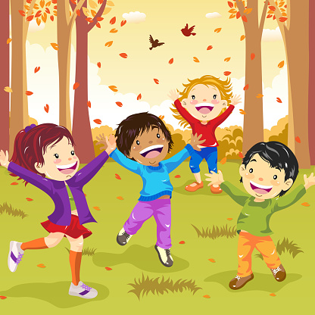
Back
Star
You get 5 stars!
Choose the best answer
It’s ……in autumn?
A. warm
B. cool
C. hot

Slide 21
Back
Star
You get 10 stars!
Choose the best answer
It’s not rainy. It’s___.
A. wet
B. sunny
C. cool

Slide 22
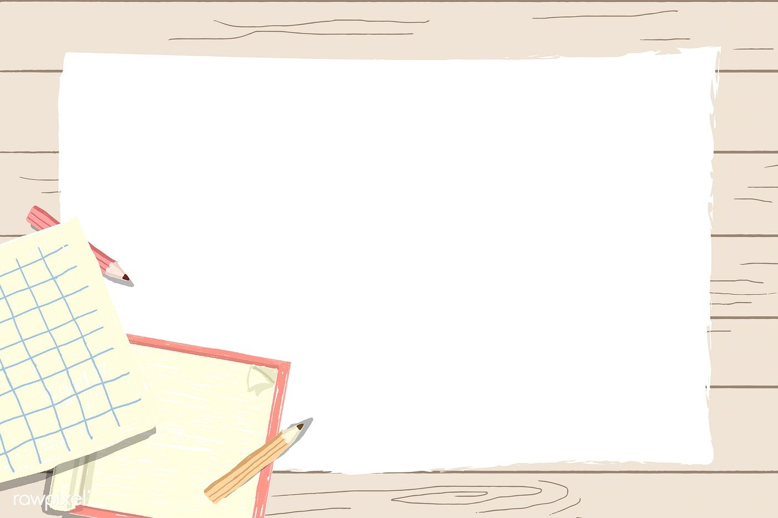
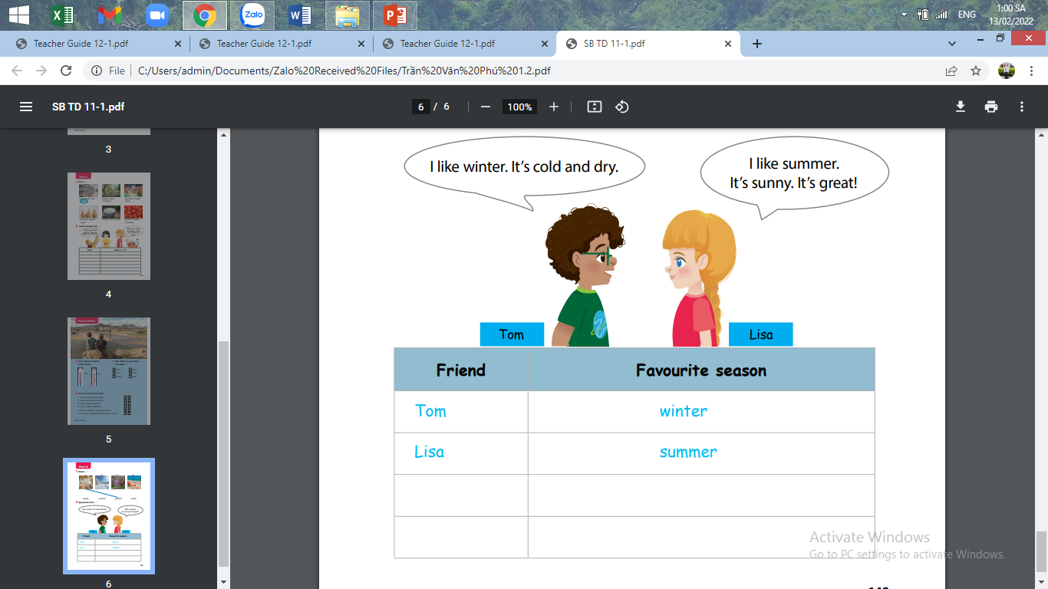
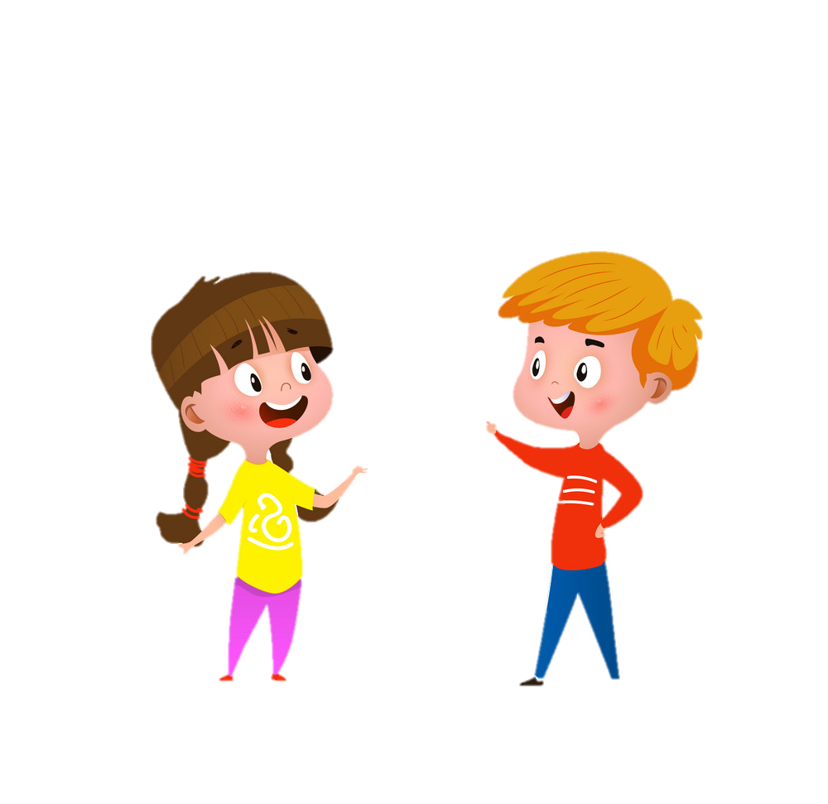
Task 2 : Speak and write

Slide 23
3.Extra activity

Slide 24
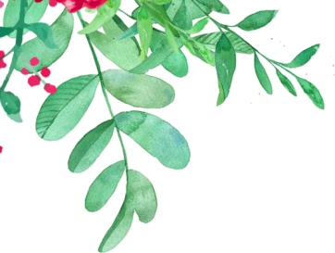
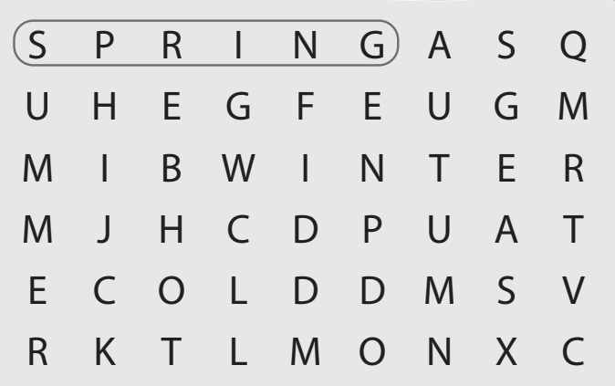

Task 1:Find and circle.

Slide 25
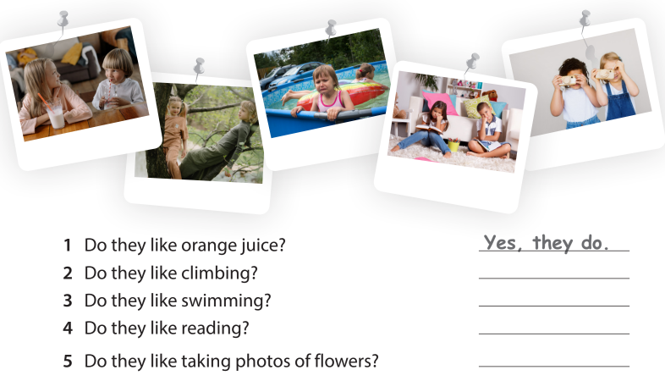
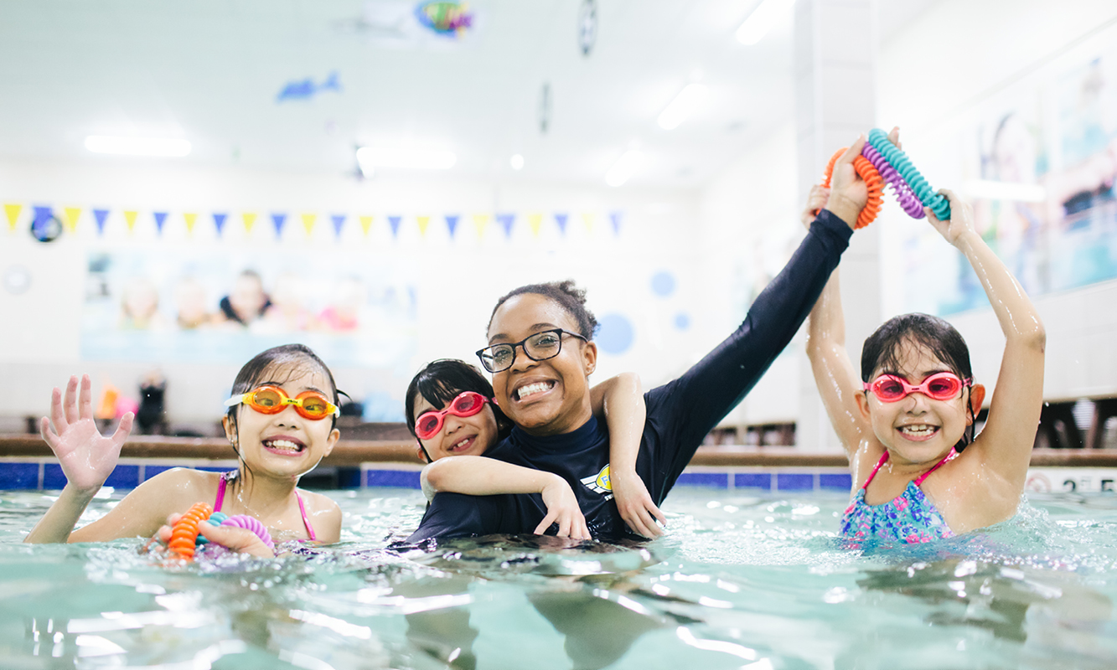
Task 2: Look and answer.
2. Do they like climbing at the weekends?
Yes, they do.
Yes, they do.
No, they don’t.
Yes, they do.

Slide 26




Thank you & goodbye!

