Slide 1





















Review 6
Part 3: Video

Slide 2










1.Warm-up

Slide 3

Arrange
the word

Slide 4
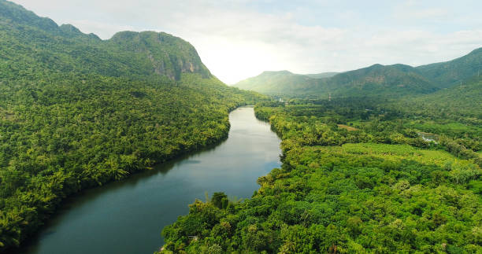
What is it ?
r-v-e-i-r
river

Slide 5
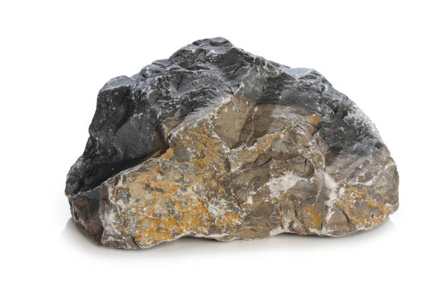
What is it ?
r-k-c-o
rock

Slide 6
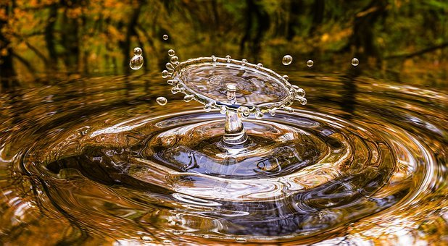
What is it ?
a-w-t-e-r
water

Slide 7
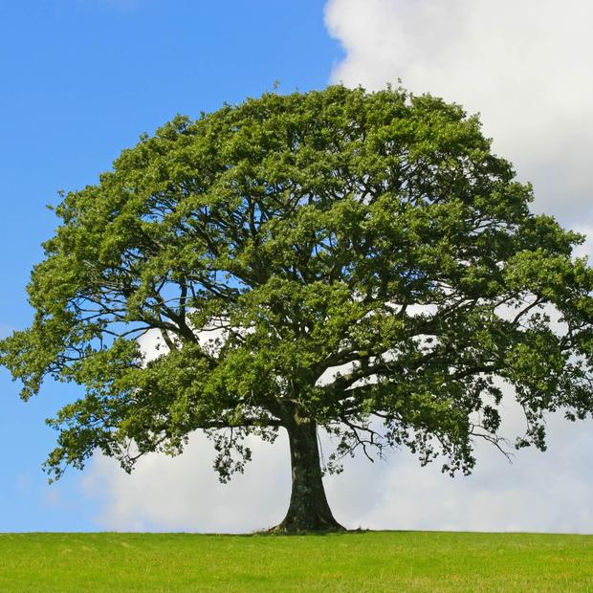
What is it ?
e-t-e-r
tree

Slide 8
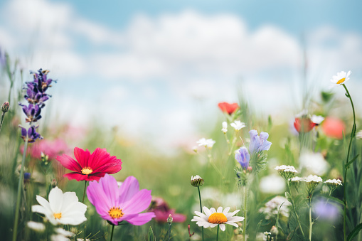
What is it ?
s-o-l-f-w-r-e
flowers

Slide 9
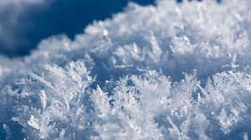
What is it ?
w-n-o-s
snow

Slide 10
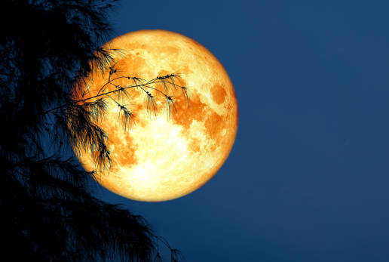
What is it ?
m-o-n-o
moon

Slide 11
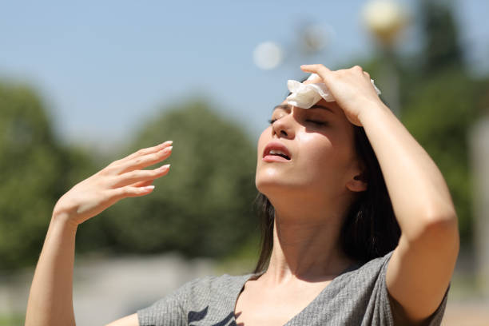
What word is it ?
o-h-t
hot

Slide 12
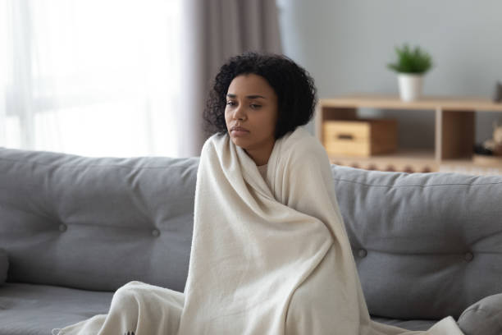
What word is it ?
c-l-o-d
cold

Slide 13
2.Review

Slide 14



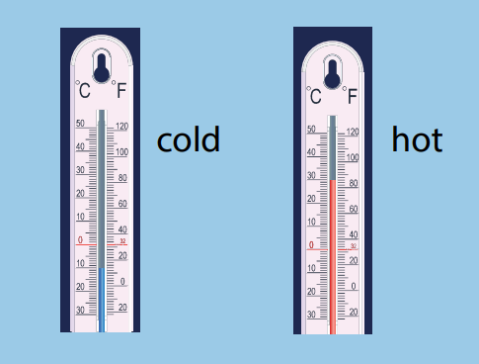

Task 1.What is it like in summer? Say.
在此输入文字
在此输入文字
在此输入文
在此输入文字

Slide 15


Slide 16
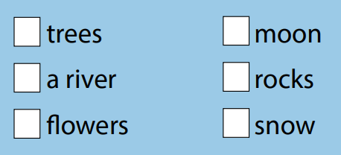

Task 2.Tick. What can you see in the video? .
在此输入文字
在此输入文字
在此输入文
在此输入文字

Slide 17
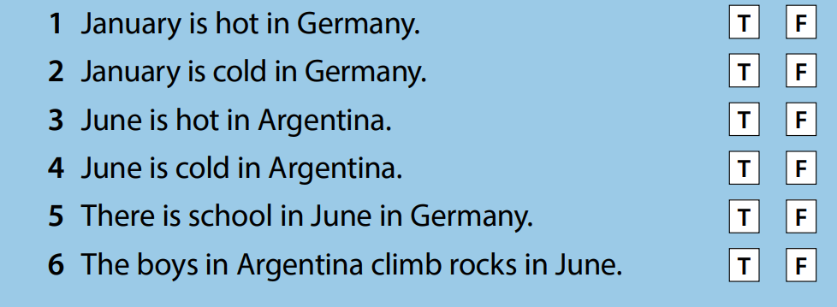
Task 3. Tick T for True or F for False.
在此输入文字
在此输入文字
在此输入文
在此输入文字

Slide 19
Task 3 Tick T for True or F for False.
在此输入文字
在此输入文字
在此输入文
在此输入文字

Slide 20
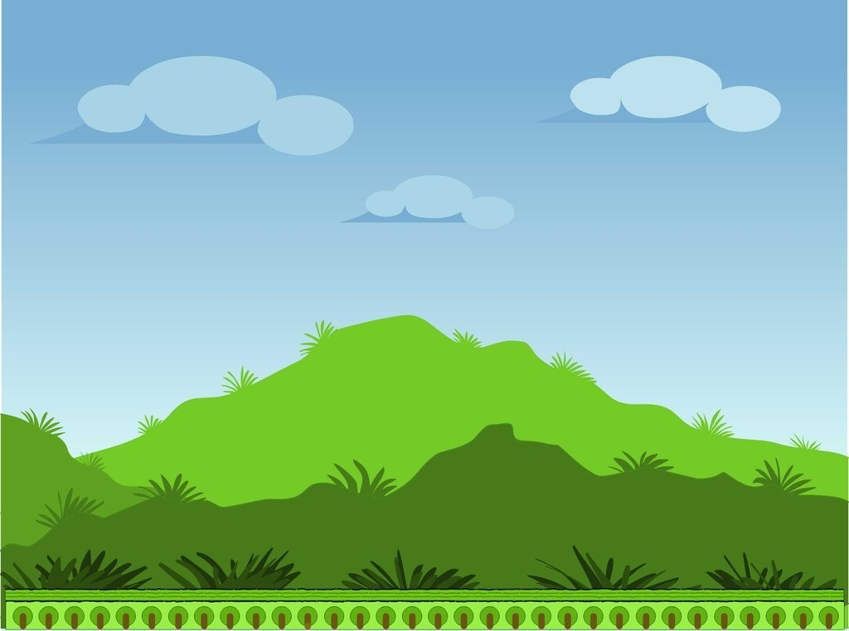






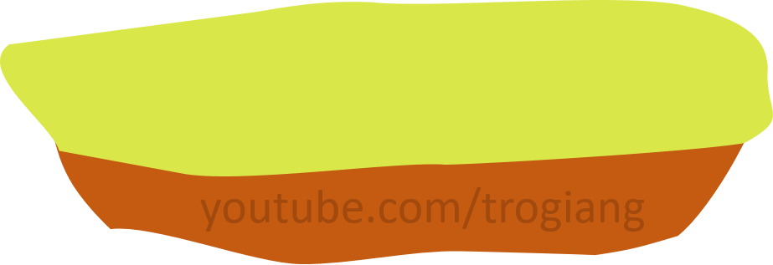

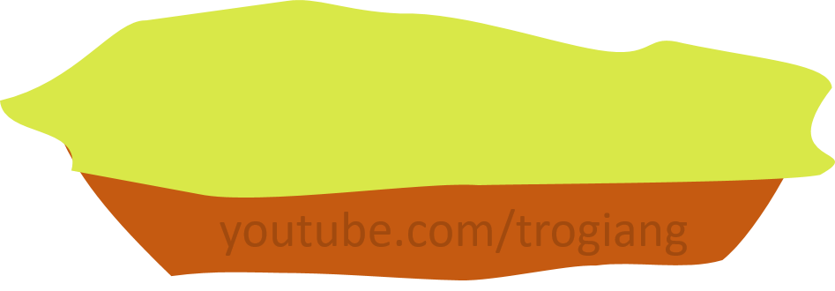

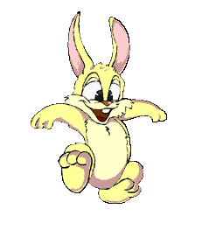
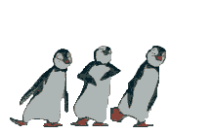



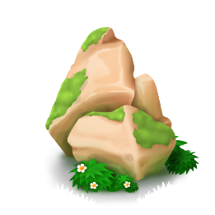


CONGRATULATIONS RABBIT TEAM
CONGRATULATIONS TIGER TEAM
Who reaches higher
4
4
3
3
2
2
1
1
Notes:
Click into numbers from 2 sides of the slide to show question for each team.
After finishing the game, click red arrow to move to next slide.

Slide 21
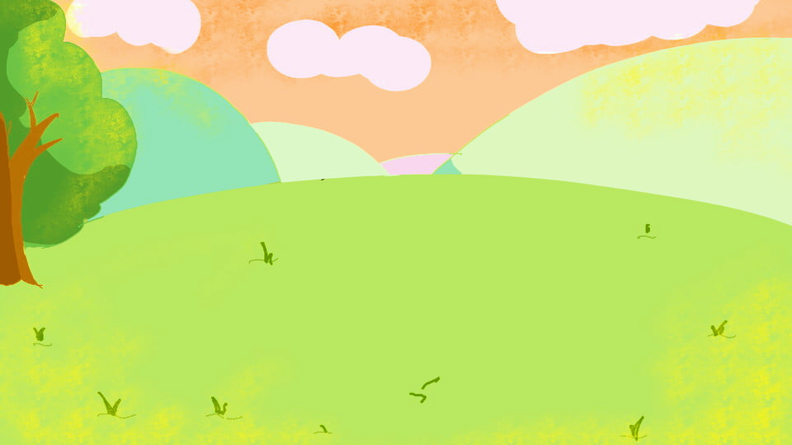
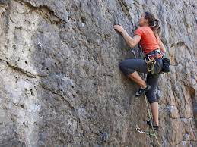

Choose to fill in the blank
she ………the rock.
A. climbs
B. drinks
BACK

Slide 22
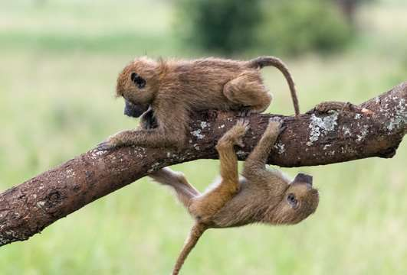
Choose to fill in the blank
They…. the tree branch.
A.climbs
B.climb
BACK

Slide 23
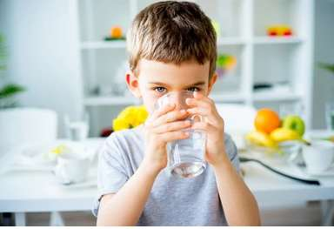
Choose to fill in the blank
He…… water.
A. drink
B. drinks
BACK

Slide 24
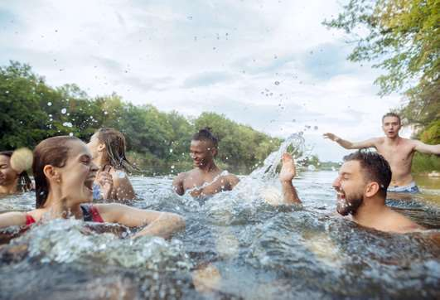
Choose to fill in the blank
They...in the river.
A.swim
B.drink
BACK

Slide 25
Choose the opposite word
It’s not cold. It’s....
A. hot
B. wet
BACK

Slide 26
Choose to fill in the blank
The weather is…
Let’s go swimming.
A. cold
B. hot
BACK

Slide 27
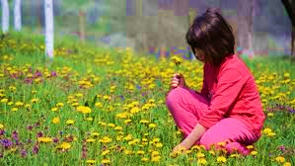
Choose to fill in the blank
She … picking up…
A. don’t like, flower
B. likes, flowers
BACK

Slide 28
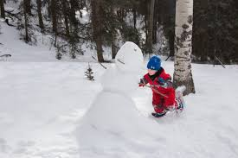
choose to fill in the blank
He …playing in…
A. likes, snow
s
B. don’t like, snows
BACK

Slide 29
3.Extra activity

Slide 30
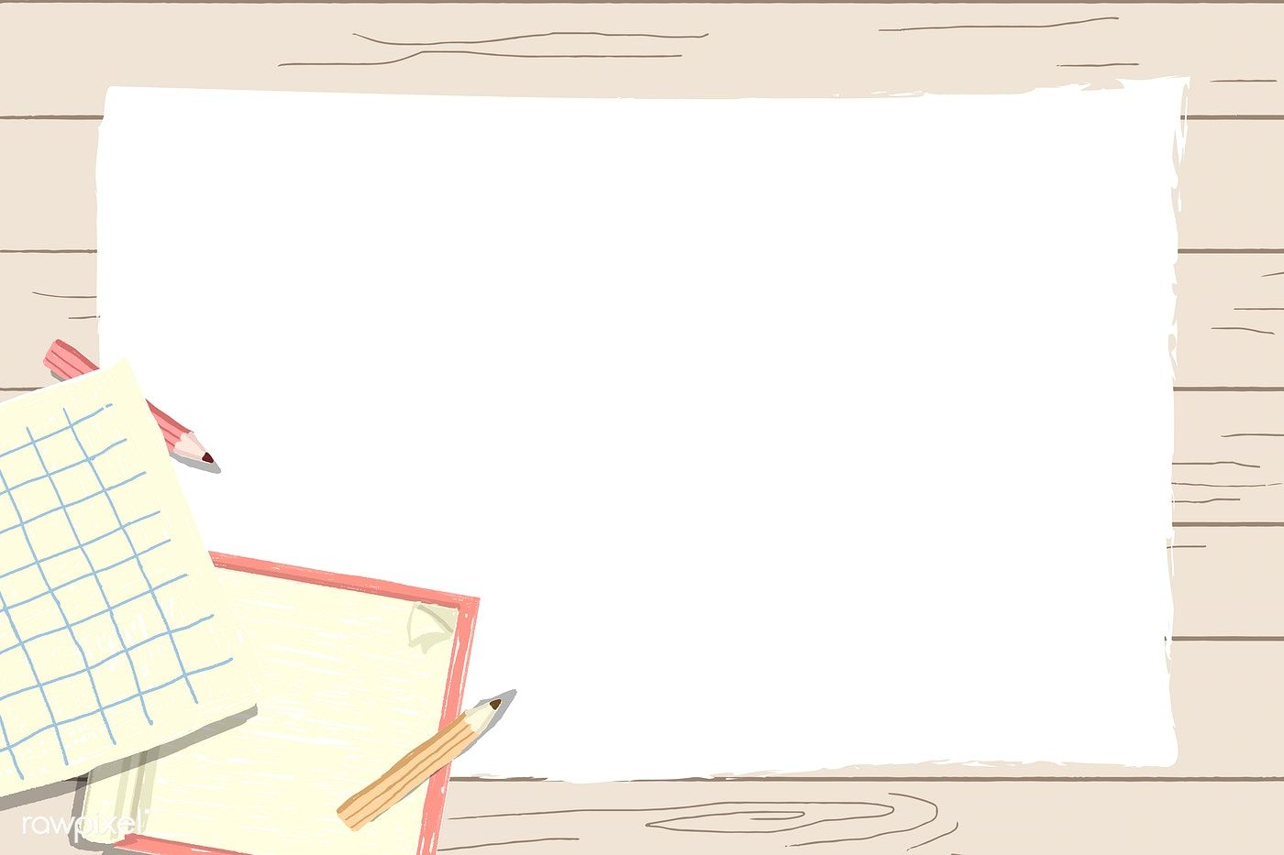
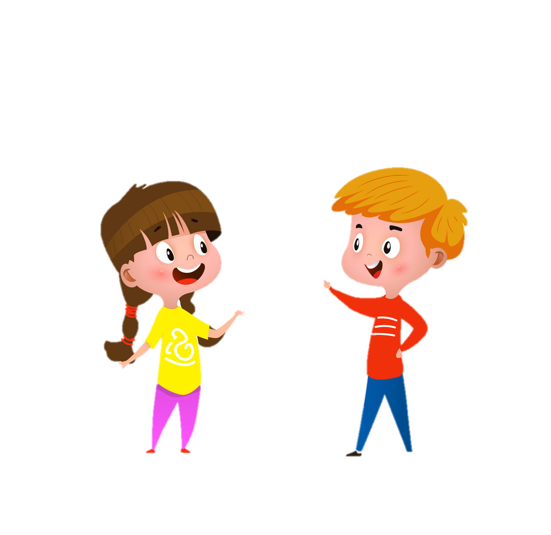
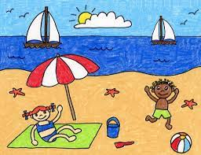
Task 1:Draw and talk.
.
Draw about your favourite season and talk what do you like doing in that season.
swimming
I like ________.

Slide 31
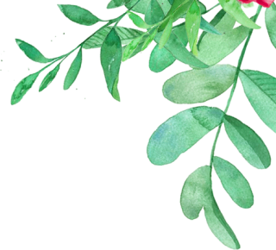


Task 2:Read and circle.
.
1 The boy is swimming in the rock / river.
2 Can you climb / play a big rock?
3 The cat is in the tree / rock.
4 There is water / rock in the river.
5 Cats buy / climb the tree.

Slide 32




Thank you & goodbye!

