Slide 1





















Notes:
Để nguyên trang bìa như này, chỉ thay đổi tên bài trong quá trình làm. Logo của sách Wonderful World

Slide 2
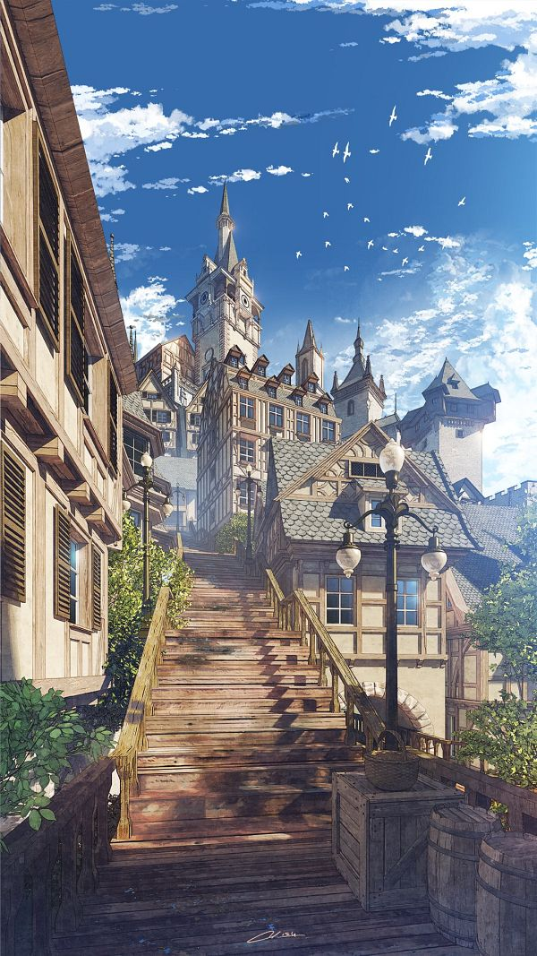
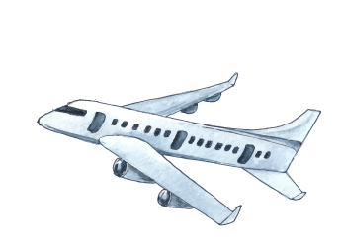



Unit 12: Cool places
Lesson 1 – Task 4, 5, 6

Slide 3
01
Warm-up
Where was the Panda?

Slide 4
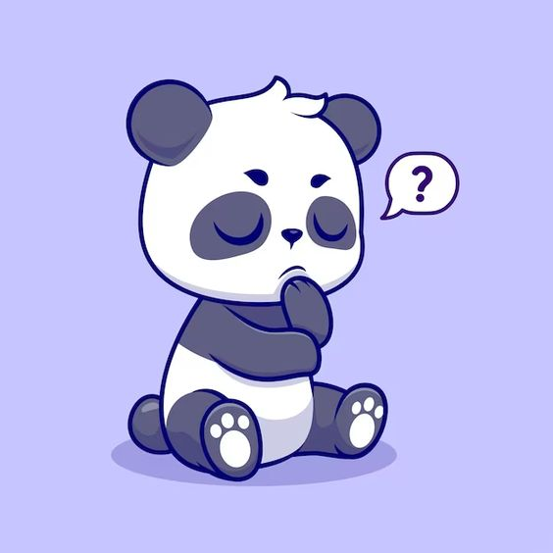

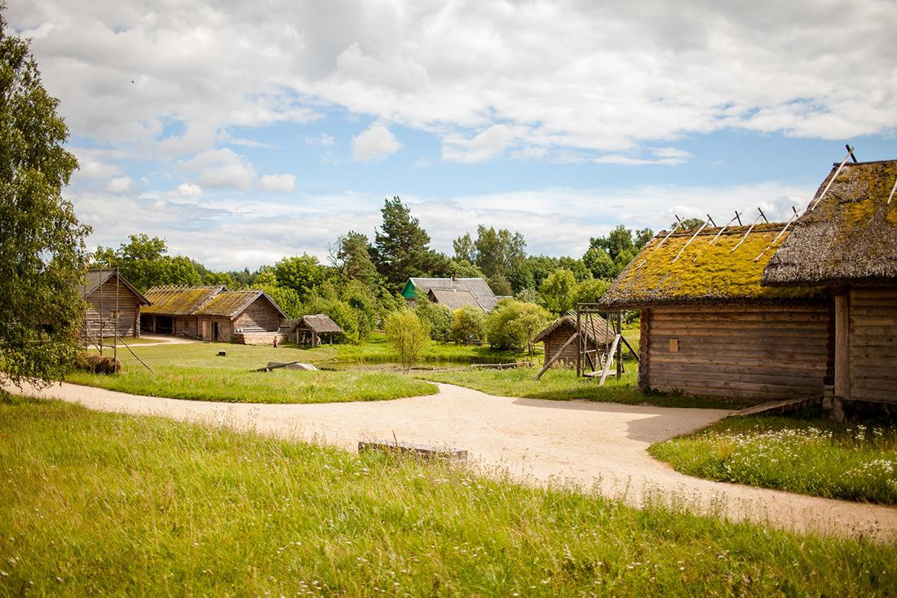

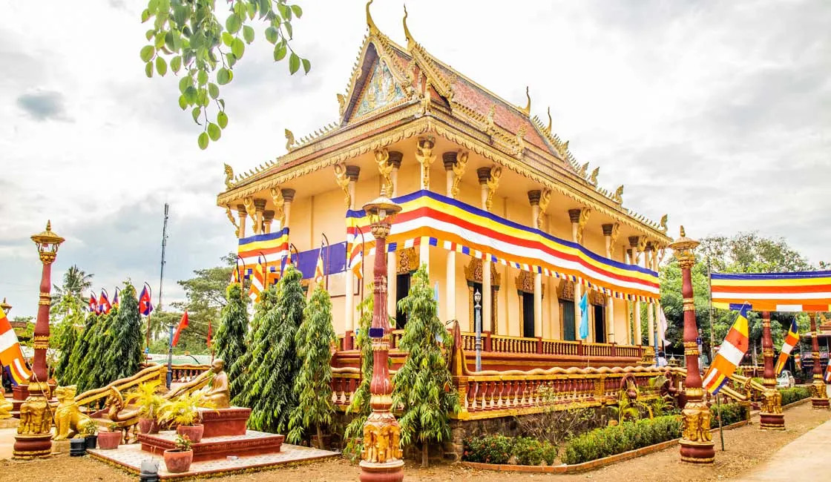
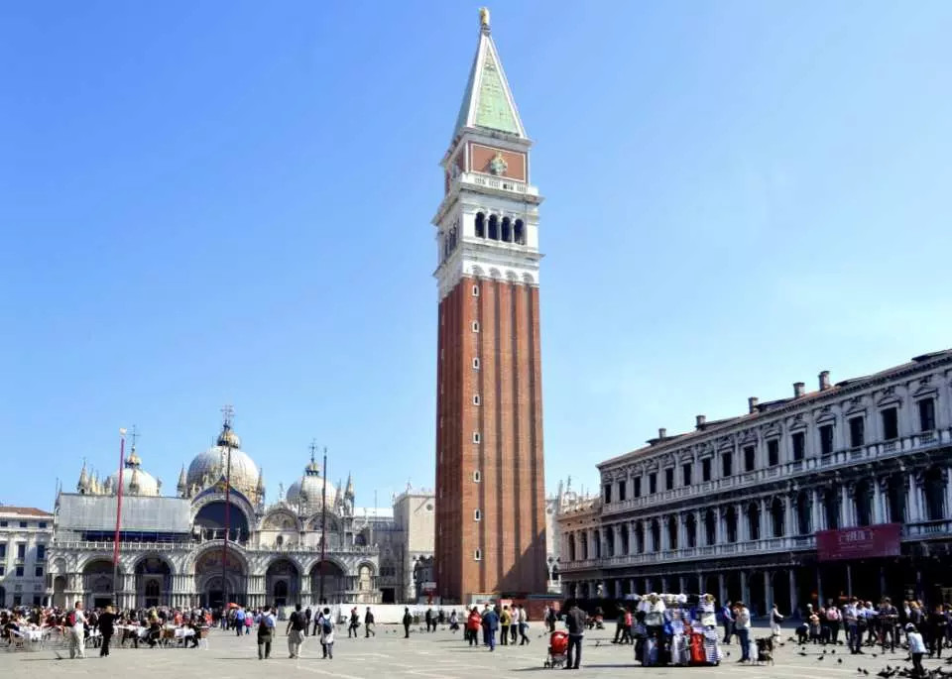

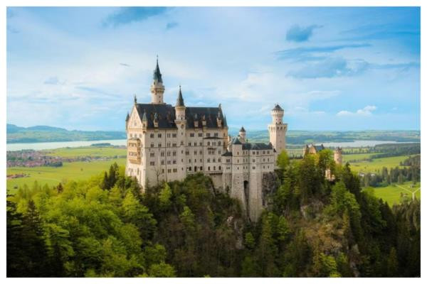
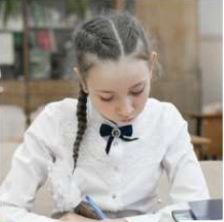
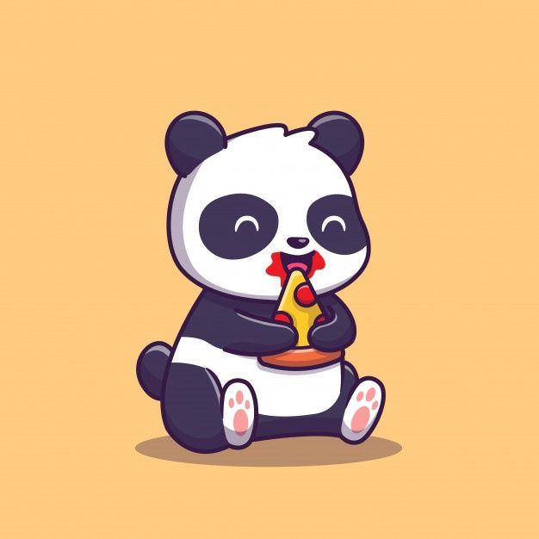
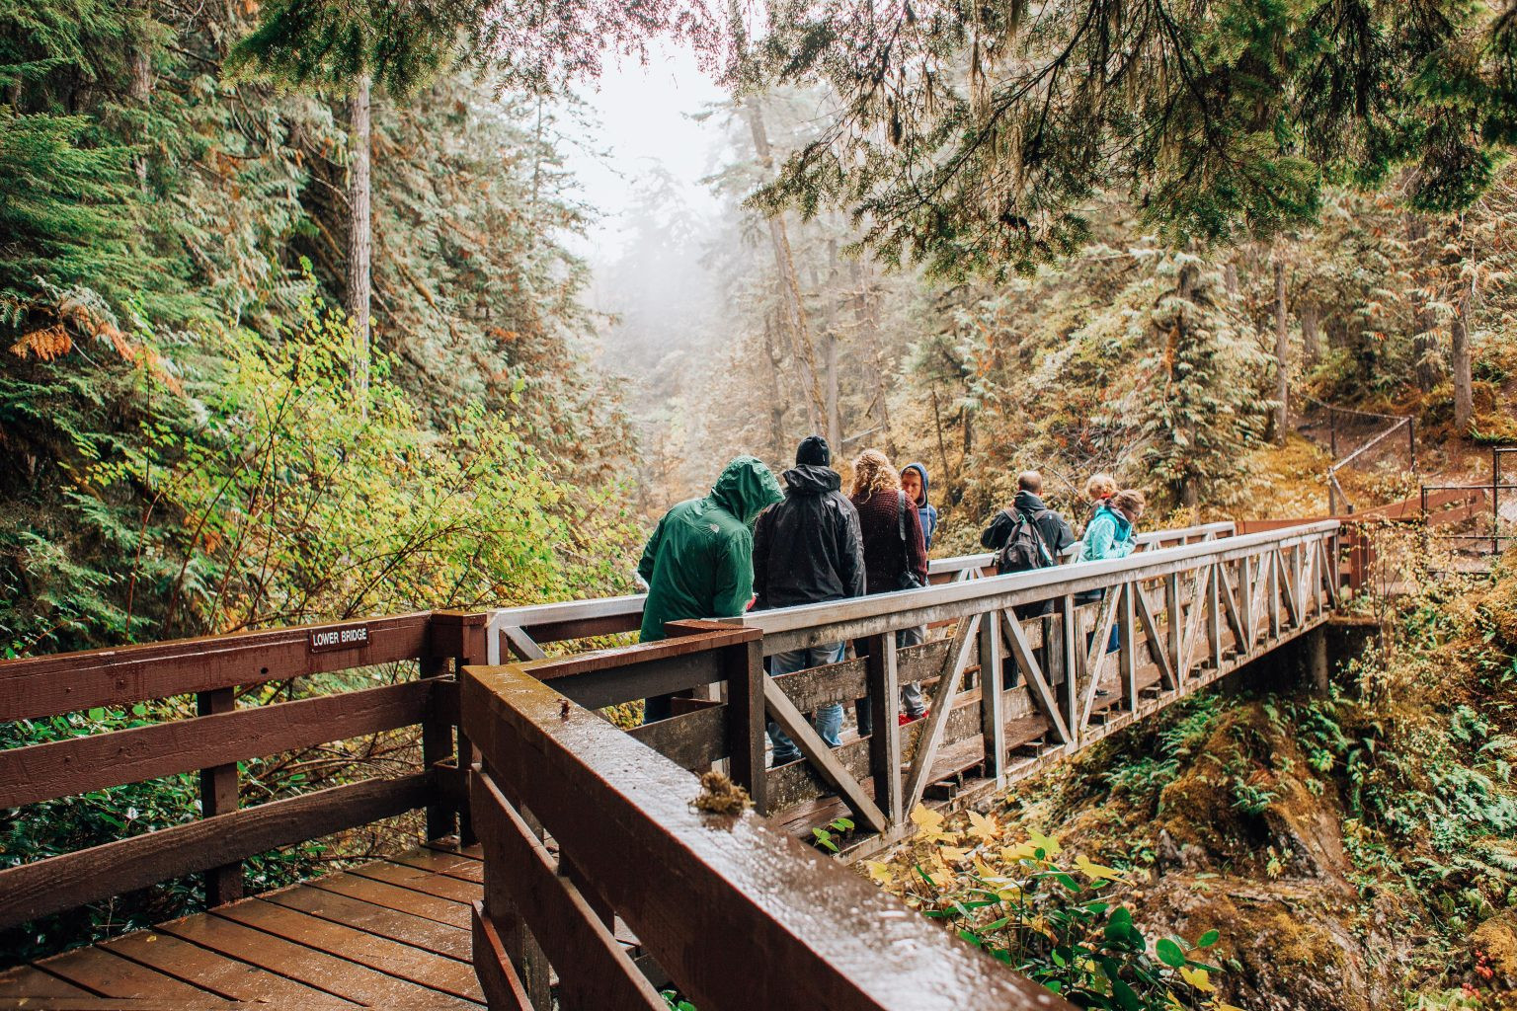

Where was the Panda?
1.
2.
3.
4.
5.
6.
Notes:
Click hình gấu để cho học sinh ghi nhớ nơi chốn và ghi từ vào bảng

Slide 5
Where was the Panda?
At the tower
At the temple
In the village
1.
2.
3.
4.
At the castle
5.
At the bridge
6.
At school
Notes:
Show đáp án

Slide 6
02
Presentation

Slide 7
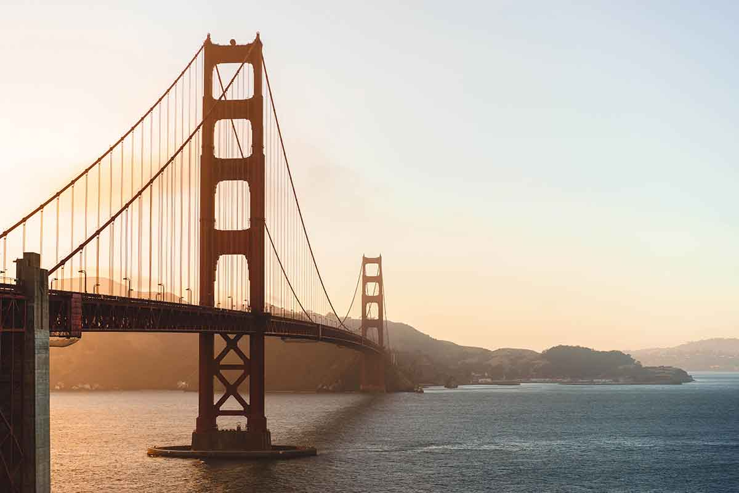
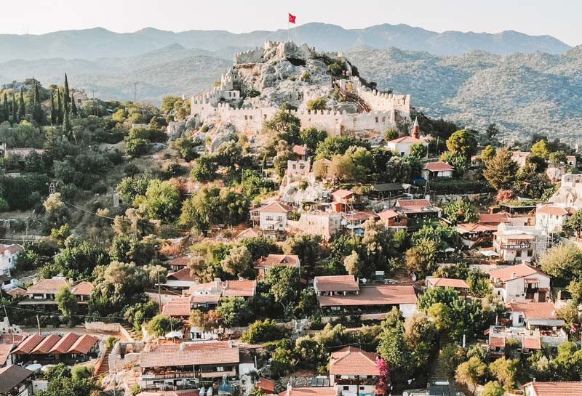
Task 4: Listen and repeat.
1. Were you at the bridge yesterday?
- Yes, we were.
2.Was she in the village last week?
- No, she wasn’t.

Slide 8
03
Practice
Look and say

Slide 9
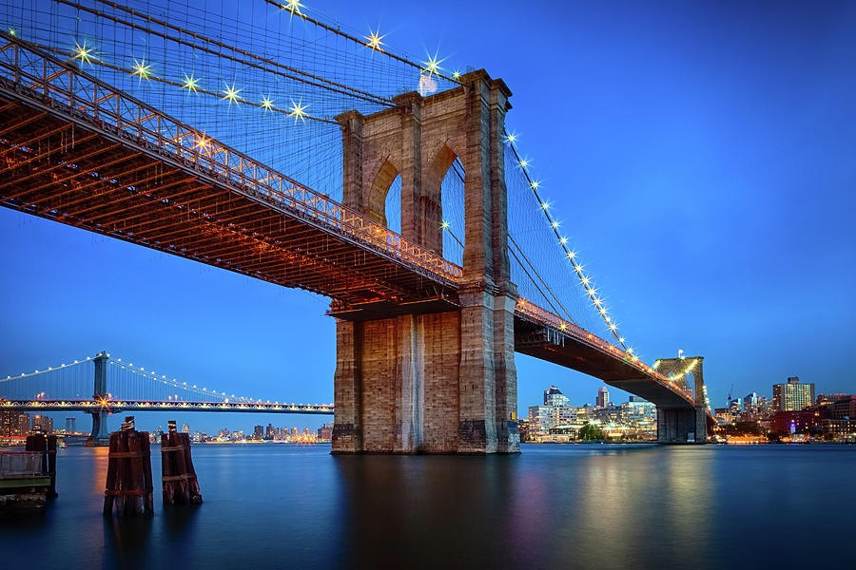
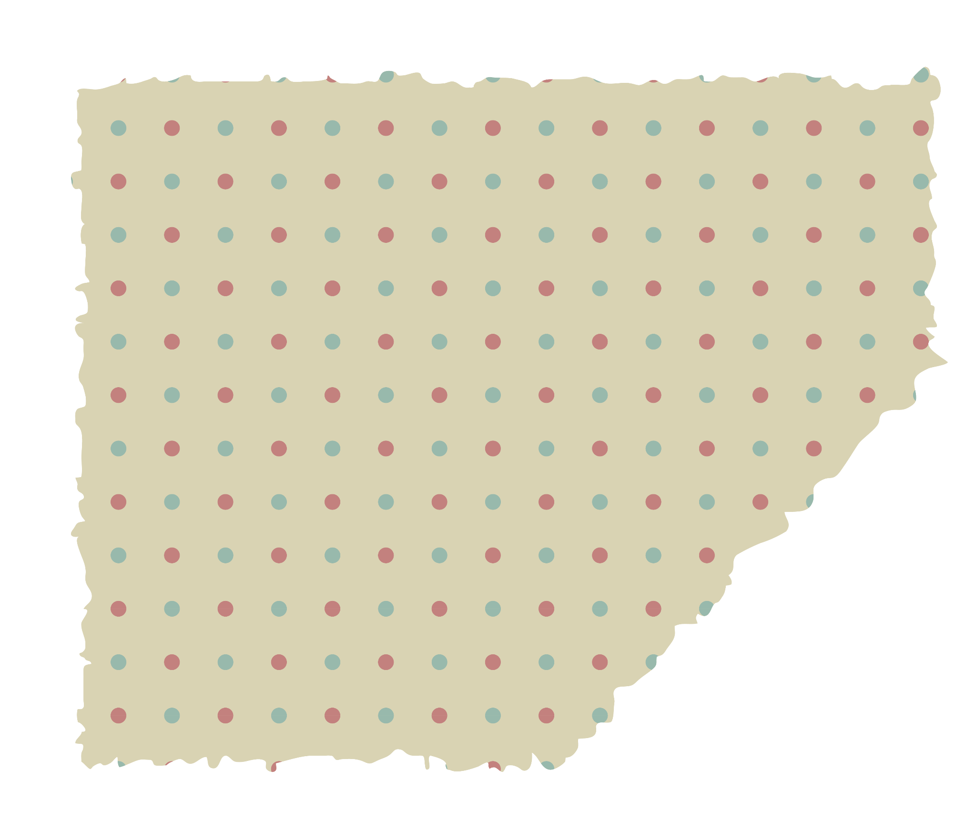
Task 5: Look and say
1. They / at the bridge / last month
Were they at the bridge last month?
No, they weren’t
x

Slide 10
Task 5: Look and say
2. my mum / at the temple / yesterday
Was my mum at the temple yesterday ?
✓
Yes, she was

Slide 11
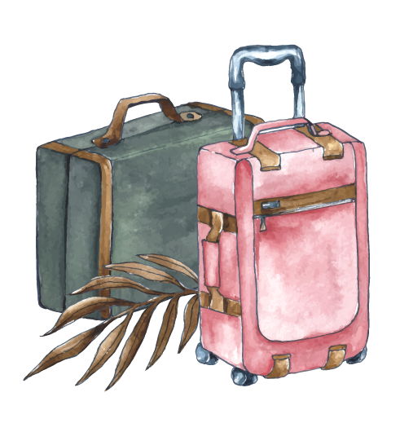
Task 5: Look and say
3. We / at the tower / last week
Were you at the tower last week?
x
No, we weren’t

Slide 12

Task 5: Look and say
4. My grandfather / in the village / yesterday
Was your grandfather in the village yesterday
✓
Yes, he was.

Slide 13
100
500
Wheel of fortune
Lose 50 points
50
2000
X2 points
Spin again
900
200
700
850
300
Next
Notes:
Click the needle to start and then again to stop the wheel. Then click on the selected section.

Slide 14
100
Were they on the bridge?
Yes, they were.
Notes:
Click vào câu hỏi để hiện đáp án

Slide 15
50
Where was your father last week?
He was at the temple.

Slide 16
X2 points
Rearrange the words in the correct order.
Their / night / last / were / at / the / tower / friends / not / Saturday
Their friends were not at the tower last Saturday night.

Slide 17
900
Rearrange the words in the correct order.
Where / yesterday / Peter / was / ? /
Where was Peter yesterday?

Slide 18
700
Where was Sarah last year?
She was in the village.

Slide 19
300
Was your brother at the tower?
No, he wasn’t.

Slide 20
850
Where was Lily yesterday?
She was at the castle.
✓
She was not at the bridge.
x

Slide 21
200
Were the students at the park?
No, they weren’t.

Slide 22
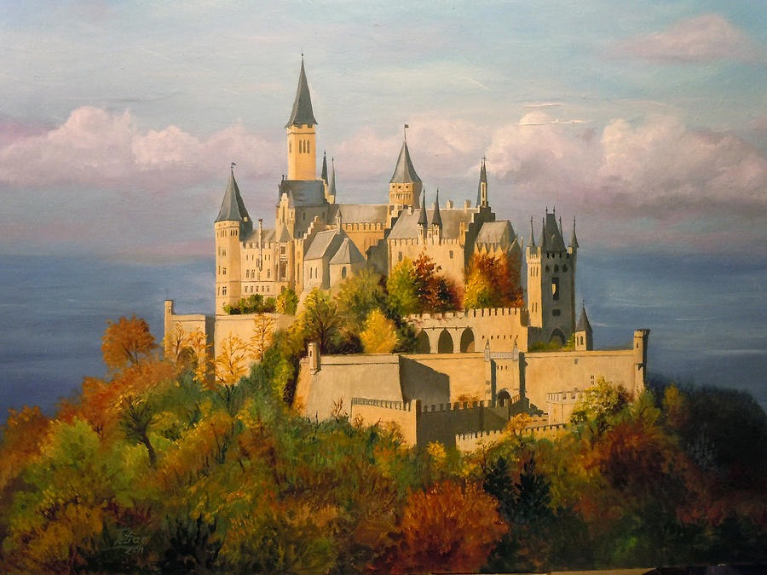
2000
Jennie ‘s friend was in the village last week.
Is it TRUE or FALSE?
It is TRUE.

Slide 23
500
Were Jim at school?
No, he wasn’t.

Slide 24
Production
04
Let’s talk

Slide 25
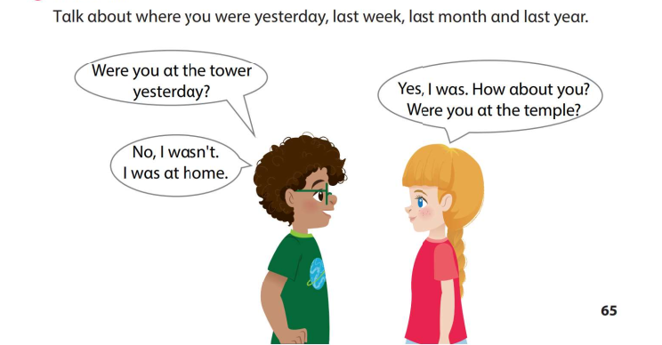

Slide 26
Assessment
05
Complete the sentences

Slide 27
Complete the sentences
1. Nick / in the village? / No
Was Nick in the village?
- No, he wasn’t.
2. Sofia / at the tower / yesterday /? / Yes.
Was Sofia at the tower yesterday?
- Yes, she was.
Notes:
Click để bài để hiện answer

Slide 28
Complete the sentences
3. Where/ his cousin / last week?
- She / in the village.
Where was his cousin last week?
- She was in the village.
4. Rose / in the village / last month? Yes.
Was Rose in the village last month?
- Yes, she was.
Notes:
Click để bài để hiện answer

Slide 29
06
Wrap up
1. Were they at the temple?
- Yes, they were.
2. Was she at the castle?
- No, she wasn’t.
Don't forget
...
Don't forget
...

Slide 30




Thank you & goodbye!

