Slide 1

Unit 9: My Favourite Food
Lesson 2 – Task 7, 8, 9

Slide 2

LUCKY PRESENT

Slide 3
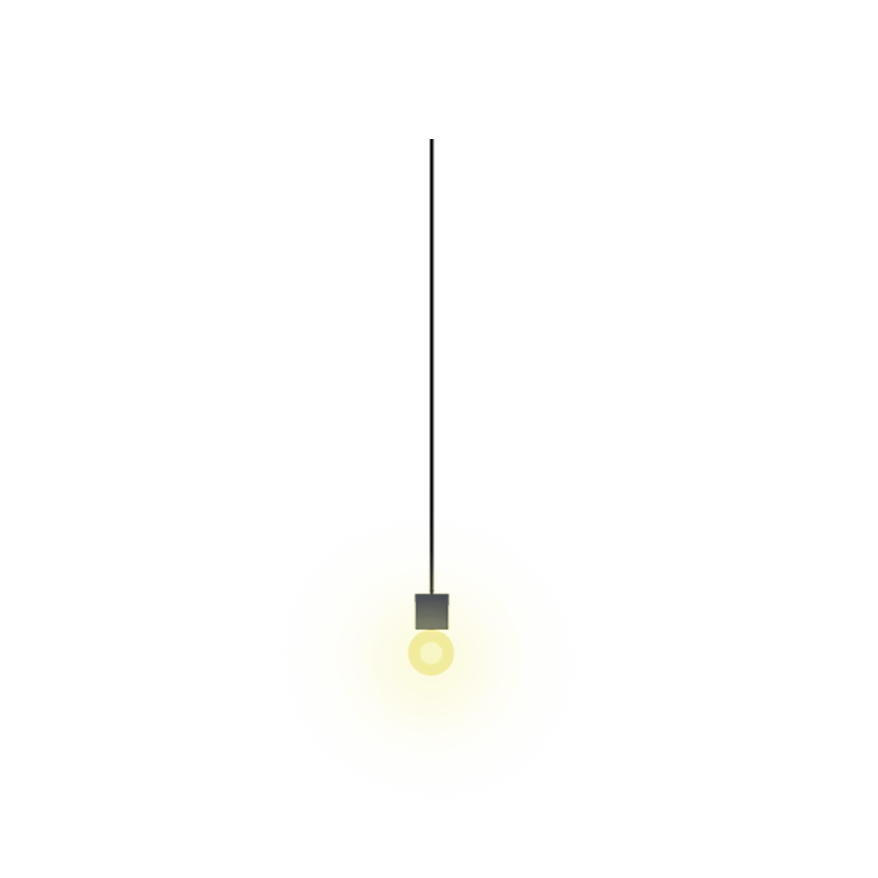

6
6
3
3
8
8
7
7
2
2
1
0
1
9
0
4
9
10
4
5
10
5

Slide 4




Slide 6
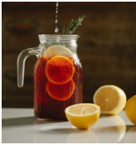
TIME ‘S UP
Where’s the juice?
It’s in the jug.

Slide 7
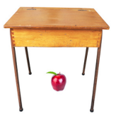
TIME’S UP
Where’s the apple?
It’s under the table.

Slide 8
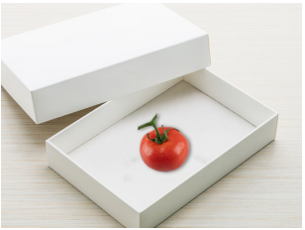
TIME’S UP
Where’s the tomato?
It’s in the box.

Slide 9
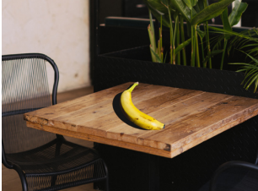
TIME’S UP
Where’s the banana?
It’s on the table.

Slide 10
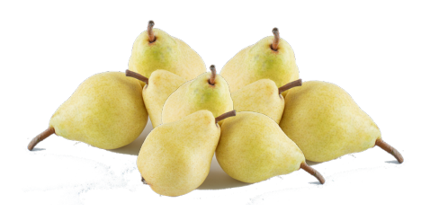
TIME’S UP
There are …. pears.
A. many B. some
There are many pears.

Slide 11
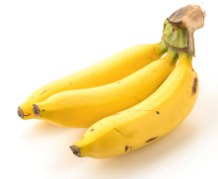
TIME’S UP
There are …..bananas.
A. a lot of B. some
There are some bananas.

Slide 12


2 PRESENTATION
Task 7 Listen and circle.

Slide 13

Listen and circle.
1 There are some / a lot of tomatoes.
2 There are many / some apples.
3 The chicken is in the jug / box.
4 The jug is under / on the table.

Slide 14

3 PRACTICE
Task 8 Look and say.

Slide 15
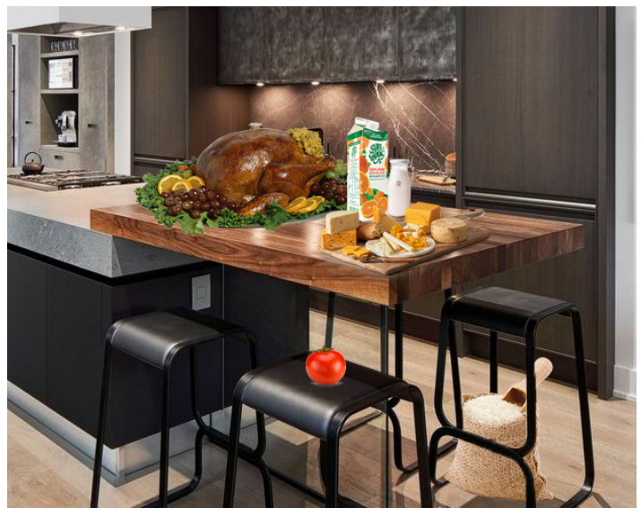
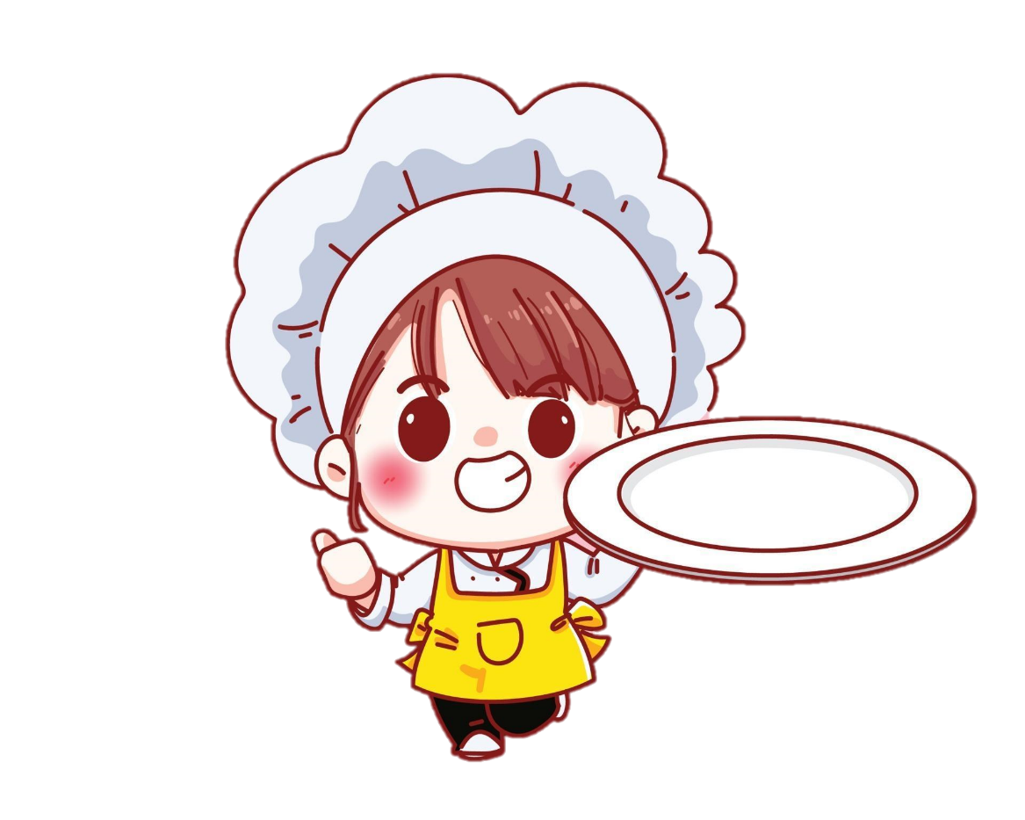
1 juice / box
2 cheese / table
3 chicken / table
4 milk / jug
5 rice / chair
6 tomato / chair

Slide 16

1 juice / box
Where’s the juice?
It’s in the box.

Slide 17
2 cheese / table
Where’s the cheese?
It’s on the table.

Slide 18
3 chicken / table
Where’s the chicken?
It’s on the table.

Slide 19
4 milk / jug
Where’s the milk?
It’s in the jug.

Slide 20
5 rice / chair
Where’s the rice?
It’s under the chair.

Slide 21
6 tomato / chair
Where’s the tomato?
It’s on the chair.

Slide 22
3 PRACTICE
Task 9 Let’s talk.

Slide 23
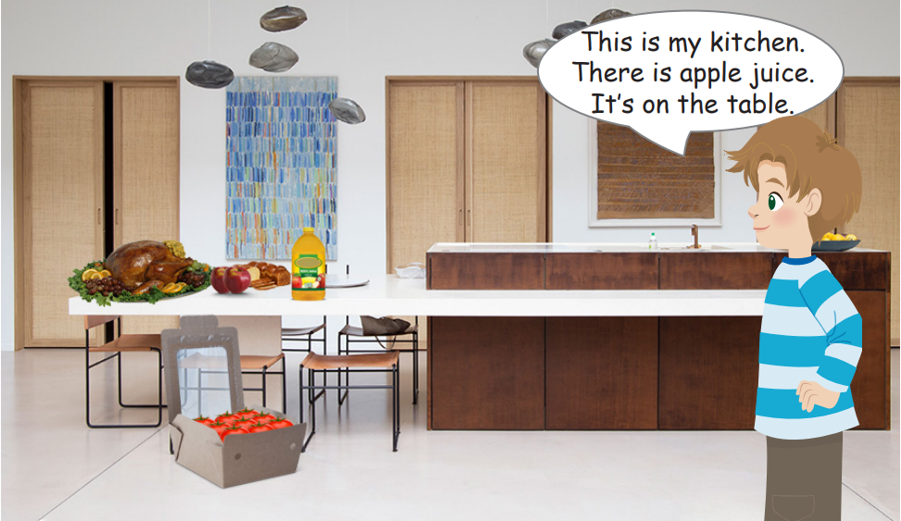
kitchen
bread
chicken
juice
apples
tomatoes

Slide 24
Where’s the bread?
Where’re the apples?
Where’s the juice?
Where’s the chicken?
Where’re the tomatoes?
They’re in the box.
They’re on the table.
It’s on the table.
It’s on the table.
It’s on the table.

Slide 26
4 PRODUCTION
.
Spot the difference.

Slide 27
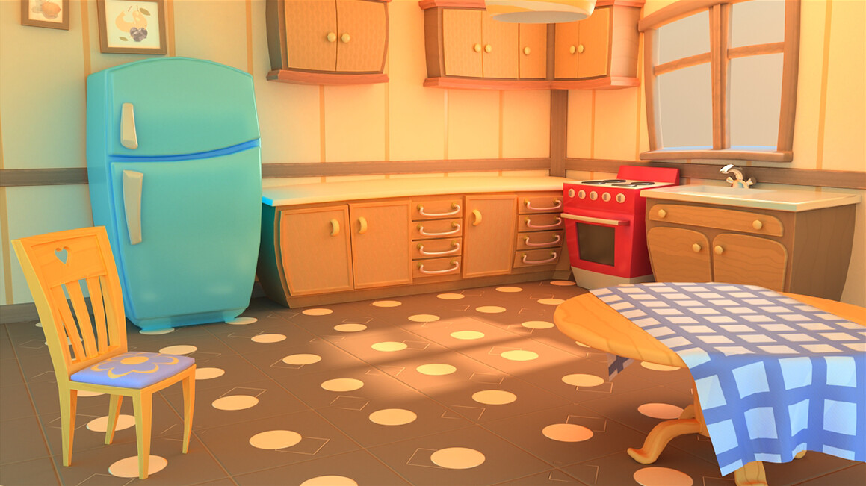
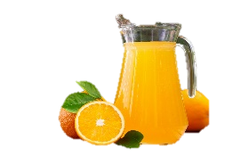
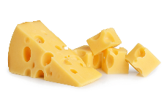
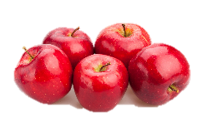
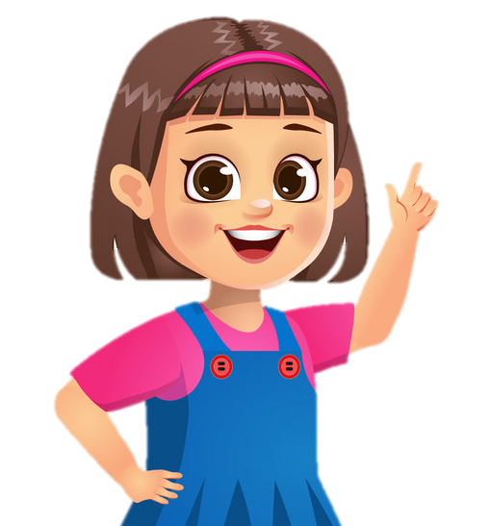
1
2
There is some cheese.
It’s on the table.
There is some chees.
It’s under the table.
There is some rice.
It’s in the bowl.
There is some juice. It’s in the jug.
There is a tomato under the chair.
There is a tomato on the chair.
There are some apples. It’s on the table.

Slide 28
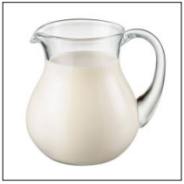
5 ASSESSMENT
Look and read. Put a tick (✓) or a cross (✗) in the box.
.
✓
1. The milk is in the jug.

Slide 29
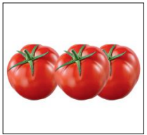
5 ASSESSMENT
Look and read. Put a tick (✓) or a cross (✗) in the box.
✗
2.There are a lot of tomatoes.

Slide 30
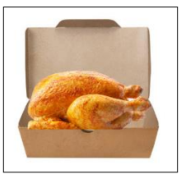
5 ASSESSMENT
Look and read. Put a tick (✓) or a cross (✗) in the box.
✗
3. The chicken is under the box.

Slide 31
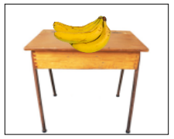
5 ASSESSMENT
Look and read. Put a tick (✓) or a cross (✗) in the box.
✓
4. There are some bananas on the table.

Slide 32
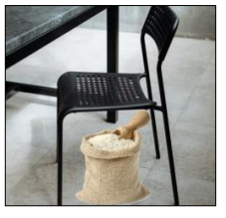
5 ASSESSMENT
Look and read. Put a tick (✓) or a cross (✗) in the box.
✗
5. The rice is on the chair.

Slide 33


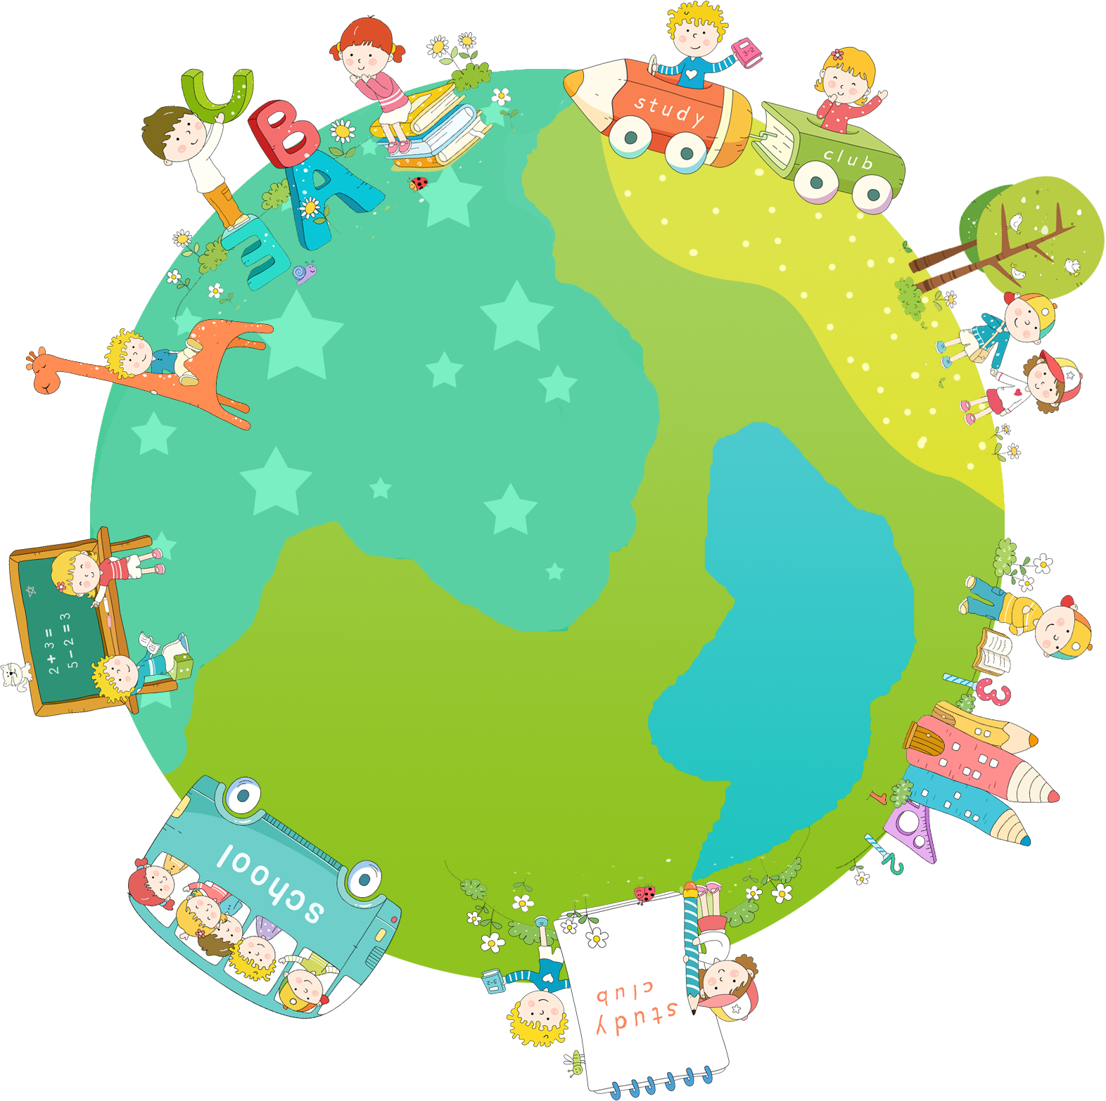
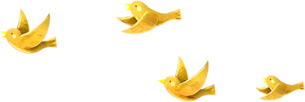
Thank you & goodbye!

