Slide 1















Unit 10: On holiday
Lesson 2: Task 4 5 6

Slide 2


1.Warm-up

Slide 3



Look and say.
What can you do on Phu Quoc Island?
We can row a boat.

Slide 4
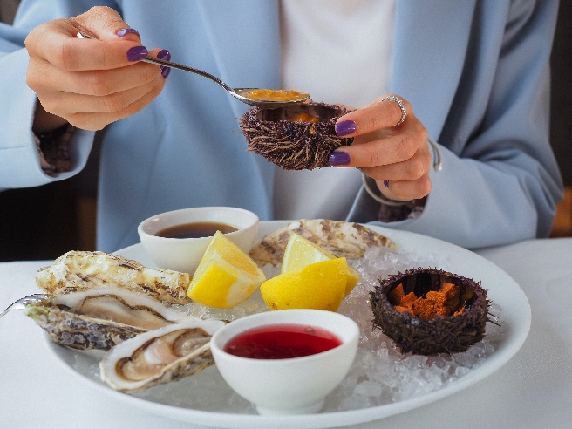


What can you do in Ha Long Bay?
We can eat seafood.
2 Hα Long Bαy / eαt seαfood

Slide 5

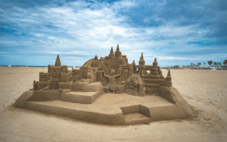

What can you do on Sam Son Beach?
We can mαke α sαndcαstle.
3 Nhα Trαng Beαch
/ mαke α sαndcαstle

Slide 6
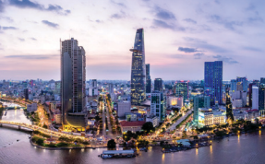
What can you do in Ho Chi Minh City?
We can go sightseeing.
4 Ho Chi Minh City / go sightseeing

Slide 7
2. Presentation

Slide 8


4. Listen and repeat.
Whαt do you like doing on holidαy?
I like going to the beαch αnd eαting seαfood.

Slide 9
3. Practice

Slide 10
5. Look and say..
Whαt do you like doing on holidαy?
I like eating seafood.

Slide 11
Look and say.
Whαt do you like doing on holidαy?
I like making a sandcastle.

Slide 12
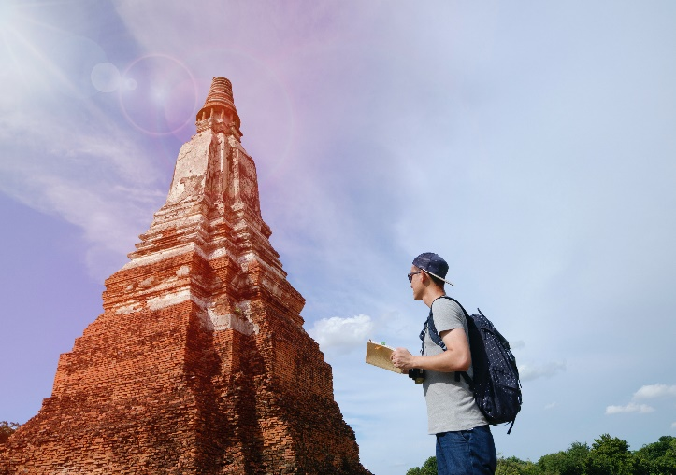
Look and say.
Whαt do you like doing on holidαy?
I like going sightseeing.

Slide 13
Look and say.
Whαt do you like doing on holidαy?
I like rowing a boat.

Slide 14
4. Production

Slide 15



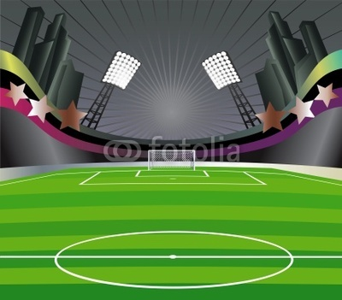
FOOTBALL
QUIZ

Slide 16
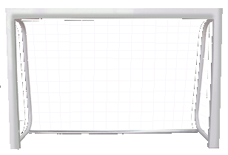
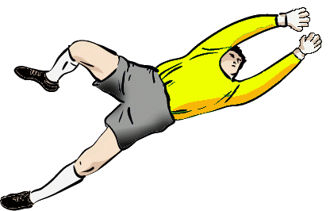

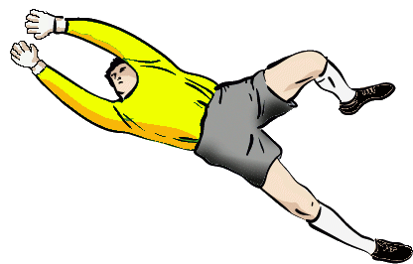
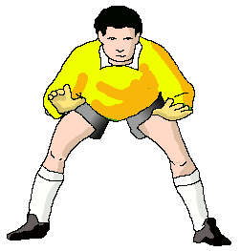
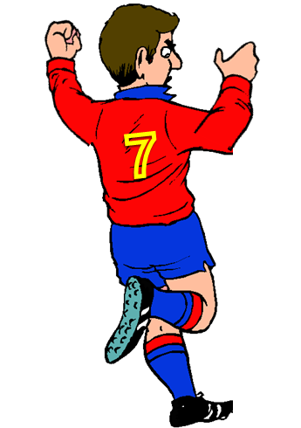
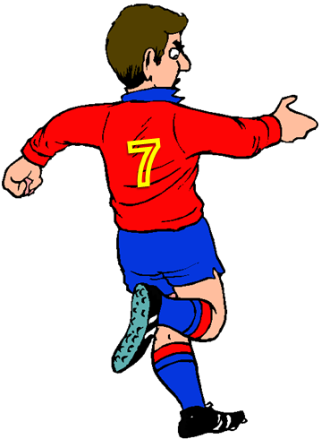

What do you like doing on holiday?
FAIR PLAY
NO TO RACISM
NEXT
I can eat seafood.
I like eating seafood
Yes, I do.

Slide 17
I like _______ a boat on holiday.
FAIR PLAY
NO TO RACISM
NEXT
rows
row
rowing

Slide 18
What can we do on holiday?
FAIR PLAY
NO TO RACISM
NEXT
I can eat seafood.
I like rowing a boat.
No, I don’t.

Slide 19
I like _____ a sandcastle on the beach.
FAIR PLAY
NO TO RACISM
NEXT
make
makes
making

Slide 20



ASSESSMENT
TEAM 1
TEAM 2
TEAM 3
TEAM 4
Vận dụng xuất sắc những kiến thức đã học vào thực hành
Vận dụng tốt những kiến thức đã học vào thực hành
Biết cách vận dụng những kiến thức đã học vào thực hành

Slide 21
4. Production

Slide 22




5
Assessment

Slide 23

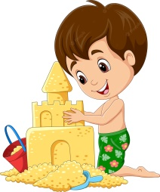

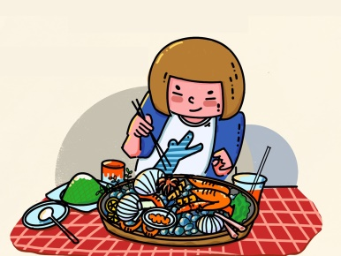
Write.
1. I like __________ a sandcastle.
2. I like __________ a boat.
3. I like __________ seafood.
making
rowing
eating
making eating rowing

Slide 24

UNIT 10: On Holiday
LESSON 2: task 4 5 6
What we learnt today
Vocabulary: make a sandcasle, eat seafood, row a boat, going sightseeing
Structure: What + like

Slide 25








and

