Slide 1




















Fun time
and project

Slide 2




1
Fun time

Slide 3


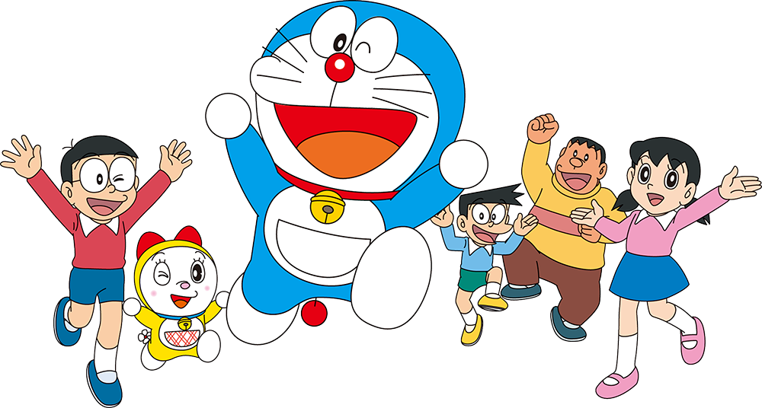
Puzzles

Slide 4
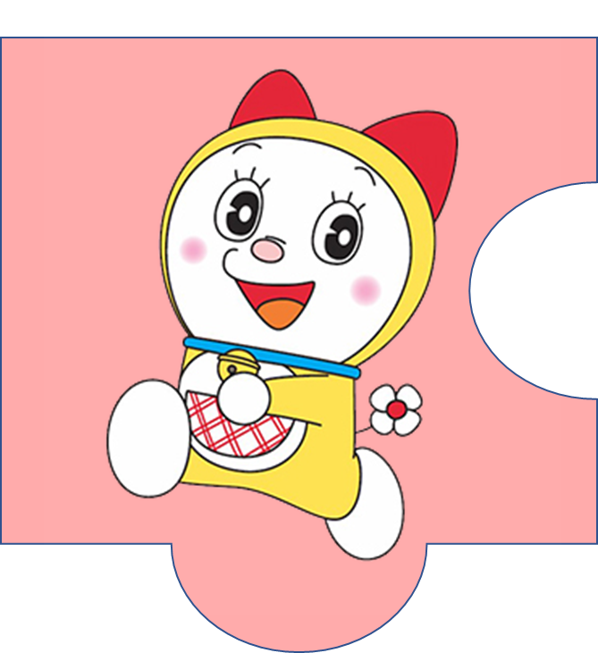

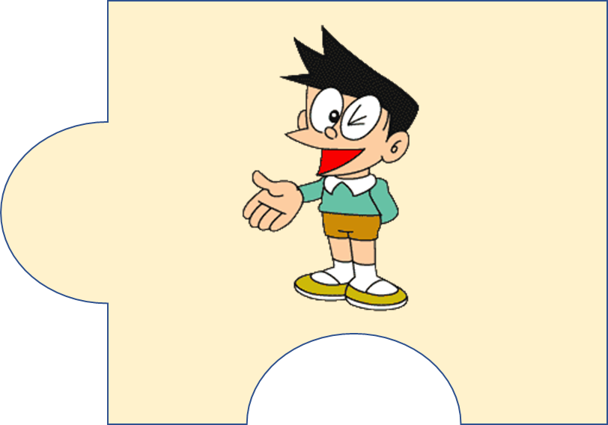
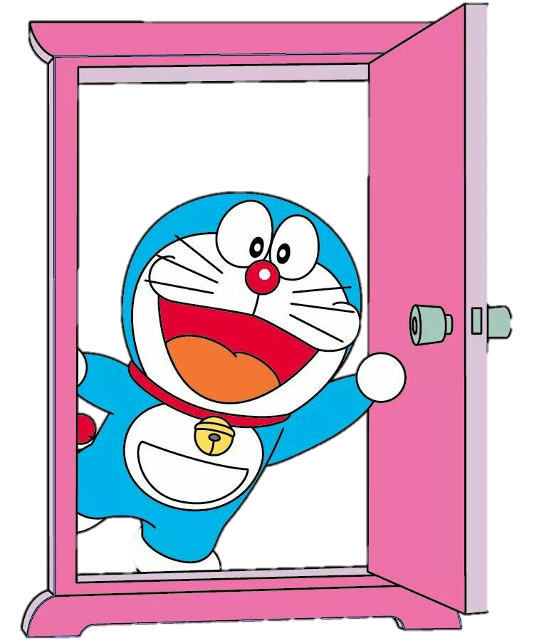



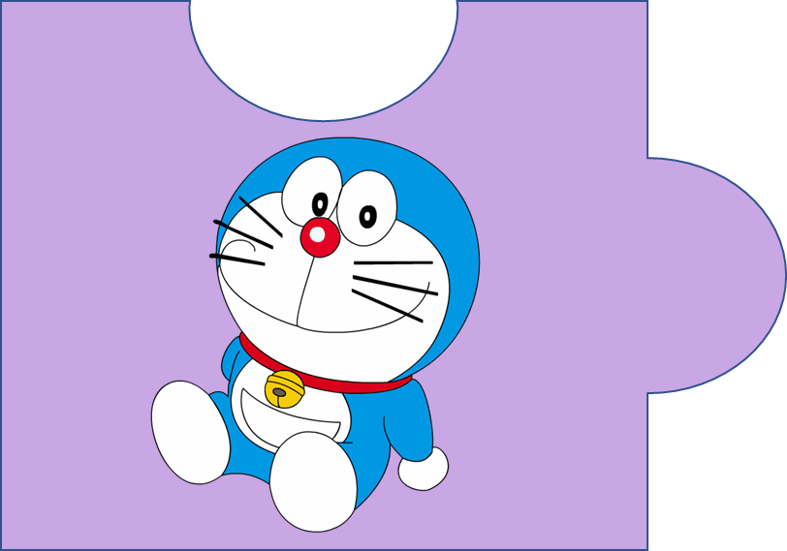


?
20
It’s a magic door.

Slide 5

f c h u l r e e
  cheerful
4

Slide 6

p e s l a n t a
  pleasant
5

Slide 7
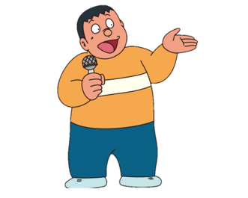
f r e d l n i y
  friendly
4

Slide 8
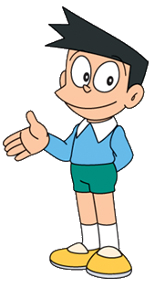
k n i d
  kind
2

Slide 9

2
Project
Family quiz

Slide 10




MATCHING GAME

Slide 11

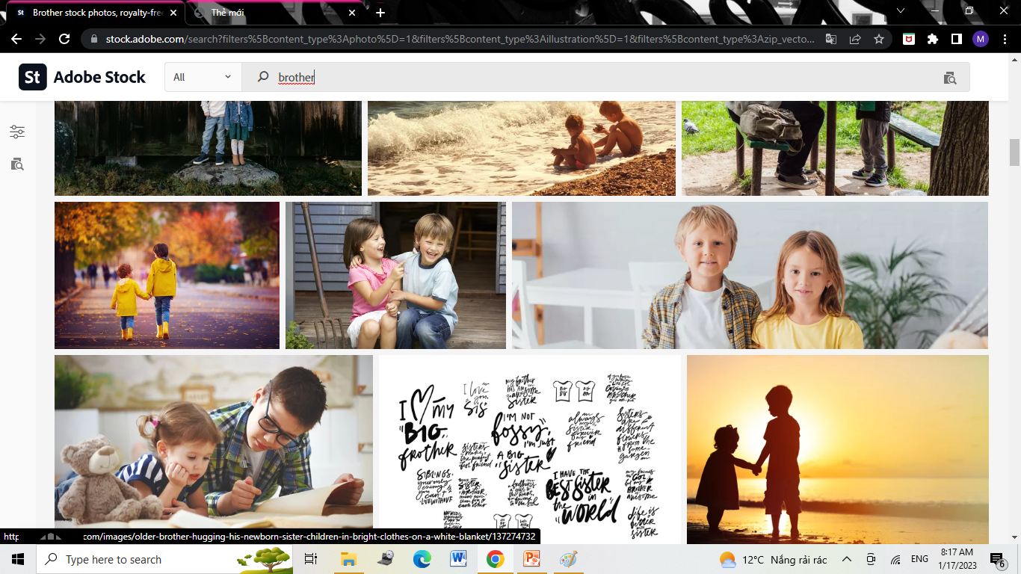
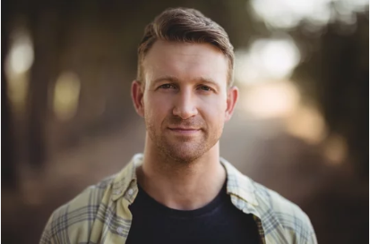
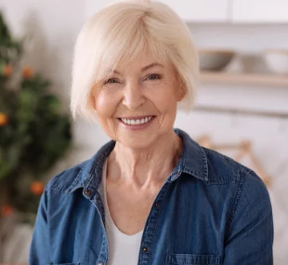
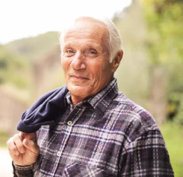
mother
father
4
1
sister
brother
2
5
grandpa
grandma
3
6

Slide 12
2
Project
My Family

Slide 13

REMEMBER !
This/ That is my ….
He/ She is … .

Slide 14
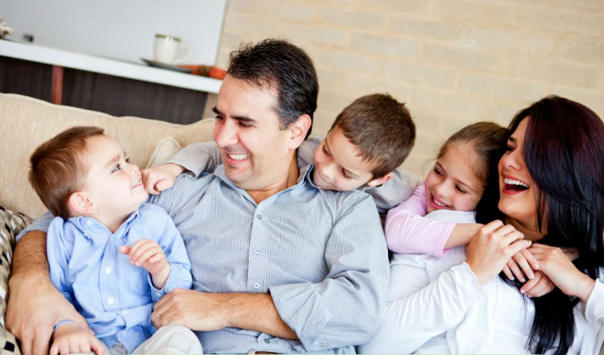
There are 5 people in my family.

Slide 15


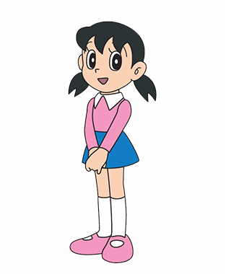
Who’s this?
This is my father.
He’s friendly and kind.

Slide 16
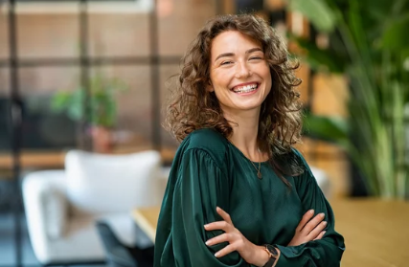
Who’s that?
That is my mother.
She’s pretty and nice.

Slide 17
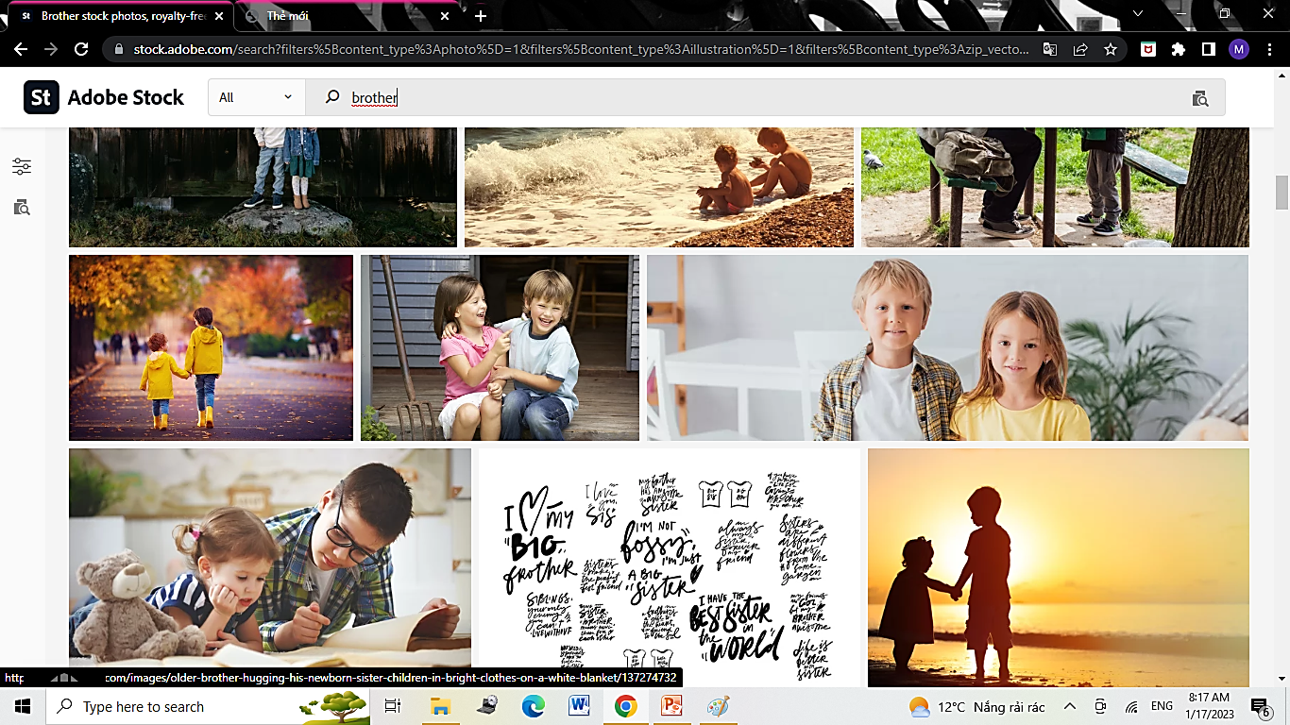
Who’s she?
She is my sister.
She’s hardworking and young.

Slide 18
2
Project
Your Family

Slide 19
kind
k_nd
pretty
pr_tty
_ardwor_ing
hardworking
h_ndsom_
handsome
chee_ful
cheerful
funny
funn_
cu_e
cute
clever
clev_r
fr_endl_
friendly
pleas_nt
pleasant
sh_rt
short

Slide 20




Thank you & goodbye!

