Slide 1





















Fun time
and project

Slide 2




1
Fun time
Let’s sing a song!

Slide 3
1
Fun time

Slide 4


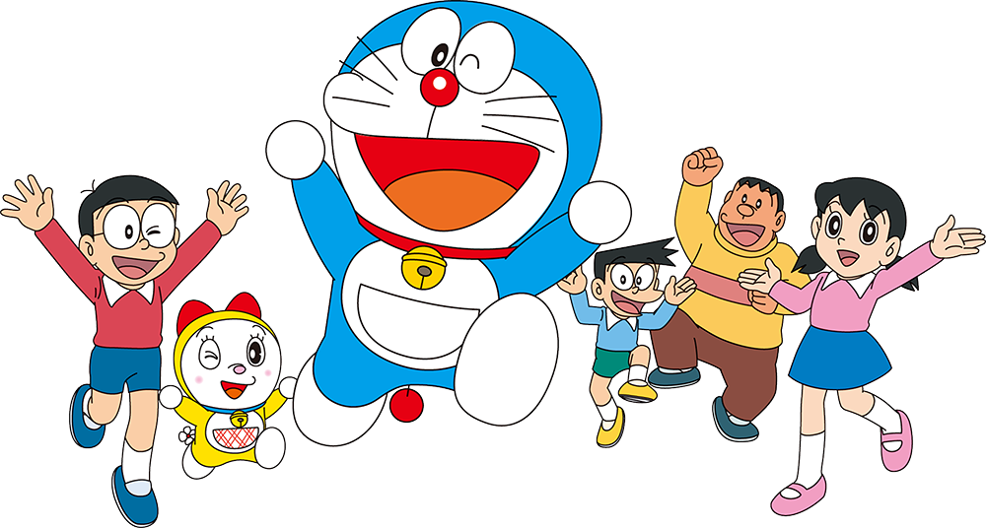
Puzzles

Slide 5
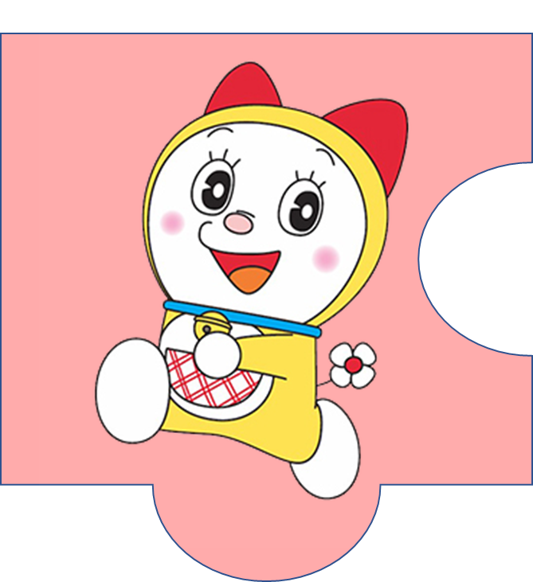

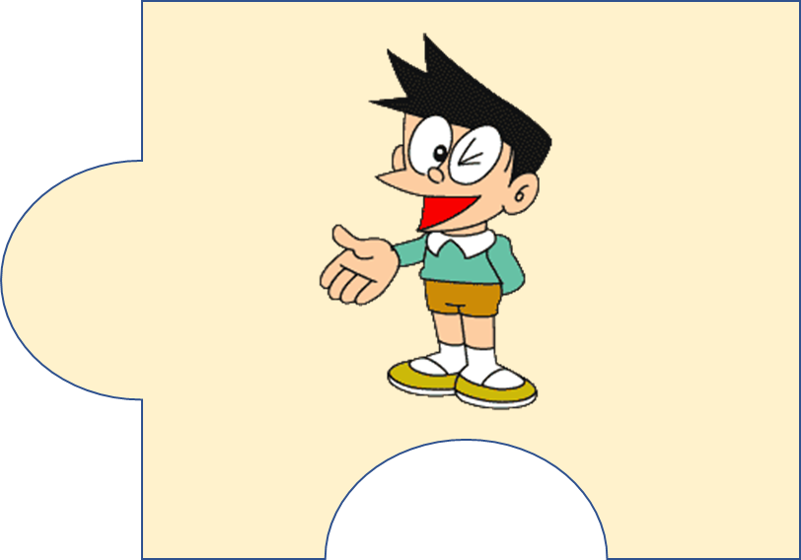
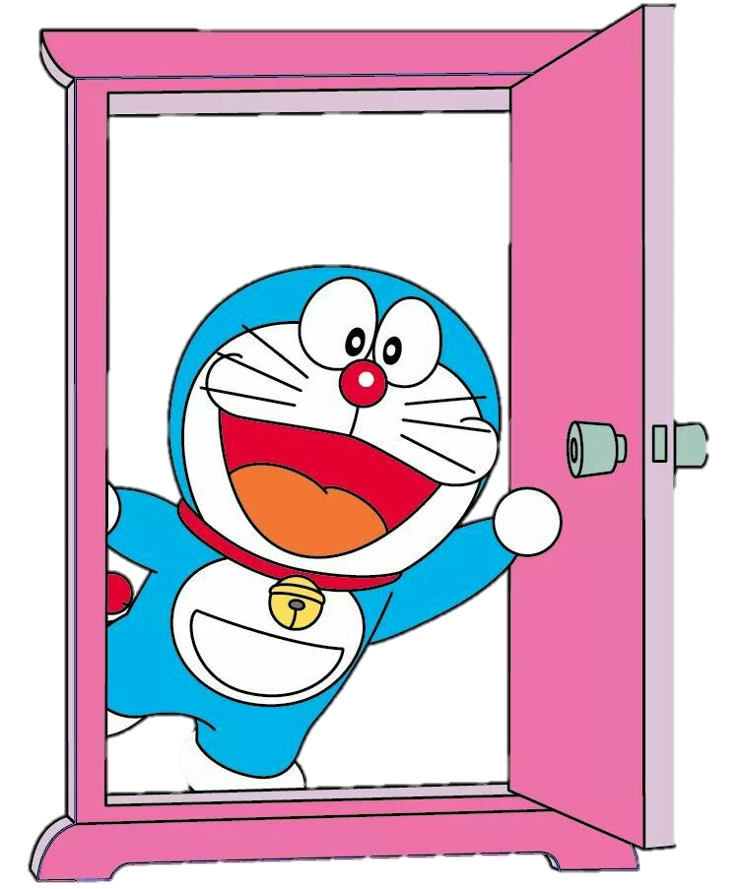



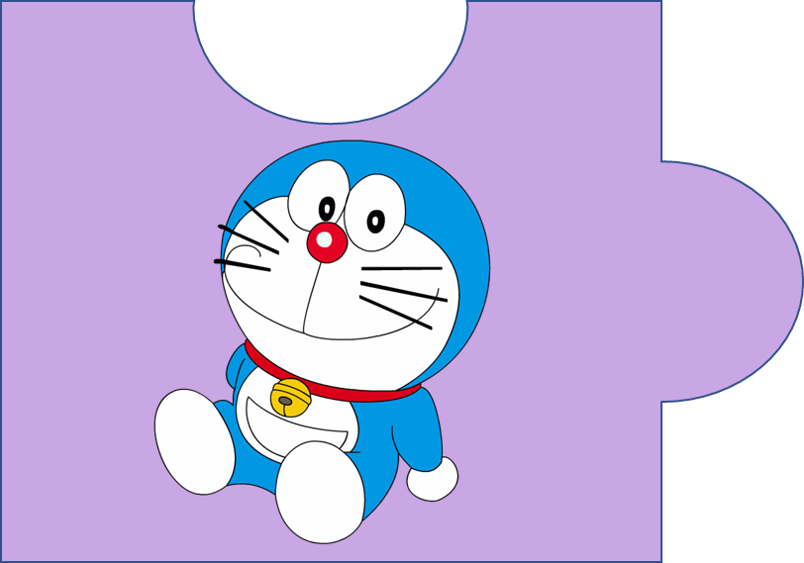


?
20
It’s a magic door.

Slide 6
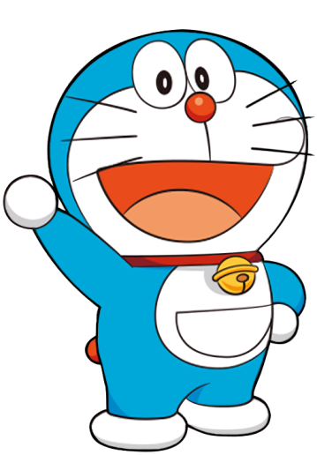
f c h u l r e e
  cheerful
4

Slide 7

p e s l a n t a
  pleasant
5

Slide 8

c l r e v e
  clever
3

Slide 9
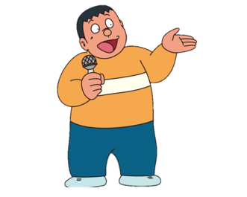
f r e d l n i y
  friendly
4

Slide 10
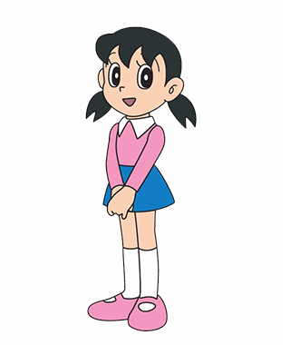
h a d r i n w o g r k
  hard-working
6

Slide 11
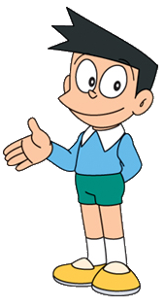
k n i d
  kind
2

Slide 12

2
Project
Family quiz

Slide 13




MATCHING GAME

Slide 14
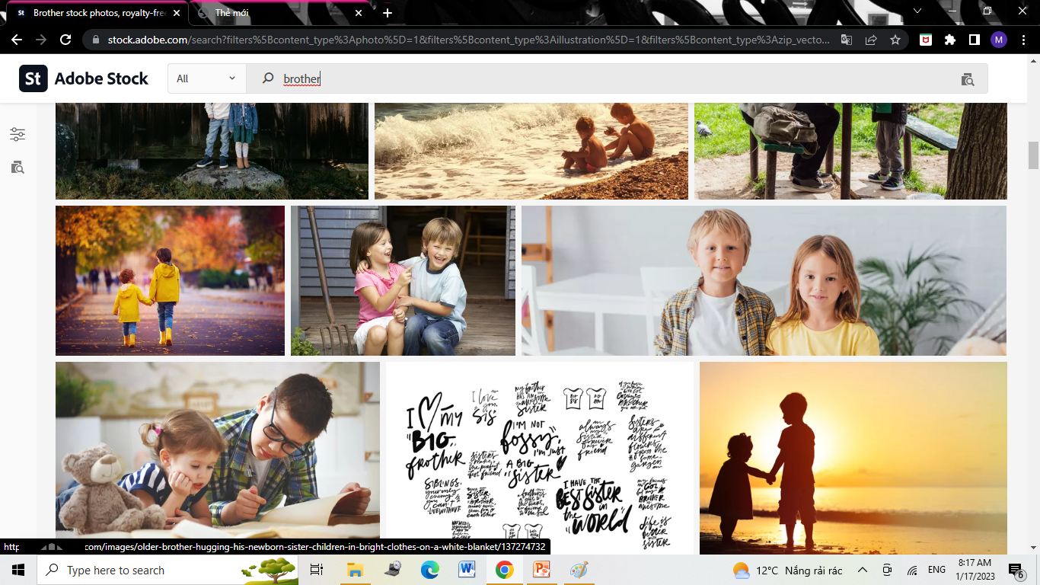
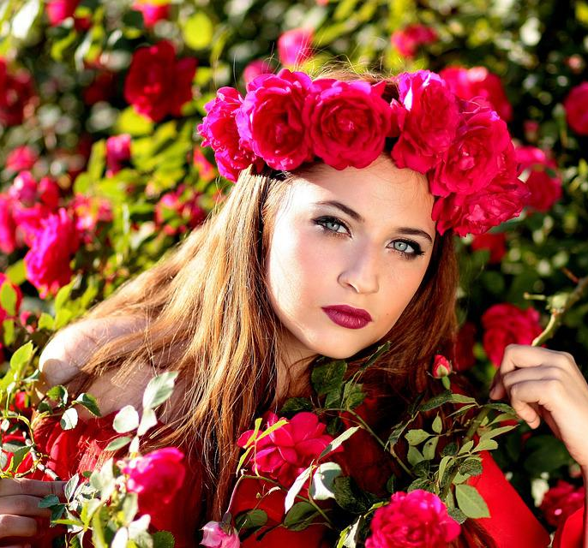
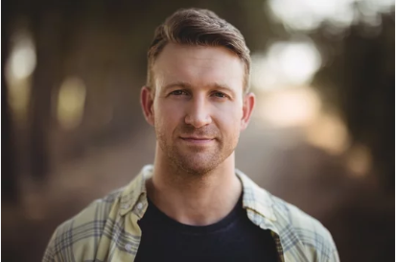
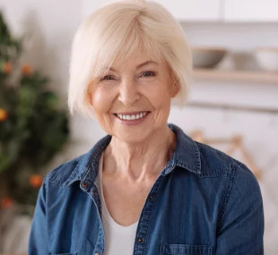
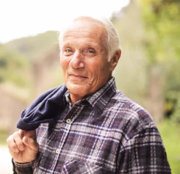
mother
father
4
1
sister
brother
2
5
grandpa
grandma
3
6

Slide 15
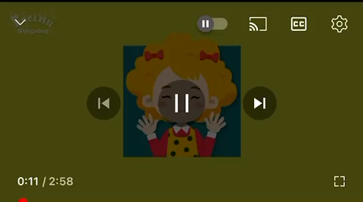

Slide 16
2
Project
My Family

Slide 17

REMEMBER !
This/That is my ….
He/She is … .

Slide 18
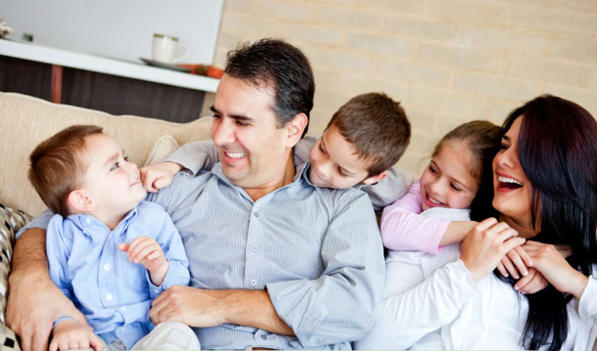
There are 5 people in my family.

Slide 19


Who’s this?
This is my father.
He’s friendly and kind.

Slide 20
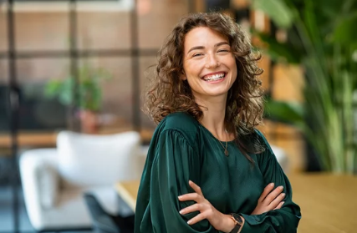
Who’s that?
That is my mother.
She’s pretty and nice.

Slide 21
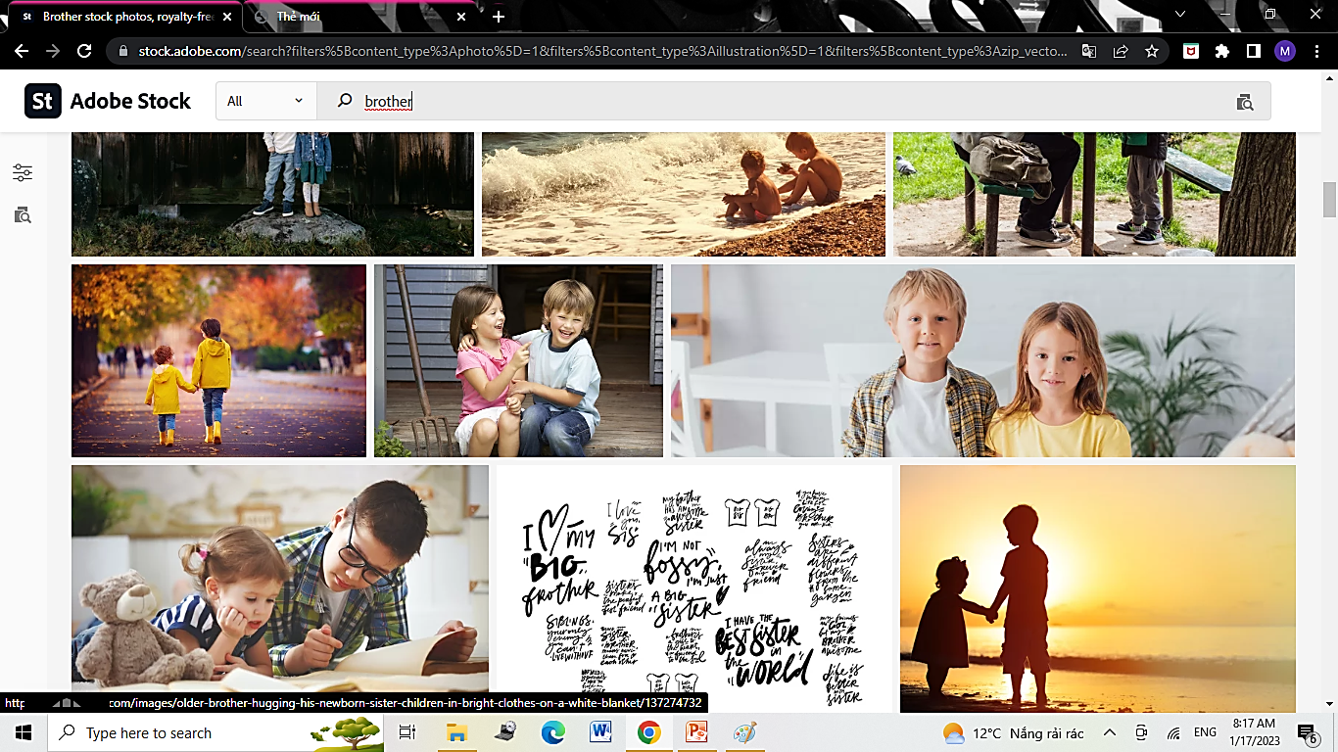
Who’s he?
He is my brother.
He’s clever and pleasant.

Slide 22
Who’s she?
She is my sister.
She’s hard-working and young.

Slide 23
2
Project
Your Family

Slide 24
kind
k_nd
pretty
pr_tty
_ardwor_ing
hard-working
h_ndsom_
handsome
cheerful
che_ful
funny
funn_
cu_e
cute
clever
clev_r
fr_endl_
friendly
pleas_nt
pleasant
sh_rt
short

Slide 25
There are … people in my family.
This is/ That is my ….
His name’s/ Her name’s….
He’s/ She’s ….

Slide 26
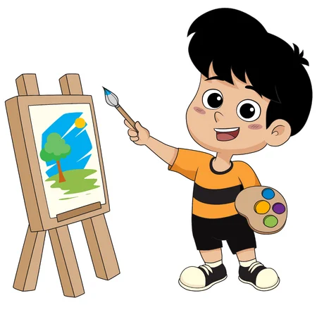
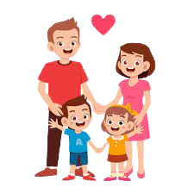
Drawing and Presenting

Slide 27
3
Assessment

Slide 28
Circle the correct answer
There are 3 … in my family.
people B. person C. kid
This is my mother. She is ….
nice B. Sunday C. sunny
3. Her uncle is not ….. He is tall.
ugly B. smelly C. short
My sister and I love … family so much.
A. his B. our C. their

Slide 29




Thank you & goodbye!

