Slide 1









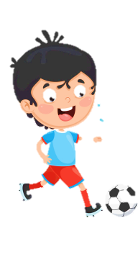
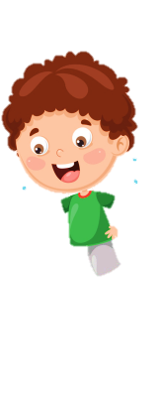






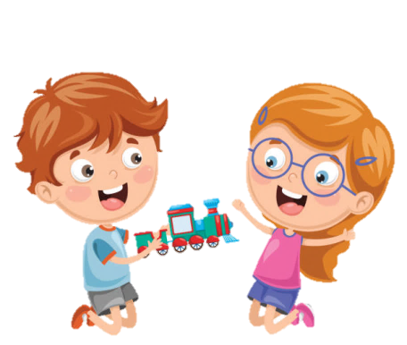




Notes:
Để nguyên trang bìa như này, chỉ thay đổi tên bài trong quá trình làm. Logo của sách Wonderful World

Slide 2
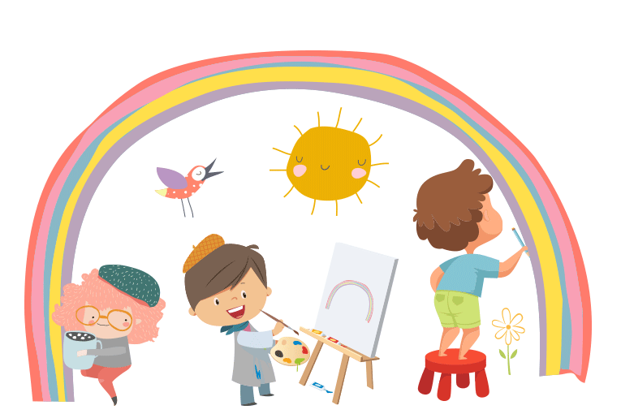

Unit 7: Jobs
Lesson 3
Task 7, 8, 9

Slide 3
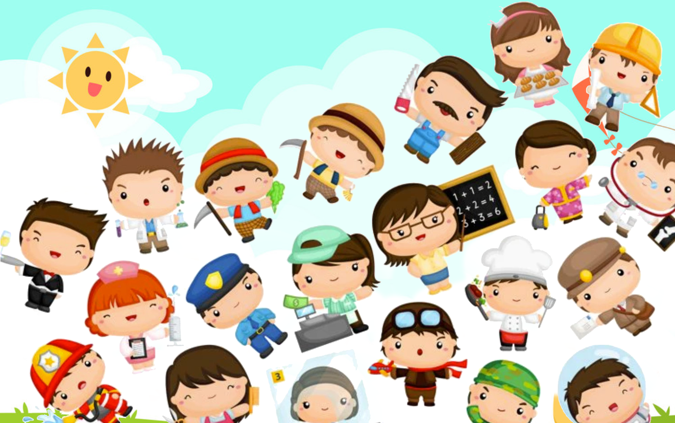

1. WARM UP
Who’s faster?

Slide 4
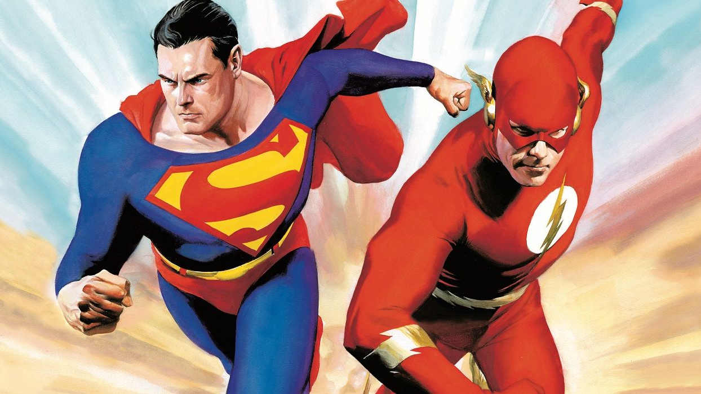
Who’s faster?
Notes:
- T puts all the pictures on the ground.
- There are 4 students standing around pictures. T calls a flashcard, and Ss will pick up the flash and raise it over his head. Who are slow or incorrect will be a loser. Who can do the best will be a winner.

Slide 5
2. PRESENTATION

Slide 6

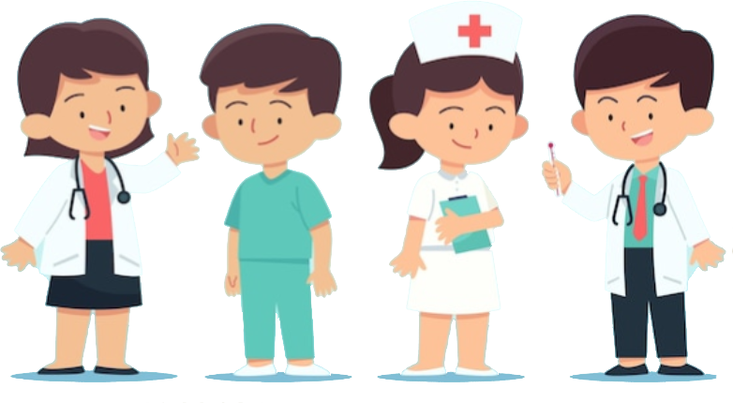
/d/
doctor

Slide 7
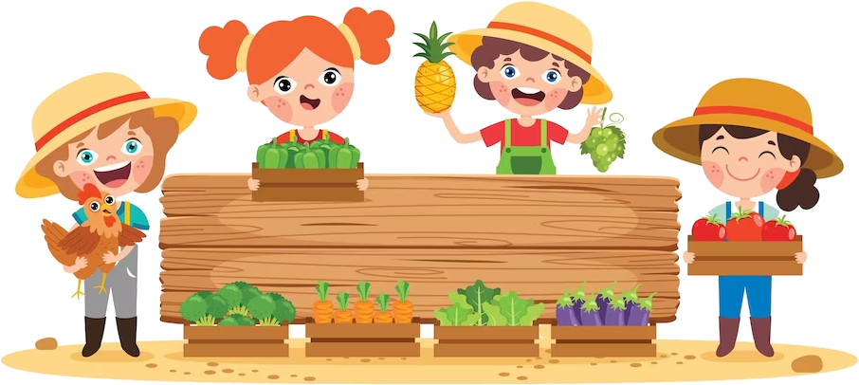
/f/
farmer

Slide 8
/d/
/f/
Sounds
doctor
farmer
Words

Slide 9

7. Listen and repeat.
doctor
farmer
A doctor takes care of people.
A farmer feeds animals.

Slide 10
3. PRACTICE

Slide 11
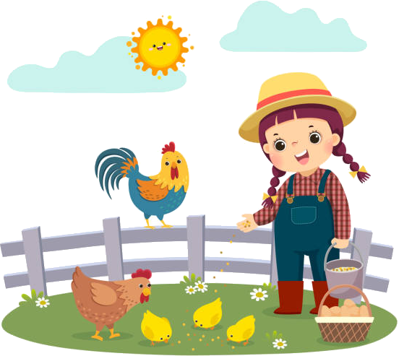
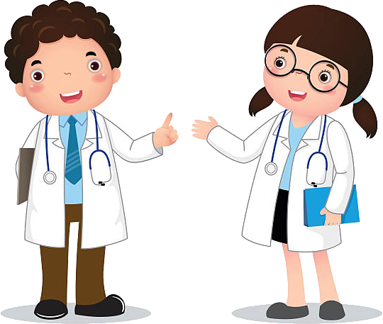
8. Listen and chant.
D, d, d
Doctor, doctor, doctor!
A doctor takes care of people.
F, f, f
Farmer, farmer, farmer!
A farmer feeds animals.

Slide 12
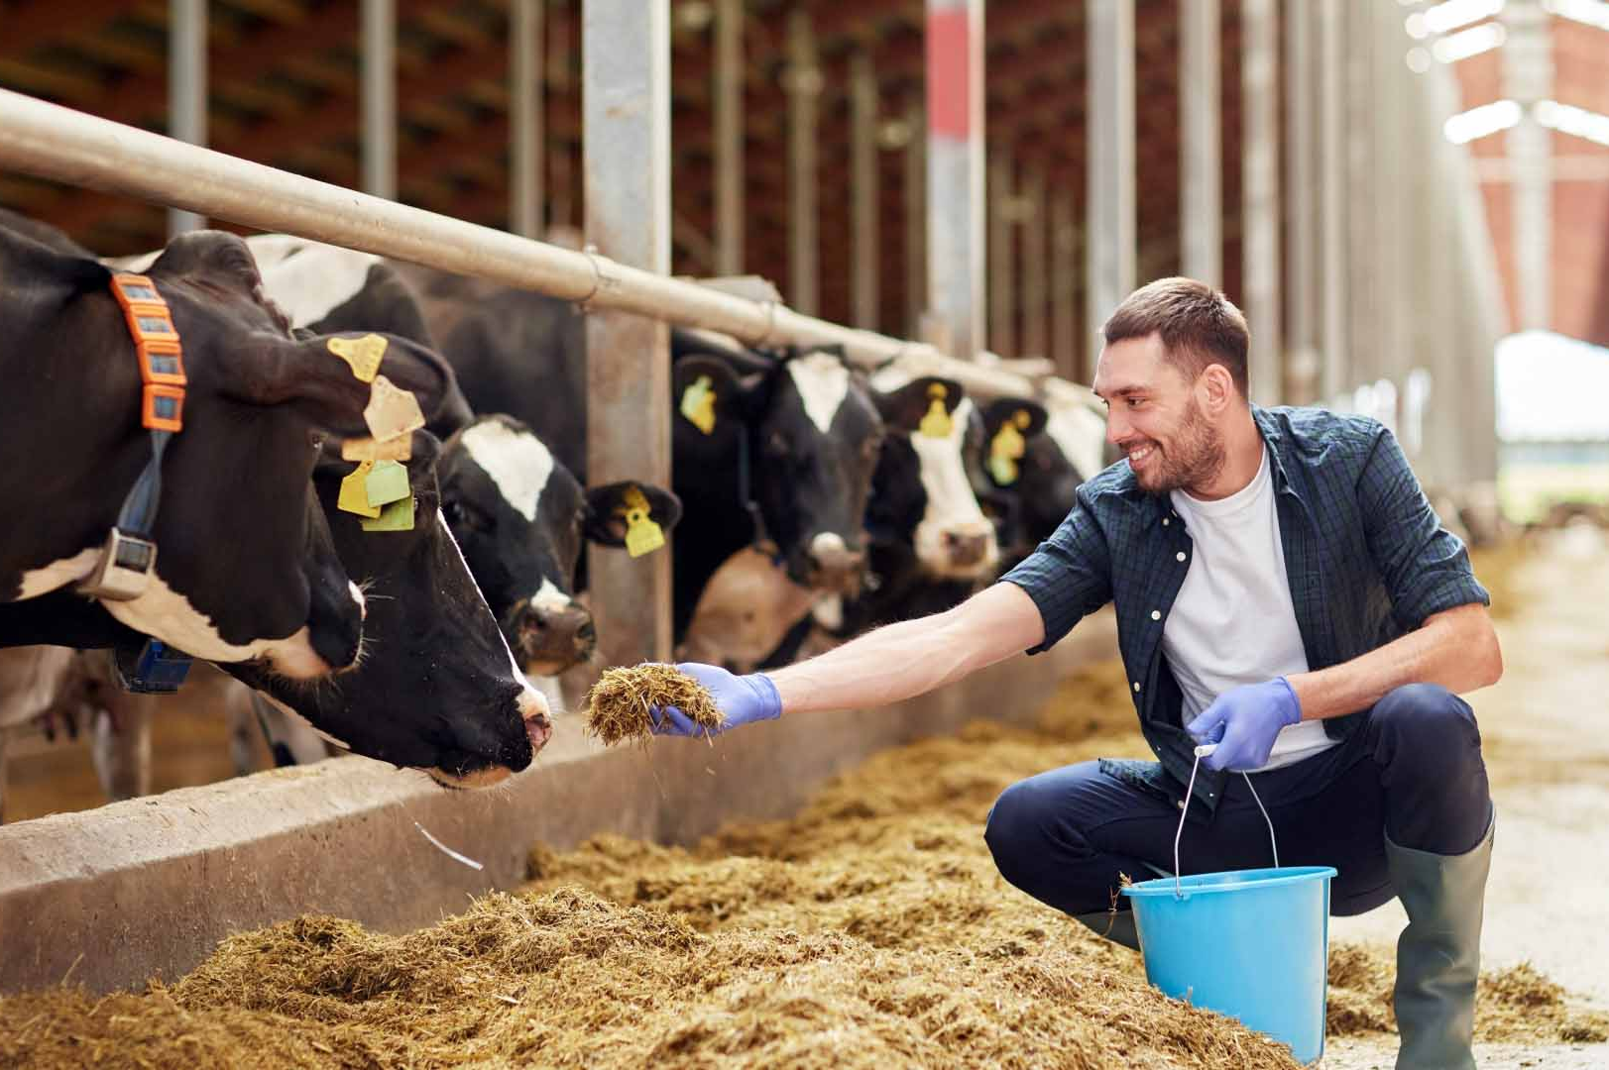
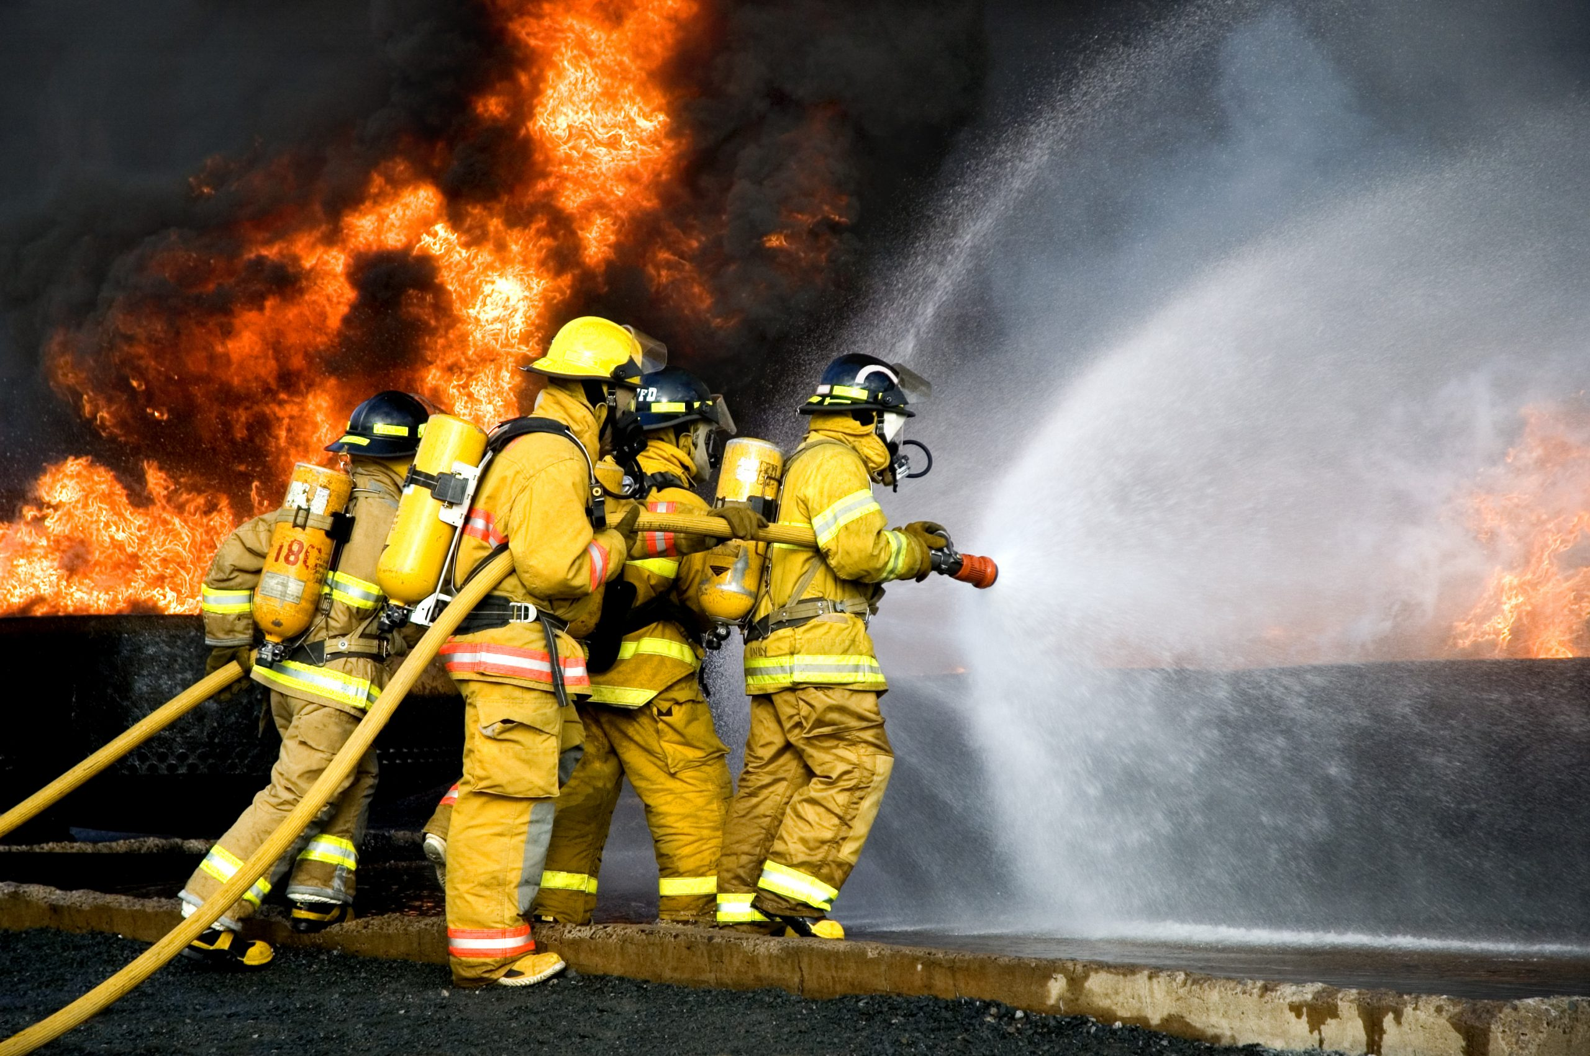
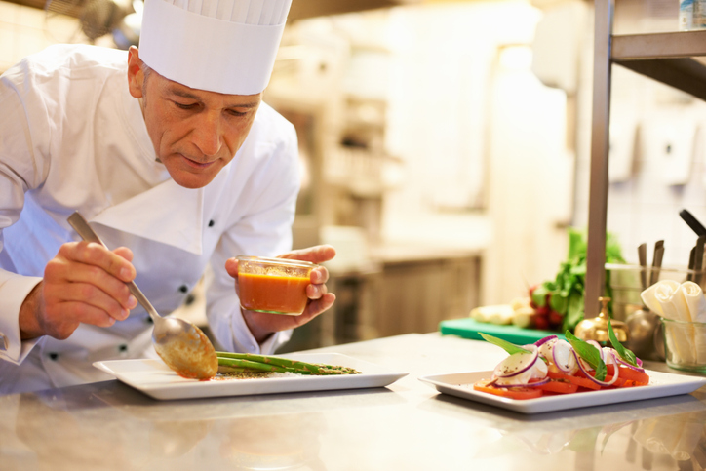
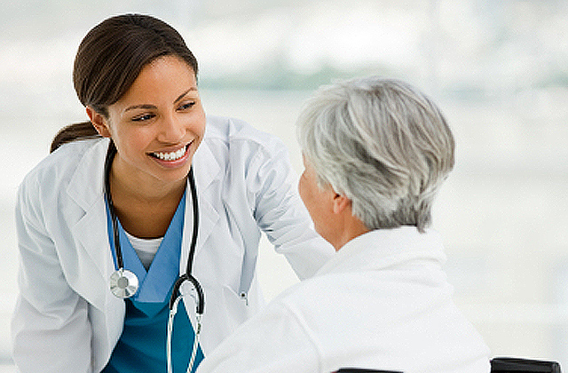
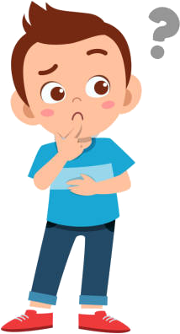
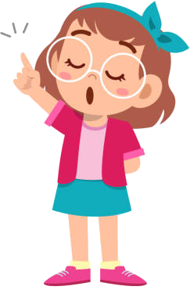
9. Say it!
1. What does a firefighter do?
- A firefighter puts out fires.
2. She wants to be a doctor.
A doctor works in a hospital.
3. Where does a farmer work?
- A farmer works on a farm.
4. What does a chef do?
- A chef cooks great food.

Slide 13
4. PRODUCTION

Slide 14

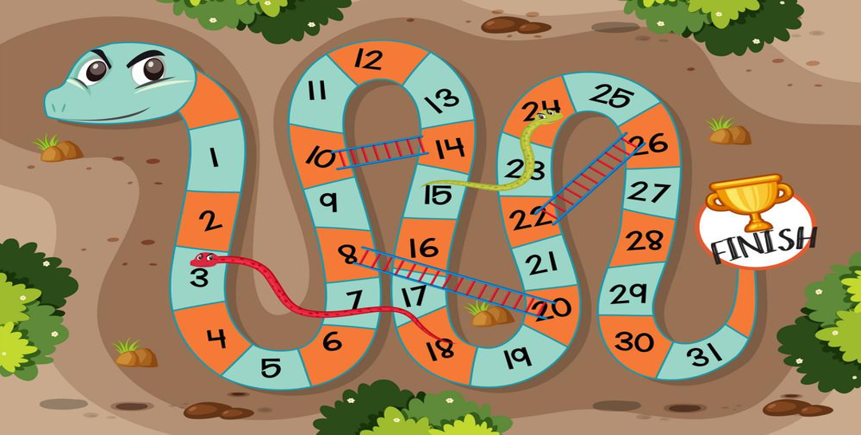



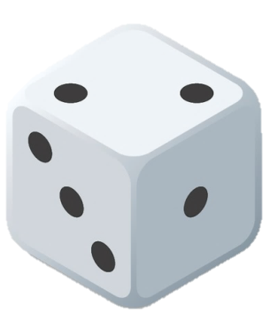
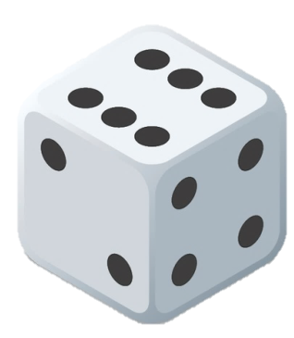
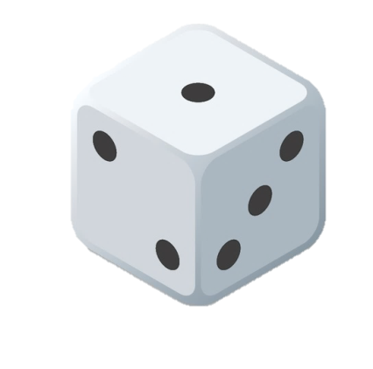
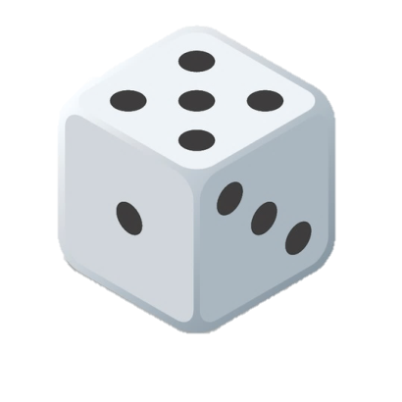
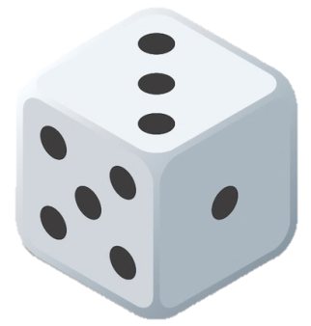
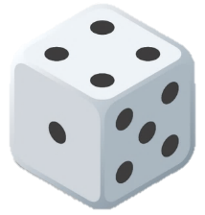
1
2
3
4
5
6
7
8
Notes:
T divides the class into 2 teams. Each team will choose a figure (girl or boy).
Each team chooses a number from 1 to 8 and answer the question. If the answer is correct, the team will get the chance to roll the dice. If not, the chance is given to the other team.
Click on the dice icon to roll. The steps each team can move are corresponding to the number on the dice. If they move to the head of snake or one side of the ladder, they can move to the tail of snake or the other side of the ladder.
The first team coming to finish will win the game.

Slide 15
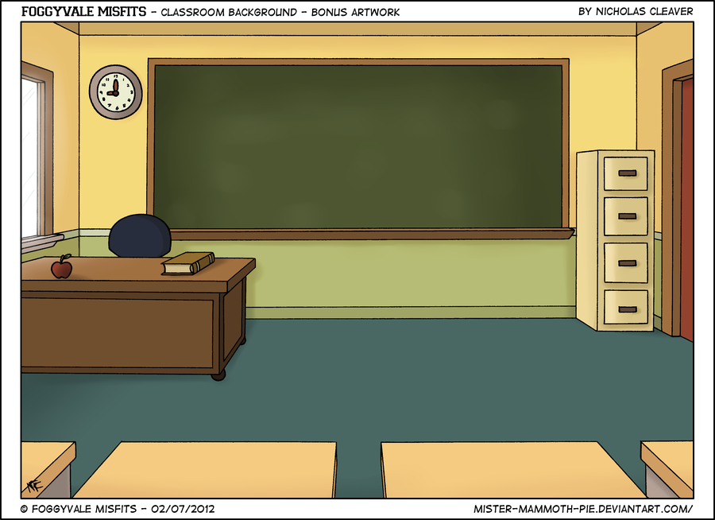


Listen and repeat:
A farmer works on a farm.

Slide 16

Congratulations!
Let’s roll the dice.

Slide 17
Make questions for the underlined words:
- A chef cooks great food.
-> What does a chef do?

Slide 18
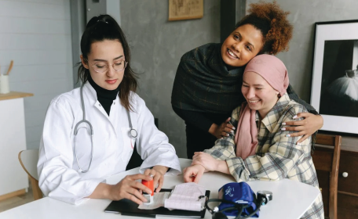
Re-order the words to make a sentence:
works/ a/ hospital/ doctor/ a/ in/.
A doctor works in a hospital.

Slide 19
Listen and answer: What does a firefighter do?
A firefighter/He puts out fire.

Slide 20
Listen and repeat:
A photographer takes photos.

Slide 21
Listen and answer: What does a vet do?
A vet takes care of animals.

Slide 22
Congratulations!
Let’s roll the dice.

Slide 23
5. ASSESSMENT

Slide 24
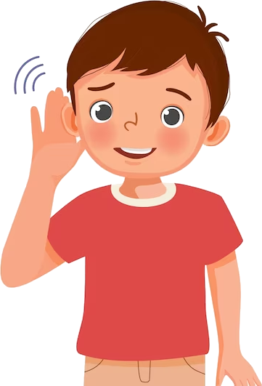
Listen and write.
1. What does your father do?
My father is a ________He takes care of ______.
2. What does your brother do?
He is a ___________.
3. My sister is a _______. She takes great ______ of animals.
4. Where does your uncle work?
- He works in the _________. He’s a _____.
doctor
people
photographer
farmer
care
restaurant
chef

Slide 25

UNIT 7: JOBS
LESSON 3: PERIOD 3
What we learnt today:
Pronunciation:
/d/: doctor
/f/: farmer
Structure:
- What does a firefighter do?
- A firefighter puts out fires.

Slide 26




Thank you & goodbye!

