Slide 1












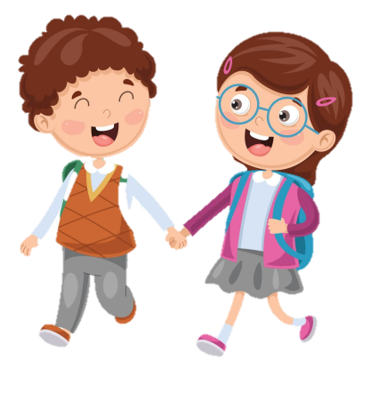









Notes:
Để nguyên trang bìa như này, chỉ thay đổi tên bài trong quá trình làm. Logo của sách Wonderful World

Slide 2
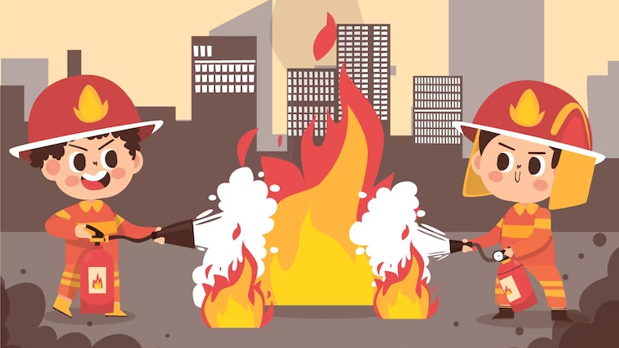

Unit 7: Jobs
Lesson 3
Task 1, 2, 3

Slide 3
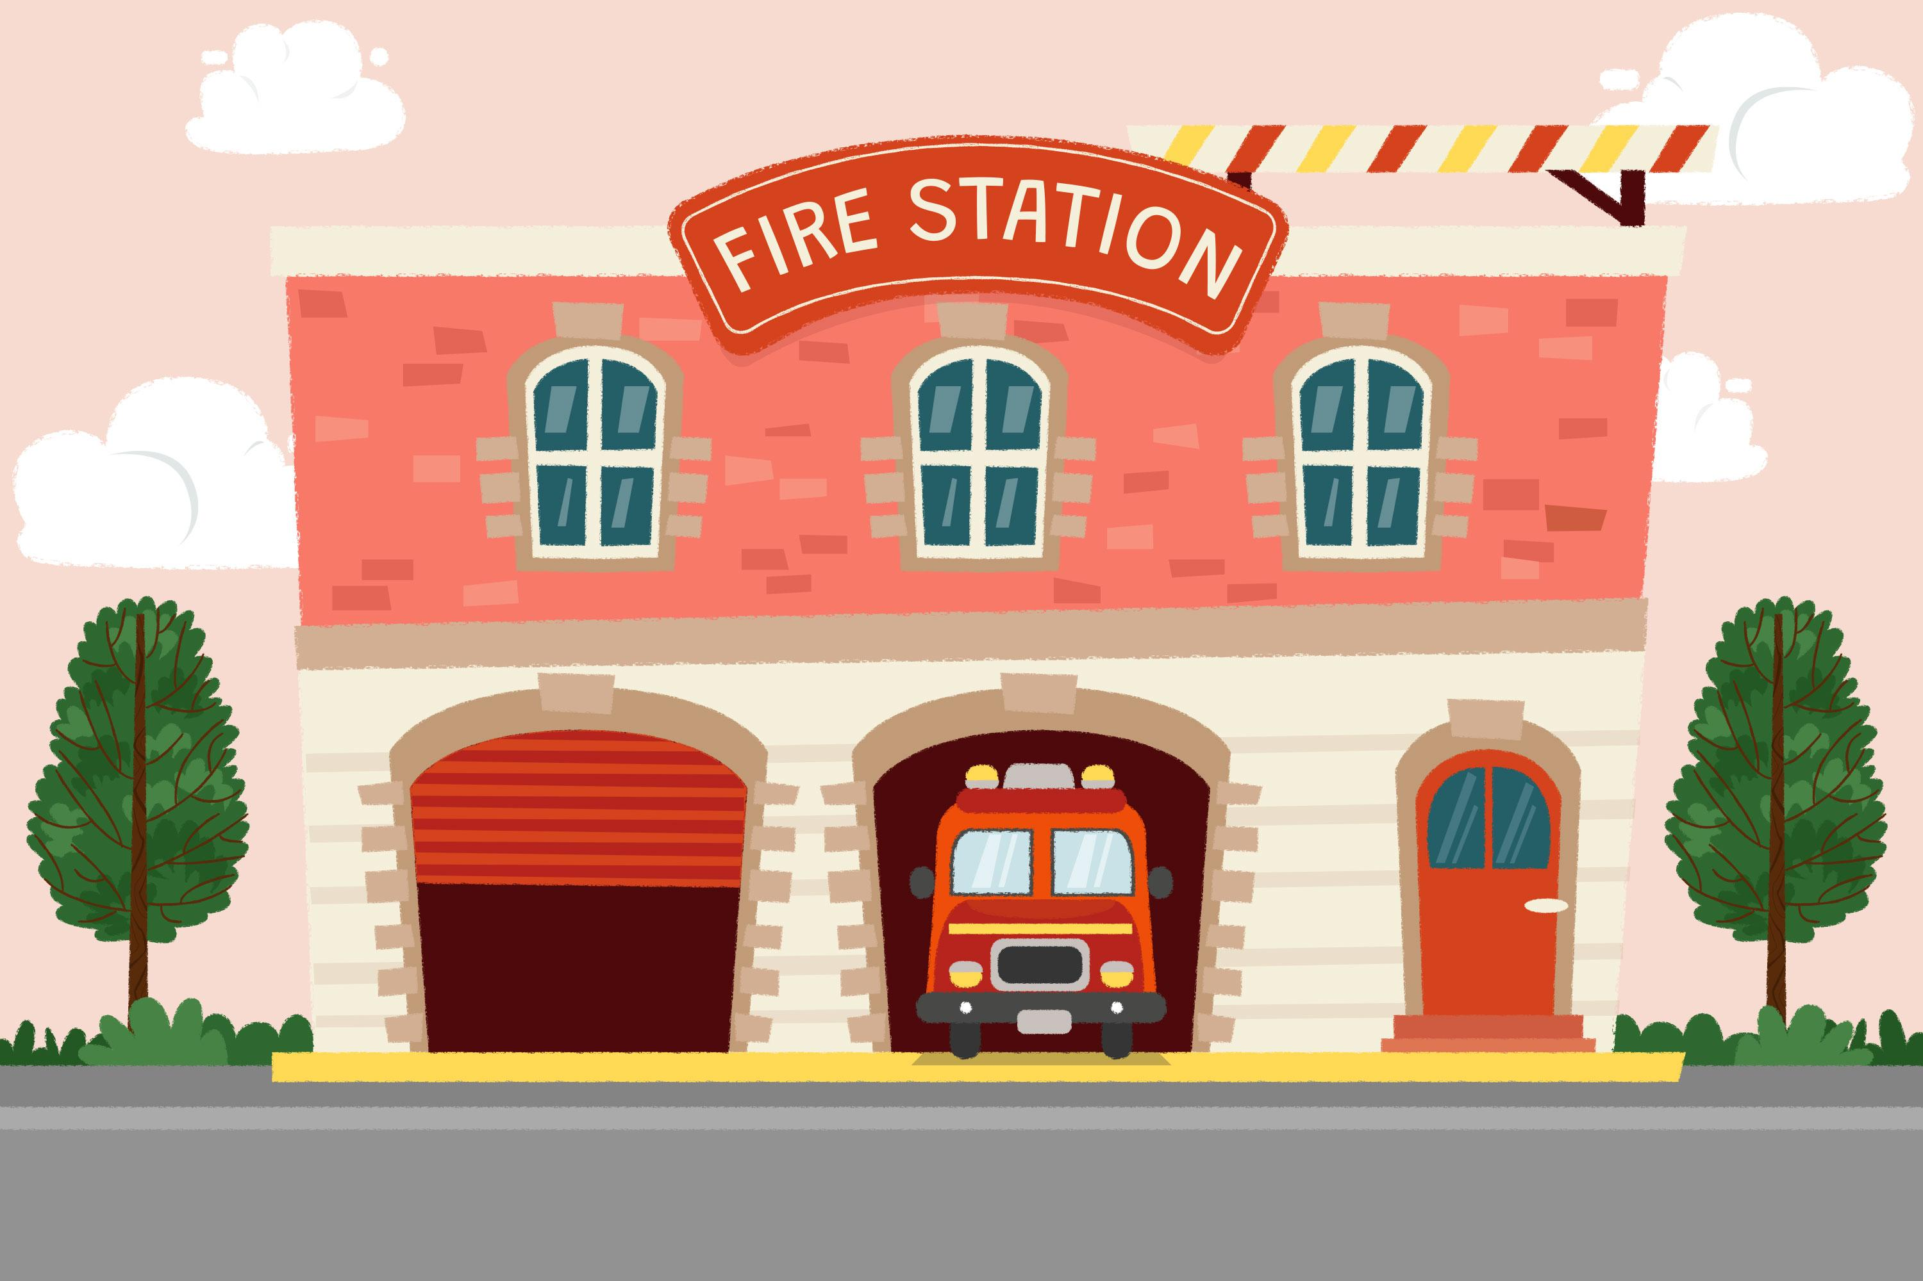
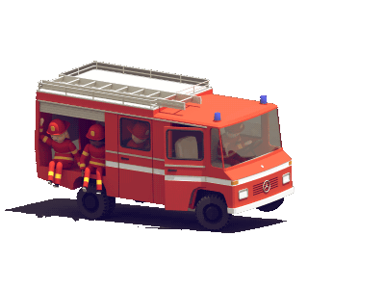
1. Warm up
Watch the video

Slide 4
2. PRESENTATION

Slide 5
3. PRACTICE

Slide 6
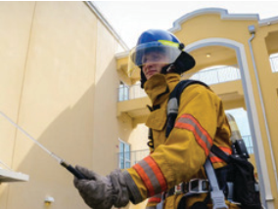
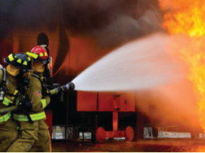
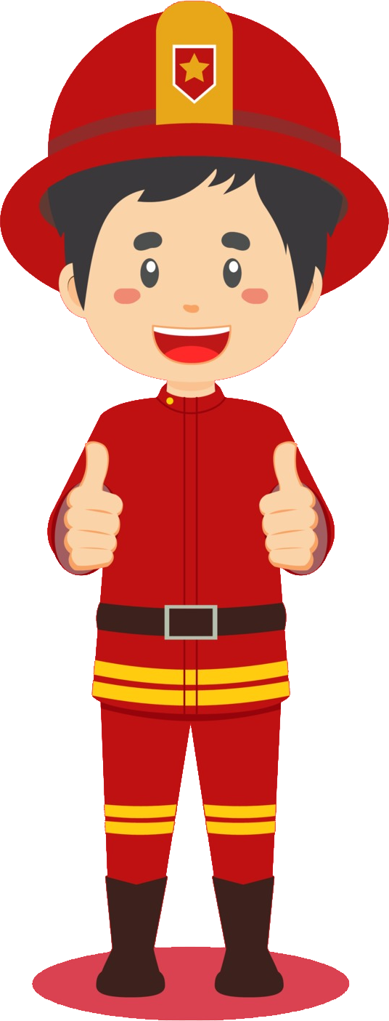
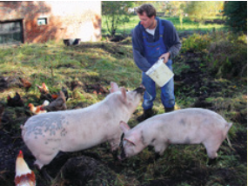
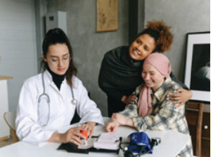
1. Listen and point. Repeat.
firefighter
put out fires
feed animals
take care of people

Slide 7
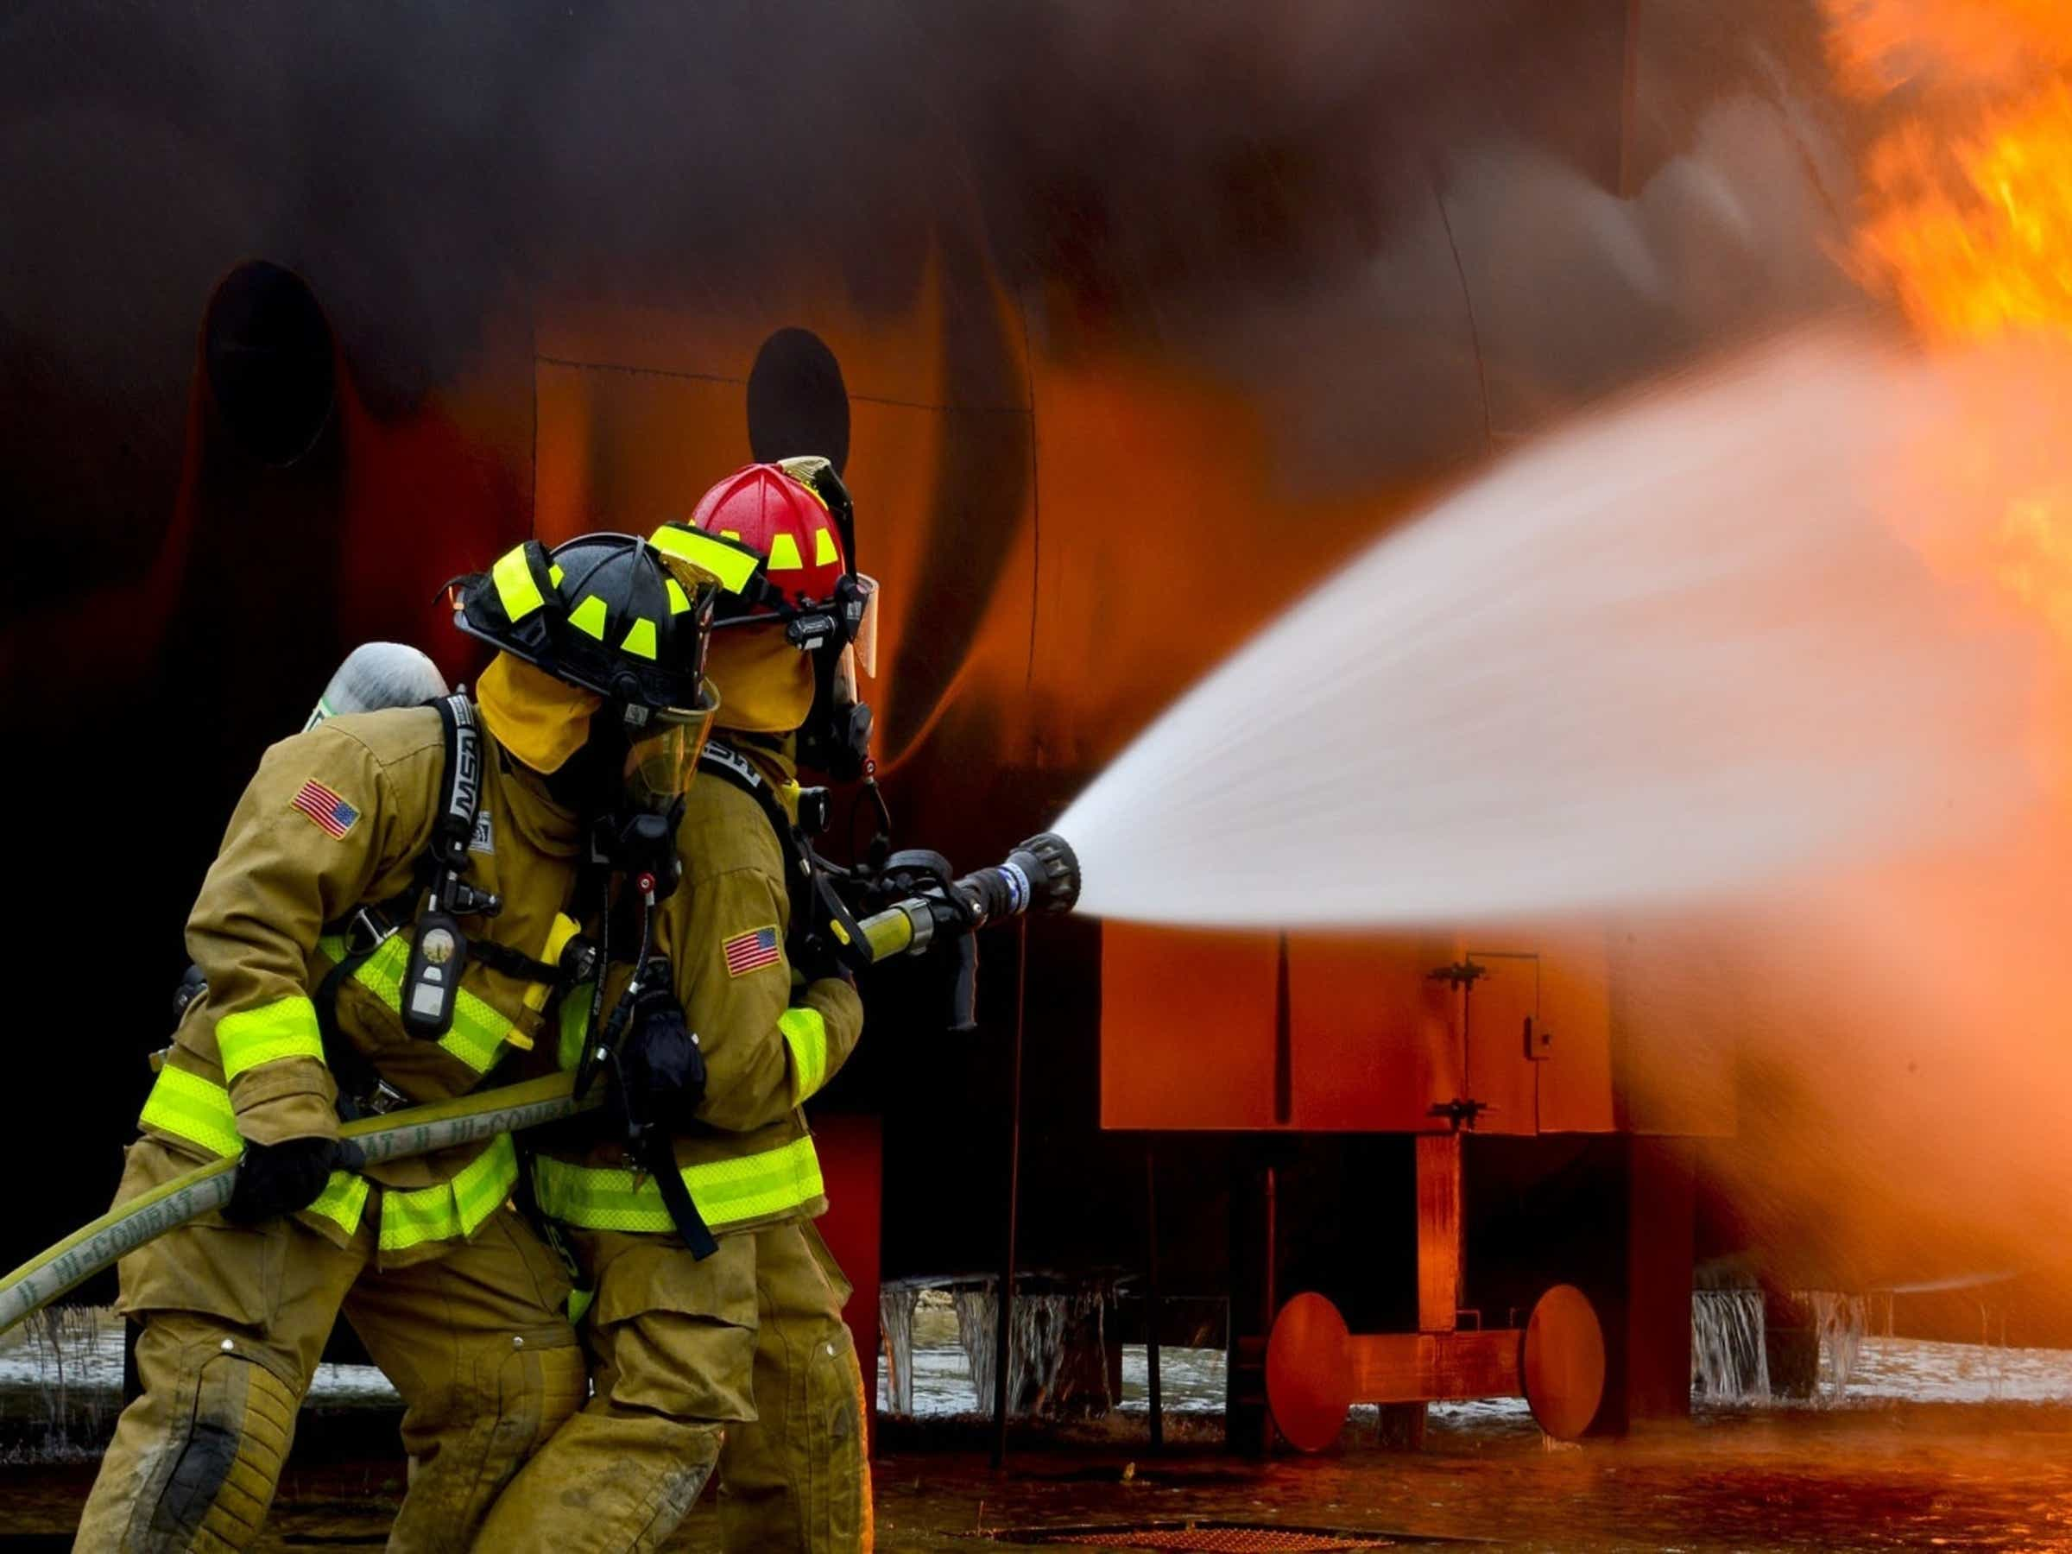


2. Listen and tick.
1. Jack wants to be a vet because he loves ____ □animals. □people.
2. Milly wants to be a ___ □firefighter. □photographer.
3. A firefighter ___ □takes care of people. □puts out fire.

Slide 8
4. PRODUCTION

Slide 9
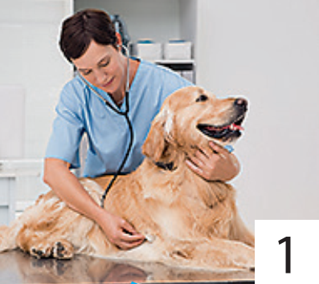
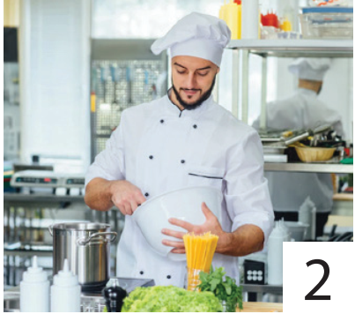
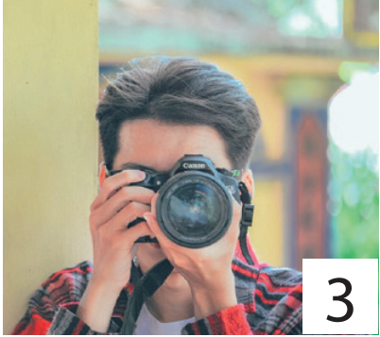
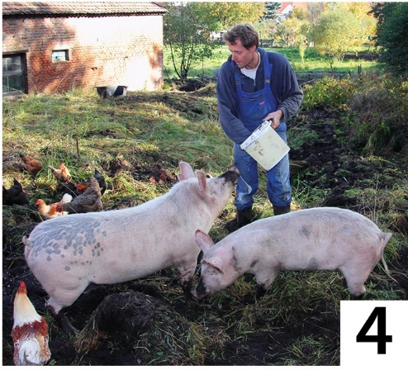
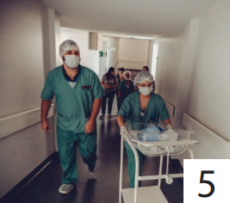
3. Look and say.
A vet takes care of animals.
takes care of people
cooks good food
feeds animals
takes care of animals
takes photos

Slide 10
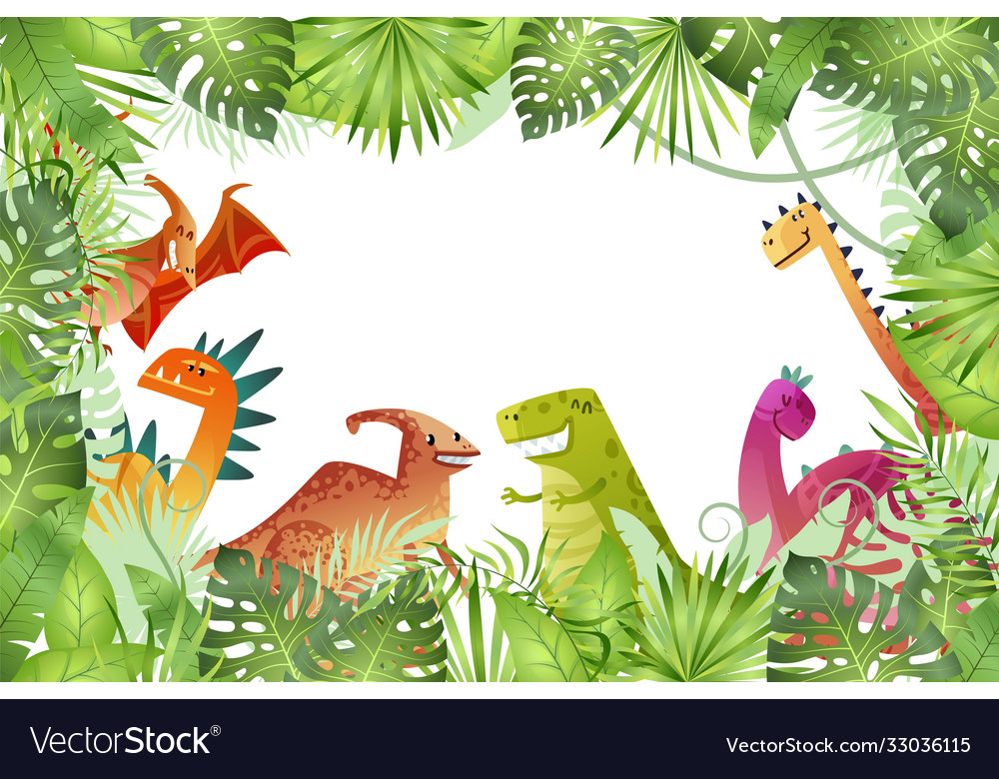




LUCKY
WHEEL
3
2
1
2
3
4
1
5
8
4
5
6
6
7
7
8
9
NEXT
SPIN
Notes:
Click on spin to spin the wheel
Click on the wheel to stop
Groups will take turns to choose a question and answer

Slide 11






What does a vet do?
A. take care of animals.
B. play the violin.
C. run a machine.
D. teach the students.
BACK

Slide 12

What does he do?
A. He’s a teacher.
B. He’s a firefighter.
C. He’s a doctor.
D. He’s a vet.
BACK

Slide 13
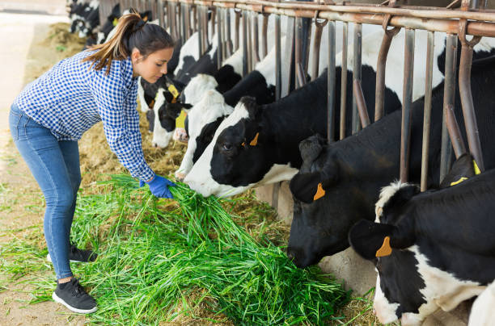
3. What does a farmer do?
A. He feeds animals.
B. He writes the song.
C. He goes to school.
D. He takes care of people.
BACK

Slide 14
4. What does a firefighter do?
A. He drives a car.
B. He cooks food.
C. He puts out fire.
D. He takes photos.
BACK

Slide 15
5. What does your sister do?
A. She’s a driver.
B. She’s a teacher.
C. She’s a nurse.
D. She’s a guard.
BACK

Slide 16
6. Where does your father work?
A. He works in a park.
B. He works in a laboratory.
C. He works in a factory.
D. He works in a restaurant.
BACK

Slide 17
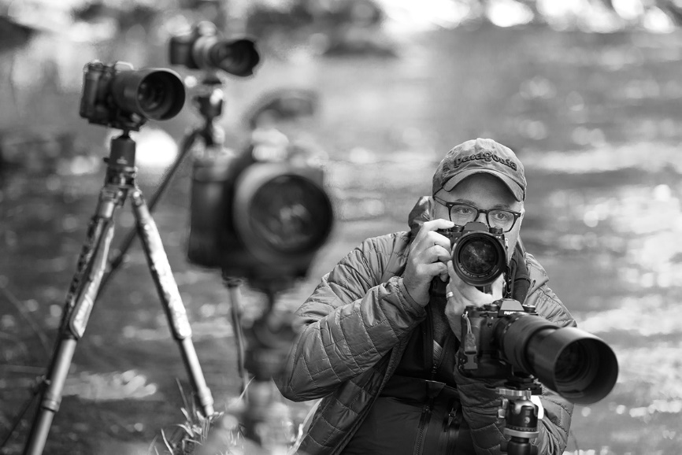
7. What does he do?
A. He’s a vet.
B. He’s a photographer.
C. He’s a worker.
D. He’s a teacher.
BACK

Slide 18

8. What does a doctor do?
A. He takes care of people.
B. He takes care of flowers.
C. He takes care of animals.
D. He takes care of the trees.
BACK

Slide 19

9. Does a builder build the house?
A. Yes, he does.
B. No, he doesn’t.
BACK

Slide 20
5. ASSESSMENT

Slide 21
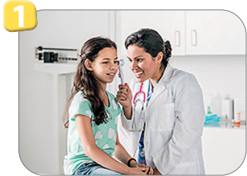
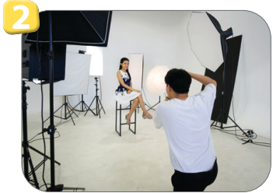
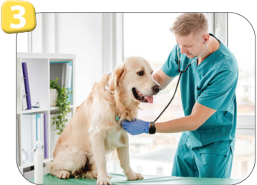
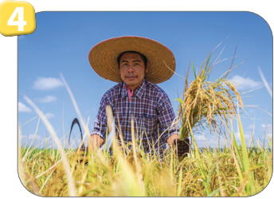

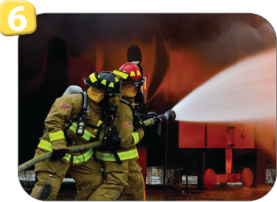
Look and write.
She takes care of people: _____
He works in a studio: ___________
He takes care of animals: ____
doctor
photographer
vet
He feeds animals: _____
She helps students: ______
He puts out fires: _________
farmer
teacher
firefighter

Slide 22
UNIT 7: JOBS
LESSON 3: PERIOD 1
What we learnt today:
Vocabulary:
1. firefighter
2. feed animals
3. put out fires
4. take care of people

Slide 23




Thank you & goodbye!

