Slide 1

Unit 1: SCHOOL
Lesson 1.1
Page 6

Slide 2
Objectives
By the end of this lesson, students will be able to point out and say different school subjects and get to know asking and answering about the subject they like.
Vocabulary: geography, history, science, I.T., Vietnamese, ethics.
Structure: Which subject do you like? - I like science.
Which subject does he like? - He likes English.

Slide 3

WARM-UP

Slide 4


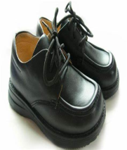














Click on SPIN and STOP.
Answer the questions.

Slide 5



WHAT IS IT?

Slide 6
WHAT IS IT?

Slide 7
WHAT IS IT?

Slide 8
WHAT IS IT?

Slide 9
WHAT IS IT?

Slide 10
WHAT IS IT?

Slide 11

New words
geography,
history,
science,
I.T.,
Vietnamese,
ethics.

Slide 12

Presentation

Slide 13

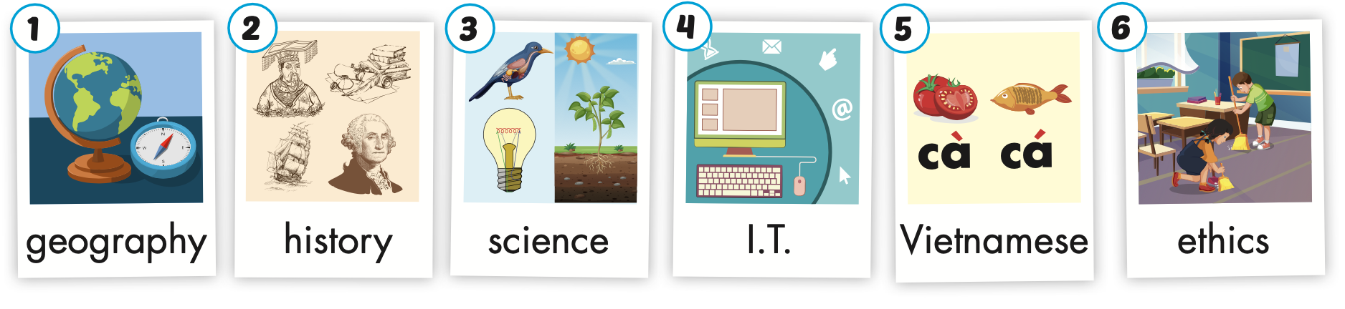
Click on the picture to hear the sound.
/ˈhɪstri/
môn Lịch sử
/ˌaɪ ˈtiː/
môn Tin học
/ˈeθɪks/
môn Đạo đức
/dʒiˈɑːɡrəfi/
môn Địa lí
/ˈsaɪəns/
môn Khoa học
/ˌviːetnəˈmiːz/
môn Tiếng Việt
Notes:
Click vào hình A. 1. Listen and point. Repeat để cho cả audio full chạy

Slide 14


Click on the picture to hear the sound.
geography
/dʒiˈɑːɡrəfi/
môn Địa lí

Slide 15
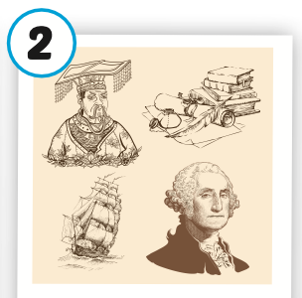
Click on the picture to hear the sound.
history
/ˈhɪstri/
môn Lịch sử

Slide 16
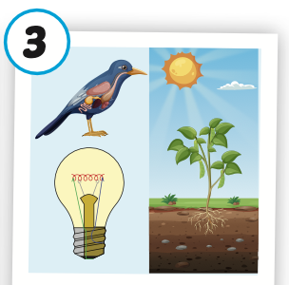
Click on the picture to hear the sound.
science
/ˈsaɪəns/
môn khoa học

Slide 17

Click on the picture to hear the sound.
I.T.
/ˌaɪ ˈtiː/
môn Tin học

Slide 18
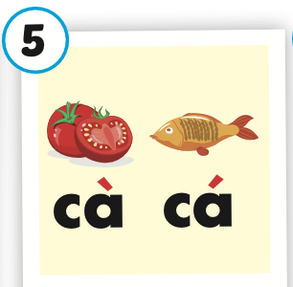
Click on the picture to hear the sound.
Vietnamese
/ˌviːetnəˈmiːz/
môn Tiếng Việt

Slide 19
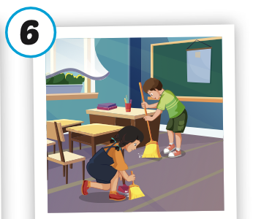
Click on the picture to hear the sound.
ethics
/ˈeθɪks/
môn Đạo đức

Slide 20
Practice

Slide 21
Structure
Which subject do you like?
- I like science.
Which subject does he like?
- He likes English.

Slide 22

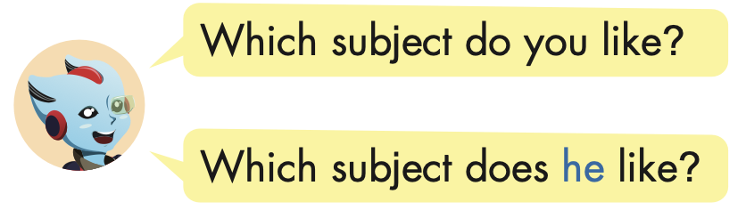
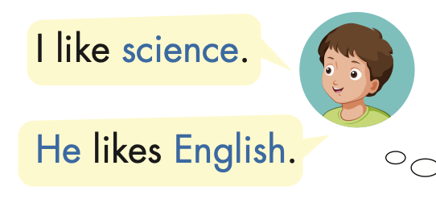
Structure

Slide 23

Practice

Slide 24


Slide 25


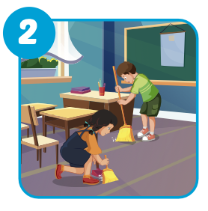
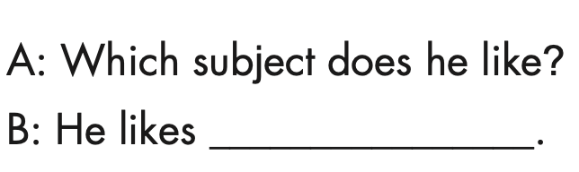
ethics

Slide 26
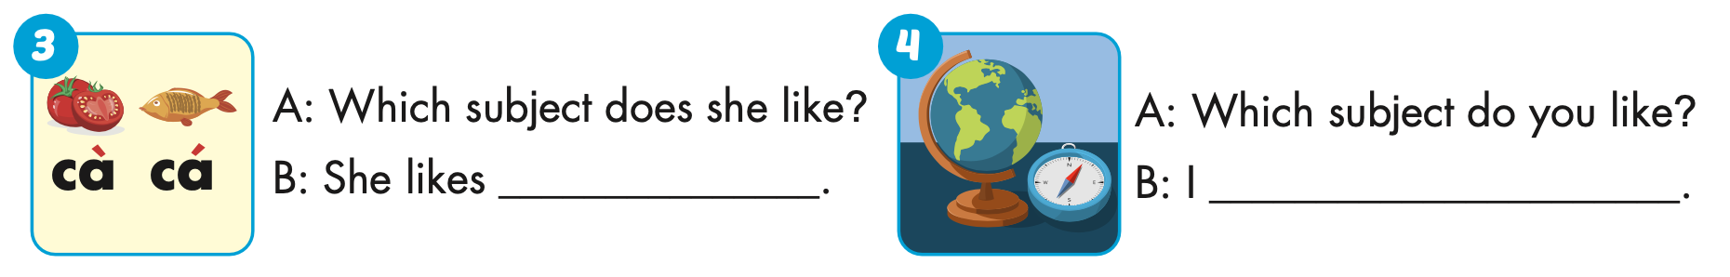
Vietnamese
like geography

Slide 27
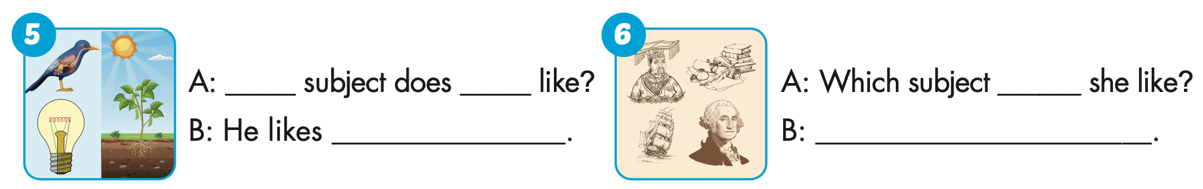
Which
he
science
does
She likes history

Slide 28

Production

Slide 29
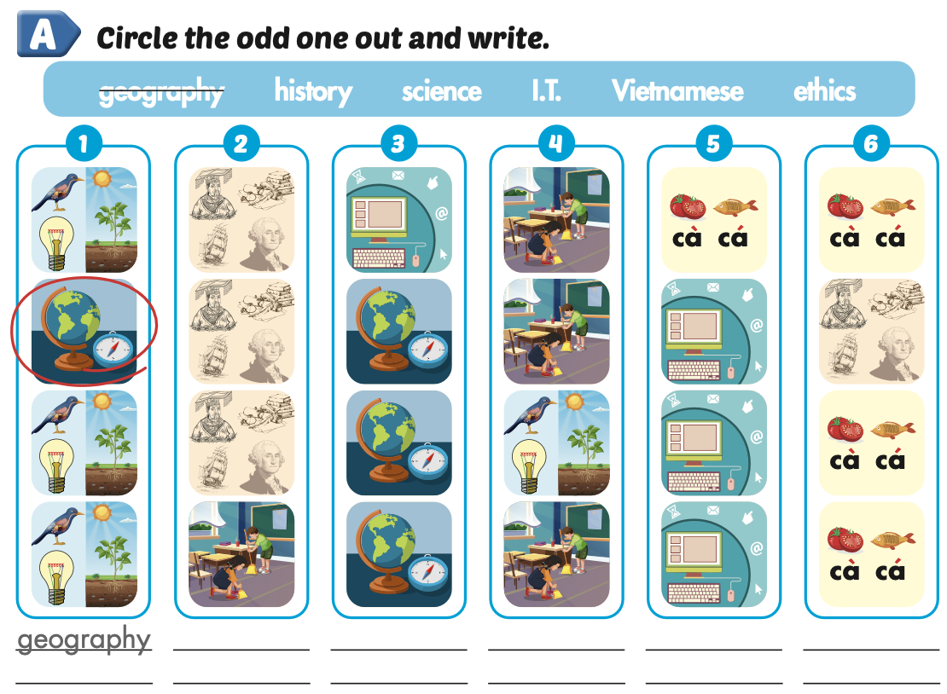
Extra Practice
WB, page 2
ethics
I.T.
science
history
Vietnamese

Slide 30

CONSOLIDATION

Slide 31

WRAP-UP

Slide 32
Today’s lesson
Vocabularies
geography, history, science, I.T., Vietnamese, ethics.
Structures/ Sentence patterns
Which subject do you like?
- I like science.
Which subject does he like?
- He likes English.

Slide 33
Homework
Practice the vocabularies and structure, and make sentences using them.
Do the exercises in Tiếng Anh 5 i-Learn Smart Start WB (page 2).
Do the exercises in Tiếng Anh 5 i-Learn Smart Start Notebook.
Prepare the next lesson (page 7 SB).
Play the consolidation games in Tiếng Anh 5 i-Learn Smart Start DHA App on www.eduhome.com.vn

Slide 34

Enjoy your day!

Slide 35

Lesson 3
Stay positive and have a nice day!

