Slide 1

Unit 3: School
Lesson 2.1
Page 41

Slide 2
Objectives
By the end of this lesson, students will be able to identify 5 school subjects and use them in questions, using the target language.
Vocabulary: math, English, art, P.E. (physical education), music
Structure: Do you like math?
- Yes, I do./No, I don't.

Slide 3

LET’S PLAY!
Stop the bus
letters | animals | school things | family members
Notes:
Put the students into teams of four.
Draw on the board a table like the one above and get each team to copy it onto a piece of paper.
Students simply have to think of one item to go in each category beginning with the set letter.
Give an example line of answers for the first time you play with a new group.
The first team to finish shouts 'Stop the Bus!'.
Check their answers and write them up on the board and if they are all okay that team wins a point. If there are any mistakes in their words, let the game continue for another few minutes.

Slide 4

New words
math
English
P.E. (physical education)
art
music

Slide 5


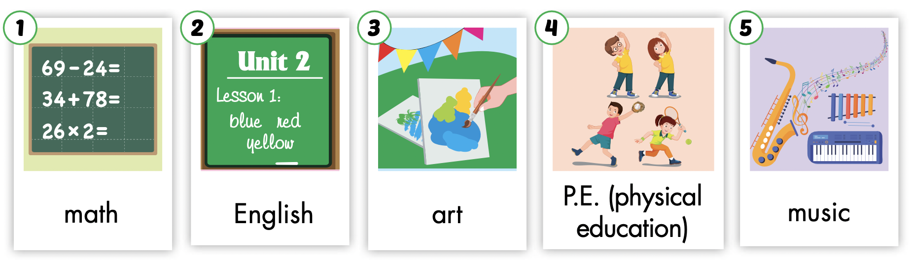

Listen and point.
Click the icons to hear the sound.

Slide 6
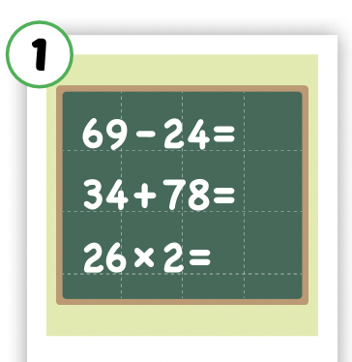
Listen and repeat.
Click each picture to hear the sound.
math
/mæθ/
môn toán

Slide 7

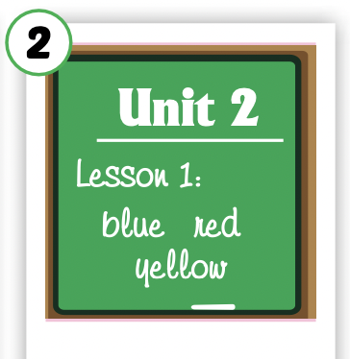
Listen and repeat.
Click each picture to hear the sound.
English
/ˈɪŋɡlɪʃ/
môn tiếng Anh

Slide 8
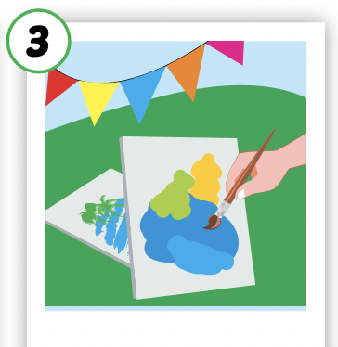
Listen and repeat.
Click each picture to hear the sound.
art
/ɑːrt/
môn mỹ thuật

Slide 9
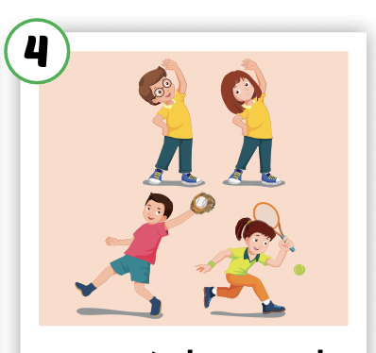
Listen and repeat.
Click each picture to hear the sound.
P.E.
(physical education)
/ˌpiː ˈiː/
môn thể dục

Slide 10
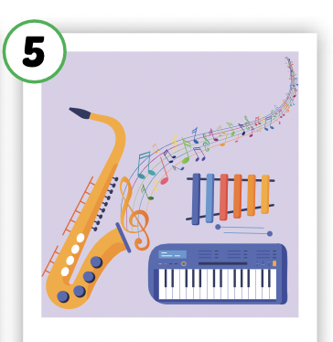
Listen and repeat.
Click each picture to hear the sound.
music
/ˈmjuːzɪk/
môn âm nhạc

Slide 11

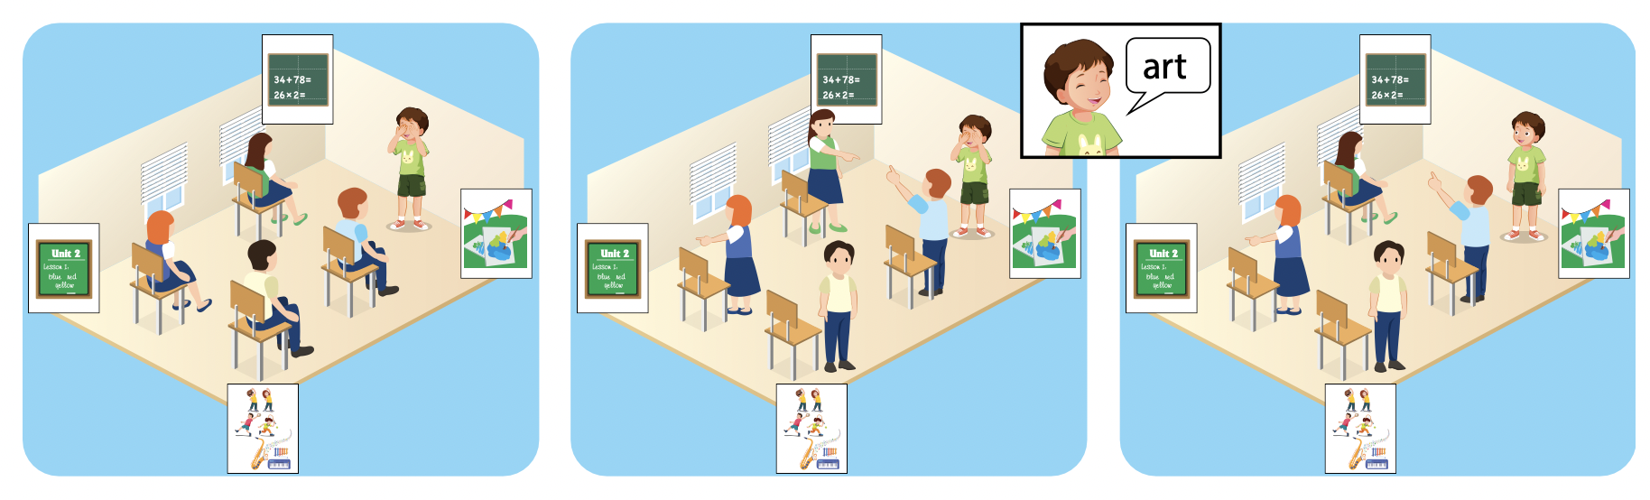

Slide 12
Let’s play!

Slide 13
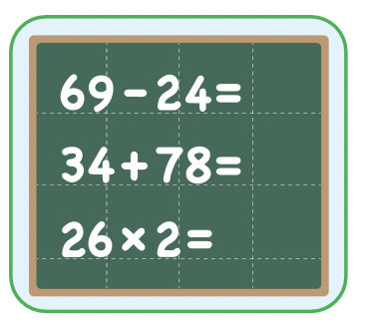
math
SHOW

Slide 14
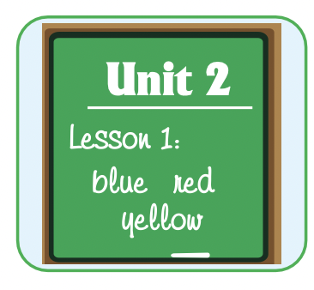
English
SHOW

Slide 15
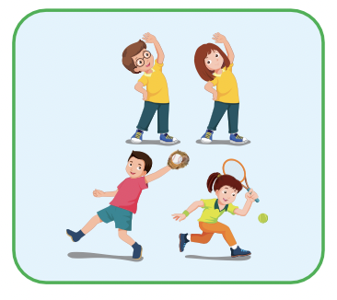
P.E.
SHOW

Slide 16
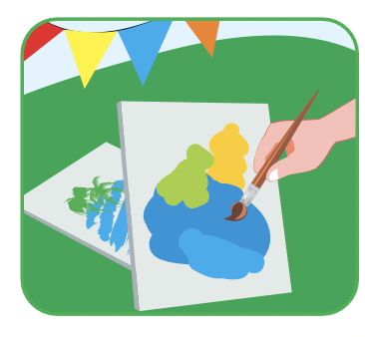
art
SHOW

Slide 17
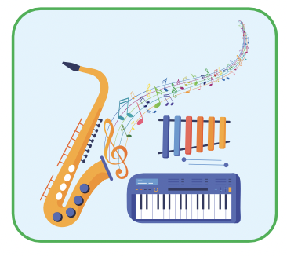
music
SHOW

Slide 18
math
SHOW

Slide 19
English
SHOW

Slide 20
P.E.
SHOW

Slide 21
art
SHOW

Slide 22
music
SHOW

Slide 23
Structures
Do you like math?
Yes, I do./No, I don’t.

Slide 24

Presentation

Slide 25

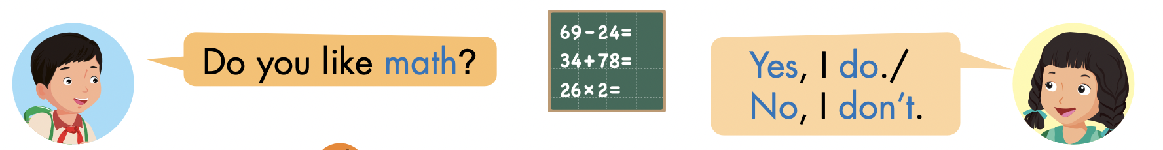
Click the icon to hear the sound.

Slide 26

Practice

Slide 27
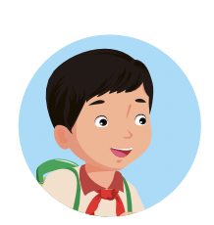
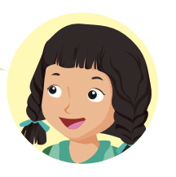
LET’S PRACTICE!
Do you like…………?
No, I don’t.
Yes, I do.
Yes, I do.
No, I don’t.
Yes, I do.

Slide 28

Production

Slide 29

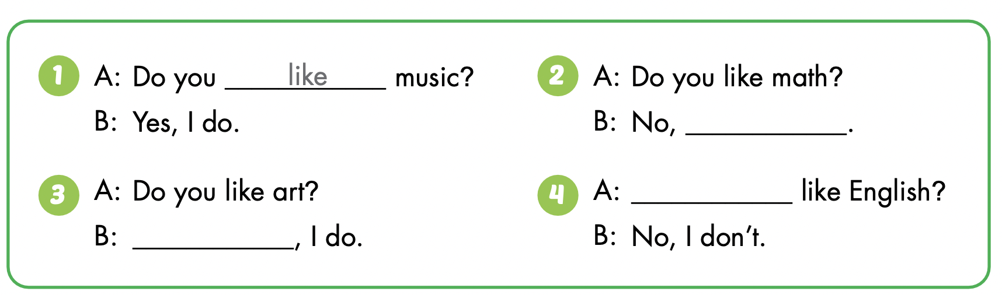

Slide 30
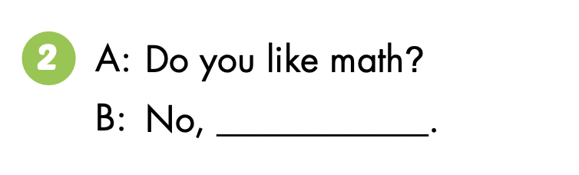
I don’t

Slide 31
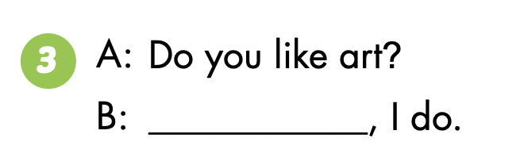
Yes

Slide 32
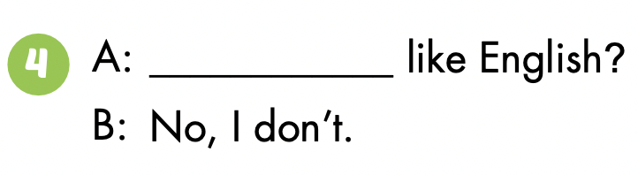
Do you

Slide 33

CONSOLIDATION

Slide 34

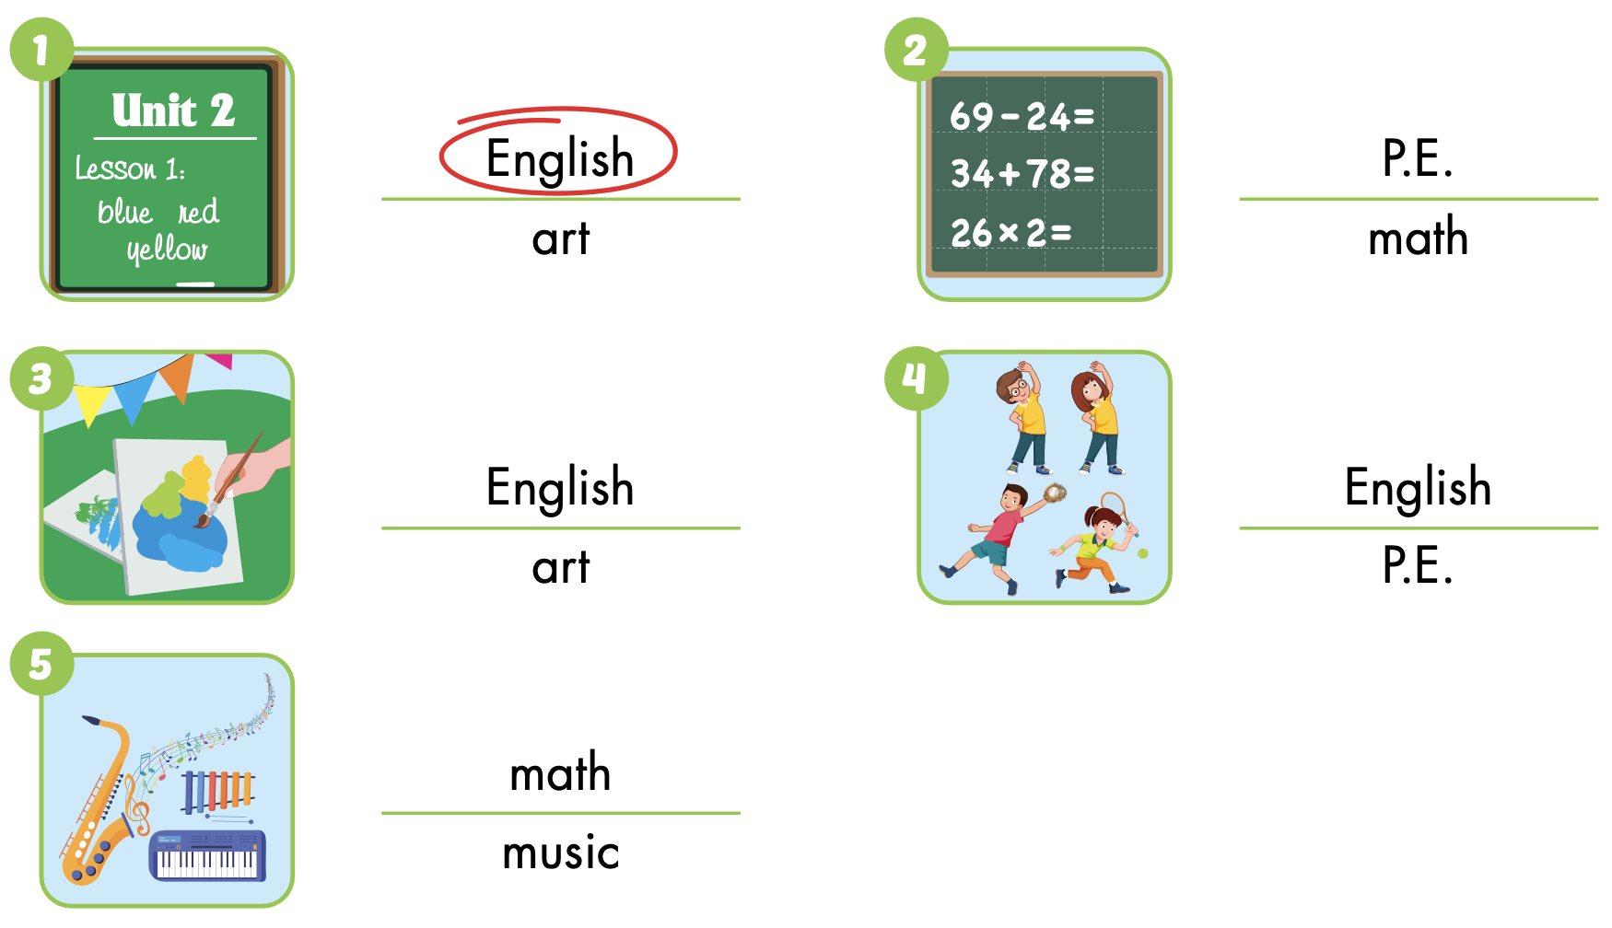
Extra Practice
WB p. 30

Slide 35

WRAP-UP

Slide 36
Today’s lesson
Vocabularies
math, English, art,
P.E. (physical education), music
Structures/ Sentence patterns
Do you like math?
- Yes, I do./No, I don't.

Slide 37
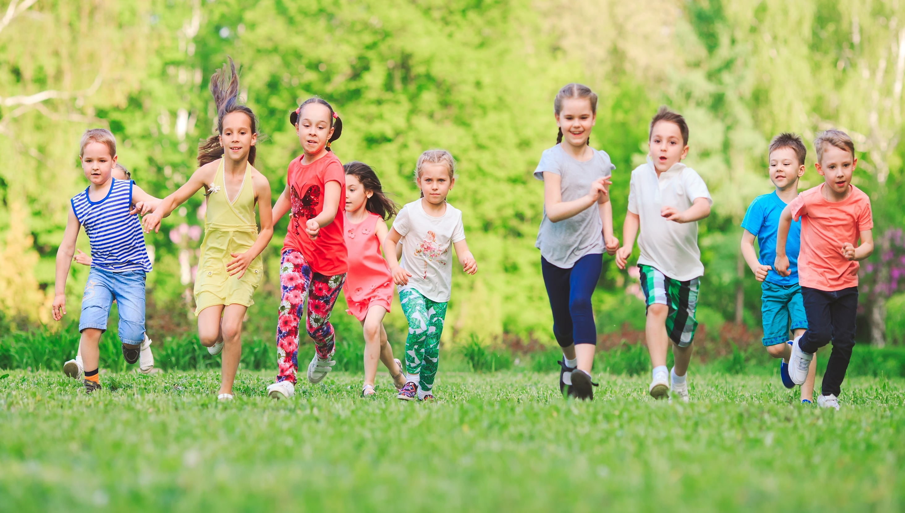
Have a nice day!

