Slide 1
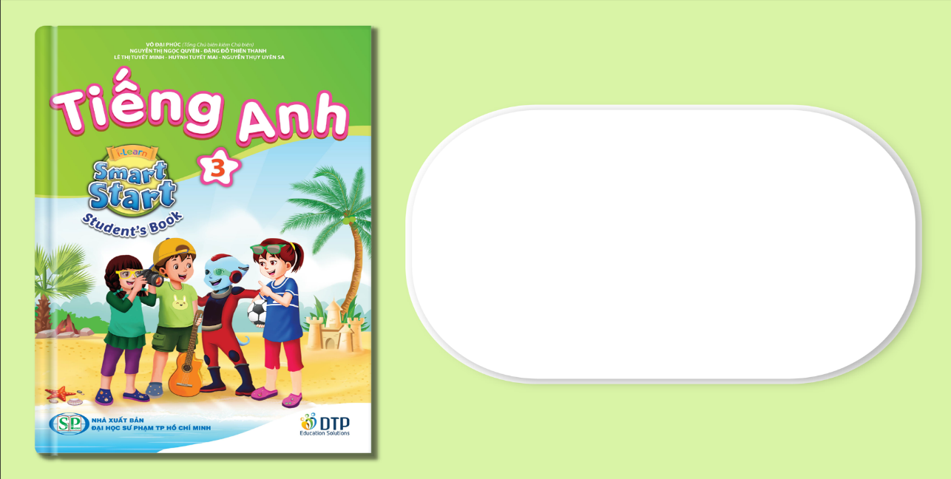
Unit 7: Toys
Lesson 2.1
Page 99

Slide 2
Objectives
By the end of this lesson, students will be able to…
Vocabulary: Pronounce and use the words related to the topic properly: card, block, dice, marble
Structure: Ask about the quantity of certain items that someone has by using:
How many marbles do you have?
I have five marbles.

Slide 3

New words
card,
block,
dice,
marble

Slide 4
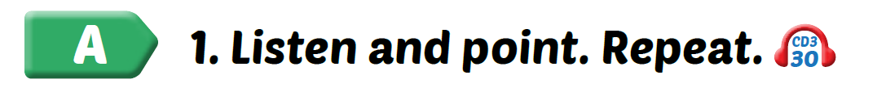
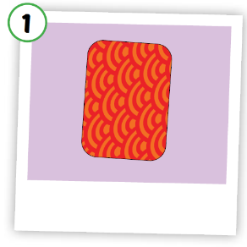
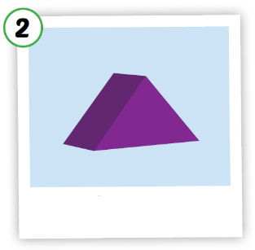
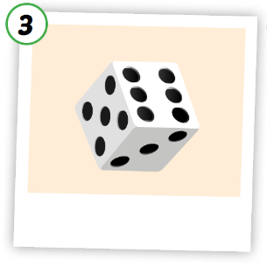





Click A to hear the sound
Notes:
Click vào hình A. 1. Listen and point. Repeat để cho cả audio full chạy

Slide 5


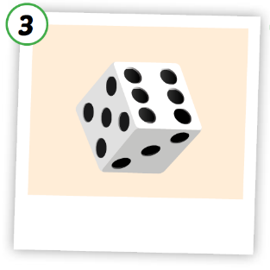
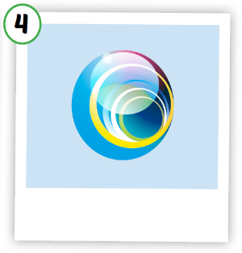
Click on each picture to hear the sound.
/kɑːrd/
tấm thẻ
/blɑːk/
đồ chơi hình khối
/daɪs/
viên xúc xắc
/ˈmɑːrbl/
viên bi
Notes:
Click vào hình A. 1. Listen and point. Repeat để cho cả audio full chạy

Slide 6
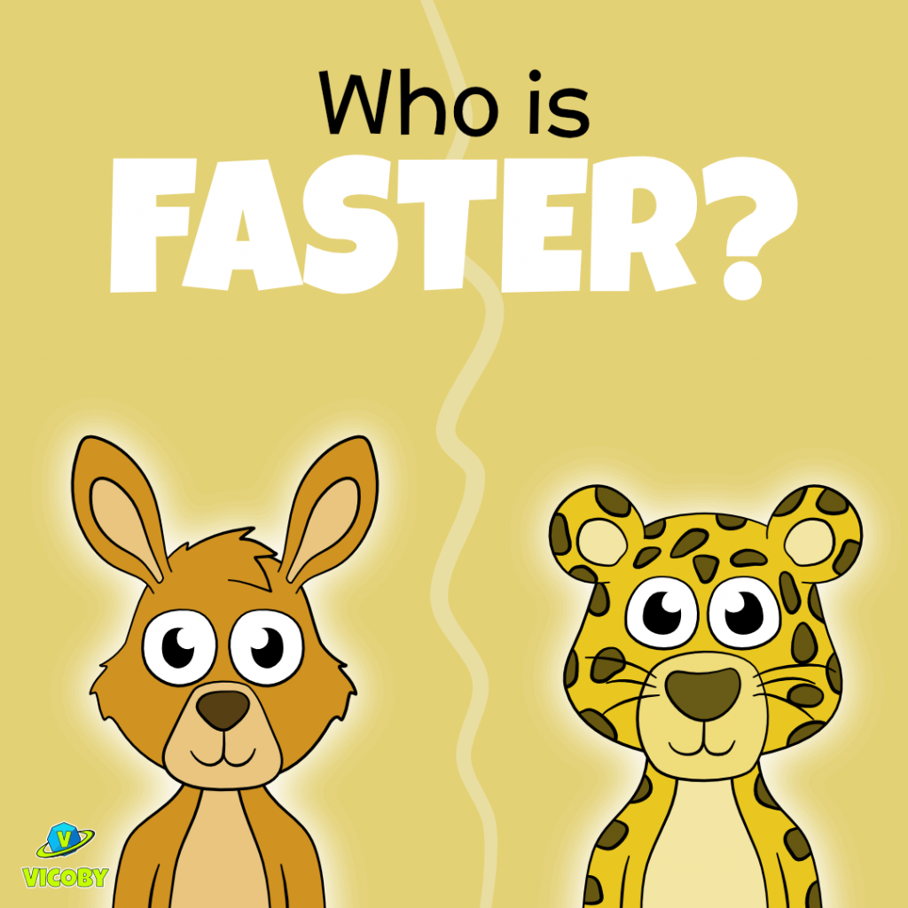
GAME

Slide 7


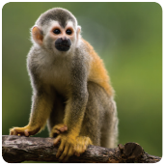
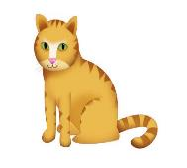
Matching Rocket
PLAY
Monkey
Notes:
Ms Huyền Phạm - 0936.082.789 – YOUTUBE: MsPham. Facebook: Dạy và học cùng công nghệ.

Slide 8

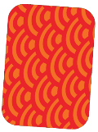


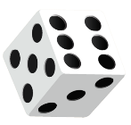




A
B
C
D
marble
Notes:
Ms Huyền Phạm - 0936.082.789 – YOUTUBE: MsPham. Facebook: Dạy và học cùng công nghệ.

Slide 9

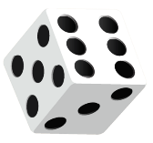

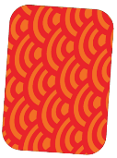


A
B
C
D
card
Notes:
Ms Huyền Phạm - 0936.082.789 – YOUTUBE: MsPham. Facebook: Dạy và học cùng công nghệ.

Slide 10
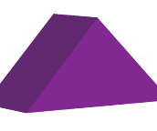
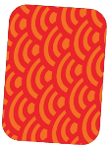
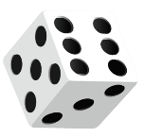


A
B
C
D
block
Notes:
Ms Huyền Phạm - 0936.082.789 – YOUTUBE: MsPham. Facebook: Dạy và học cùng công nghệ.

Slide 11
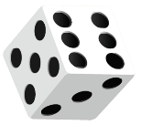

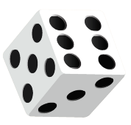
A
B
C
D
dice
Notes:
Ms Huyền Phạm - 0936.082.789 – YOUTUBE: MsPham. Facebook: Dạy và học cùng công nghệ.

Slide 12
Structures
How many marbles do you have?
- I have five marbles.

Slide 13
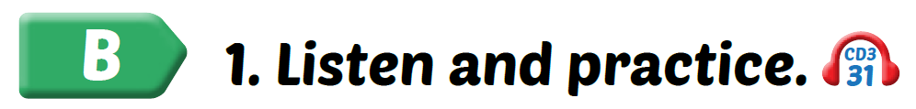

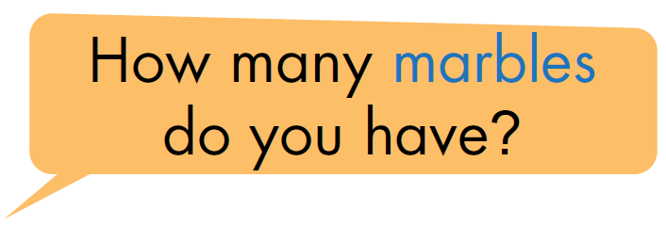

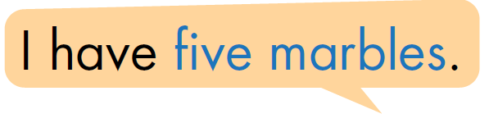
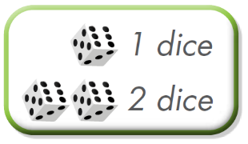

Click on each sentence to listen

Slide 14
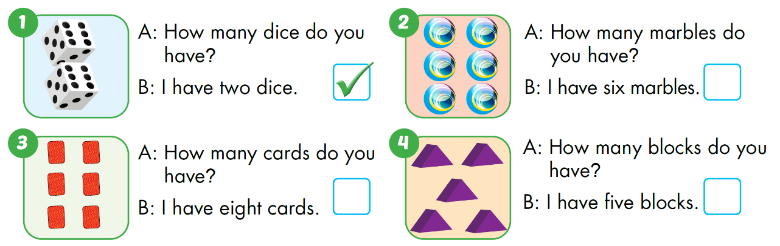






Slide 15
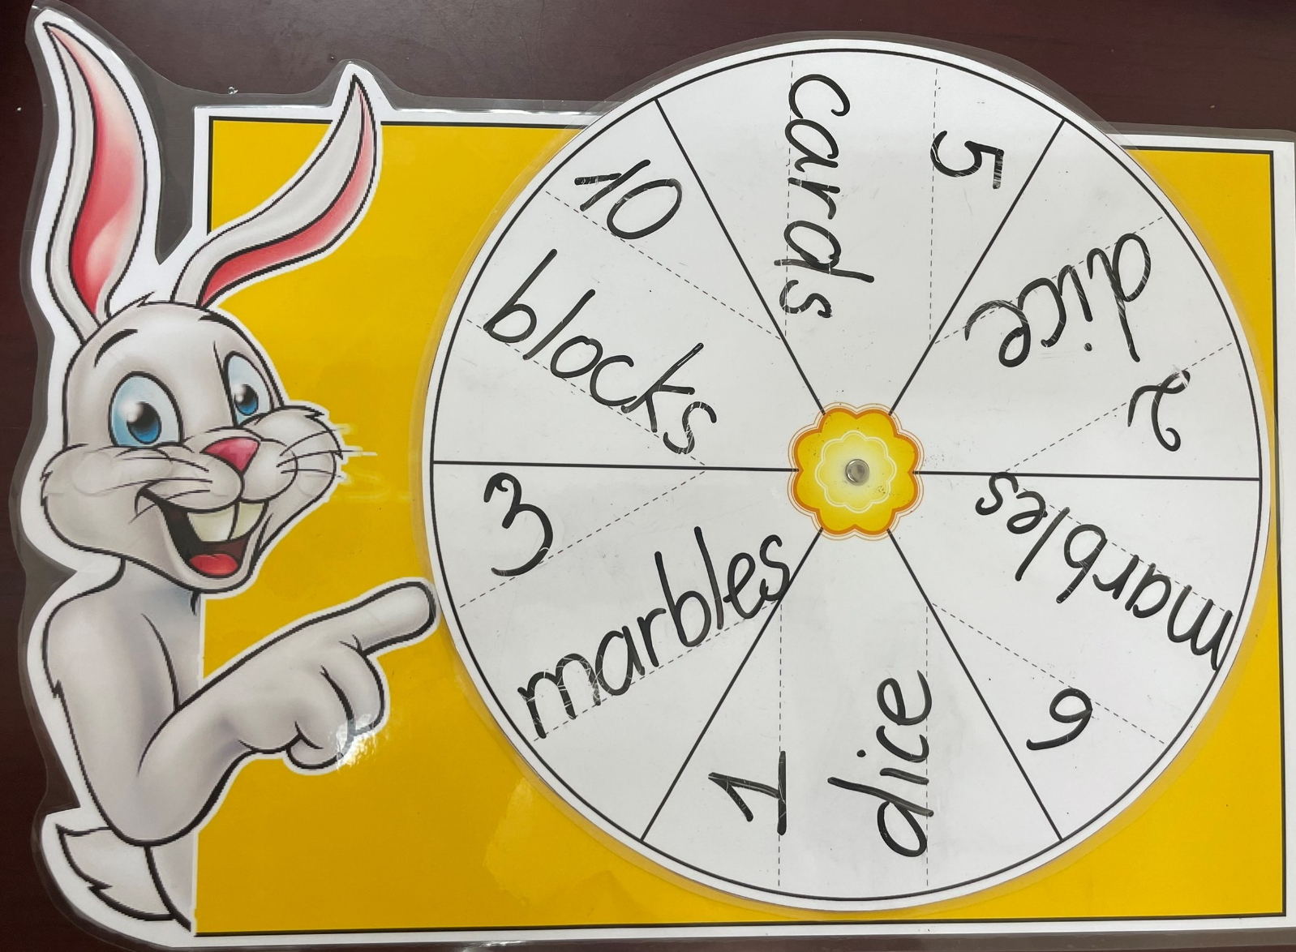
LET’S PRACTICE

Slide 16

PRACTICE SPEAKING
Look at the picture and make sentences.
How many _________ do you have?
marbles
I have ________ marbles.
six

Slide 17
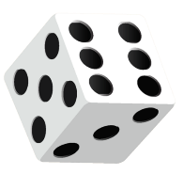
Look at the picture and make sentences.
How many ____________________?
dice do you have
I have _________________.
two dice

Slide 18
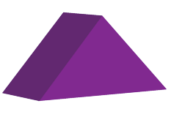
Look at the picture and make sentences.
_________________________?
How many blocks do you have
_______________________.
I have ten blocks.

Slide 19
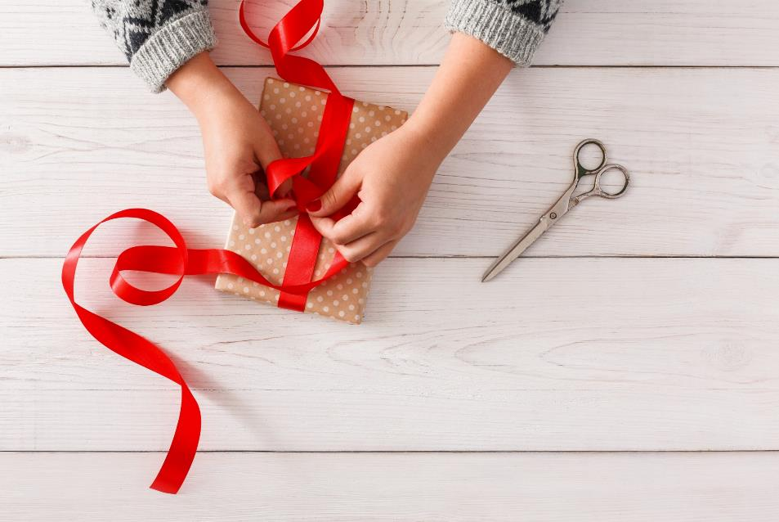
WRAP-UP

Slide 20
Today’s lesson
Vocabularies
card, block, dice, marble
Structures/ Sentence patterns
How many marbles do you have?
I have five marbles.

Slide 21
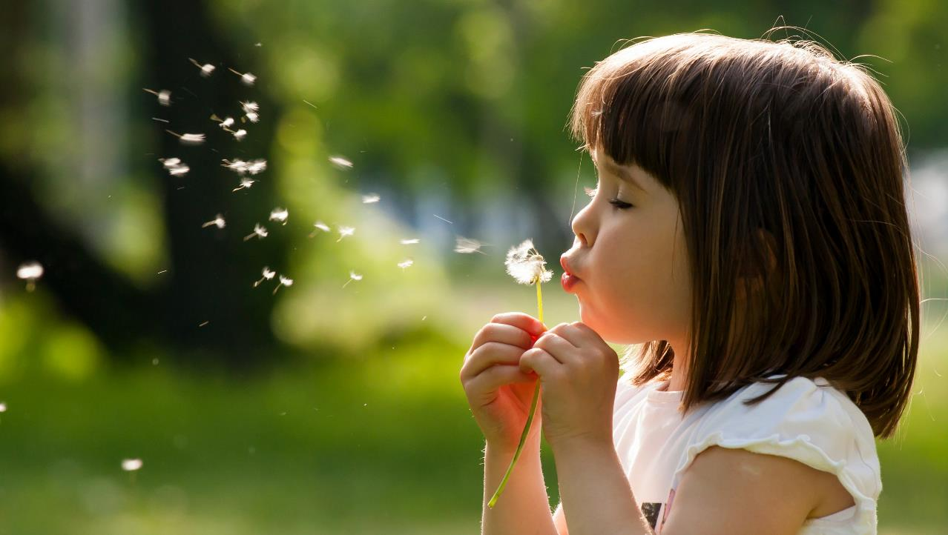
THANK YOU

