Slide 1

Unit 7: MY FAMILY
Lesson 1.1
Page 92

Slide 2

Lesson Outline
Warm-up
Vocabulary
Structure
Consolidation
Wrap-up

Slide 3
Objectives
By the end of this lesson, students will be able to talk about what job their family members do.
Vocabulary: cashier, doctor, office worker, factory worker, farmer, waiter.
Structure: What does your father do?
He's a doctor.
What does your mother do?
She's an office worker.

Slide 4

WARM UP

Slide 5
Talk about what your family members look like.
Pair work:
Students take turns to talk what their family members look like.
E.g. My grandfather is handsome and old.
My brother is tall and cute.
My sister has long, blond hair.

Slide 6

It’s time to learn …

Slide 7

New words
cashier,
doctor,
office worker, factory worker, farmer,
waiter.

Slide 8

Presentation

Slide 9


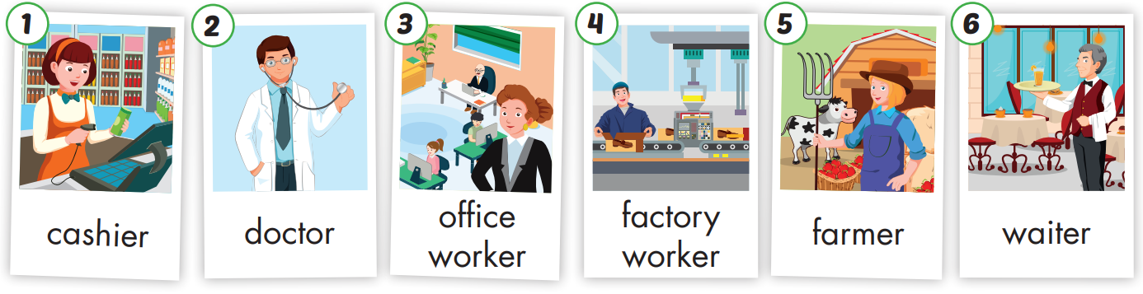

Slide 10

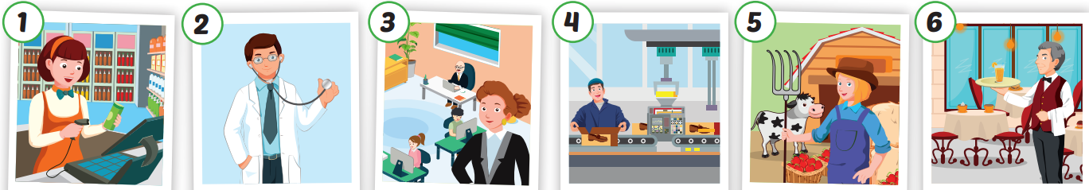
Click each English word to hear the sound.
cashier
doctor
office worker
factory worker
farmer
waiter
/kæˈʃɪr/
Thu ngân
/ˈdɑːktər/
Bác sĩ
Nhân viên văn phòng
Công nhân nhà máy
/ˈfɑːrmər/
Nông dân
/ˈweɪtər/
Nhân viên phục vụ bàn

Slide 11
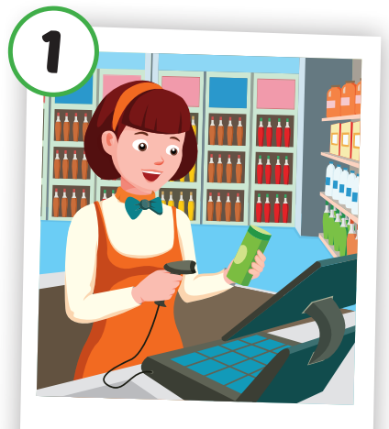
Click each English word to hear the sound.
cashier
/kæˈʃɪr/
Thu ngân

Slide 12
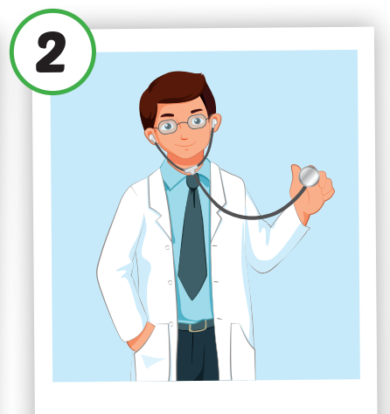
Click each English word to hear the sound.
doctor
/ˈdɑːktər/
Bác sĩ

Slide 13
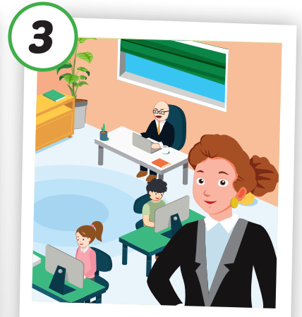
Click each English word to hear the sound.
office worker
Nhân viên văn phòng

Slide 14
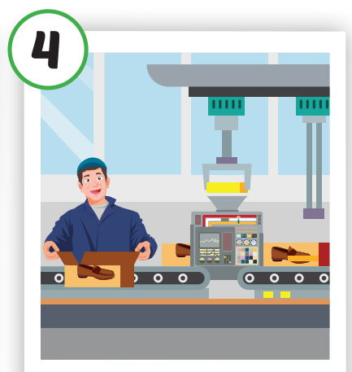
Click each English word to hear the sound.
factory worker
Công nhân nhà máy

Slide 15
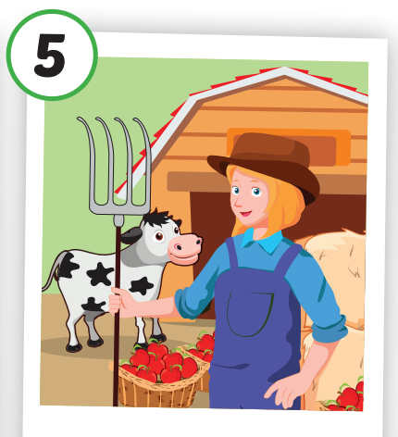
/ˈfɑːrmər/
Nông dân
Click each English word to hear the sound.
farmer
/ˈfɑːrmər/
Nông dân

Slide 16
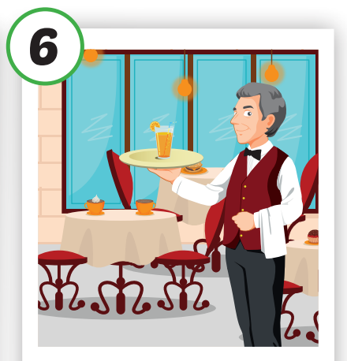
/ˈfɑːrmər/
Nông dân
Click each English word to hear the sound.
waiter
/ˈweɪtər/
Nhân viên phục vụ bàn

Slide 17

Practice

Slide 18

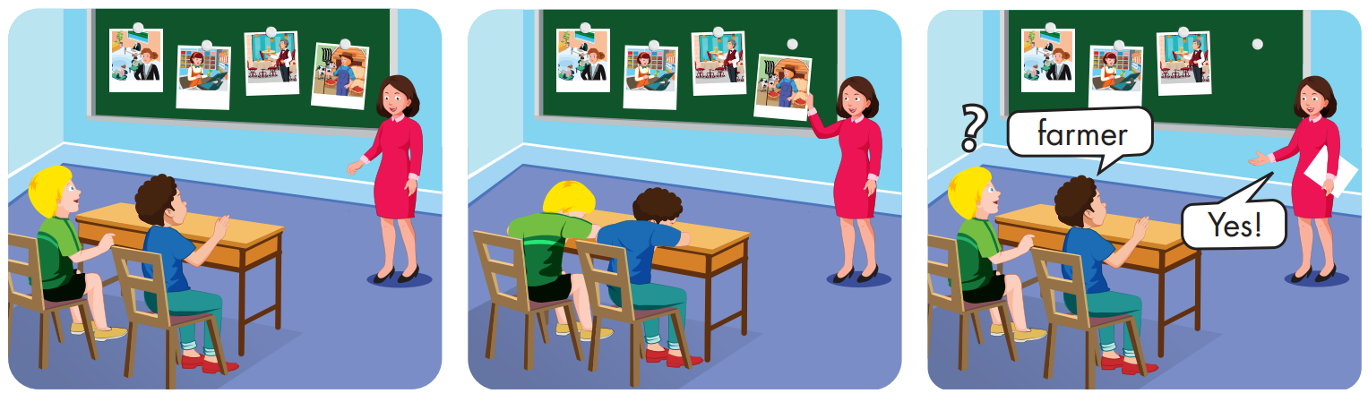

Slide 19
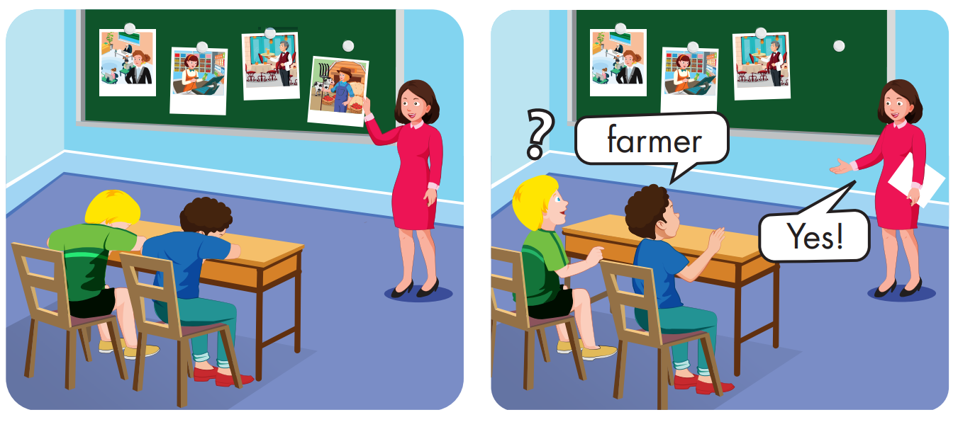
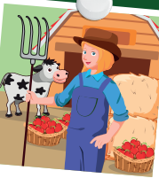

cashier

Slide 20
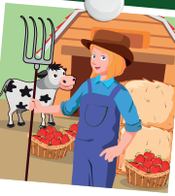

office
worker

Slide 21
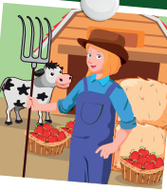
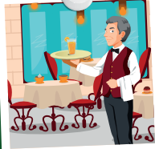
waiter

Slide 22
Structures:
What does your father do?
He's a doctor.
What does your mother do?
She's an office worker.

Slide 23
Presentation

Slide 24


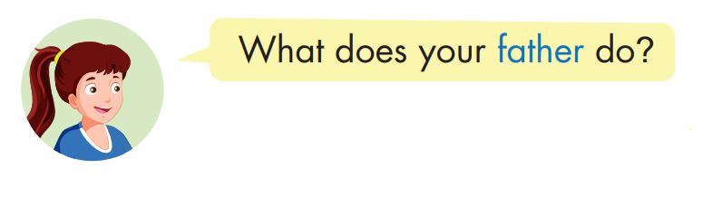

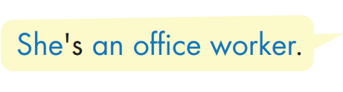
Click each English word to hear the sound.

Slide 25

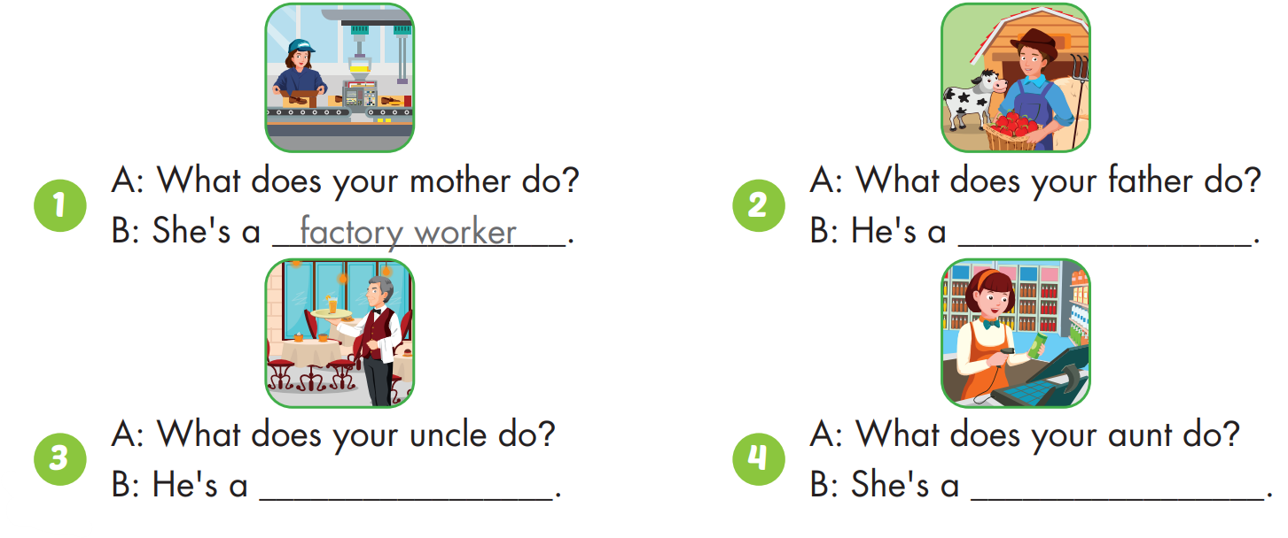
farmer
waiter
cashier

Slide 26

Practice

Slide 27

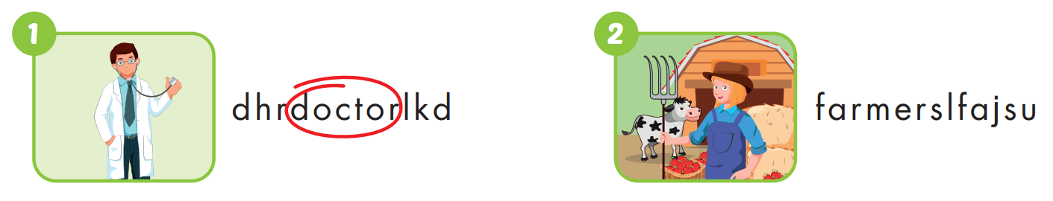

Slide 28


Slide 29
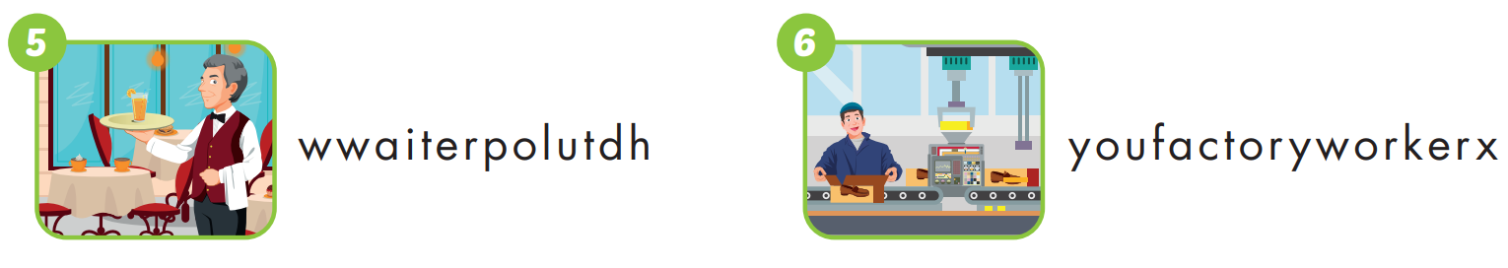

Slide 30

CONSOLIDATION

Slide 31

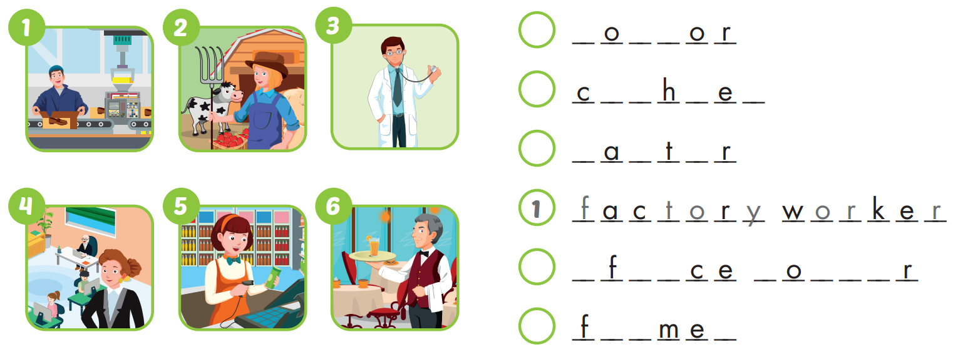
3
d
c
t
5
a
s
i
r
6
w
i
e
4
o
f
i
w
r
k
e
2
a
r
r

Slide 32

WRAP-UP

Slide 33
Lesson 3
Today’s lesson
Vocabularies
cashier, doctor, office worker, factory worker, farmer, waiter.
Structures/ Sentence patterns
What does your father do?
He's a doctor.
What does your mother do?
She's an office worker.

Slide 34
Lesson 3
Homework
Practice the vocabularies and structure; and make sentences using them.
Do the exercises in Tiếng Anh 4 i-Learn Smart Start WB (page 62)
Do the exercises in Tiếng Anh 4 i-Learn Smart Start Notebook (page 40)
Prepare the next lesson (page 93 SB)
Play the consolidation games in Tiếng Anh 4 i-Learn Smart Start DHA App on www.eduhome.com.vn

Slide 35

Have a nice day!

