Slide 1

Unit 4: Travel
Lesson 4.3
Page 59

Slide 2
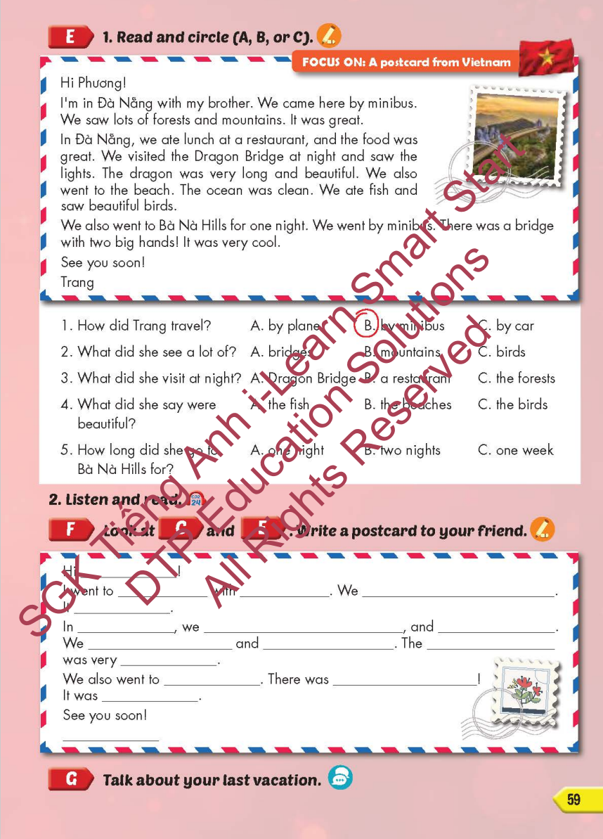
Lesson Outline
Warm-up
Practice
Speaking
Consolidation
Wrap-up

Slide 3
Objectives
By the end of this lesson, students will be able to…
Reading: a postcard from Vietnam.
Writing: complete a postcard
Speaking: Talk about their last vacation.

Slide 4

WARM-UP

Slide 5




LẮP RÁP TÊN LỬA
PLAY
Monkey

Slide 6







A
B
C
D
China

Slide 7




A
B
C
D
Cambodia

Slide 8




A
B
C
D
Laos

Slide 9



A
B
C
D
Thailand

Slide 10



A
B
C
D
Singapore

Slide 11

A
B
C
D
Indonesia

Slide 12

It’s time to learn …

Slide 13

Practice

Slide 14

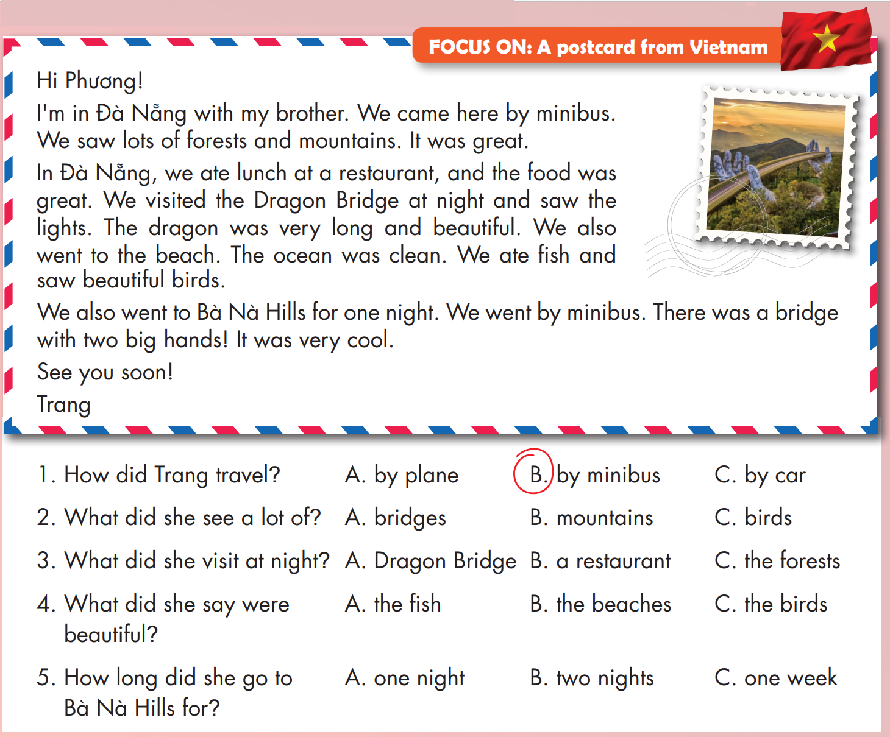

Slide 15
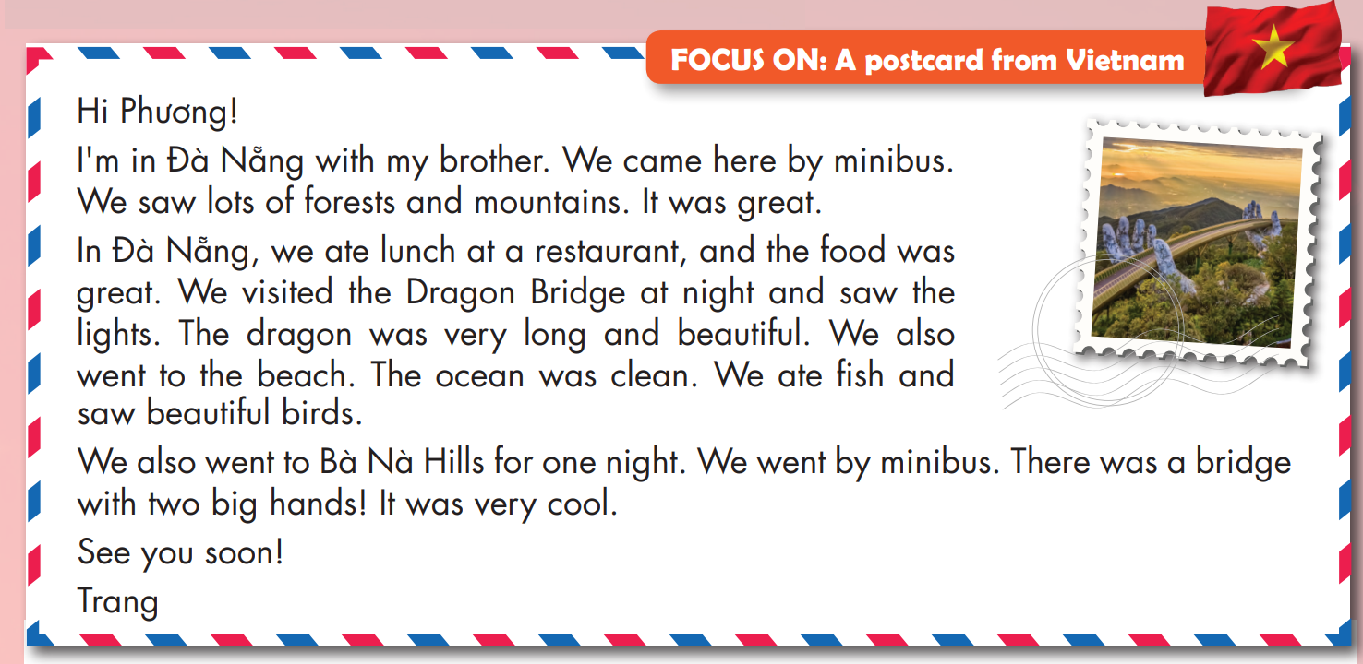

Slide 16
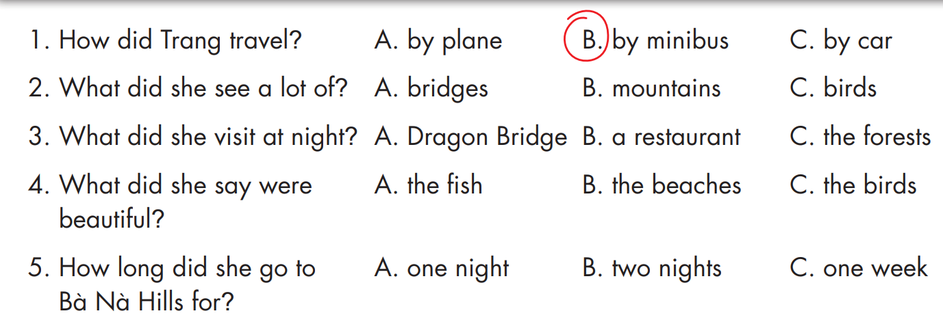


Slide 17


Slide 18

Production

Slide 19
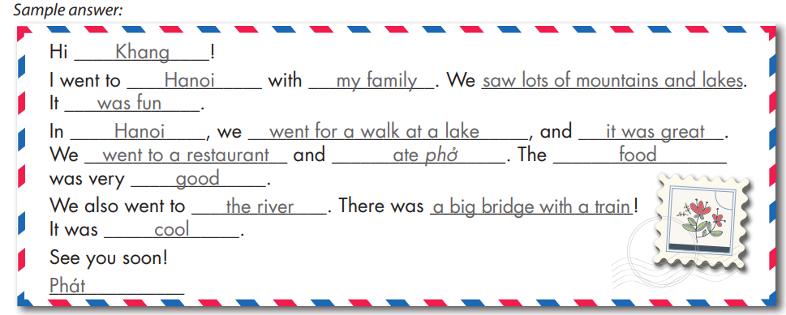
1. What's your friend's name?
2. Where did you go?
3. Who did you go with?
4. What did you do there?

Slide 20
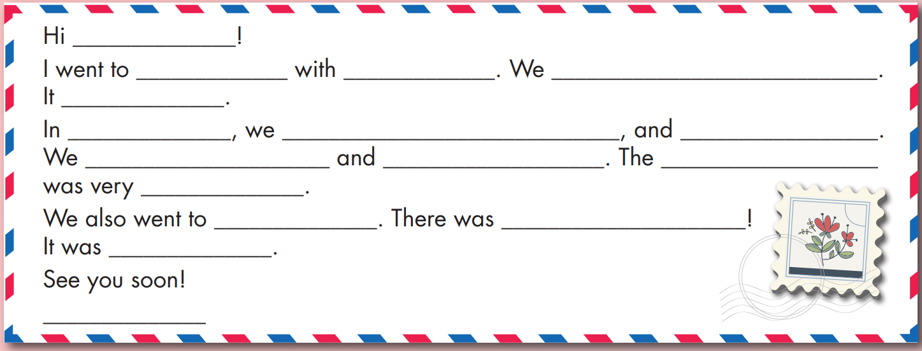

Slide 21


Slide 22

CONSOLIDATION

Slide 23

Extra Practice
WB, page 39
1. What's your friend's name?
2. Where did you go?
3. How did you get there?
4. What did you do there?
Sample writing:
Hi Ly!
My family went to Thailand. We went by plane. We went to the beach and swam in the ocean. It was beautiful. We also ate lots of delicious food. I'm having a great time.
See you soon.
My

Slide 24
Extra Practice
WB, page 39

Slide 25

WRAP-UP

Slide 26
Today’s lesson
Speaking
Ask and answer about which country they went to and what they did there correctly.
Structures/ Sentence patterns
I went to Laos last month.
- What did you do there?
- I watched a soccer game.

Slide 27
Homework
Practice the vocabularies and structure, and make sentences using them.
Do the exercises in Tiếng Anh 5 i-Learn Smart Start WB (page 19)
Do the exercises in Tiếng Anh 5 i-Learn Smart Start Notebook (page 25)
Prepare the next lesson (page 32 SB)
Play the consolidation games in Tiếng Anh 5 i-Learn Smart Start DHA App on www.eduhome.com.vn

Slide 28

Enjoy your day!

Slide 29

Lesson 3
Stay positive and have a nice day!

