Slide 1

Unit 4: Travel
Lesson 2.3
Page 53

Slide 2
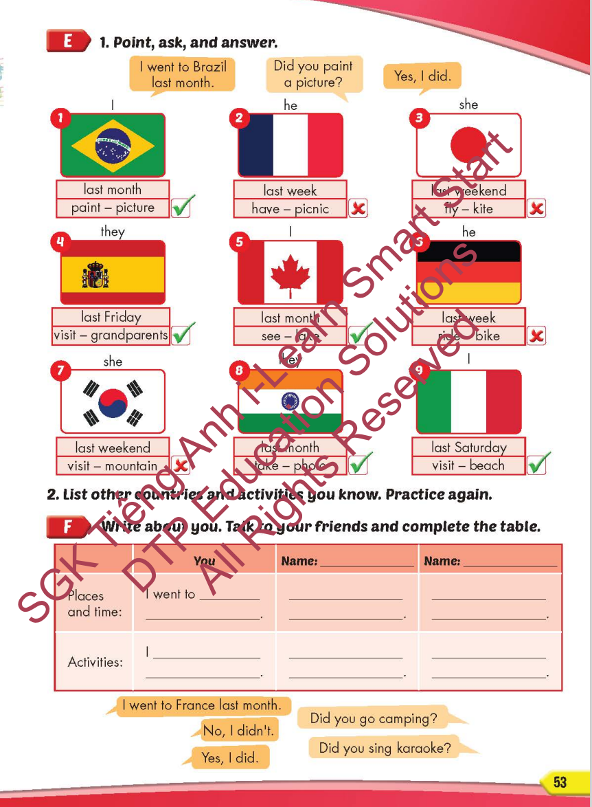
Lesson Outline
Warm-up
Practice
Speaking
Consolidation
Wrap-up

Slide 3
Objectives
By the end of this lesson, students will be able to…
Vocabulary: Pronounce and use the words related to the topic properly: Canada, France, South Korea, Brazil, Germany, Spain
Structure: I went to South Korea last month.
- Did you sing karaoke?
- Yes, I did./No, I didn't.

Slide 4

WARM-UP

Slide 5












Travel
Where did he go last month?
He went to Canada.
TIME
IS UP

Slide 6


Travel
Where did she go last week?
She went to France.
TIME
IS UP

Slide 7



Travel
Where did they go last Monday?
They went to South Korea.
TIME
IS UP

Slide 8

Travel
Where did you go last year?
I went to Brazil.
TIME
IS UP

Slide 9
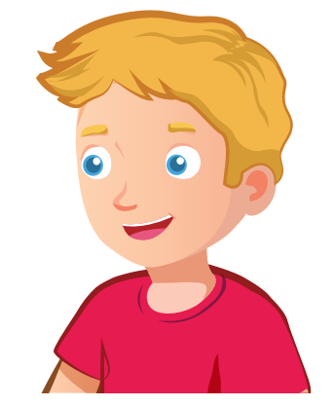

Travel
Where did Nick go last Friday?
He went to Germany.
TIME
IS UP

Slide 10

Travel
Where did she go last weekend?
She went to Spain.
TIME
IS UP

Slide 11



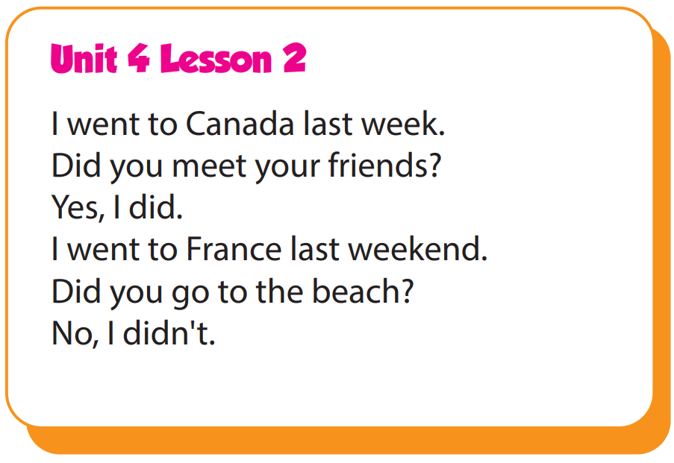

Slide 12

It’s time to learn …

Slide 13

Practice

Slide 14

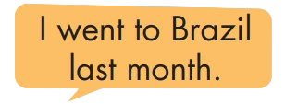
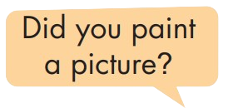
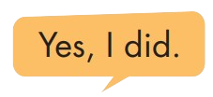
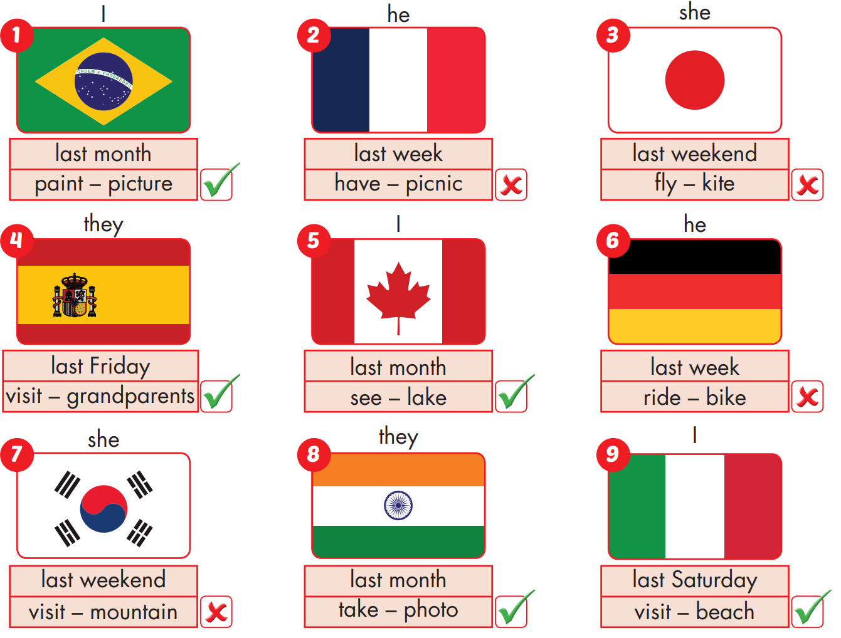

Slide 15
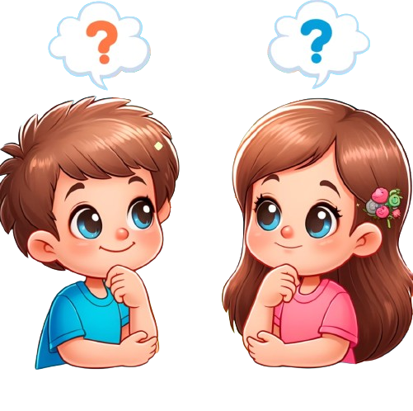
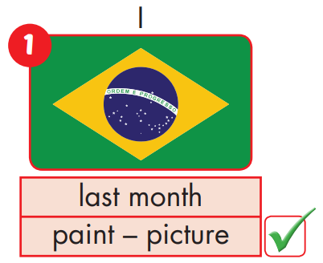
I went to Brazil last month.
Yes, I did.
Did you paint a picture?

Slide 16
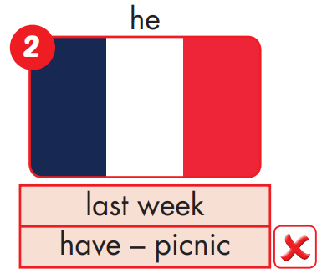
He went to France last week.
No, he didn't.
Did he have a picnic?

Slide 17
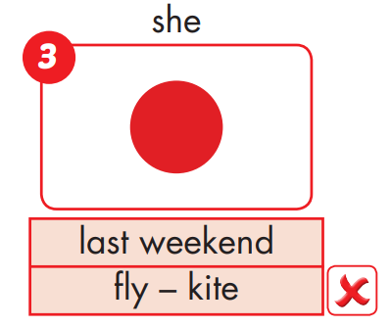
She went to Japan last weekend.
No, she didn't.
Did she fly a kite?

Slide 18
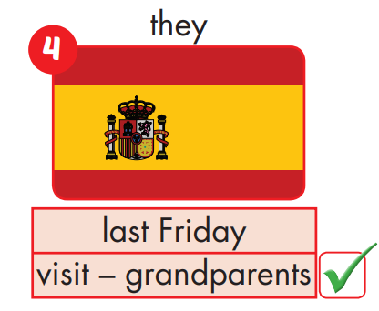
They went to Spain last Friday.
Yes, they did.
Did they visit their grandparents?

Slide 19
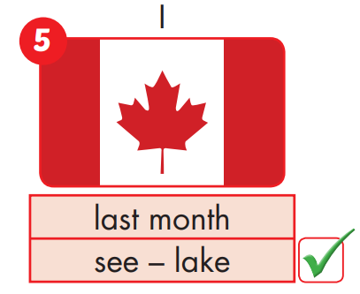
I went to Canada last month.
Yes, I did.
Did you see the lake?

Slide 20
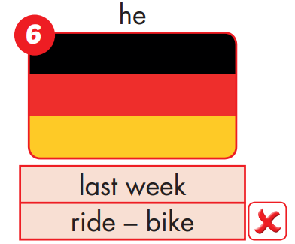
He went to Germany last week.
No, he didn't.
Did he ride a bike?

Slide 21
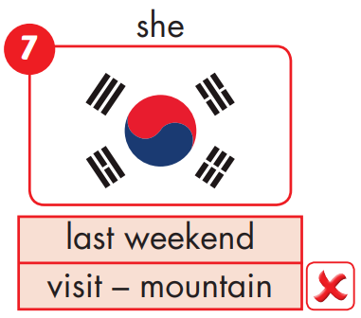
She went to South Korea last weekend.
No, she didn't.
Did she visit the mountain?

Slide 22
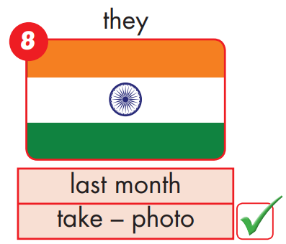
They went to India last month.
Yes, they did.
Did they take photos?

Slide 23
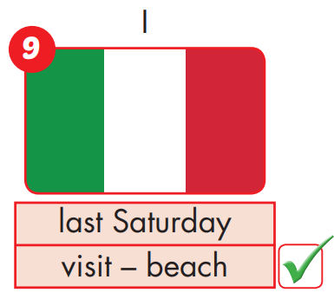
I went to Italy last Saturday.
Yes, I did.
Did you visit the beach?

Slide 24

Production

Slide 26

CONSOLIDATION

Slide 27
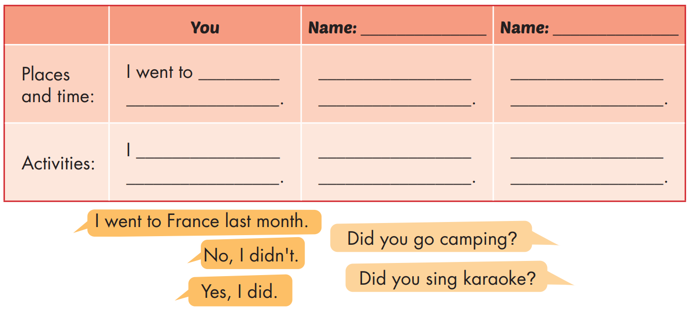
What's your friend's name?
Where did he/she go?
What did he/she do?

Slide 29

WRAP-UP

Slide 30
Today’s lesson
Vocabularies
Canada, France, South Korea, Brazil, Germany, Spain
Structures/ Sentence patterns
I went to South Korea last month.
- Did you sing karaoke?
- Yes, I did./No, I didn't.

Slide 31
Homework
Practice the vocabularies and structure, and make sentences using them.
Do the exercises in Tiếng Anh 5 i-Learn Smart Start WB (page 35)
Do the exercises in Tiếng Anh 5 i-Learn Smart Start Notebook (page 23)
Prepare the next lesson (page 54 SB)
Play the consolidation games in Tiếng Anh 5 i-Learn Smart Start DHA App on www.eduhome.com.vn

Slide 32

Enjoy your day!

Slide 33

Lesson 3
Stay positive and have a nice day!

