Slide 1

Unit 4: Travel
Lesson 1.3
Page 50

Slide 2
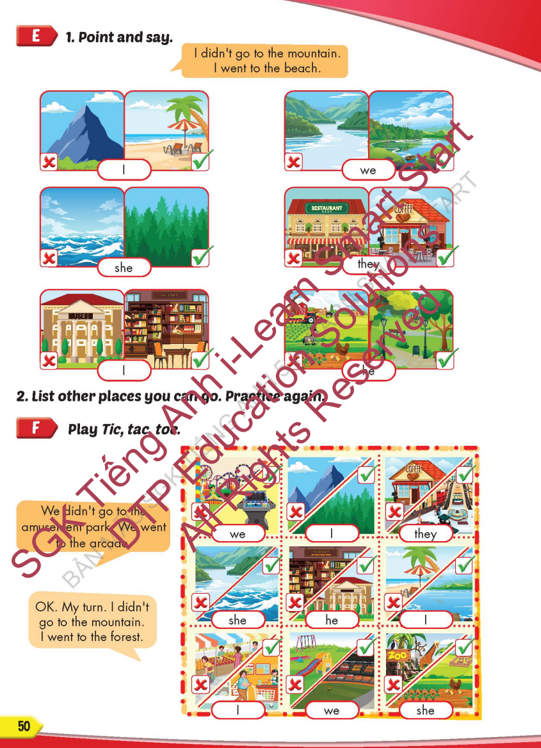
Lesson Outline
Warm-up
Practice
Speaking
Consolidation
Wrap-up

Slide 3
Objectives
By the end of this lesson, students will be able to…
Vocabulary: Pronounce and use the words related to the topic properly: mountain, lake, river, beach, ocean, forestYear (Tết), Christmas, Teachers' Day, Children's Day.
Structure: I didn't go to the river. I went to the beach.

Slide 4

WARM-UP

Slide 5



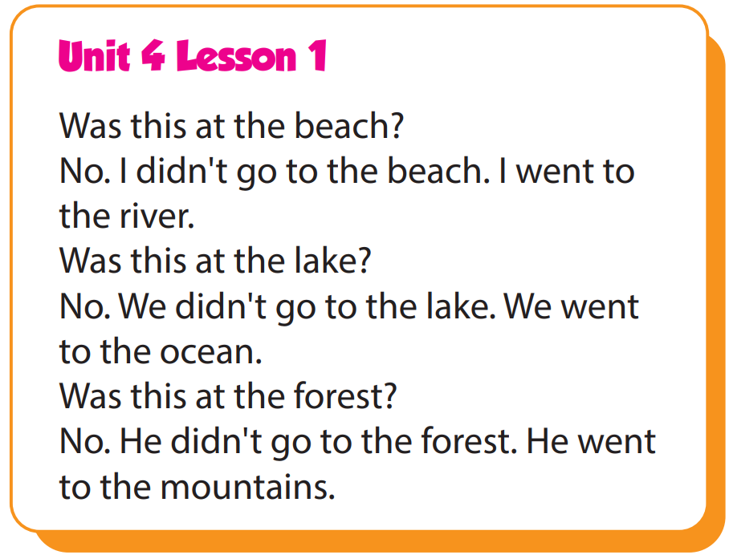

Slide 6

It’s time to learn …

Slide 7

Practice

Slide 8

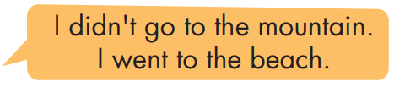
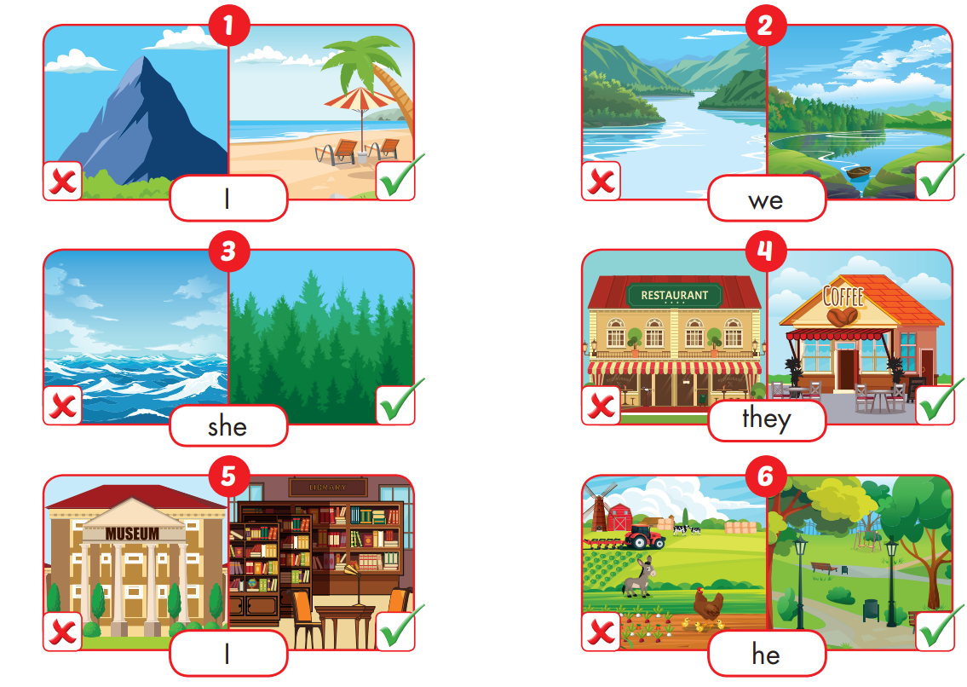

Slide 9
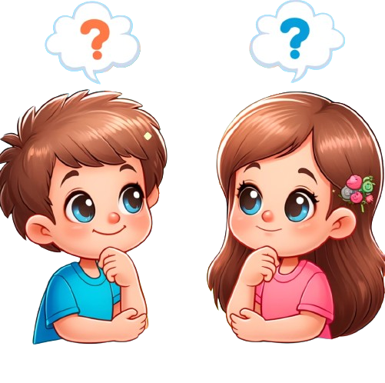
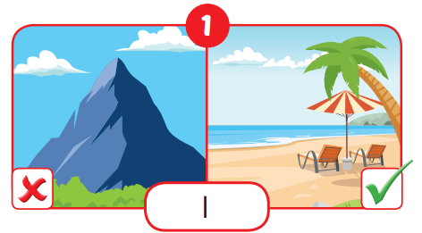
I didn't go to the moutain.
I went to the beach.

Slide 10
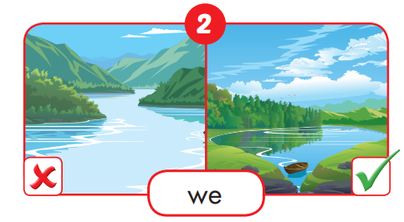
We didn't go to the river.
We went to the lake.

Slide 11
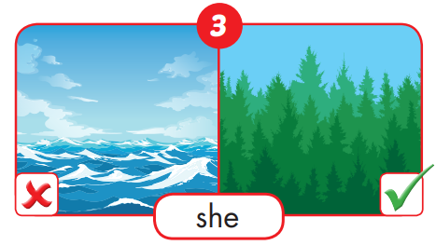
She didn't go to the ocean.
She went to the forest.

Slide 12
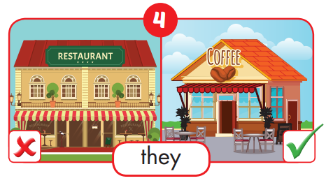
They didn't go to the restaurant.
They went to the coffee.

Slide 13
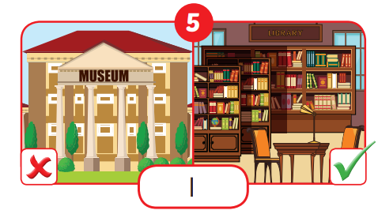
I didn't go to the museum.
I went to the library.

Slide 14
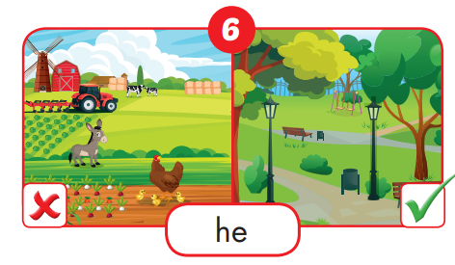
He didn't go to the farm.
He went to the park.

Slide 16

Production

Slide 17

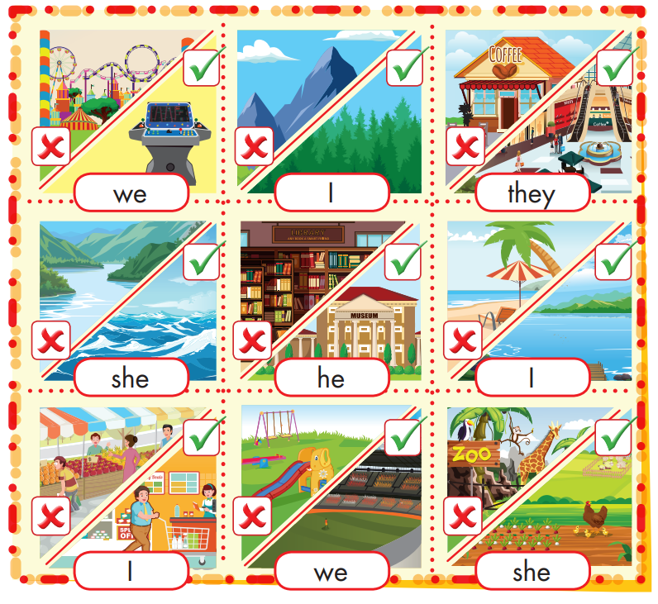
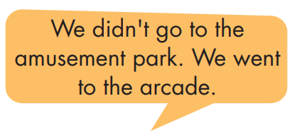
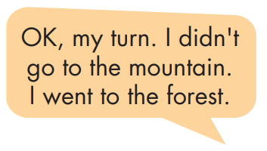

Slide 18

CONSOLIDATION

Slide 19


CHECK YOUR MEMORY

Slide 20


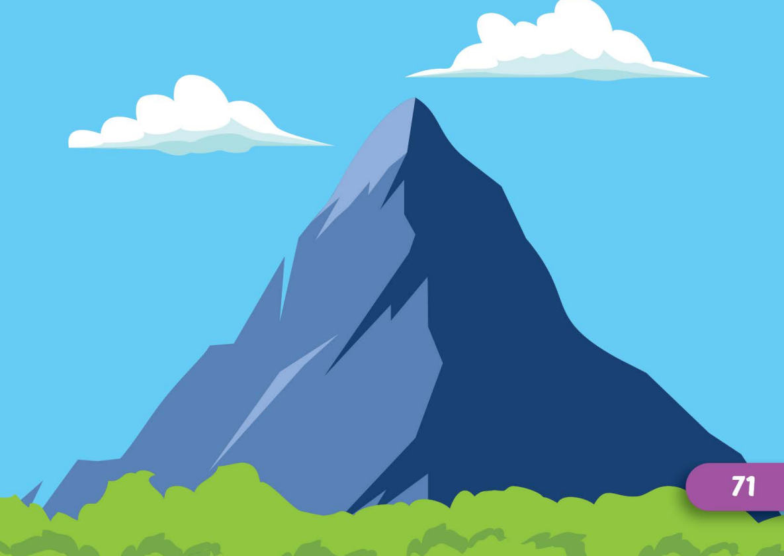
mountain
Click here to guess what vehicle behind.

Slide 21
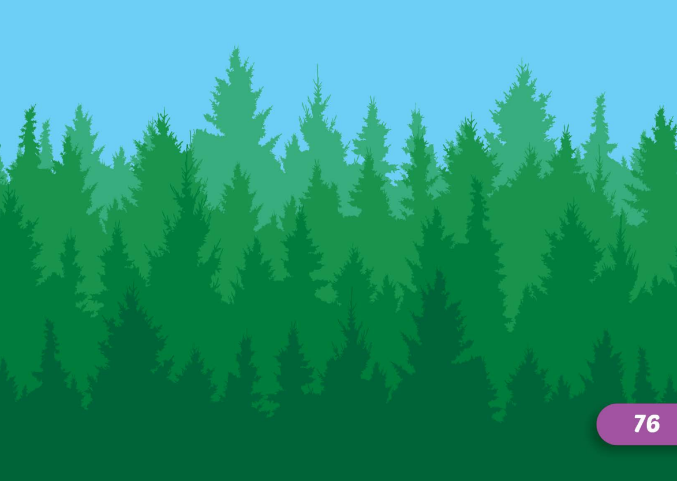
forest
Click here to guess what vehicle behind.

Slide 22
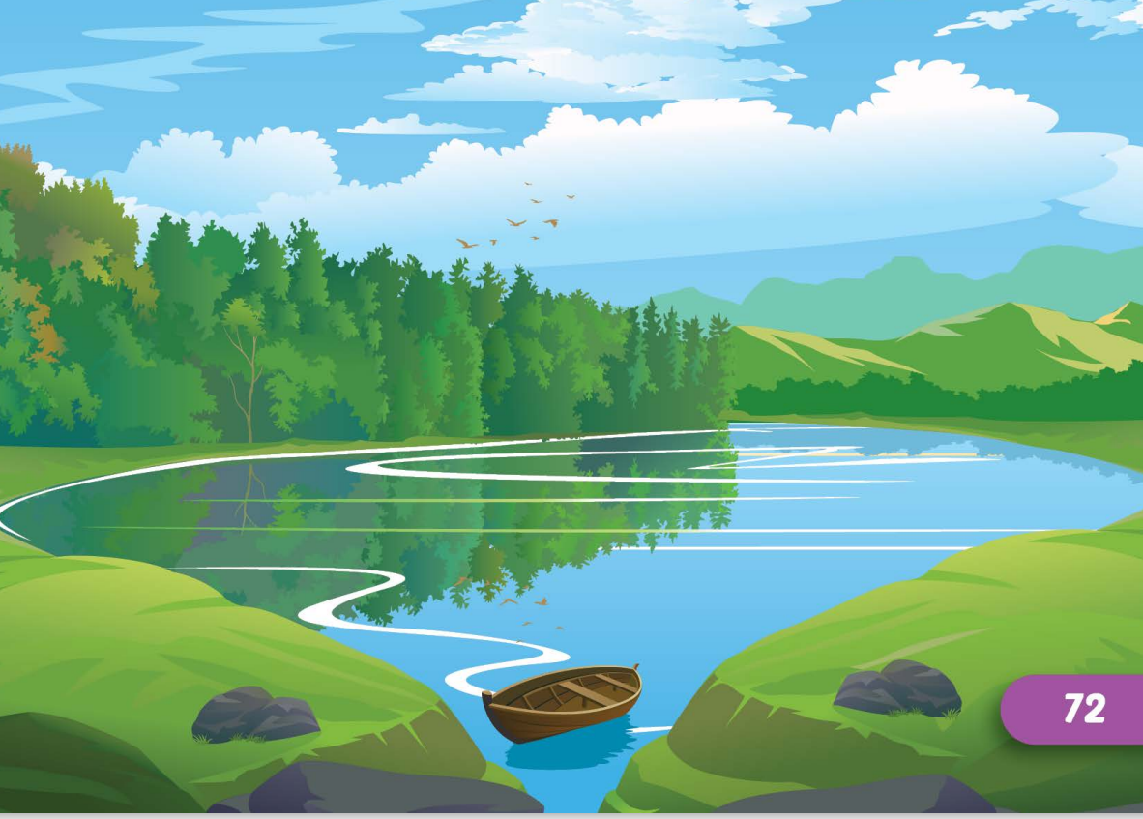
lake
Click here to guess what vehicle behind.

Slide 23
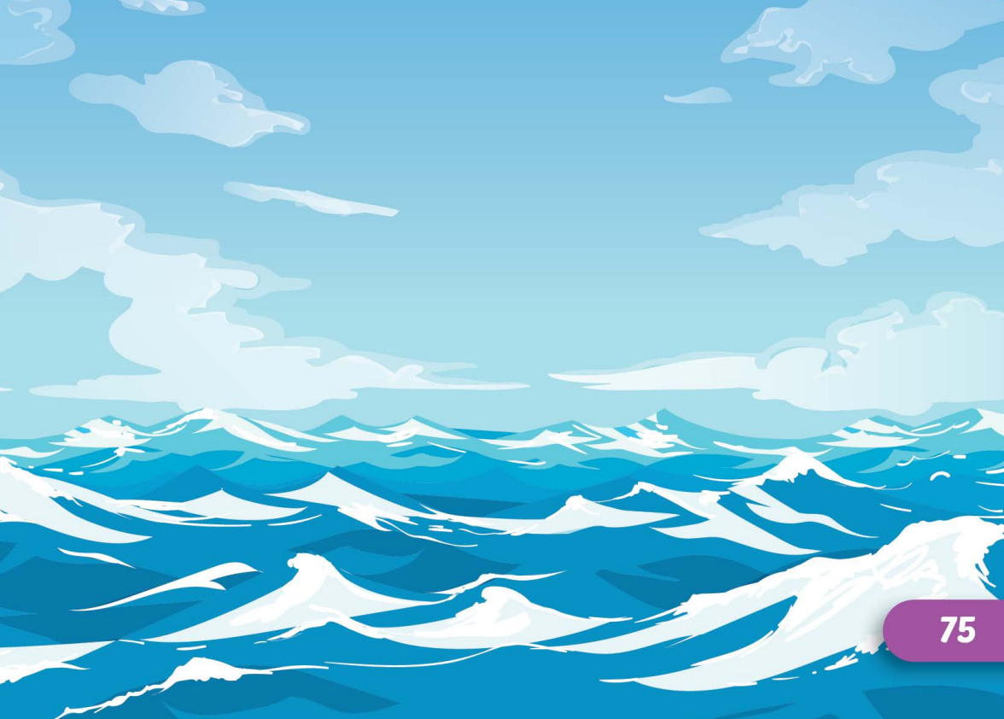
ocean
Click here to guess what vehicle behind.

Slide 24
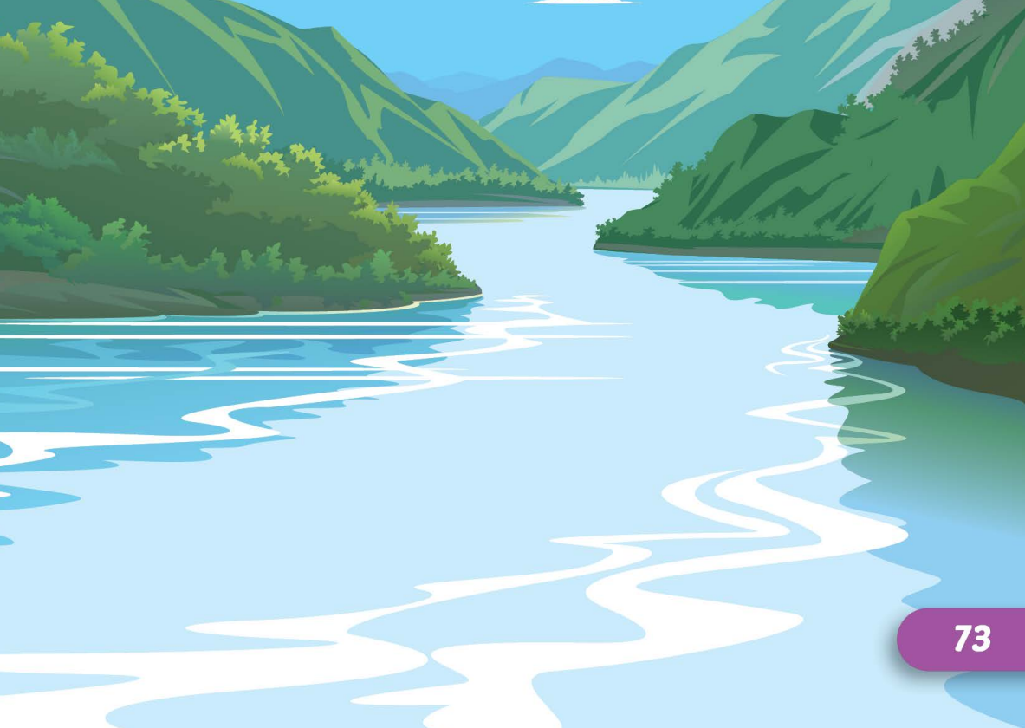
river
Click here to guess what vehicle behind.

Slide 25
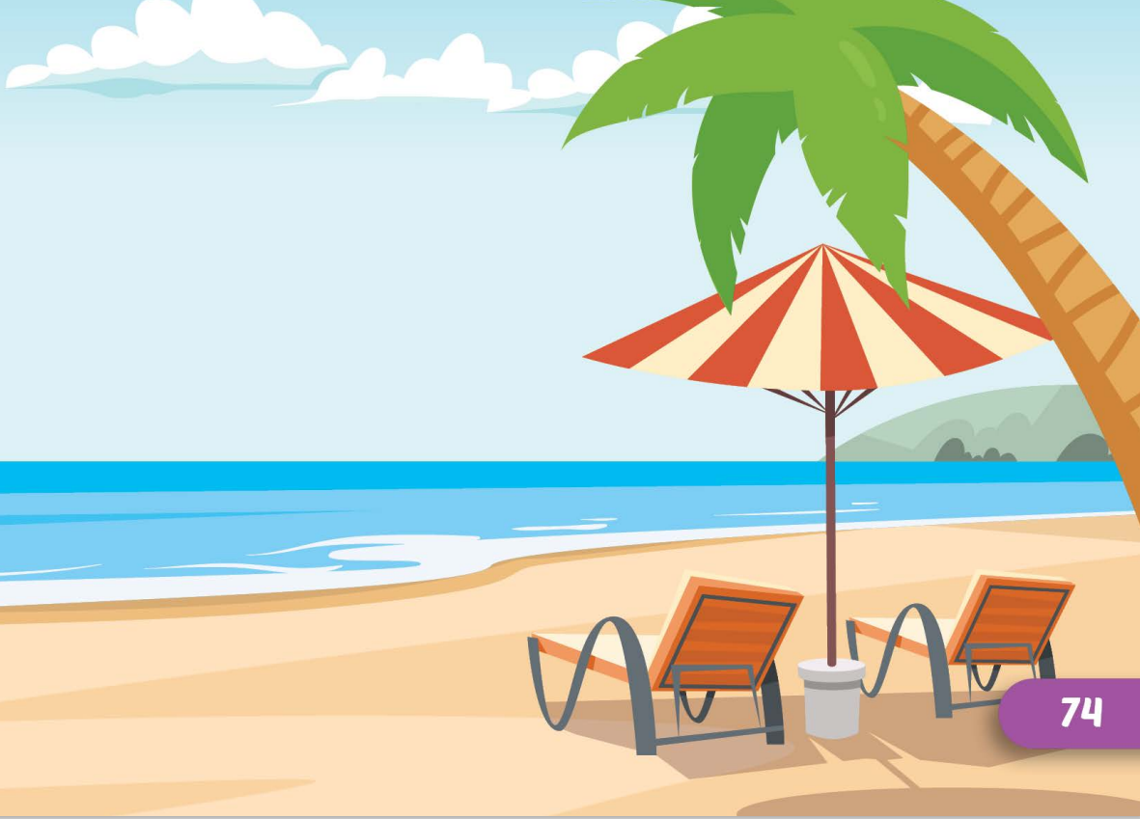
beach
Click here to guess what vehicle behind.

Slide 26

WRAP-UP

Slide 27
Today’s lesson
Vocabularies
mountain, lake, river, beach, ocean, forest
Structures/ Sentence patterns
I didn't go to the river.
I went to the beach.

Slide 28
Homework
Practice the vocabularies and structure, and make sentences using them.
Do the exercises in Tiếng Anh 5 i-Learn Smart Start WB (page 33)
Do the exercises in Tiếng Anh 5 i-Learn Smart Start Notebook (page 22)
Prepare the next lesson (page 51 SB)
Play the consolidation games in Tiếng Anh 5 i-Learn Smart Start DHA App on www.eduhome.com.vn

Slide 29

Enjoy your day!

Slide 30

Lesson 3
Stay positive and have a nice day!

