Slide 1

Unit 3: MY FRIENDS AND I
Lesson 1.3
Page 36

Slide 2
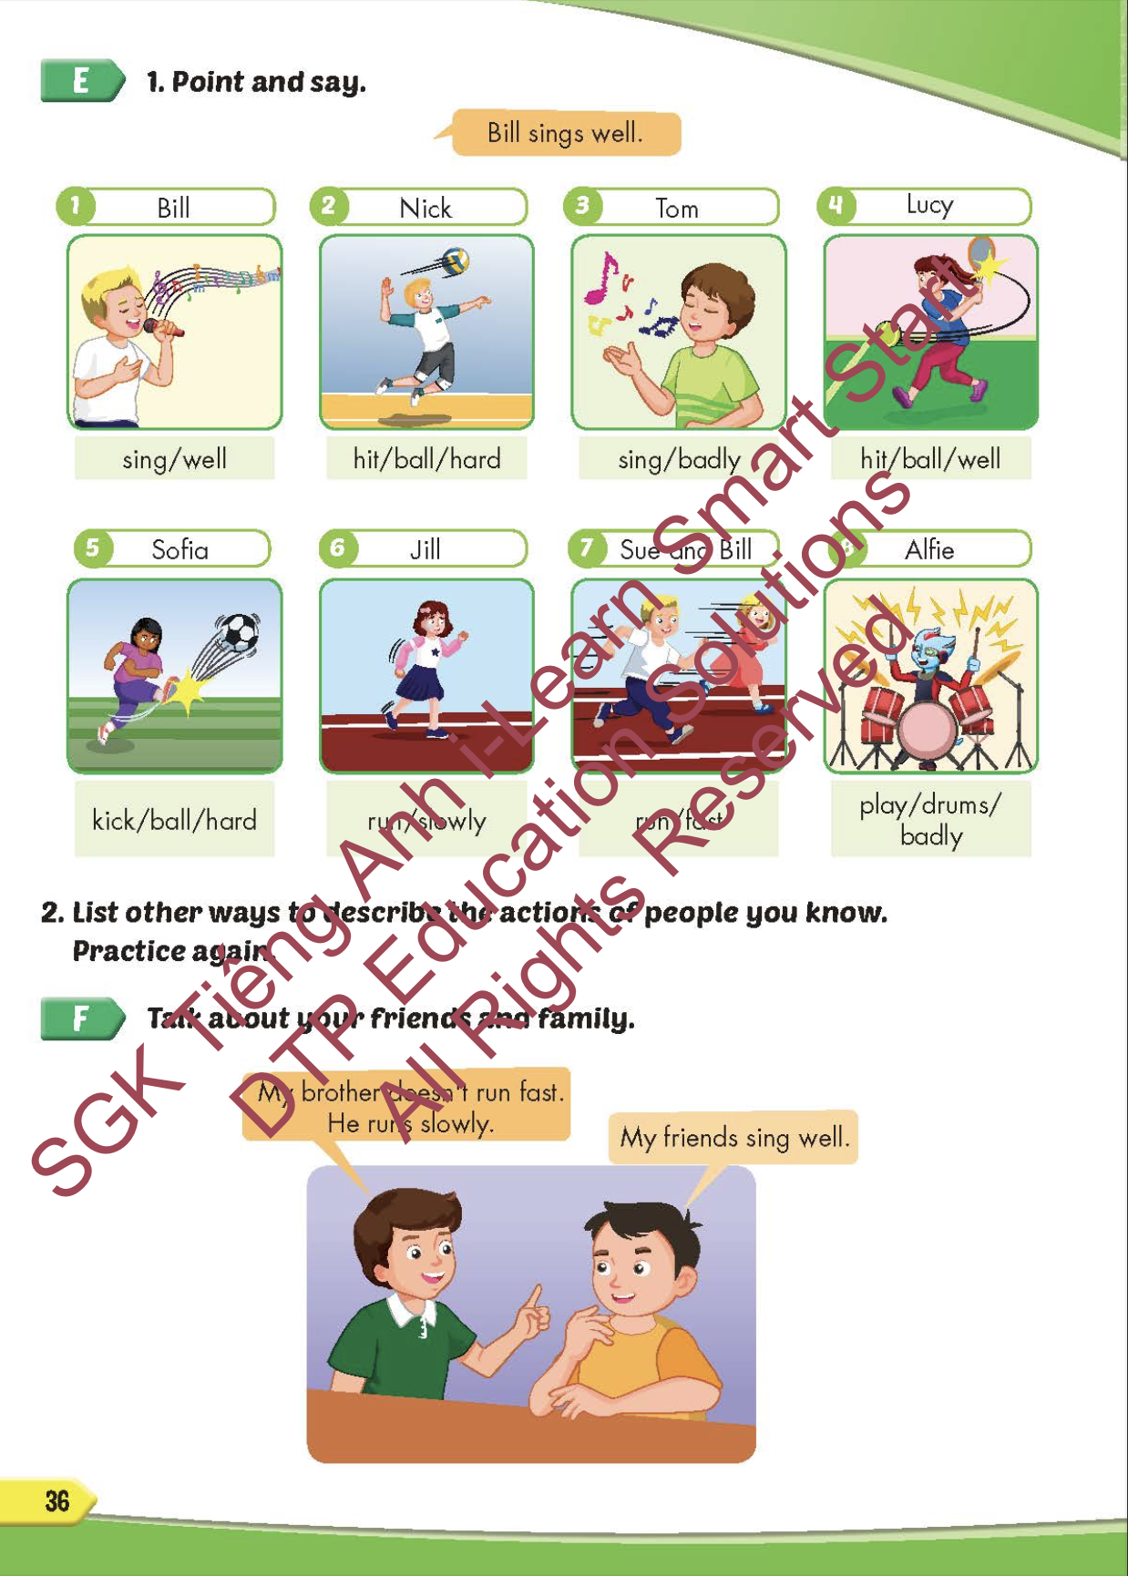
Lesson Outline
Warm-up
Practice
Speaking
Consolidation
Wrap-up

Slide 3
Objectives
By the end of this lesson, students will be able to to say how good people are at different activities.
Vocabulary: slowly, fast, badly, well, hard.
Structure: Tom kicks the ball hard.

Slide 4

WARM-UP

Slide 5



Slide 6
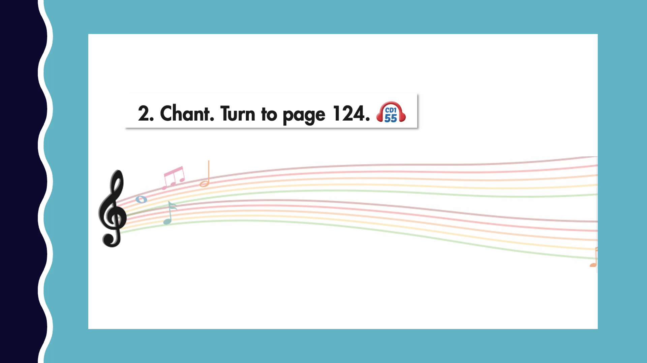

Slide 7

New words
slowly,
fast,
badly,
well,
hard.

Slide 8

Structure
Tom kicks the ball hard.

Slide 9

Practice

Slide 10

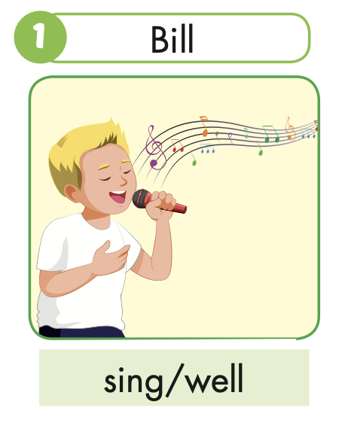


Slide 11
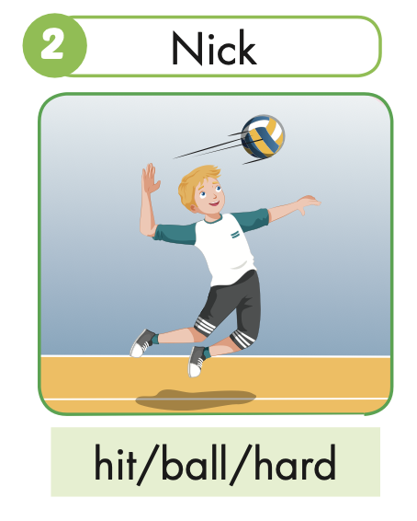
Nick hits the ball hard.

Slide 12
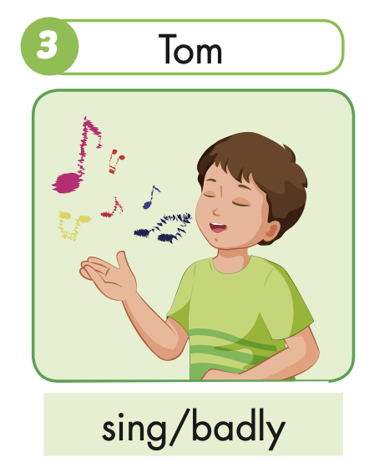
Tom sings badly.

Slide 13
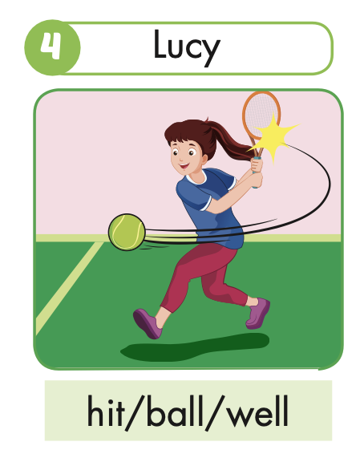
Lucy hits the ball well.

Slide 14
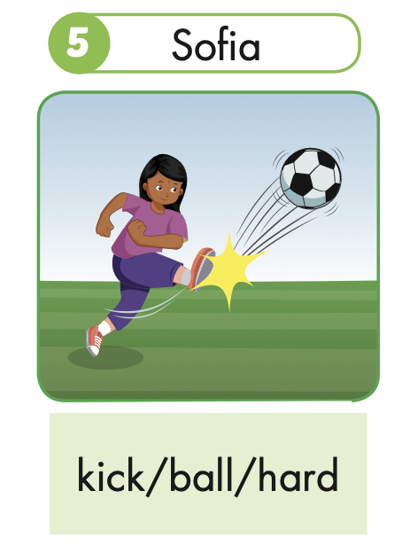
Sofia kicks the ball hard.

Slide 15
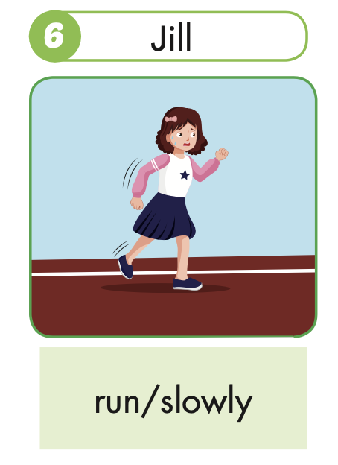
Jill runs slowly.

Slide 16
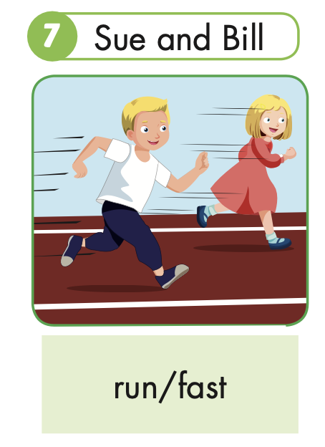
Sue and Bill run fast.

Slide 17
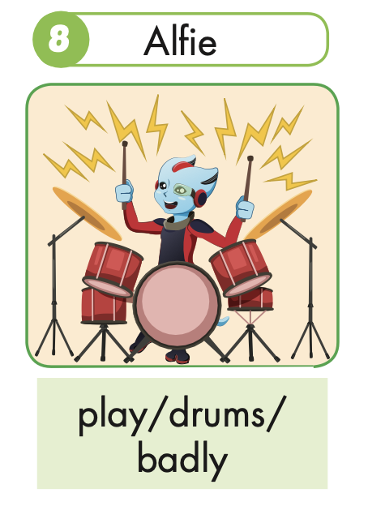
Alfie plays the drums badly.

Slide 18

Speaking

Slide 20

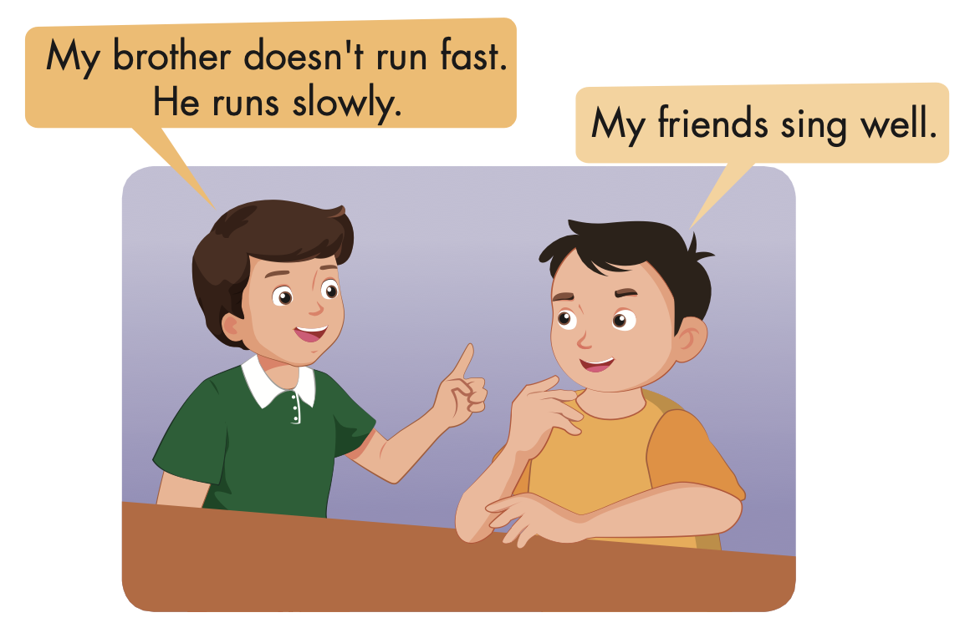

Slide 21

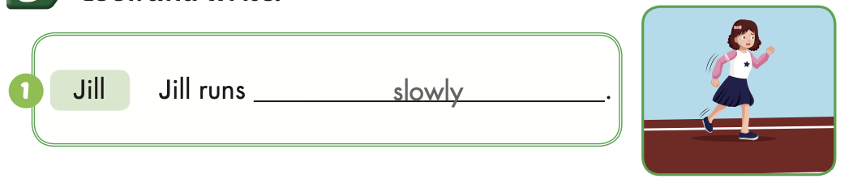
Extra Practice
WB, page 23

Slide 22
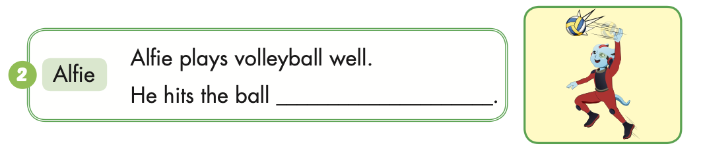
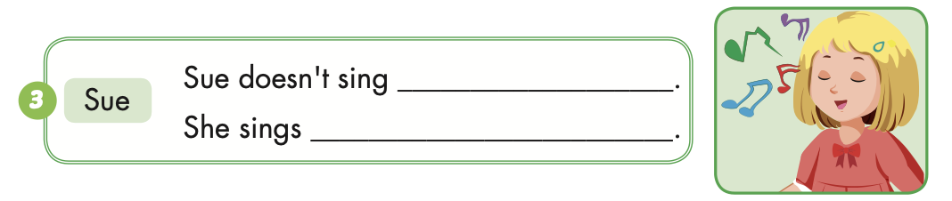
Extra Practice
WB, page 23
hard
well
badly

Slide 23
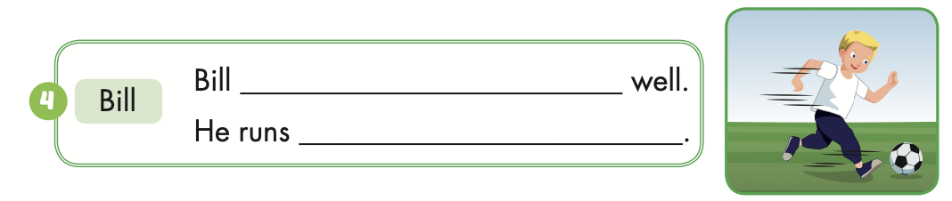
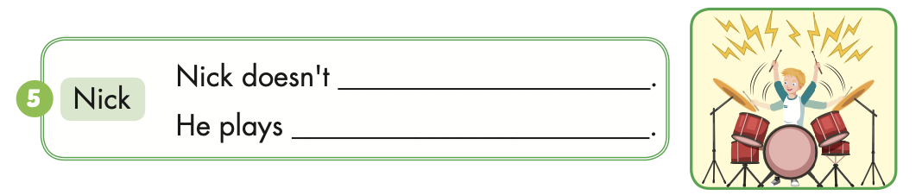
Extra Practice
WB, page 23
plays soccer
fast
play the drums well
the drums badly

Slide 24

CONSOLIDATION

Slide 25

Correct the mistakes!
GO!

Slide 26
play
Bill play the drums well.
NEXT

Slide 27
Bill plays the drums well.
NEXT

Slide 28
Sue runs slow.
slow
NEXT

Slide 29
Sue runs slowly.
NEXT

Slide 30
She doesn’t sing good.
She sing badly.
good
NEXT
sing

Slide 31
She doesn’t sing well.
She sings badly.
NEXT

Slide 32
Tom and Tim doesn’t kick the ball hard.
doesn’t
NEXT

Slide 33
Tom and Tim don’t kick the ball hard.
END

Slide 34

WRAP-UP

Slide 35
Today’s lesson
Vocabulary
slowly, fast, badly, well, hard.
Structures/ Sentence patterns
Tom kicks the ball hard.

Slide 36
Homework
Practice the vocabularies and structure, and make sentences using them.
Do the exercises in Tiếng Anh 5 i-Learn Smart Start WB (page 23).
Do the exercises in Tiếng Anh 5 i-Learn Smart Start Notebook.
Prepare the next lesson (page 37 SB).
Play the consolidation games in Tiếng Anh 5 i-Learn Smart Start DHA App on www.eduhome.com.vn

Slide 37

Enjoy your day!

Slide 38

Lesson 3
Stay positive and have a nice day!

