Slide 1

Unit 3: MY FRIENDS AND I
Lesson 3.3
Page 42

Slide 2
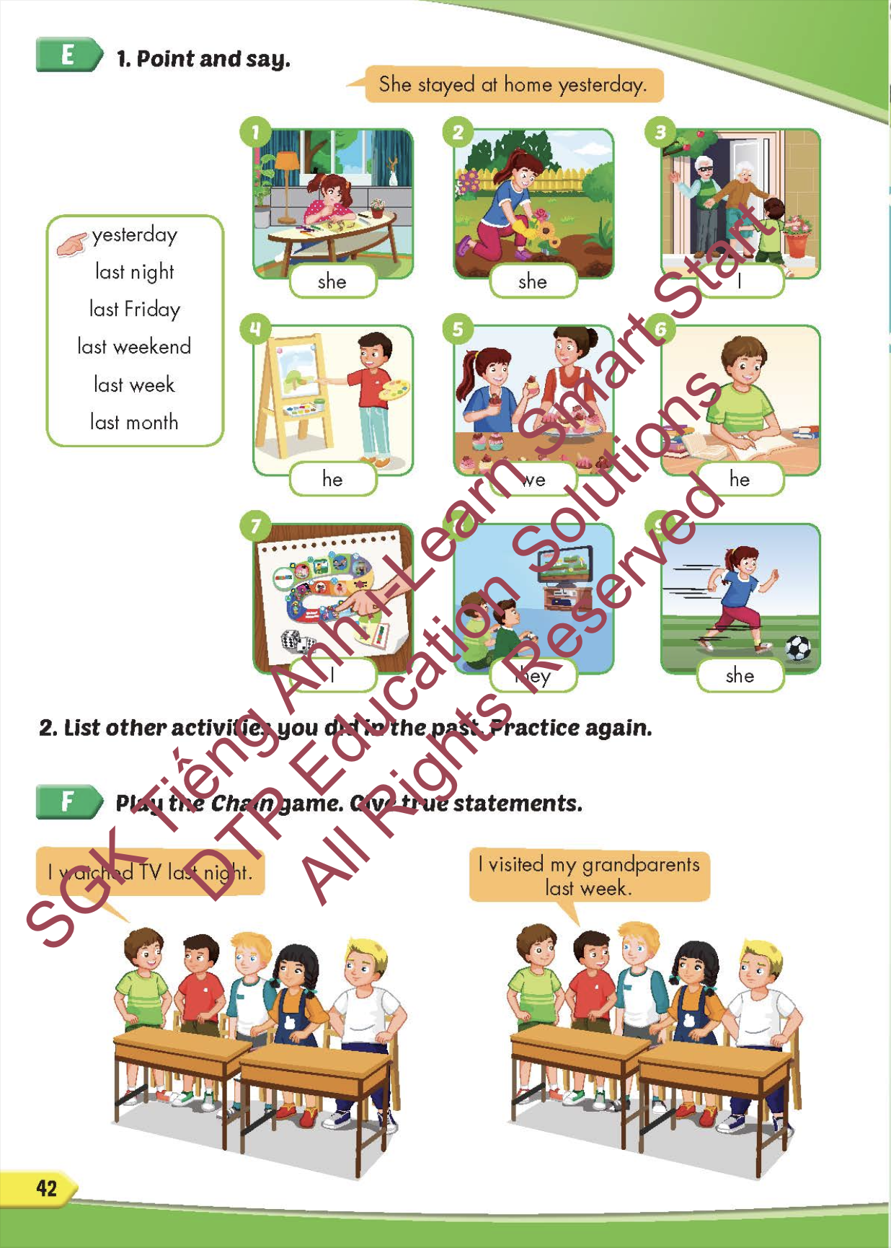
Lesson Outline
Warm-up
Practice
Speaking
Consolidation
Wrap-up

Slide 3
Objectives
By the end of this lesson, students will be able to say how often they do things in different classes.
Vocabulary: bake cupcakes, paint a picture, plant some flowers, visit my grandparents, stay at home, study.
Structure: I planted some flowers yesterday.

Slide 4

WARM-UP

Slide 5



Slide 6
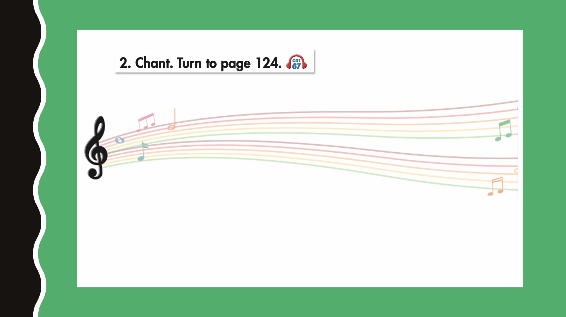

Slide 7

New words
bake cupcakes,
paint a picture,
plant some flowers,
visit my grandparents,
stay at home,
study.

Slide 8


Slide 9
Divide into 4 teams.
Students look, read and choose.
The first student answers the question correctly, wins 1 point.

Slide 10
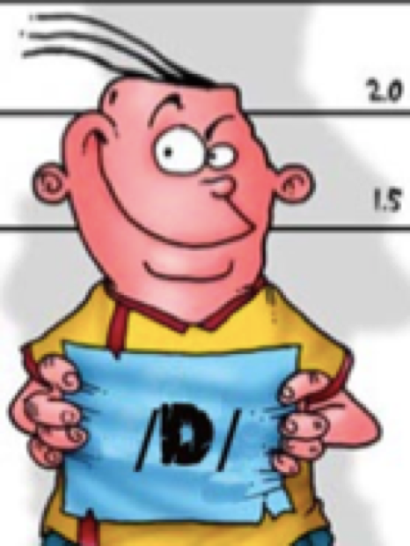
Which one belongs?
planted
painted
baked
stayed
visited
needed

Slide 11
stayed

Slide 12
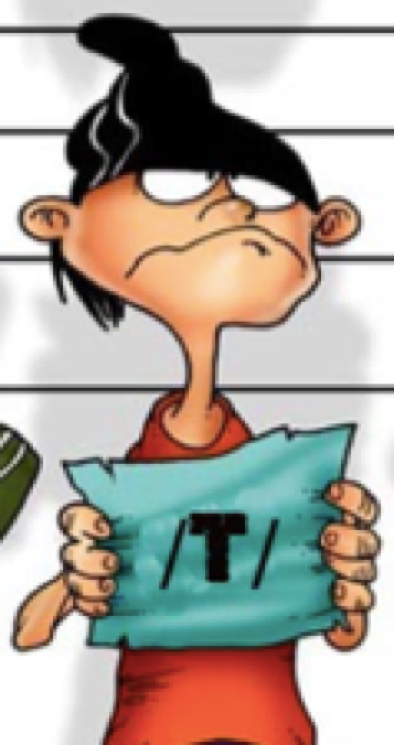
Which one doesn’t belong?
washed
looked
fixed
closed
baked
planted

Slide 13
planted

Slide 14
Which one is wrong?
decided
needed
ended
played
painted
visited
planted

Slide 15
played

Slide 16
Structure
I planted some flowers yesterday.

Slide 17

Review

Slide 18


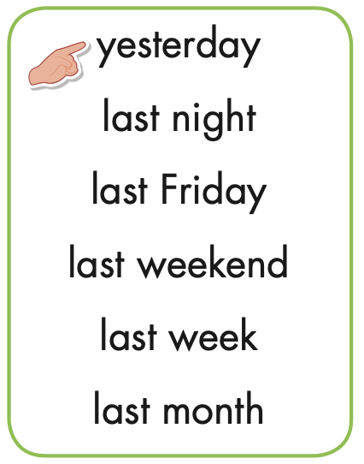
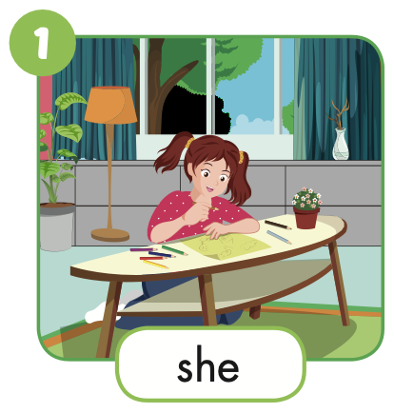

Slide 19

Practice

Slide 20
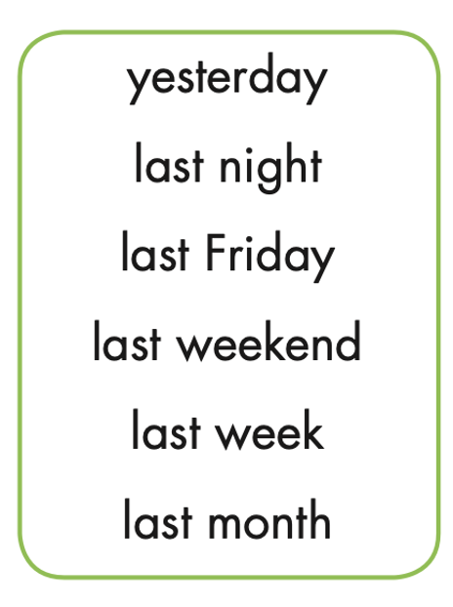
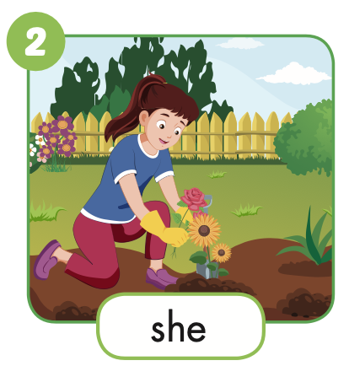

She planted some flowers last night.

Slide 21
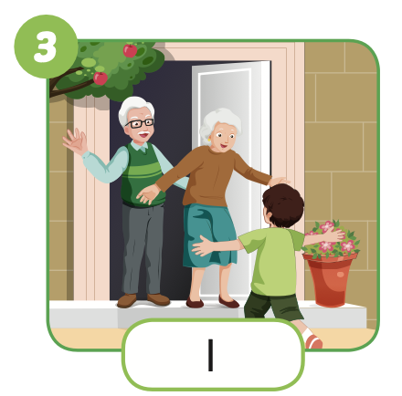
I visited my grandparents last Friday.

Slide 22
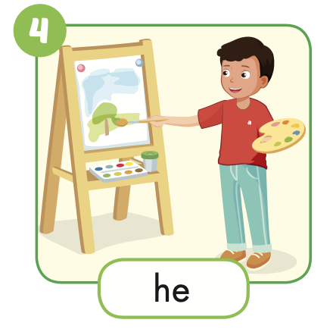
He painted a picture last weekrnd.

Slide 23
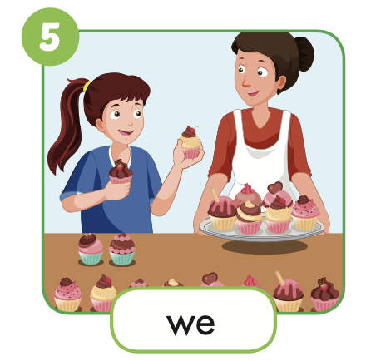
We baked cupcakes last week.

Slide 24
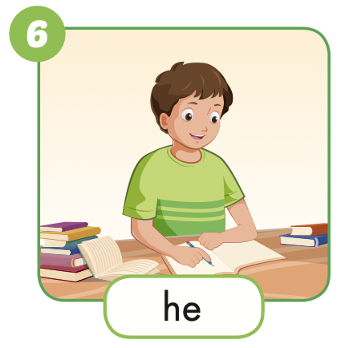
He studied last month.

Slide 25
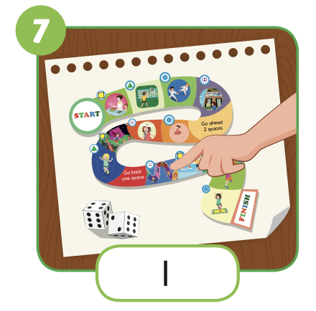
I played a boardgame last night.

Slide 26
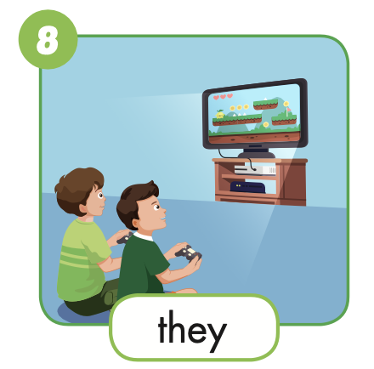
They played a video game yesterday.

Slide 27
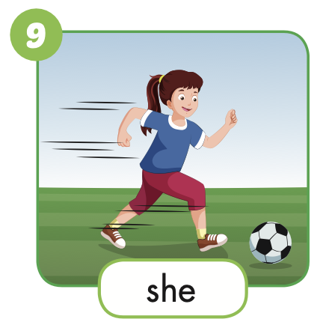
She played soccer last month.

Slide 28
Work in pairs. One points at the picture and the other says the sentences. Mind your intonation and the sounds of the verbs ending in ‘ed’.

Slide 29

Production

Slide 31

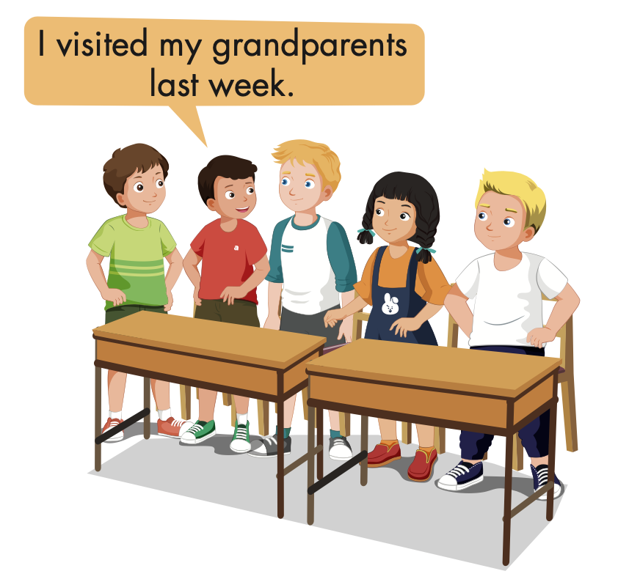
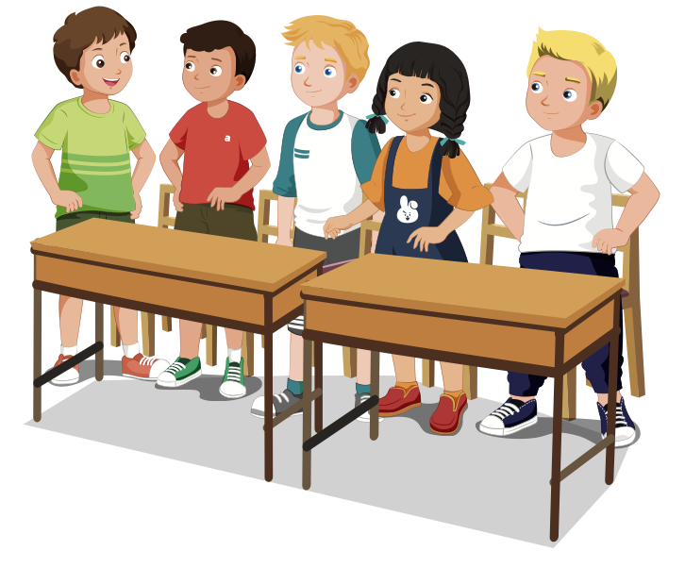

Slide 32


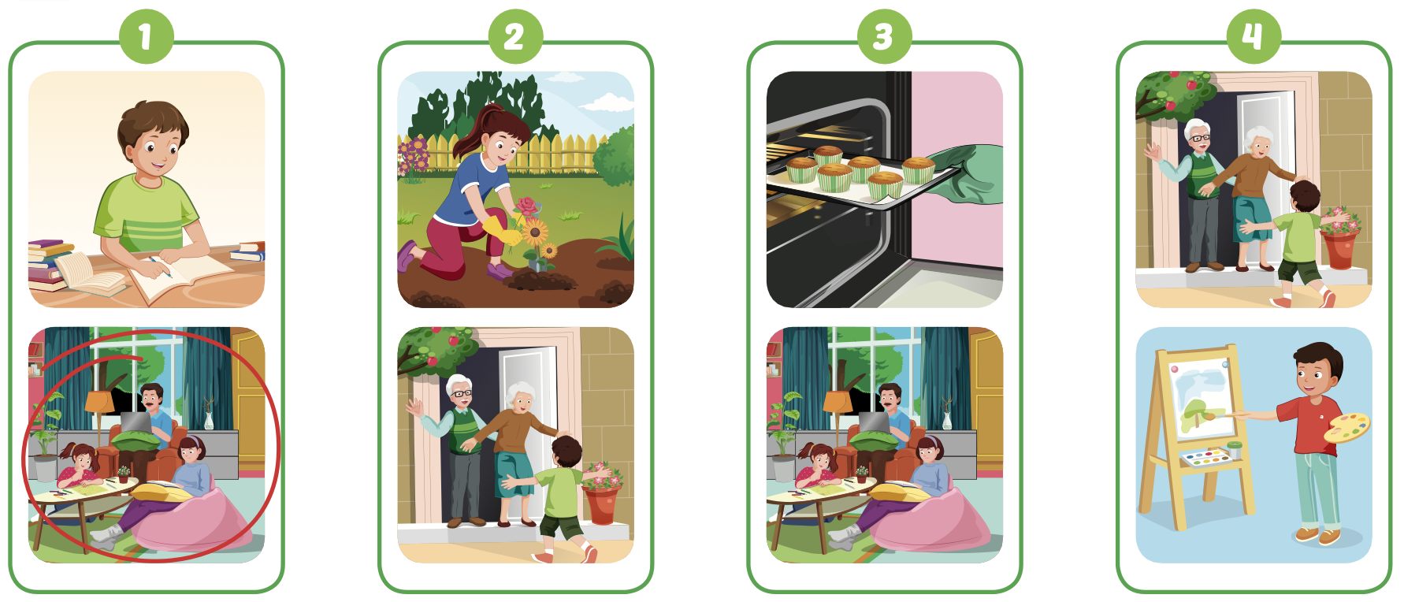
Extra Practice
WB, page 26

Slide 33

CONSOLIDATION

Slide 34

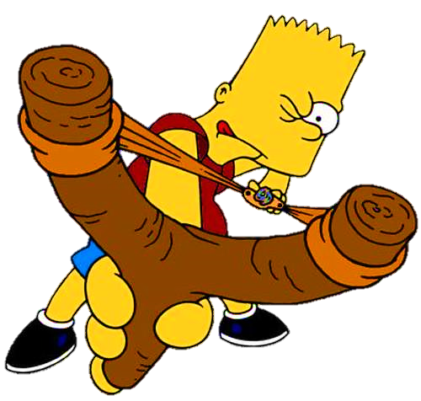



Slide 35
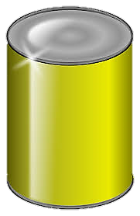
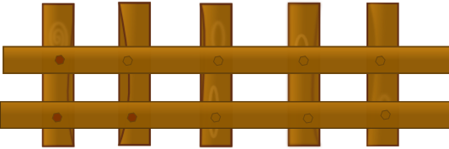


planted
I __________ some flowers yesterday.
planted
painted
played
NEXT
Click on the right can

Slide 36
They __________ soccer last weekend.
played
stayed
painted
played
NEXT
Click on the right can

Slide 37
painted
She __________ a picture last Sunday.
stayed
painted
baked
Click on the right can
NEXT

Slide 38
stayed
We __________ at home last night.
stayed
visited
baked
NEXT
Click on the right can

Slide 39

WRAP-UP

Slide 40
Today’s lesson
Vocabularies
bake cupcakes,
paint a picture,
plant some flowers, visit my grandparents, stay at home,
study.
Structures/ Sentence patterns
I planted some flowers yesterday.

Slide 41
Homework
Practice the vocabularies and structure, and make sentences using them.
Do the exercises in Tiếng Anh 5 i-Learn Smart Start WB (page 27).
Do the exercises in Tiếng Anh 5 i-Learn Smart Start Notebook.
Prepare the next lesson (page 43 SB).
Play the consolidation games in Tiếng Anh 5 i-Learn Smart Start DHA App on www.eduhome.com.vn

Slide 42

Enjoy your day!

Slide 43

Lesson 3
Stay positive and have a nice day!

