Slide 1

Unit 3: MY FRIENDS AND I
Review 2
Page 47

Slide 2
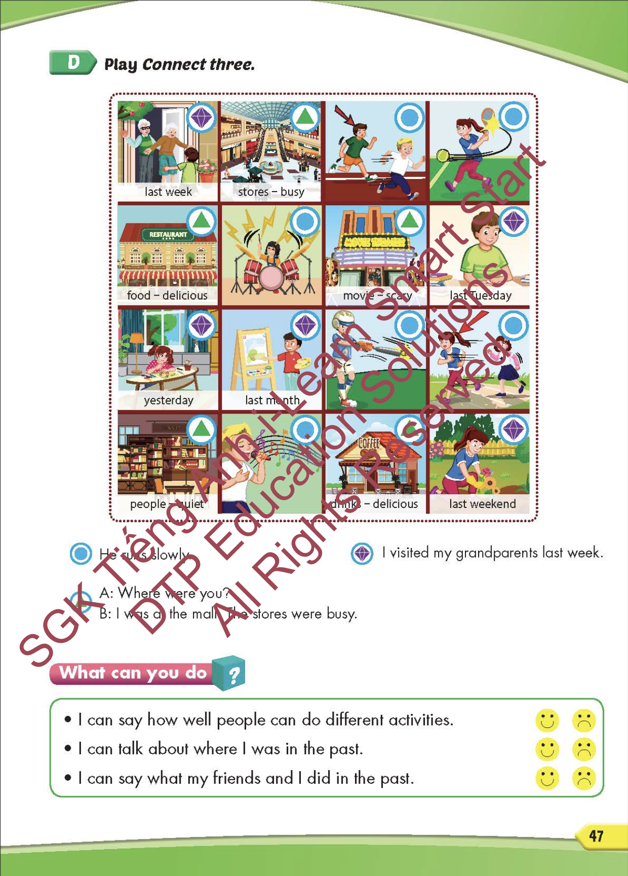
Lesson Outline
Warm-up
Speaking
Listening
Writing
Wrap-up

Slide 3
Objectives
By the end of this lesson, students will be able to review and practice the target language and skills in unit 3.
Vocabulary: unit 3
Structure: unit 3

Slide 4

WARM-UP

Slide 5
Look, read and choose. Then say.

Slide 6

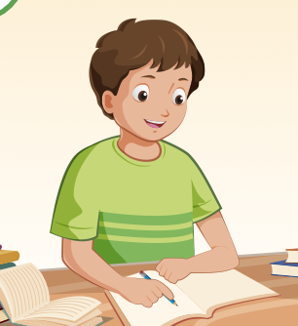
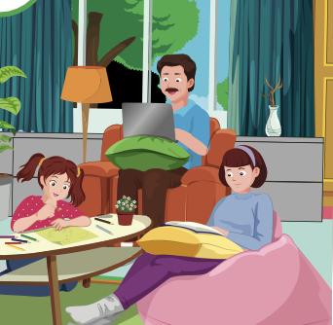
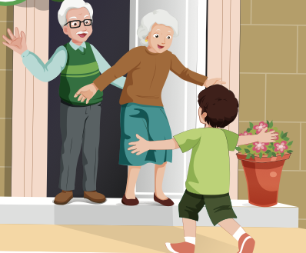
study
A
B
C

Slide 7
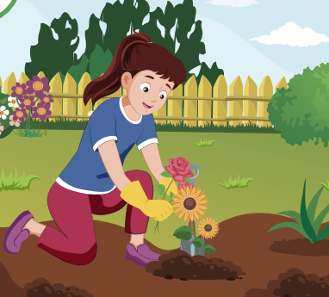
plant some flowers
A
B
C

Slide 8
visit my grandparents
A
B
C

Slide 9
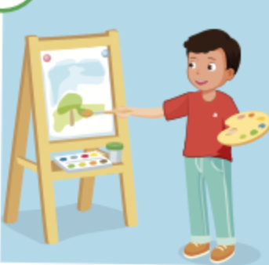
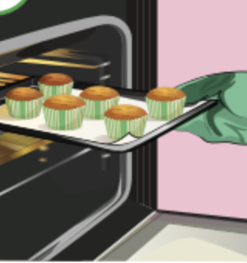
paint a picture
A
B
C

Slide 10

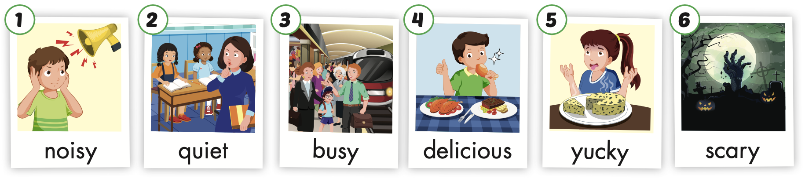
A
B
C
quiet

Slide 11
A
B
C
busy

Slide 12
A
B
C
scary

Slide 13
C
A
B
yucky

Slide 14

It’s time to learn …

Slide 15

Review

Slide 16
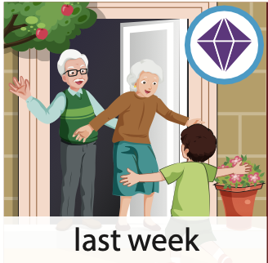


Slide 17
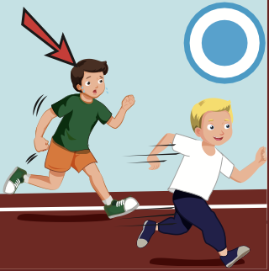


Slide 18

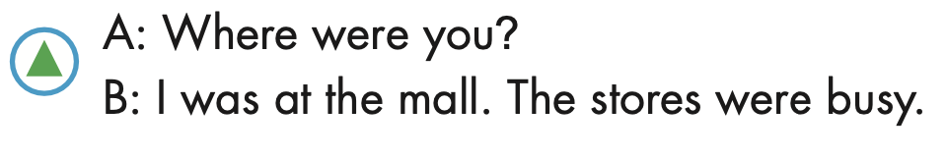

Slide 19
Practice

Slide 20

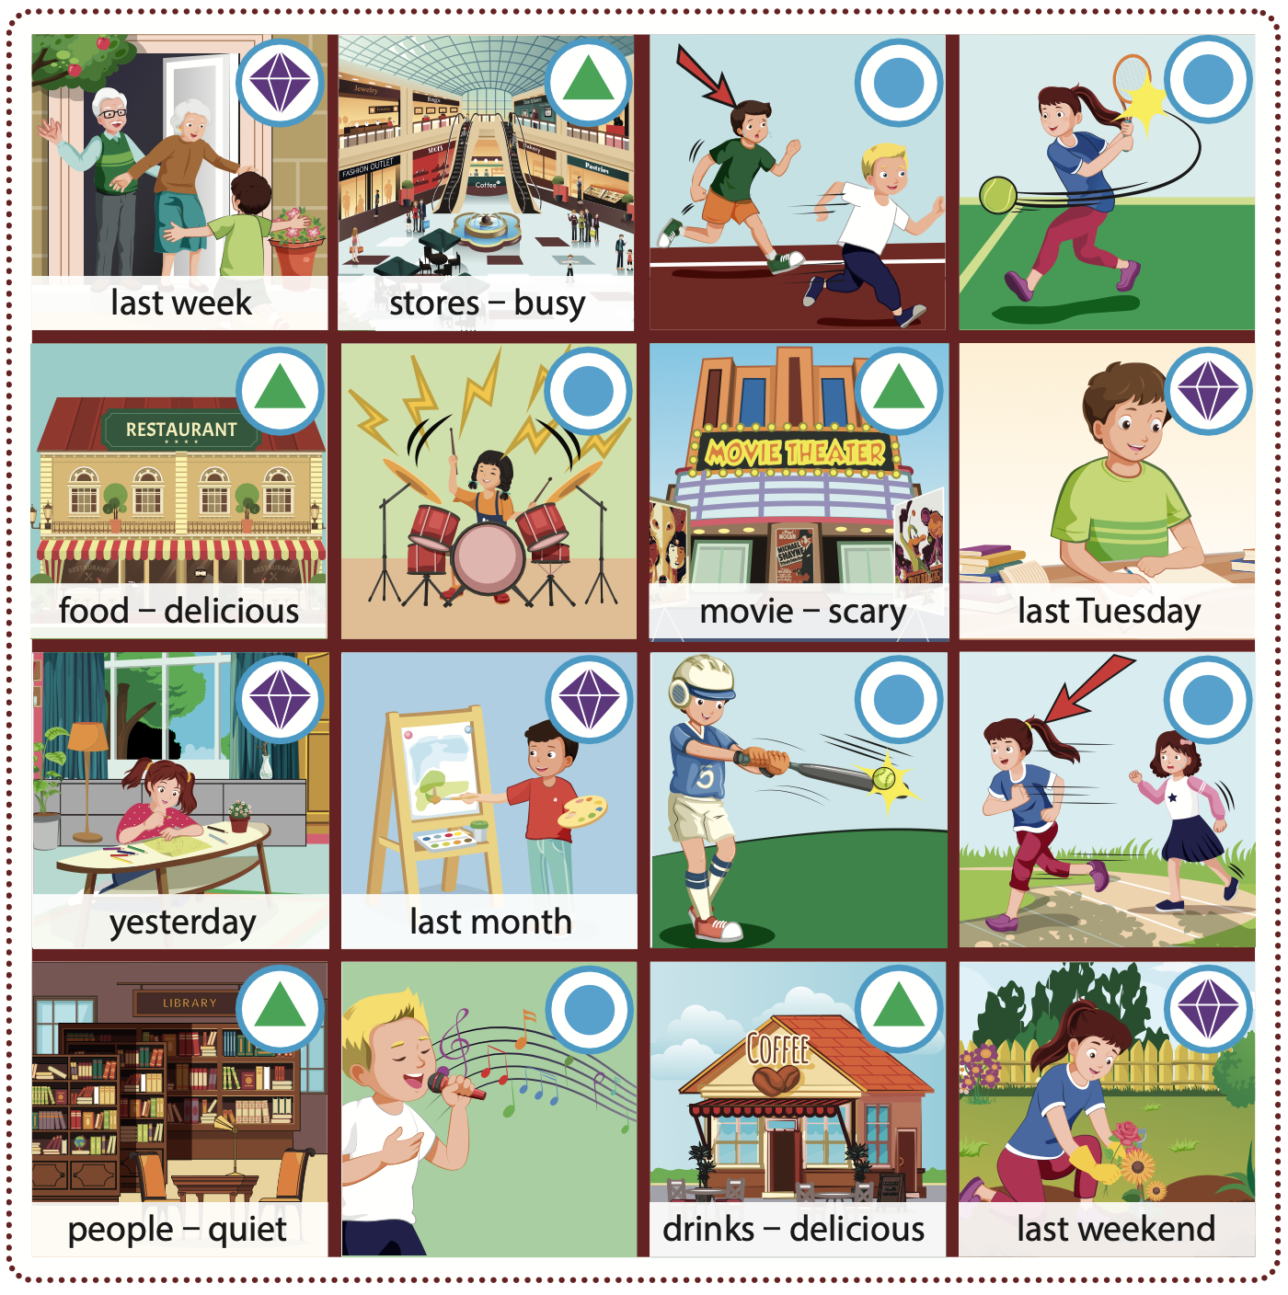
Work in pairs and play the game.

Slide 21

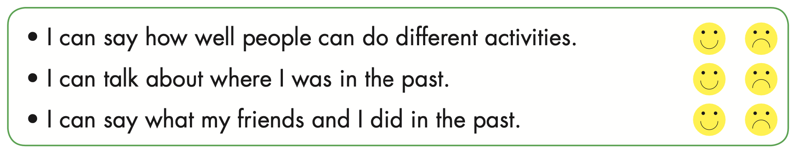

Slide 22

Listening

Slide 23


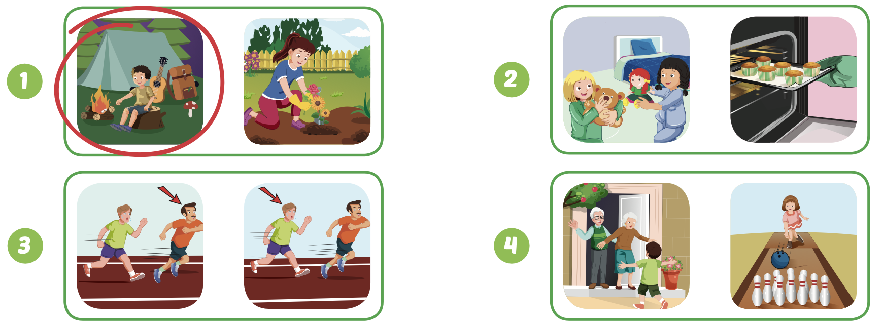
Extra Practice
WB, page 31

Slide 24

Writing

Slide 25

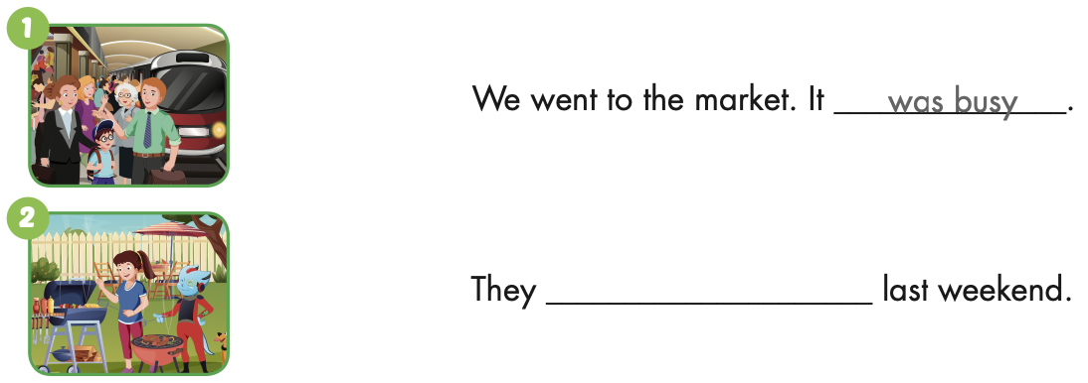
Extra Practice
WB, page 31
had a barbecue

Slide 26
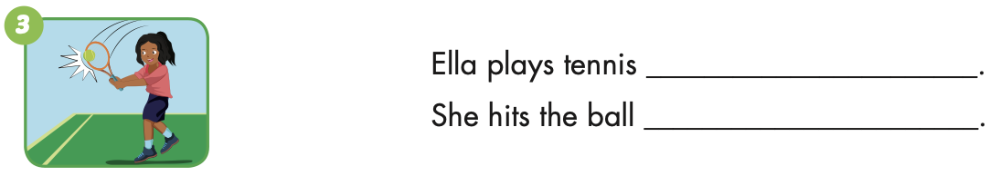
Extra Practice
WB, page 31
well
hard

Slide 27
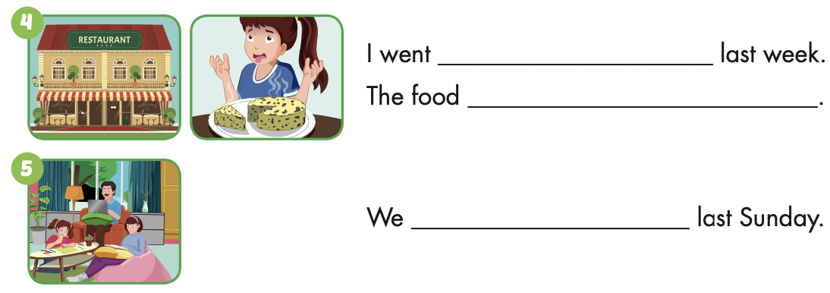
Extra Practice
WB, page 31
to a restaurant
was yucky
stayed at home

Slide 28

CONSOLIDATION

Slide 29
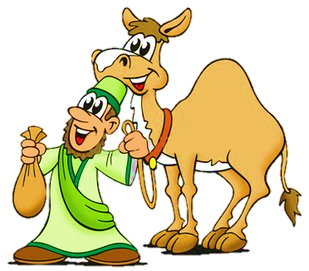


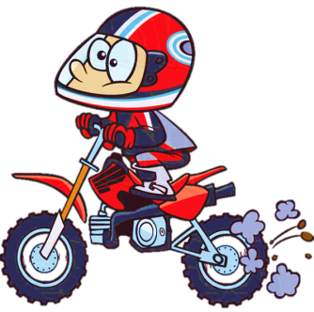


Click on the rider
START
5
4
3
2
1
6
7
8
9
10
15
14
13
12
11
16
17
18
19
20
25
24
23
22
21
FINISH LINE

Slide 30
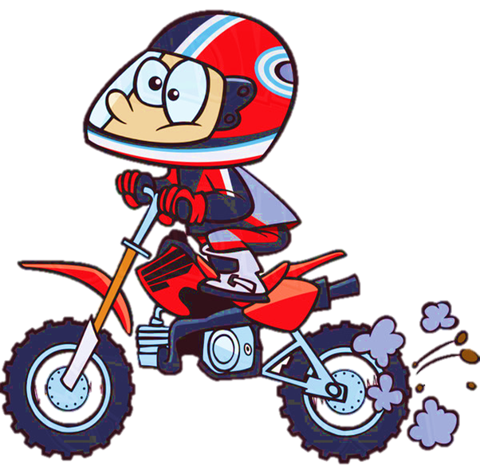
STAGE
1
TIME’S UP
Say the past simple form of the verb
(8 seconds).
play
played
CHECK

Slide 31
Click on the rider
START
5
4
3
2
1
6
7
8
9
10
15
14
13
12
11
16
17
18
19
20
25
24
23
22
21
FINISH LINE

Slide 32
STAGE
2
TIME’S UP
Say the past simple form of …
make
made
CHECK

Slide 33
Click on the rider
START
5
4
3
2
1
6
7
8
9
10
15
14
13
12
11
16
17
18
19
20
25
24
23
22
21
FINISH LINE

Slide 34
STAGE
3
TIME’S UP
Say the past simple form of …
have
had
CHECK

Slide 35
Click on the rider
START
5
4
3
2
1
6
7
8
9
10
15
14
13
12
11
16
17
18
19
20
25
24
23
22
21
FINISH LINE

Slide 36
STAGE
4
TIME’S UP
Say the past form of …
go
went
CHECK

Slide 37
Click on the rider
START
5
4
3
2
1
6
7
8
9
10
15
14
13
12
11
16
17
18
19
20
25
24
23
22
21
FINISH LINE

Slide 38
STAGE
5
TIME’S UP
Say the past simple form of …
paint
painted
CHECK

Slide 39
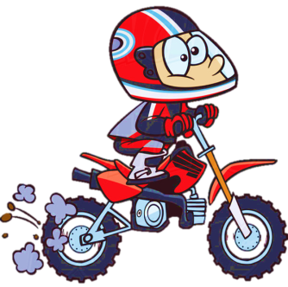
Click on the rider
START
5
4
3
2
1
6
7
8
9
10
15
14
13
12
11
16
17
18
19
20
25
24
23
22
21
FINISH LINE

Slide 40

STAGE
6
TIME’S UP
Say the past simple form of …
sing
sang
CHECK

Slide 41
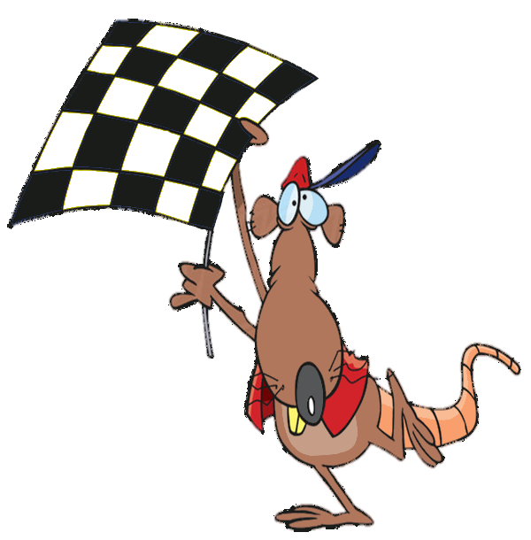

FINISH
GOOD JOB!
YOU ARE THE WINNER!
EXIT

Slide 42

WRAP-UP

Slide 43
Today’s lesson
Vocabularies
Unit 3
Structures/ Sentence patterns
Unit 3

Slide 44
Homework
Practice the vocabularies and structure, and make sentences using them.
Do the exercises in Tiếng Anh 5 i-Learn Smart Start WB (page 31).
Do the exercises in Tiếng Anh 5 i-Learn Smart Start Notebook.
Prepare the next lesson (page 48 SB).
Play the consolidation games in Tiếng Anh 5 i-Learn Smart Start DHA App on www.eduhome.com.vn

Slide 45

Enjoy your day!

Slide 46

Lesson 3
Stay positive and have a nice day!

