Slide 1

Unit 3: MY FRIENDS AND I
Culture - Lesson 3
Page 45

Slide 2
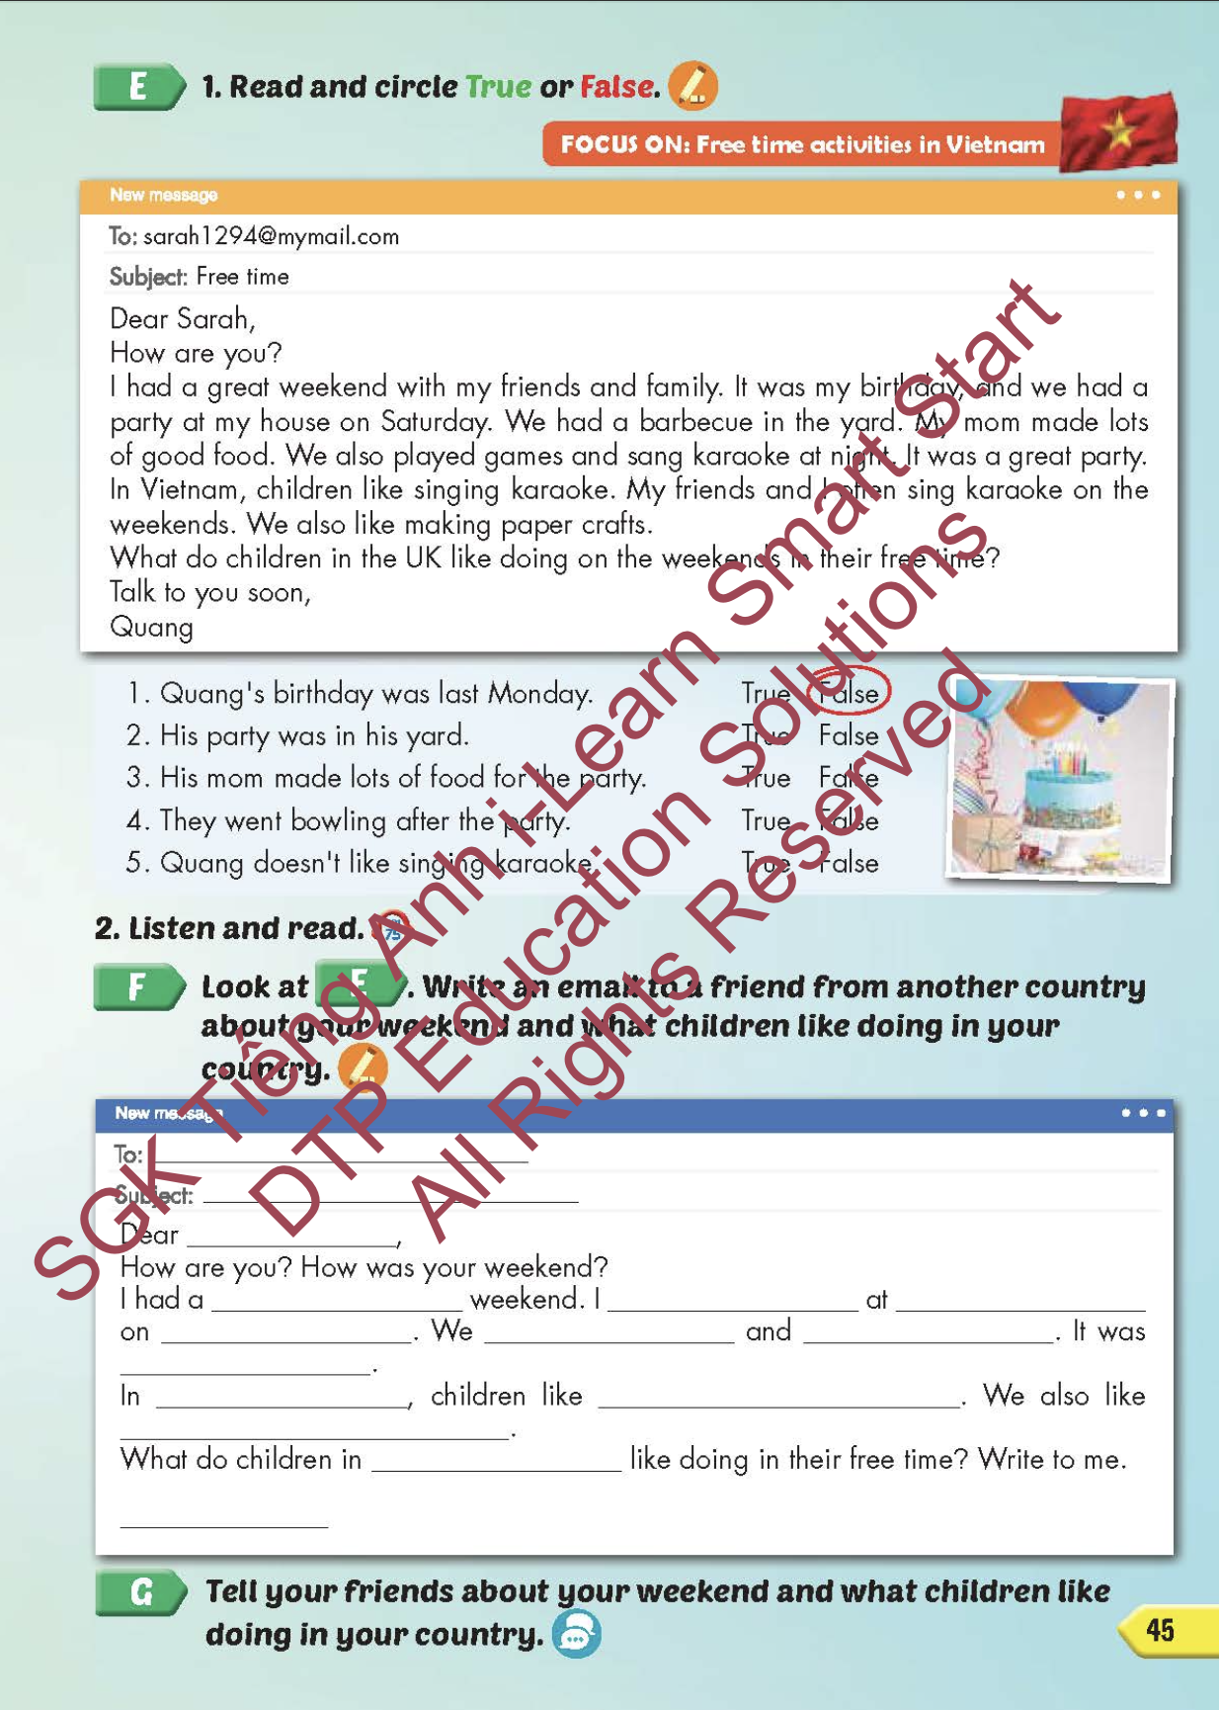
Lesson Outline
Warm-up
Reading
Writing
Speaking
Consolidation
Wrap-up

Slide 3
Objectives
By the end of this lesson, students will be able to familiarize themselves with aspects of Vietnamese culture. Then students will be able to talk about what they and their friends did in the past and when.
Vocabulary: have a sleepover, go camping, have a barbecue, sing karaoke, go bowling, make paper crafts.
Structure: I went camping last week.

Slide 4

WARM-UP

Slide 5
Memory game

Slide 6
The first student chooses 2 numbers.
If the pictures match (a verb in present tense and its past tense), the student wins a point.

Slide 7
Memory
Sing
Watch
Had
planted
stayed
played
1
2
3
4
5
6
Hide All
Show All
Go
8
11
12
plant
stay
Watched
play
paint
7
9
10
Went
14
15
17
13
were
Have
Walk
Sang
make
16
18
Walked
20
22
23
was
made
19
21
are
is
painted
24

Slide 8

It’s time to learn …

Slide 9

Lead-in

Slide 10

WHAT COUNTRY IS IT?

Slide 11
LIST 5 THINGS ABOUT VIETNAM!
It’s a beautiful country in …..
……. is the capital city.
Ho Chi Minh is in the …...
…………………..
…………………..

Slide 12
Practice

Slide 13

Reading

Slide 14


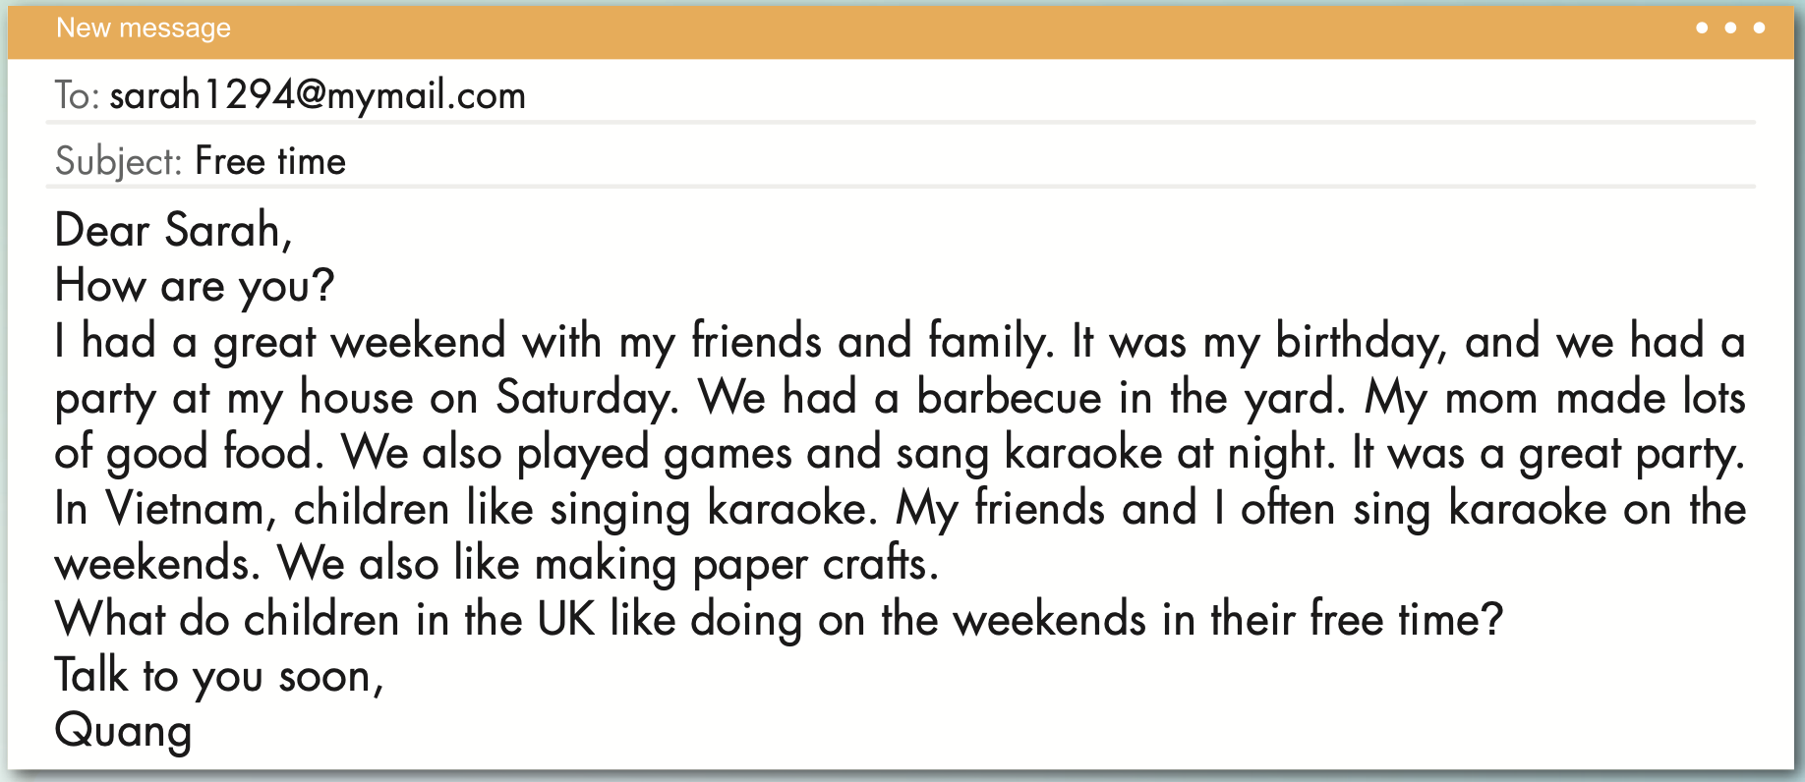

Slide 15
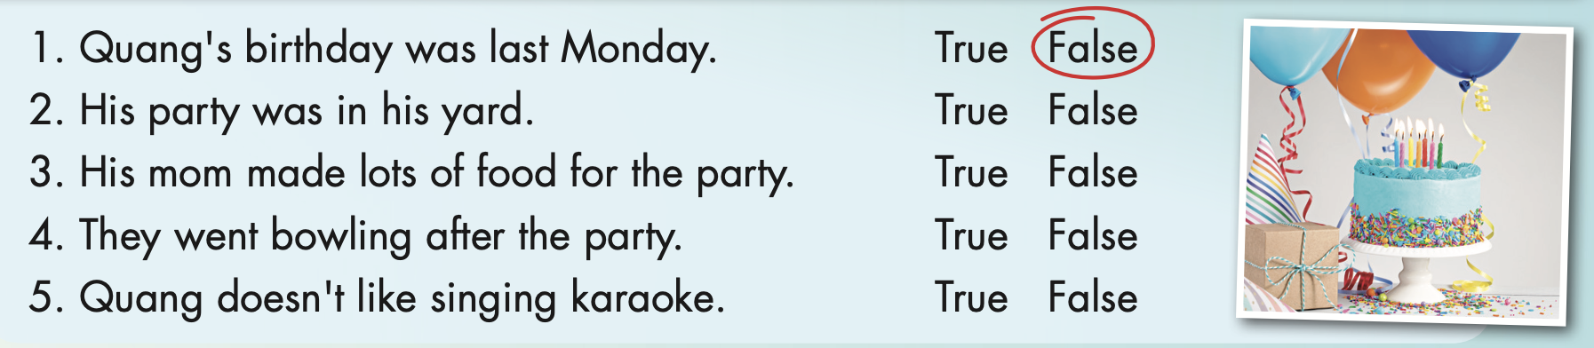

Slide 16



Slide 17
READ AND CHOOSE THE CORRECT OPTION.
START

Slide 18

was
Quang’ birthday ……… last Saturday.
had

Slide 19
was
had
Quang ……… a party at home.

Slide 20
made
Quang’ mom ……… lots of good food.
makes

Slide 21
liked
like
In Vietnam, Children …….. singing karaoke.

Slide 22

Writing

Slide 23
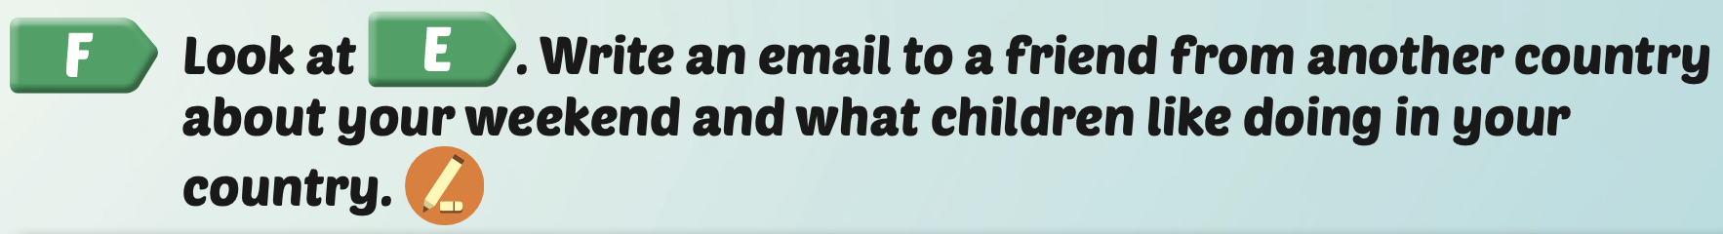
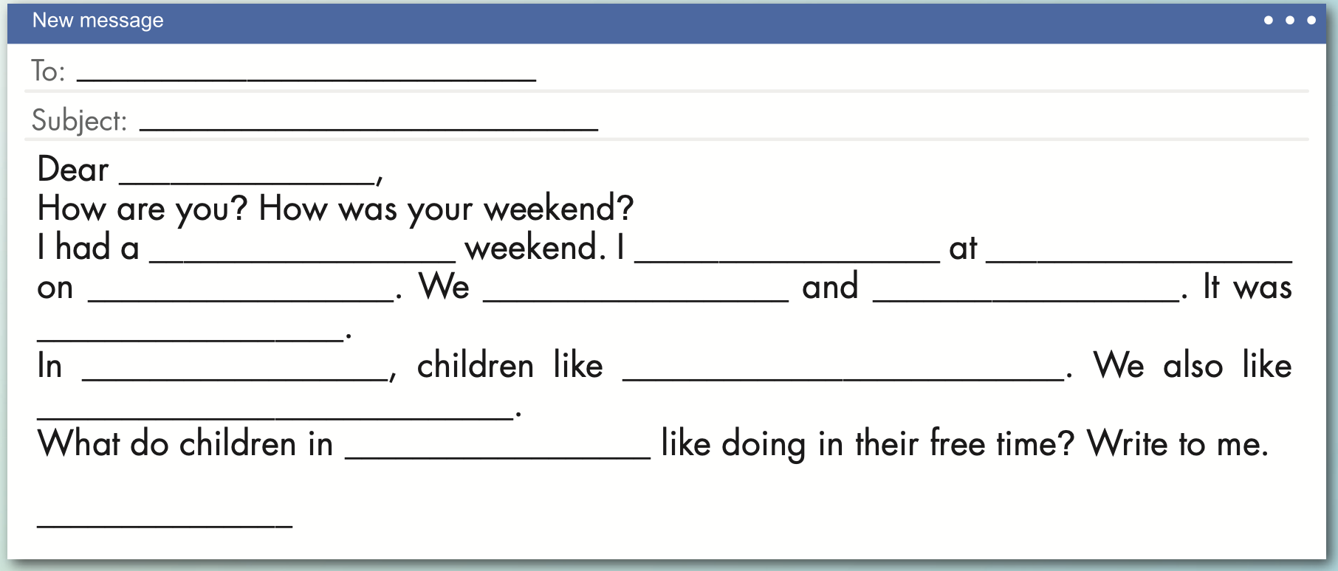
Examples:
lisa1907@mymail.com
Free time
Lisa
great
had a barbecue
my grandparents’ house
Sunday
had lots of good food
really fun
sang karaoke in the afternoon
Vietnam
playing video games in free time
singing karaoke
Ireland
Linh

Slide 24

Production

Slide 25


Slide 26

CONSOLIDATION

Slide 27

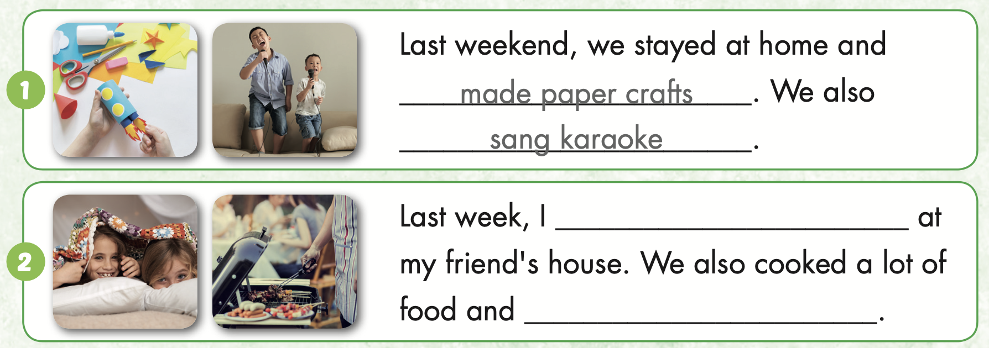
Extra Practice
WB, page 29
had a sleepover
had a barbecue.

Slide 28
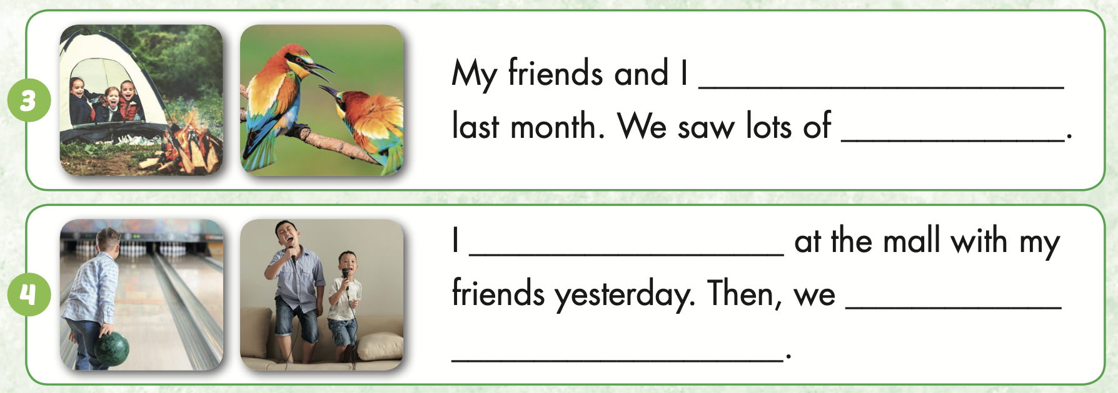
Extra Practice
WB, page 29
went camping
went bowling
sang karaoke.

Slide 29

WRAP-UP

Slide 30
Today’s lesson
Vocabularies
have a sleepover,
go camping,
have a barbecue,
sing karaoke,
go bowling,
make paper crafts.
Structures/ Sentence patterns
I went camping last week.

Slide 31
Homework
Practice the vocabularies and structure, and make sentences using them.
Do the exercises in Tiếng Anh 5 i-Learn Smart Start WB (page 29).
Do the exercises in Tiếng Anh 5 i-Learn Smart Start Notebook.
Prepare the next lesson (page 46 SB).
Play the consolidation games in Tiếng Anh 5 i-Learn Smart Start DHA App on www.eduhome.com.vn

Slide 32

Enjoy your day!

Slide 33

Lesson 3
Stay positive and have a nice day!

