Slide 1

Unit 6: Clothes
Lesson 3.1
Page 88

Slide 2
Lesson Outline
Warm-up
Vocabulary
Structure
Consolidation
Wrap-up

Slide 3
Objectives
By the end of this lesson, students will be able to ask and answer about their clothes.
Vocabulary: belt, scarf, sweater, pajamas, skiing.
Structure: Is that your belt? Yes, it is./No, it isn’t.
Are those your pajamas? Yes, they are./No, they aren’t.

Slide 4

WARM-UP

Slide 5
Let’s play!
Say
the clothes
Click on
the number
Say
the number
3
2
1

Slide 6


1
2

Slide 7
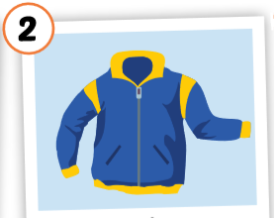
2
1
3

Slide 8
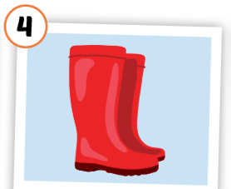
1
4
3
2

Slide 9
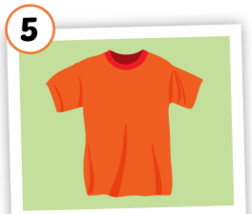
3
1
2
5
4

Slide 10
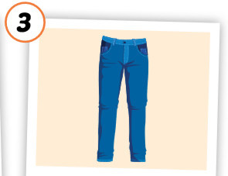
2
1
3

Slide 11
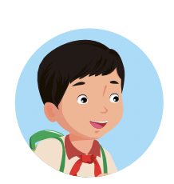
Good job!

Slide 12

It’s time to learn …

Slide 13

New words
belt,
scarf,
sweater,
pajamas,
skiing.

Slide 14

Presentation

Slide 15


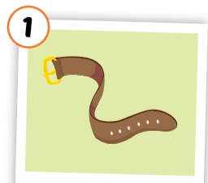
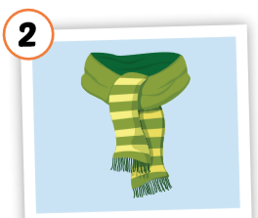
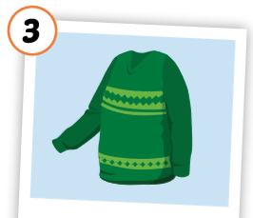
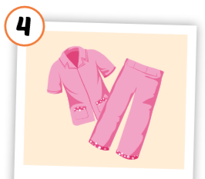
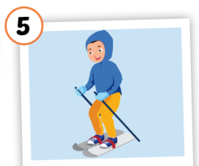
Click each English word to hear the sound.
belt
scarf
sweater
pajamas
skiing
/belt/
thắt lưng
/ skɑːrf /
khăn choàng
/ ˈswetər /
áo len
/ pəˈdʒɑːməz /
quần áo ngủ
/skiːɪŋ/
trượt tuyết

Slide 16
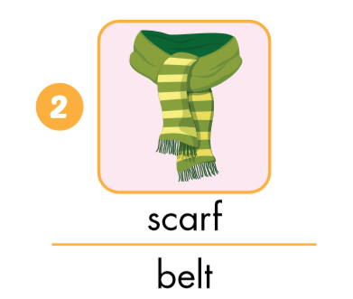
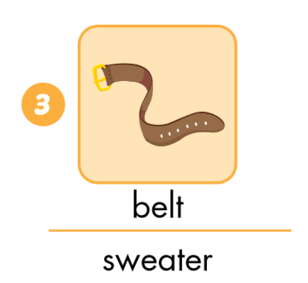
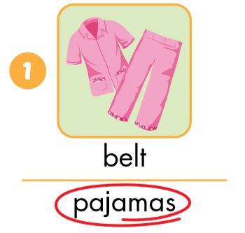
Look and circle.

Slide 17
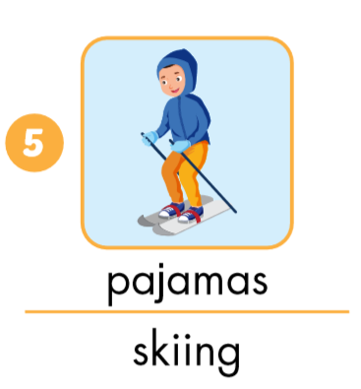
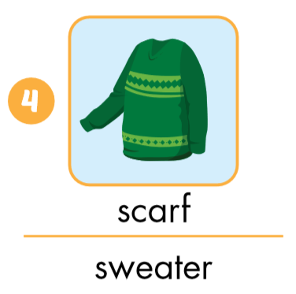
Look and circle.

Slide 18
Put the pictures in the right group.
◆
❖
is
are

Slide 19

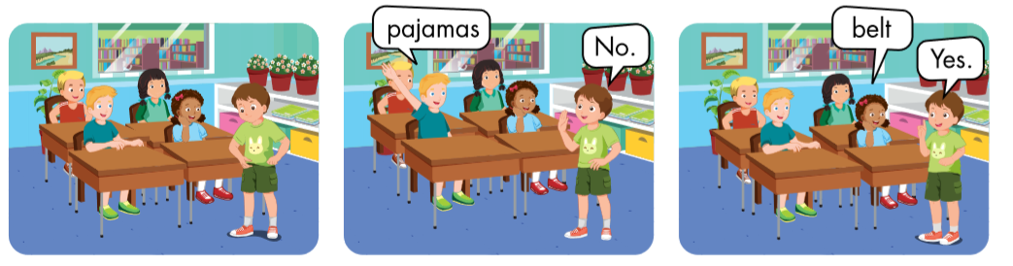

Slide 20

Practice

Slide 21
Structures
Is that your belt?
- Yes, it is./No, it isn’t.
Are those your pajamas?
- Yes, they are./
No, they aren’t.

Slide 22





Click on the earphone to hear the sound.
Is that your belt?
Yes, it is./No, it isn’t.
Are those your pajamas?
Yes, they are./No, they aren’t.

Slide 23

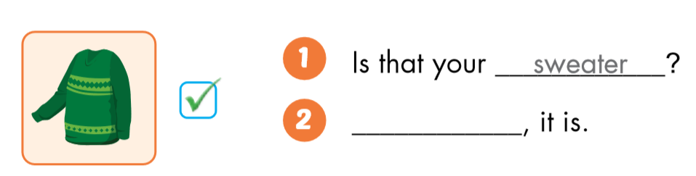
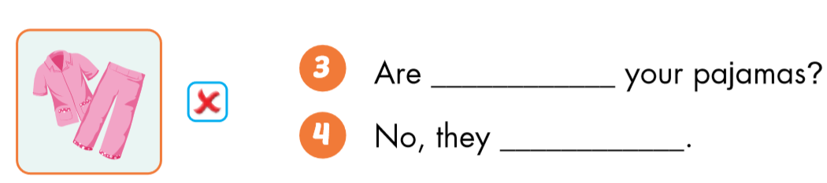
Yes
those
aren’t

Slide 24

Workbook
p. 59

Slide 25

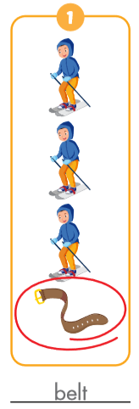
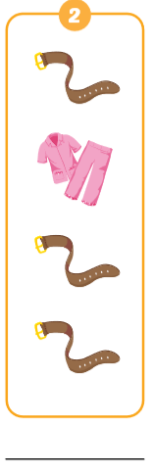
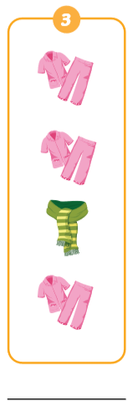
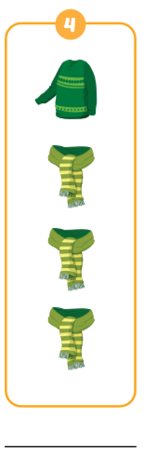
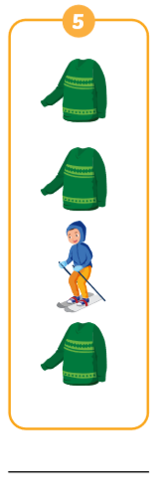
v
belt
pajamas
scarf
sweater
skiing

Slide 26

CONSOLIDATION

Slide 27
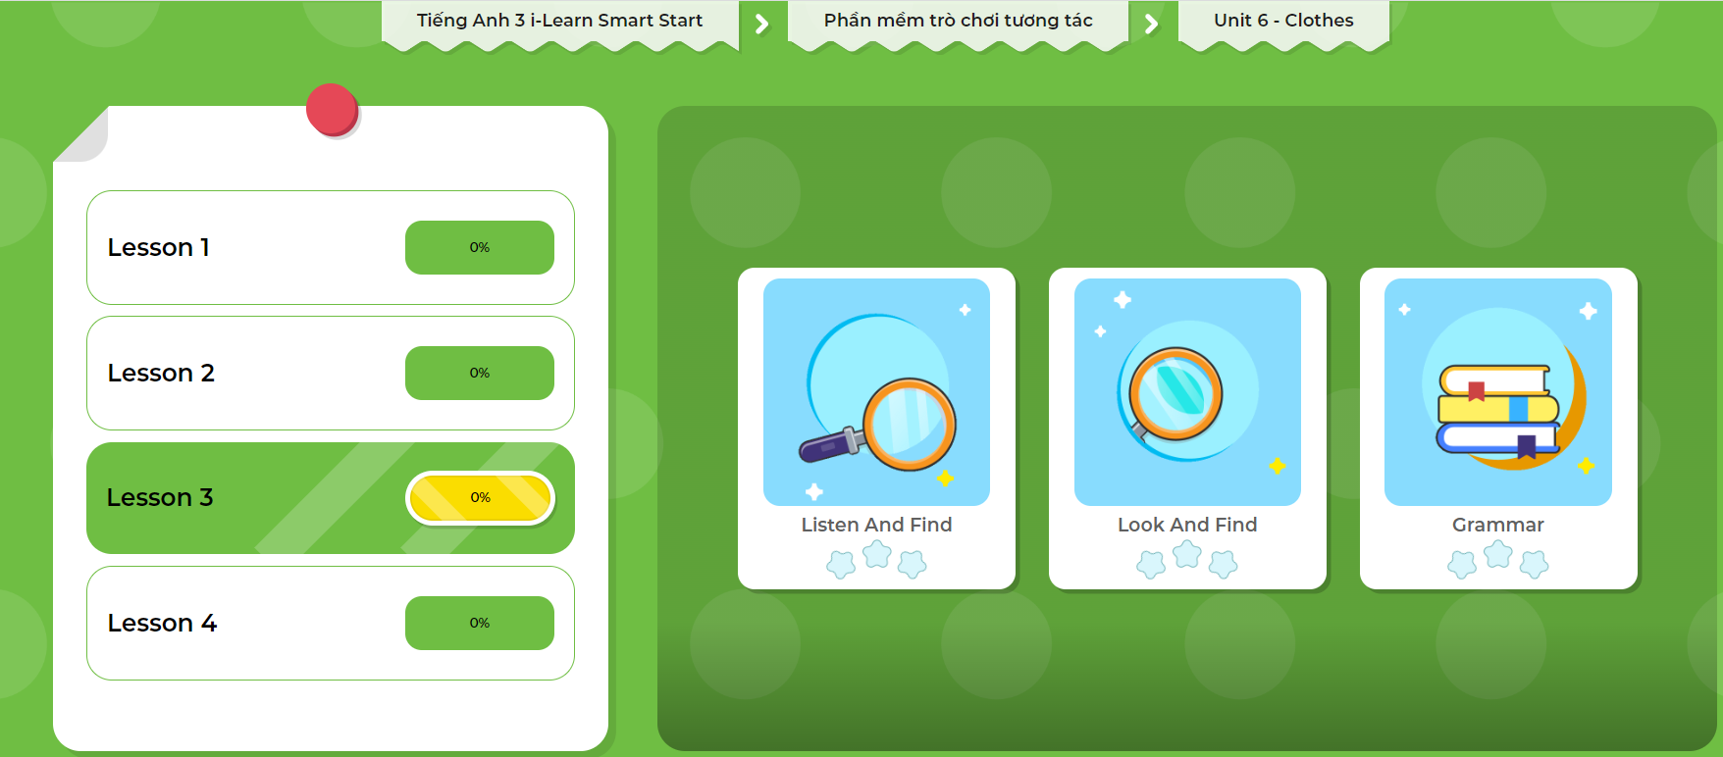
Click here to play the games!

Slide 28

Let’s draw!
Work in pairs.
Draw your clothes thing.
Tell your friend about your picture.

Slide 29

WRAP-UP

Slide 30
Today’s lesson
Vocabularies
belt,
scarf,
sweater,
pajamas,
skiing
Structures/ Sentence patterns
Is that your belt?
- Yes, it is./No, it isn’t.
Are those your pajamas?
- Yes, they are./No, they aren’t.

Slide 31
Homework
Practice the vocabularies and structure, and make sentences using them.
Do the exercises in Tiếng Anh 3 i-Learn Smart Start Workbook (page 62).
Prepare the next lesson (page 89 SB).
Play the consolidation games in Tiếng Anh 3 i-Learn Smart Start DHA App on www.eduhome.com.vn

Slide 32

Enjoy your day!

