Slide 1


UNIT 14. WHAT HAPPEN
IN THE STORY?
LESSON 1

Slide 2

NOW

Slide 3


Slide 4
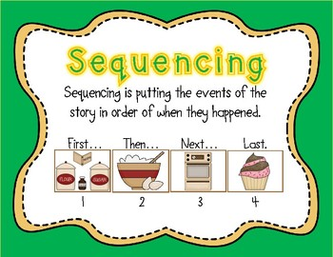

Slide 5

WATERMELON

Slide 6
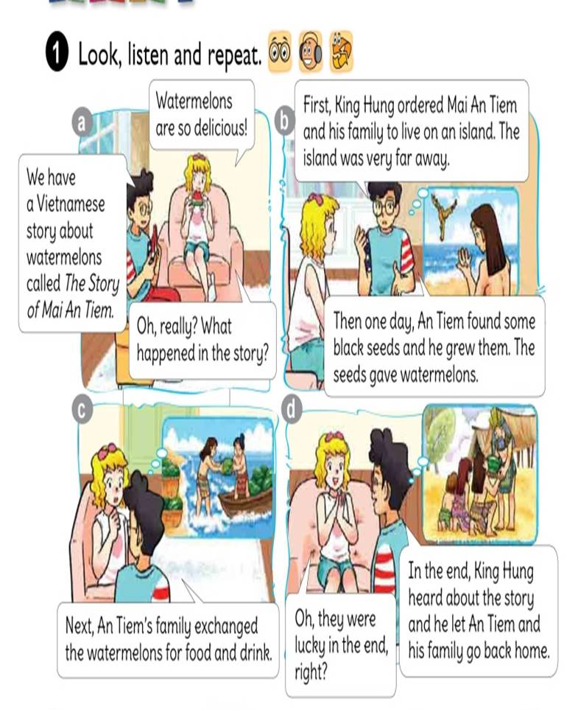



Slide 7

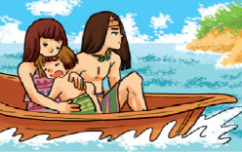
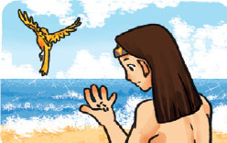
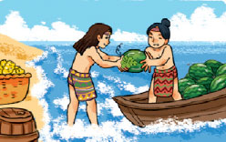
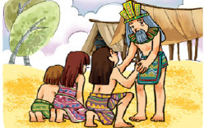
MATCHING
Then
In the end
Next
First

Slide 8



FIRST …
King Hung ordered Mai An Tiem and his family to live on an island. The island was very far away.

Slide 9
THEN …
One day, An Tiem found some black seeds and he grew them. The seeds gave watermelons.

Slide 10
NEXT …
An Tiem’s family exchanged the watermelons for food and drink.

Slide 11
IN THE END …
King Hung heard about the story and he let An Tiem and his family go back home.

Slide 12
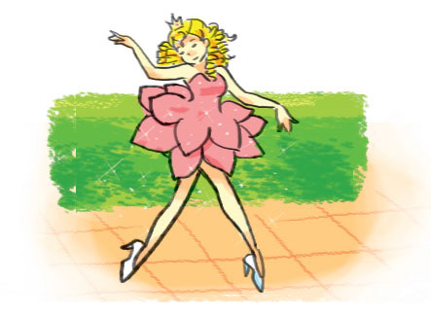
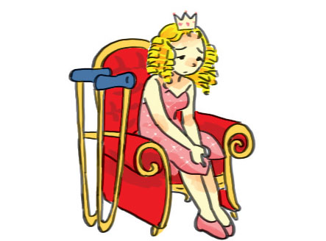
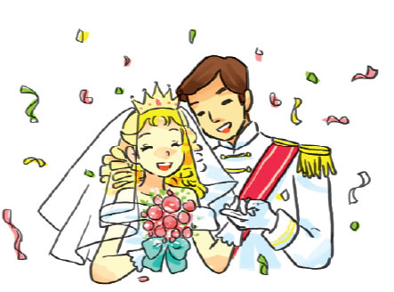
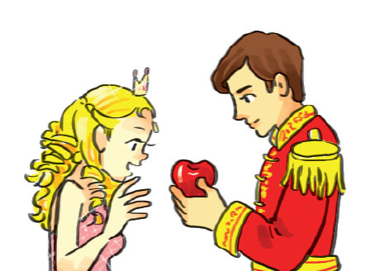

LISTEN AND NUMBER
4
a
1
b
5
c
2
3
e
d

Slide 13
READ AND COMPLETE
In the end
apple
Got up
legs
princess
Many years ago, there was a very beautiful (1) who
lived in a castle.The princess had a problem with her (2) and couldn’t walk. One day, a prince visited the castle and met the beautiful princess. He gave her an (3) and said, “This magic apple can make you walk!” The princess was very happy. She ate the apple. Then the next morning, she (4) and was so surprised because she could walk and run and dance. (5) , the prince and the princess got married and lived happily ever after.
princess
legs
apple
got up
In the end

Slide 14
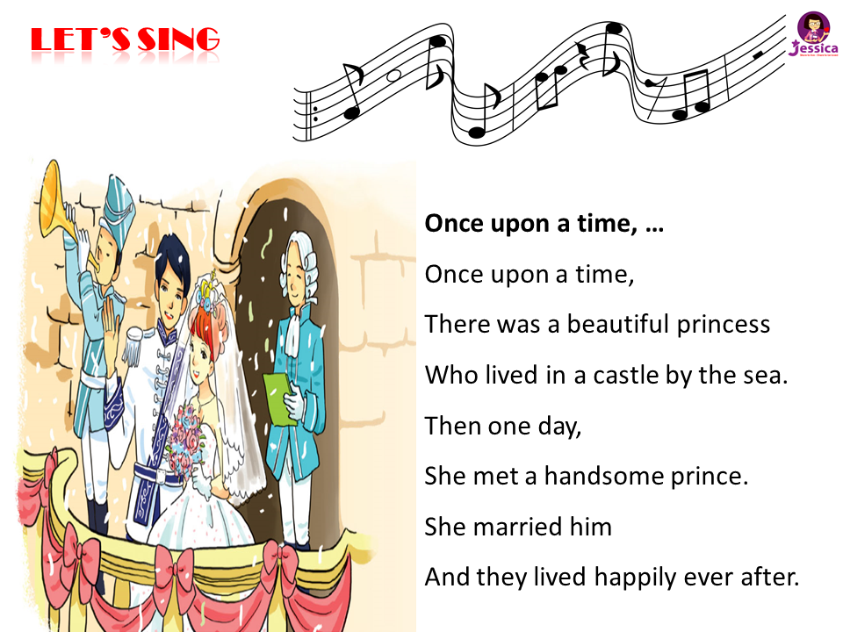
LET’S SING

