Slide 1

Unit 6
DESCRIBING PEOPLE
LESSON 3.1 - PAGE 84

Slide 2
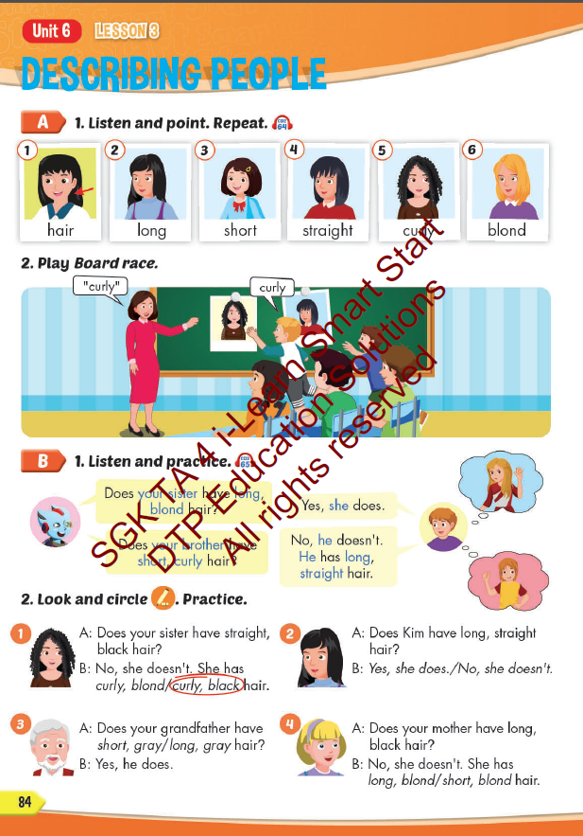
Lesson Outline
Warm-up
Vocabulary
Structure
Consolidation
Wrap-up

Slide 3
Objectives
By the end of this lesson, students will be able to describe hairstyles.
Vocabulary: hair, long, short, straight, curly, blond.
Structure:
Does your sister have long, blond hair?
- Yes, she does.
Does your brother have short, curly hair?
- No, he doesn't. He has long, straight hair.

Slide 4

WARM UP

Slide 5

have or has
GAME

Slide 6
Great
She________ a small nose.
have
has

Slide 7
Great
I _______ big eyes .
have
has

Slide 8
Great
My father_______ a mustache.
have
has

Slide 9
Great
He doesn’t_______ big ears.
have
has

Slide 10

It’s time to learn …

Slide 11

New words
hair,
long,
short,
straight,
curly,
blond.

Slide 12

Presentation

Slide 13

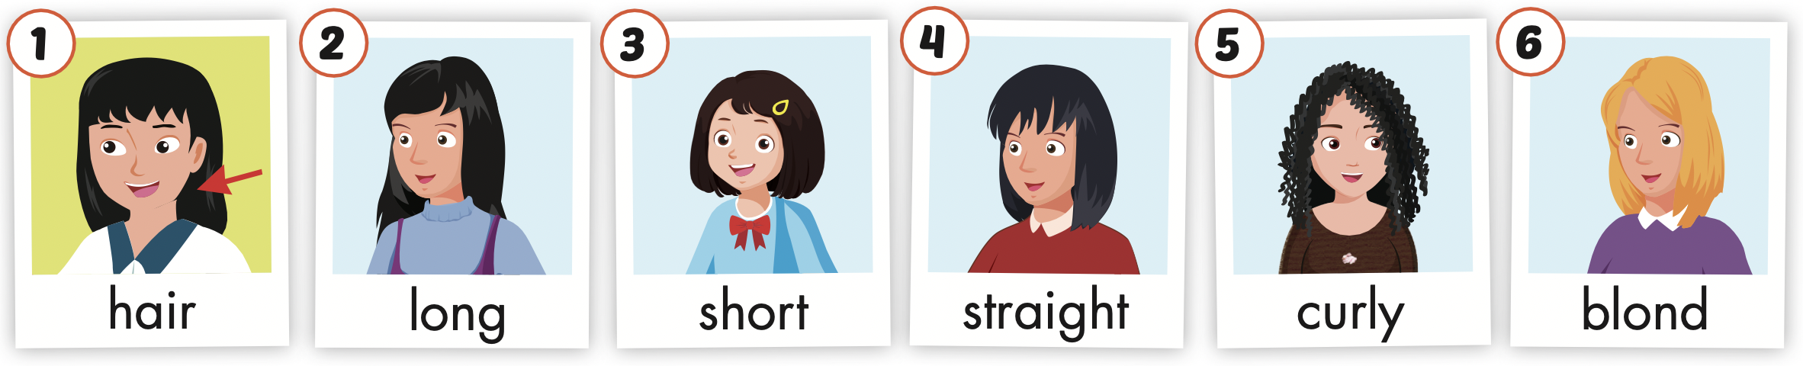
Click the icon to hear the sound.

Slide 14
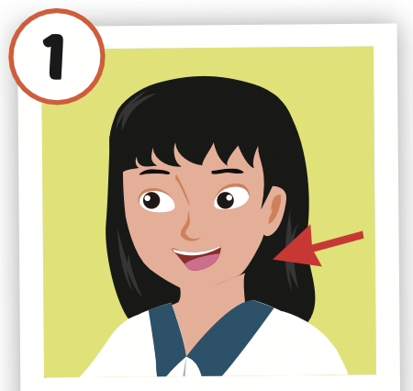
Click the picture to hear the sound.
hair
/her/
tóc

Slide 15
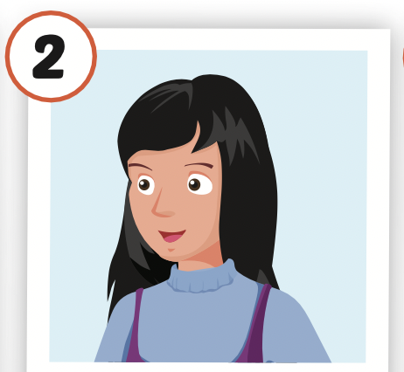
Click the picture to hear the sound.
long
/lɑːŋ/
dài

Slide 16
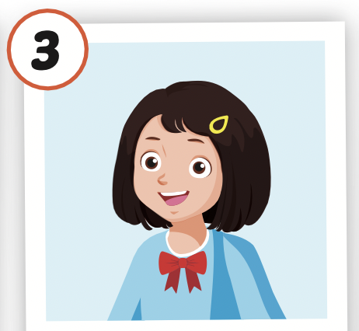
Click the picture to hear the sound.
short
/ʃɔːrt/
thấp, ngắn

Slide 17
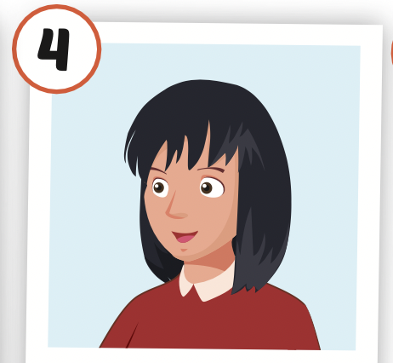
Click the picture to hear the sound.
straight
/streɪt/
thẳng

Slide 18
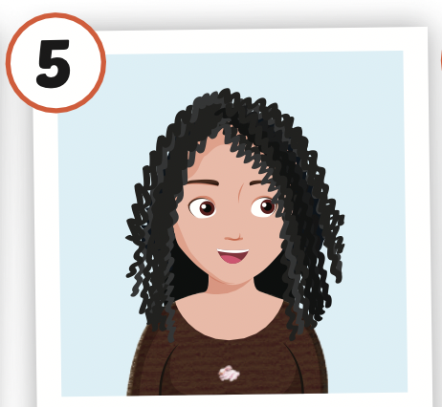
Click the picture to hear the sound.
curly
/ˈkɜːrli/
xoăn, quăn

Slide 19
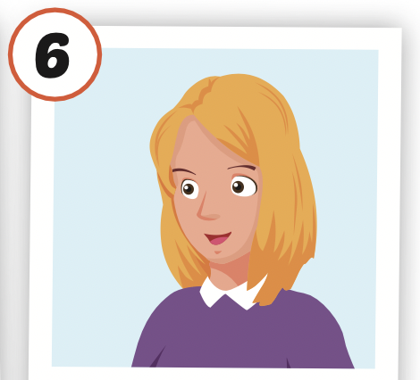
Click the picture to hear the sound.
blond
/blɑnd/
(tóc) vàng hoe

Slide 20

Practice

Slide 21



LISTEN AND CHOOSE

Slide 25

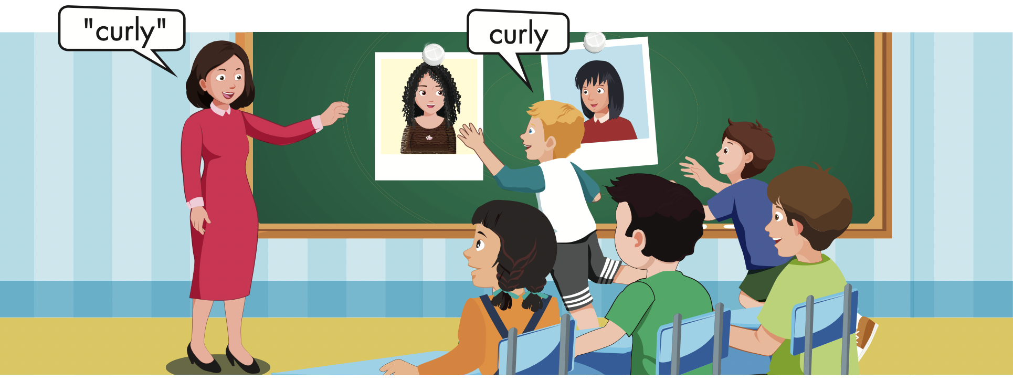

Slide 26
Structures
Does your sister have long, blond hair?
- Yes, she does.
Does your brother have short, curly hair?
- No, he doesn't. He has long, straight hair.

Slide 27
Presentation

Slide 28

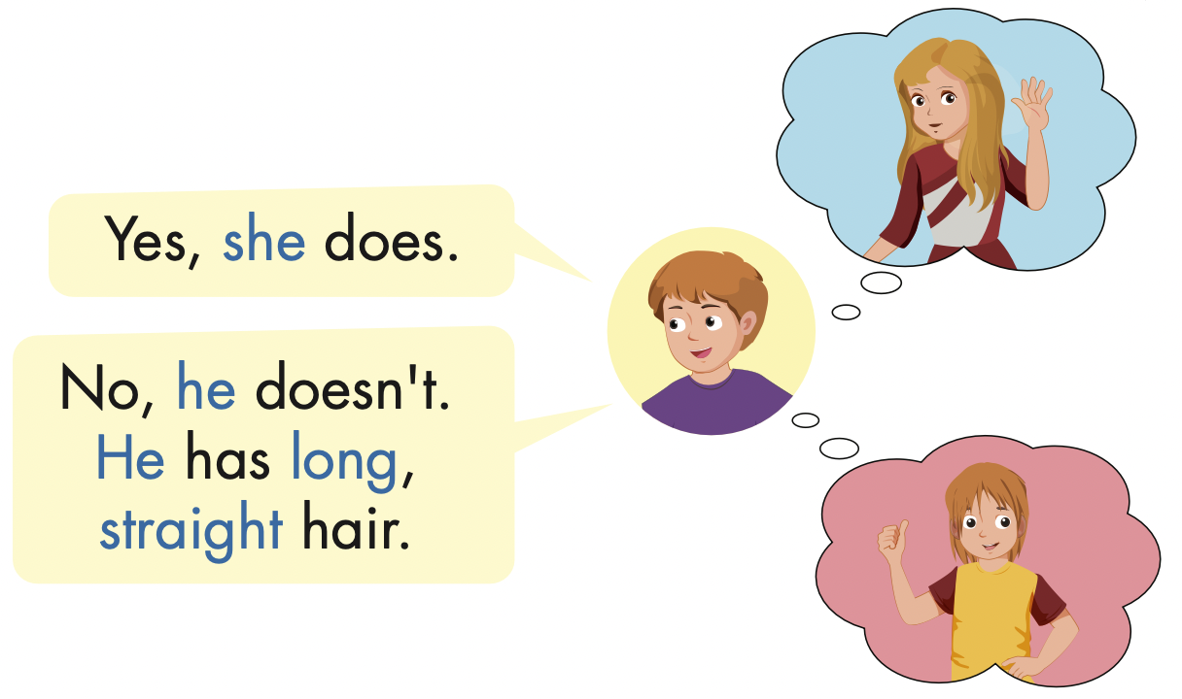
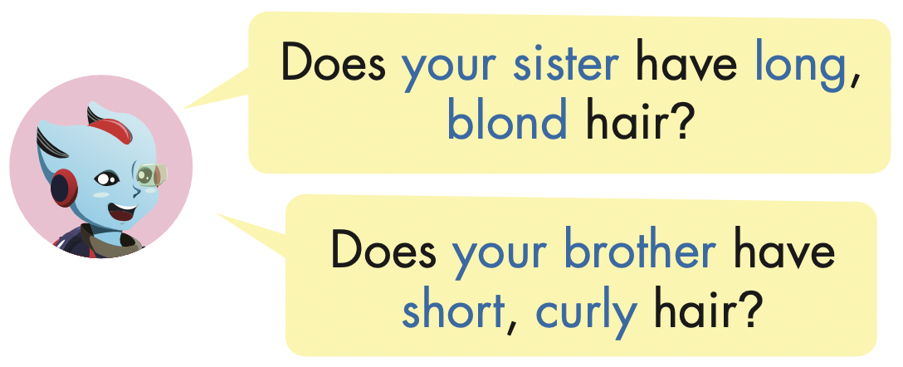

Slide 29
Practice

Slide 30
Does she have long curly hair?
Yes, she does.

Slide 31
Does she have straight, black hair?
No, she doesn’t.
She has straight, blond hair.

Slide 32
No, she doesn’t.
She has short, black hair.
Does your sister have long, black hair?

Slide 33
Does Kim have long, straight hair?
Yes, she does.

Slide 34

Writing

Slide 35

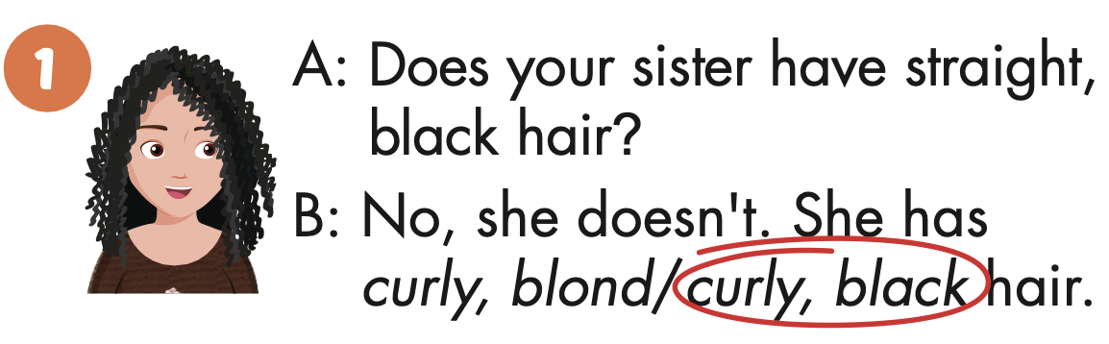

Slide 36
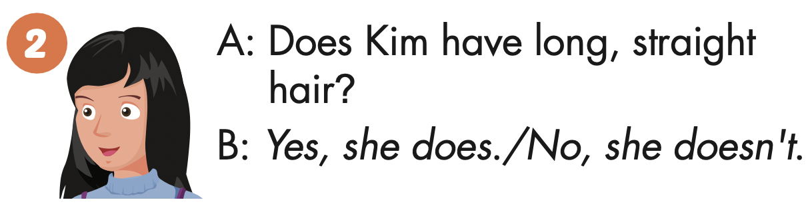

Slide 37
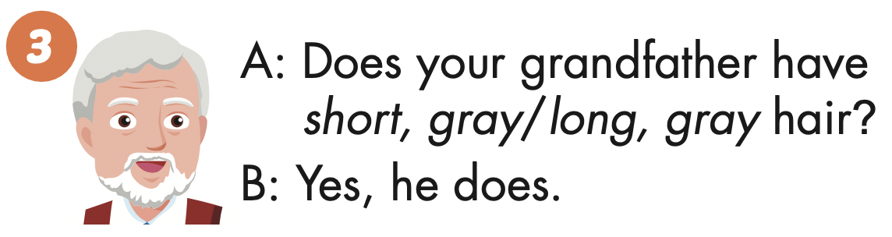

Slide 38
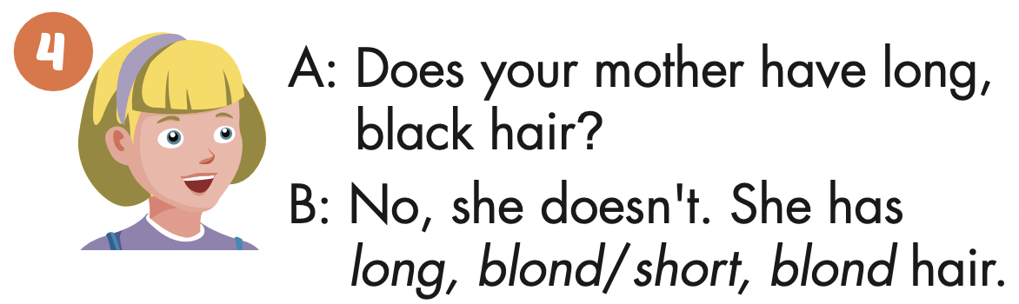

Slide 39

Production

Slide 40

Read and answer

Slide 41
Next
CHECK
Does she have short, black hair?
Yes, she does.
…………….………………….

Slide 42
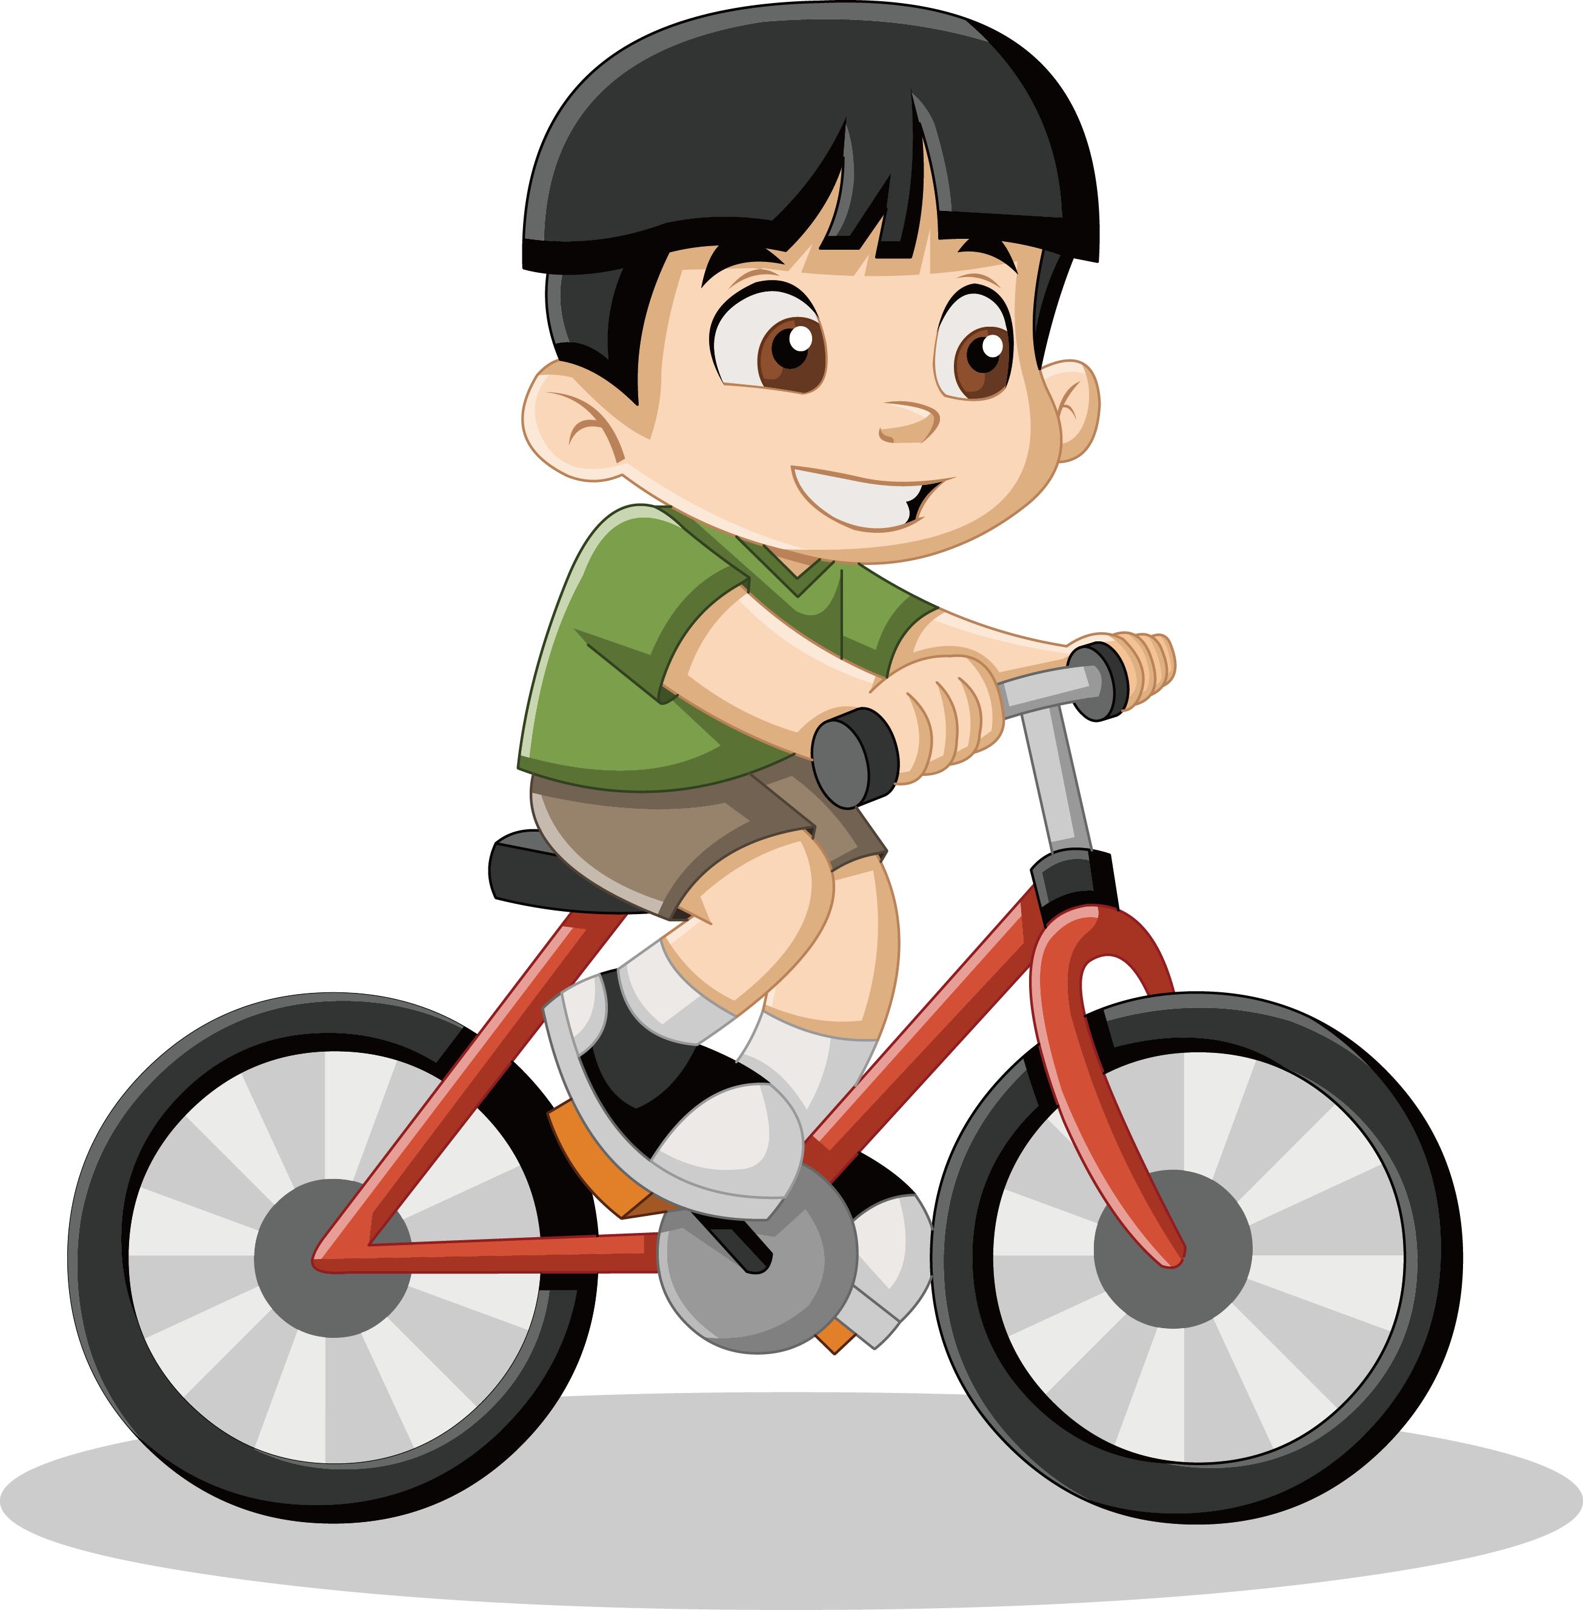
Next
CHECK
Does he have long, black hair?
No, he doesn’t.
…………….………………….

Slide 43

Next
CHECK
Does Tom have curly, black hair?
Yes, he does.
…………….………………….

Slide 44
Next
CHECK
Does your friend have curly, blond hair?
No, she doesn’t.
…………….………………….

Slide 45

CONSOLIDATION

Slide 46

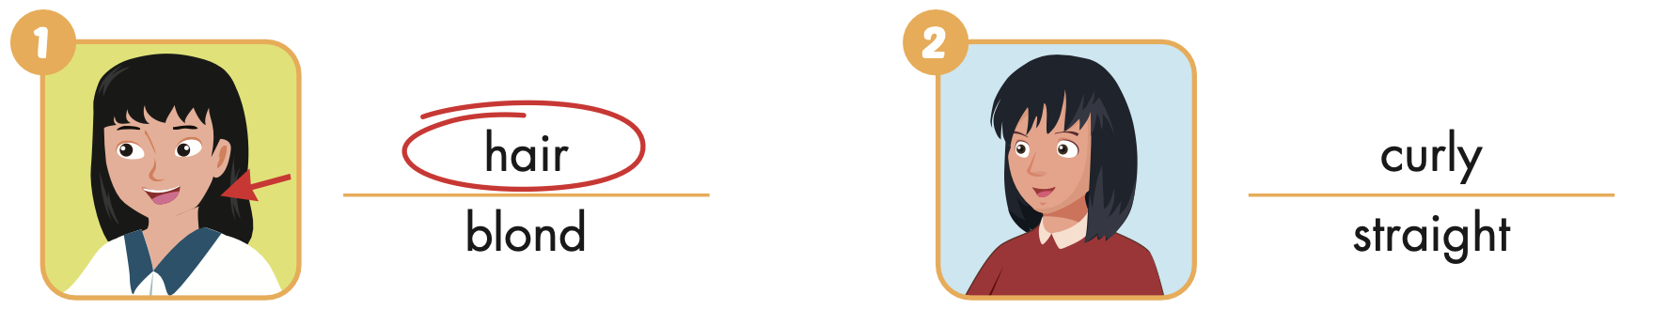
Extra Practice
WB, page 16

Slide 47
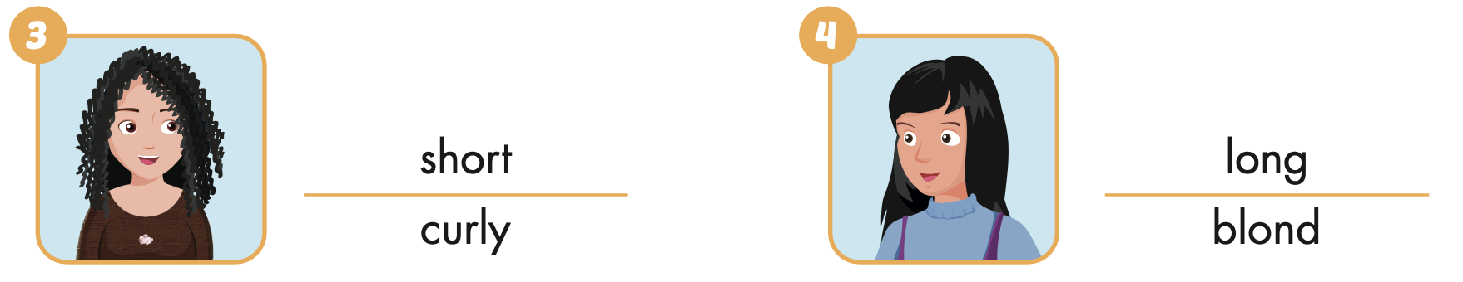
Extra Practice
WB, page 16

Slide 48
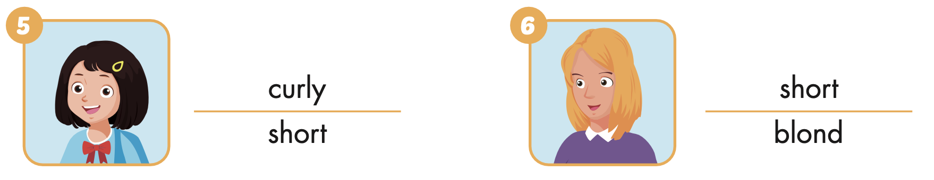
Extra Practice
WB, page 16

Slide 49

WRAP-UP

Slide 50
Today’s lesson
Vocabularies
hair,
long,
short,
straight,
curly,
blond.
Structures/ Sentence patterns
Does your sister have long, blond hair?
- Yes, she does.
Does your brother have short, curly hair?
- No, he doesn't. He has long, straight hair.

Slide 51
Homework
Practice the vocabularies and structure; and make sentences using them.
Do the exercises in Tiếng Anh 4 i-Learn Smart Start WB (page 56)
Do the exercises in Tiếng Anh 4 i-Learn Smart Start Notebook (page 36).
Prepare the next lesson (page 85 SB)
Play the consolidation games in Tiếng Anh 4 i-Learn Smart Start DHA App on www.eduhome.com.vn

Slide 52

Enjoy your day!

