Slide 1

UNIT 13. WHAT DO YOU DO IN YOUR FREE TIME?
LESSON 2

Slide 2
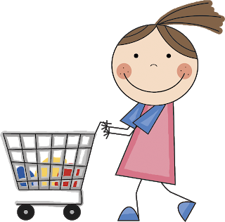
GO SHOPPING

Slide 3
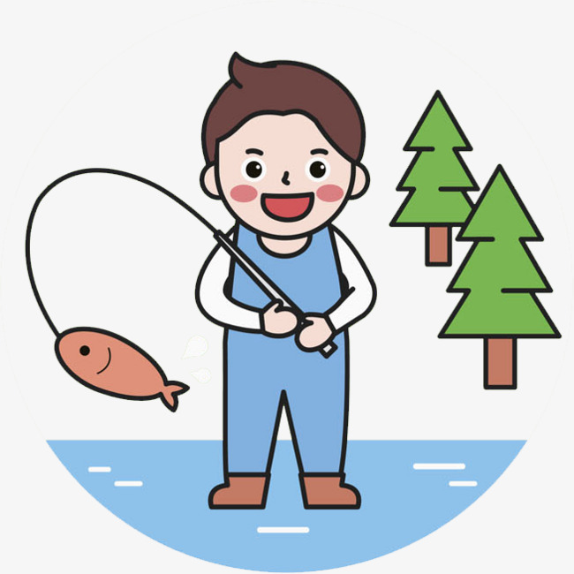
GO FISHING

Slide 4
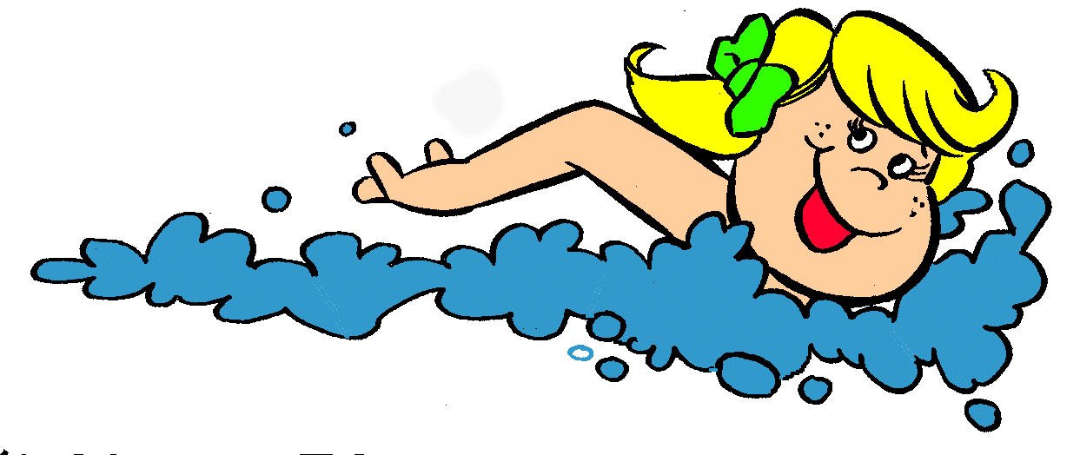
GO SWIMMING

Slide 5

GO SKATING

Slide 6
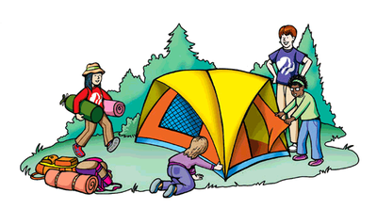
GO CAMPING

Slide 7
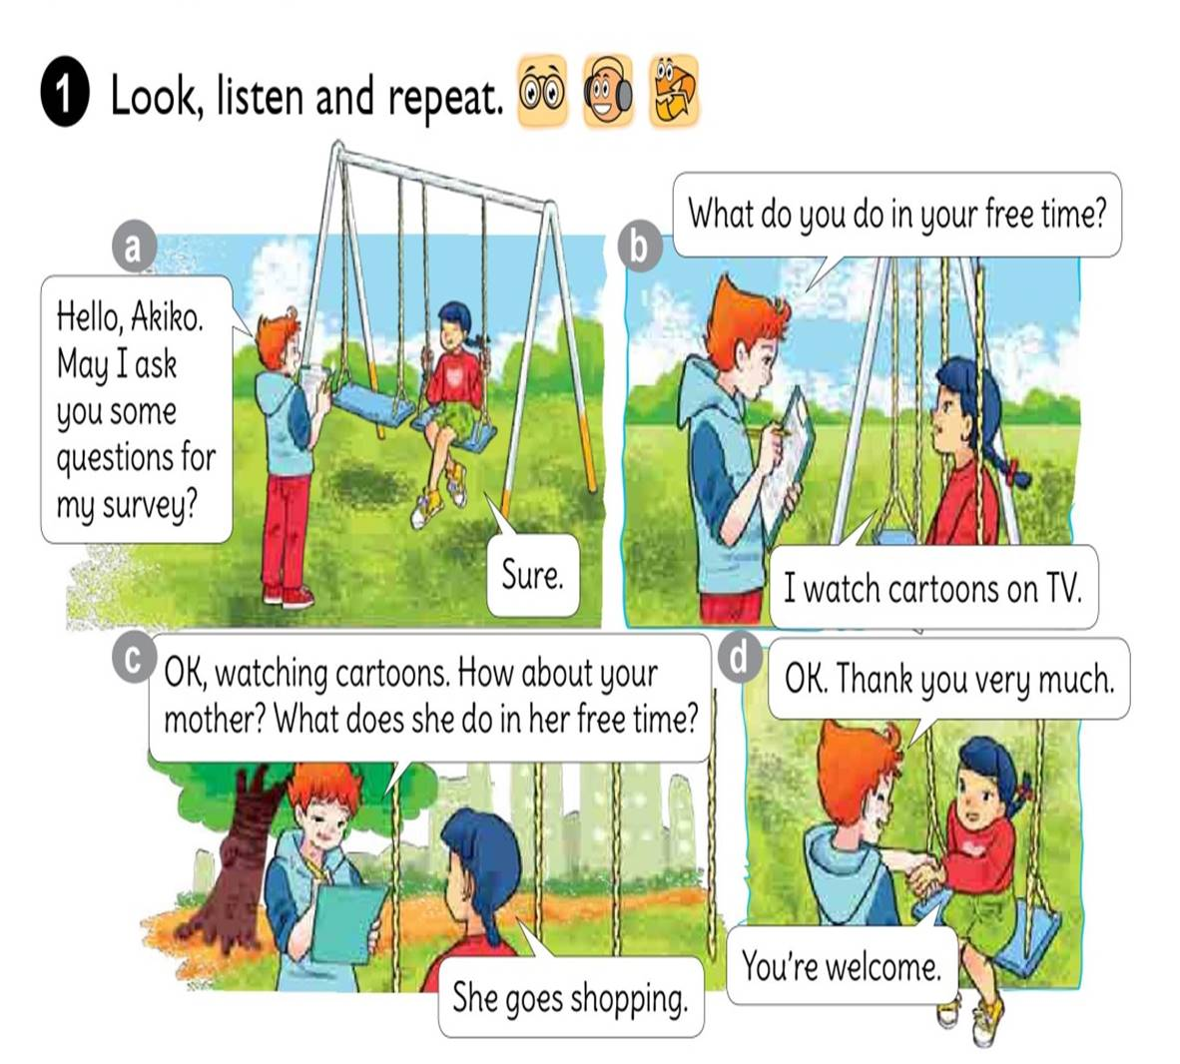




Slide 8
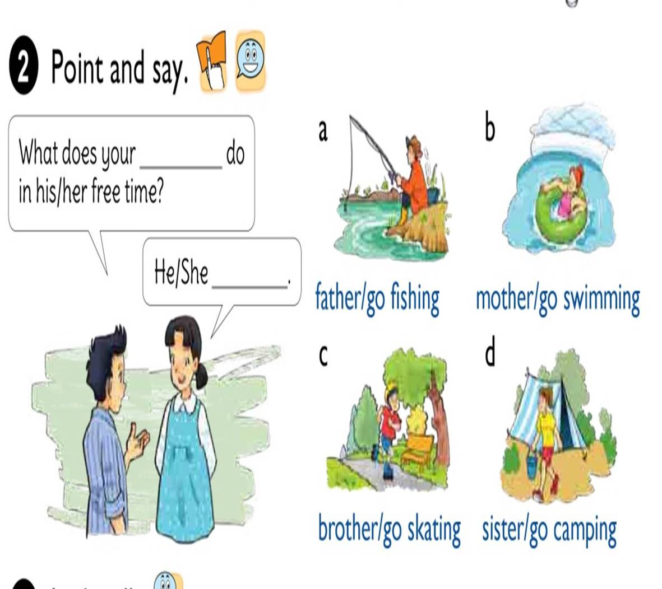

Slide 9


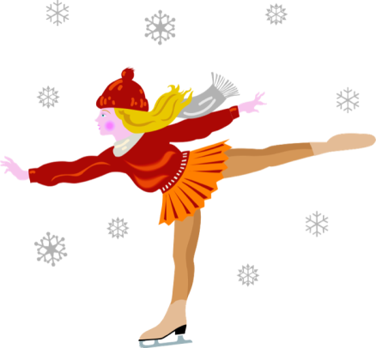
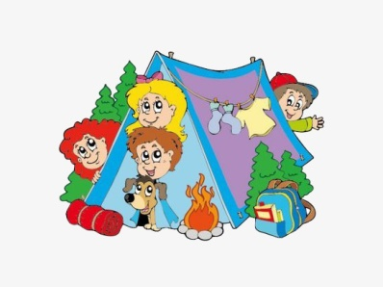
1. Vocabulary
- Go shopping
- Go fishing
- Go swimming
- Go skating
- Go camping
2. Model sentence
What does your father do in his free time?
He goes fishing.

Slide 10
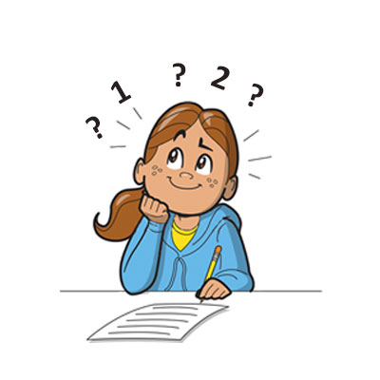

What does your do in his free time?
father
He
goes fishing.

Slide 11
What does your do in her free time?
mother
She
goes swimming.

Slide 12
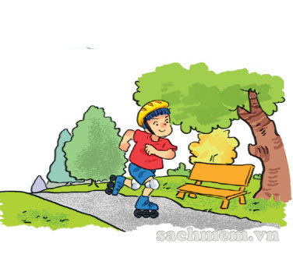
What does your do in his free time?
brother
He
goes skating.

Slide 13

What does your do in her free time?
sister
She
goes camping.

Slide 14

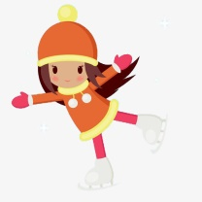



LISTEN AND circle
1.Phong often goes ___________ in his free time.
a.fishing b.camping c.skating
2.His father ___________ twice a week.
a.does karate b.plays football c.works in the garden
3.His mother goes ___________ at weekends.
a.swimming b.shopping c.camping
4.His sister ___________ in her free time.
a.surfs the Internet b.does homework c.cleans the house

Slide 15

Write abour your family member
1. What do you do in your free time?
→
2. How often do you do it?
→
3. What does your father do in his free time?
→
4. What does your mother do in her free time?
→
I surf the Internet.
Every day.
He goes fishing.
She goes shopping.

Slide 16
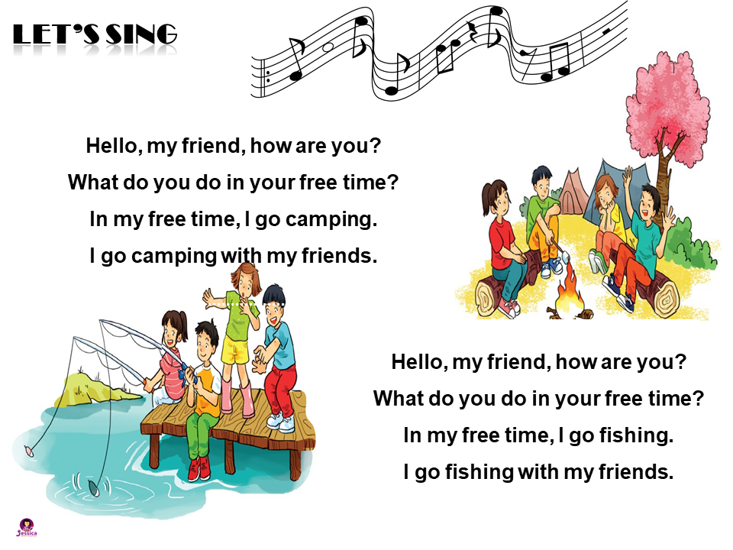

LET’S SING

