Slide 1

Unit 6
DESCRIBING PEOPLE
LESSON 1. 1 - PAGE 78

Slide 2

WARM UP

Slide 3

Pass the Ball Game
Pass the ball.
When the music stops – whoever has the ball must answer the question.

Slide 4

Pass the BALL!

Slide 5

What does this sign mean?

Slide 6
Pass the BALL!

Slide 7


Where's the school?

Slide 8
Pass the BALL!

Slide 9
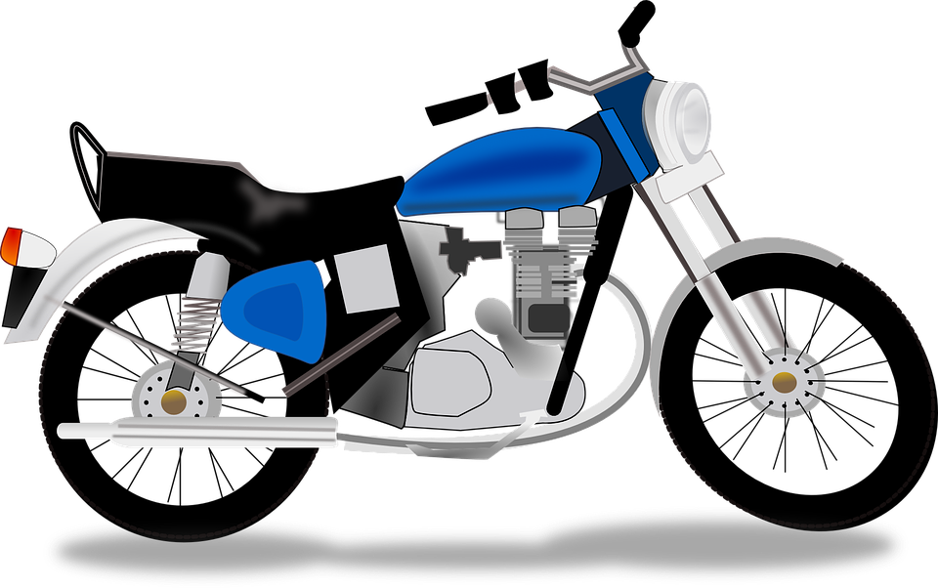
How do you go to school?

Slide 10
Pass the BALL!

Slide 11

How do you go to the library?

Slide 12

It’s time to learn …

Slide 13

New words
tall,
short,
big,
slim,
strong,
weak.

Slide 14

Presentation

Slide 15

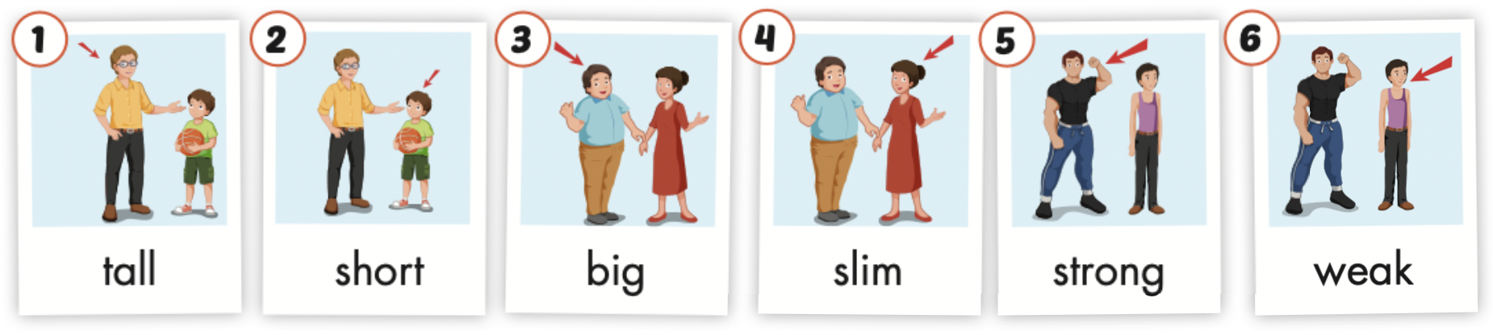
Click the icon to hear the sound.

Slide 16
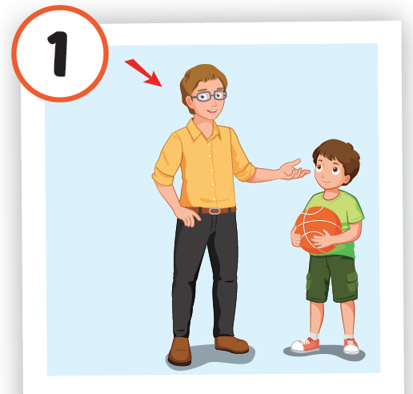
Click the picture to hear the sound.
tall
/tɑːl/
cao

Slide 17
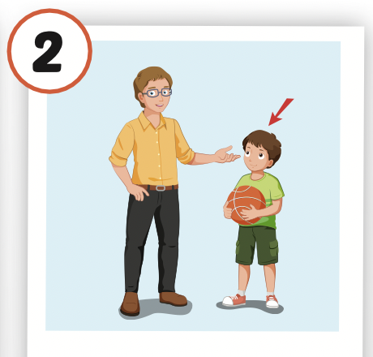
Click the picture to hear the sound.
short
/ʃɔːrt/
thấp, ngắn

Slide 18
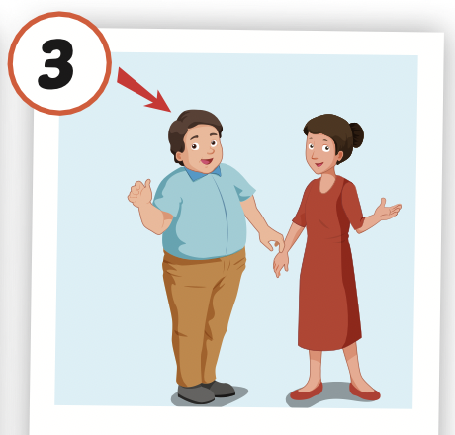
Click the picture to hear the sound.
big
/bɪɡ/
to, lớn

Slide 19
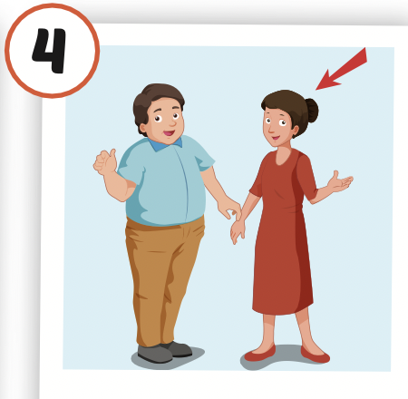
Click the picture to hear the sound.
slim
/slɪm/
mảnh khảnh, thon thả

Slide 20
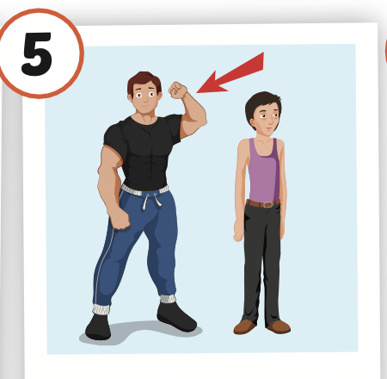
Click the picture to hear the sound.
strong
/strɔːŋ/
khỏe, mạnh

Slide 21
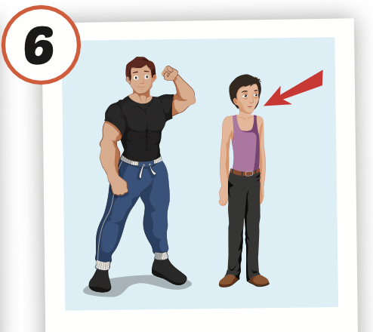
Click the picture to hear the sound.
weak
/wiːk/
yếu

Slide 22

Practice

Slide 23
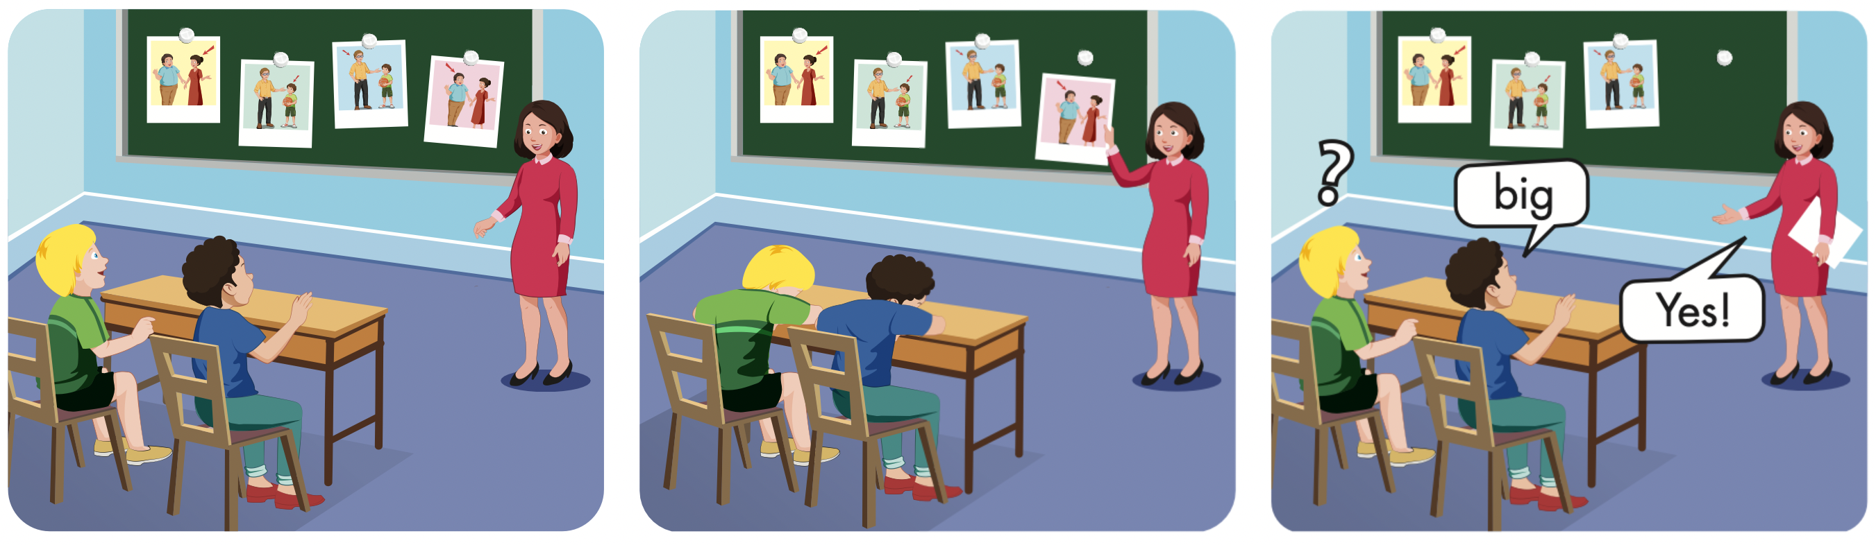

Slide 24
Lucky Numer
A
B
1
2
3
1
2
3
4
5
1
2
3
4
5
4
5
6
7
8
9

Slide 31
Lucky Number

Slide 32
Structures
Is your father big or slim?
He's slim.
Is your sister tall or short?
She's tall.

Slide 33
Presentation

Slide 34

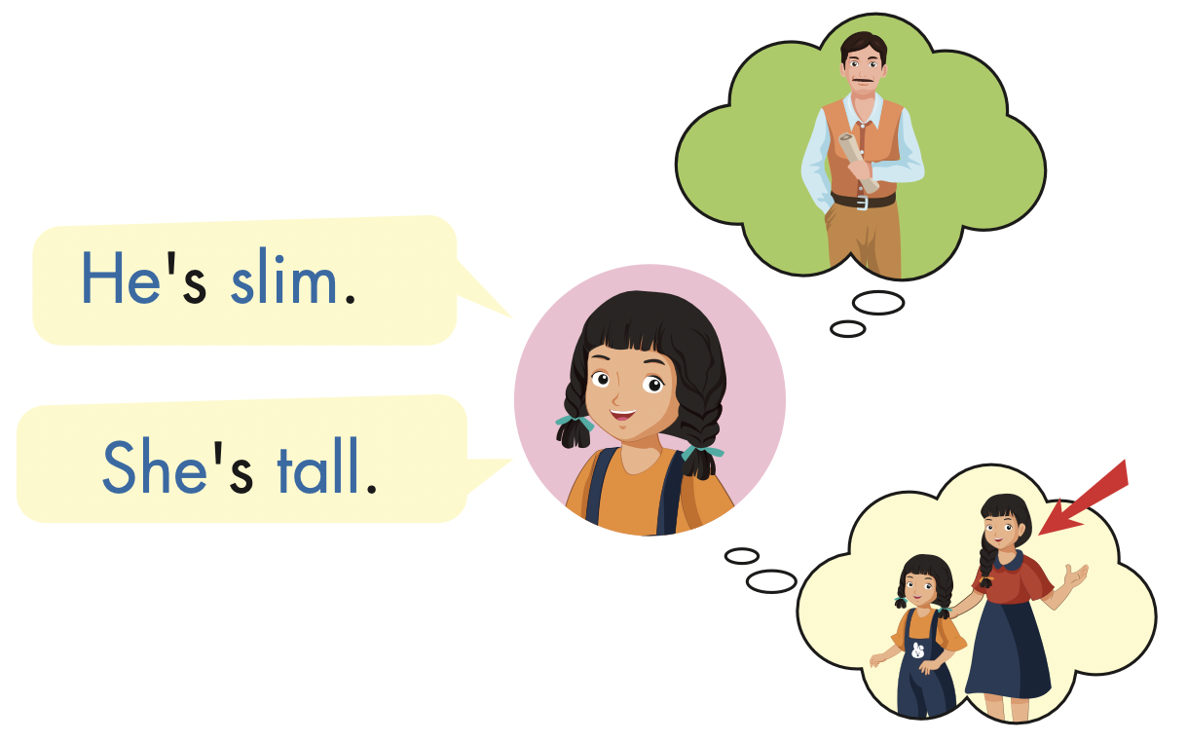
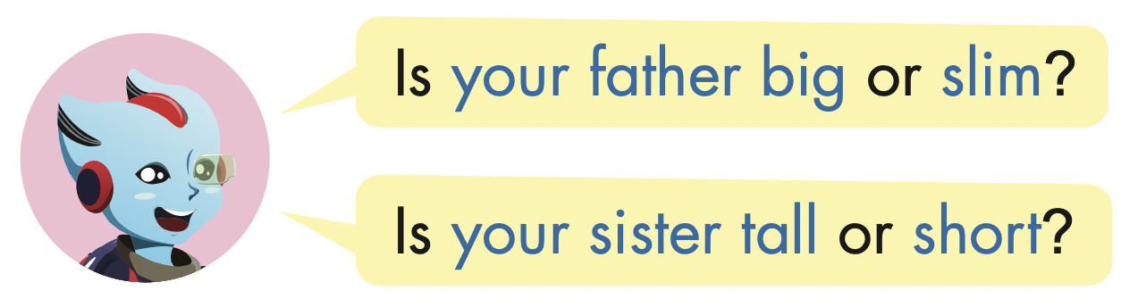

Slide 35
Practice

Slide 36
father/big/ slim/
Is your father big or slim?
He’s slim.

Slide 37
mother/ short/ tall
Is your mother short or tall?
She’s short.

Slide 38
brother /big / slim/
Is your brother big or slim?
He’s big.

Slide 39
Grandma /strong / weak/
Is your grandma strong or weak?
She’s weak.

Slide 40

Writing

Slide 41

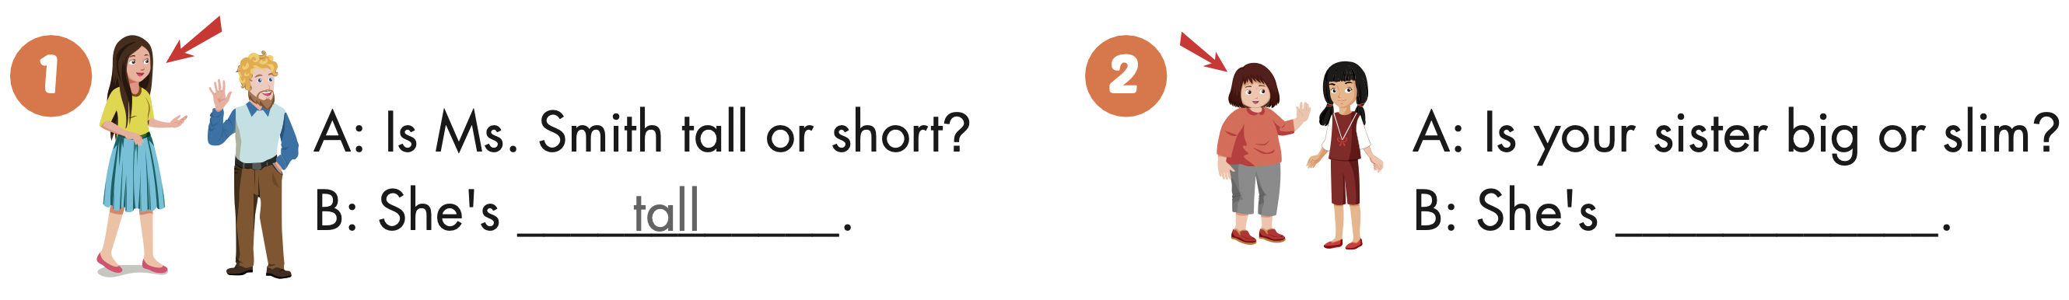

Slide 42
big

Slide 43
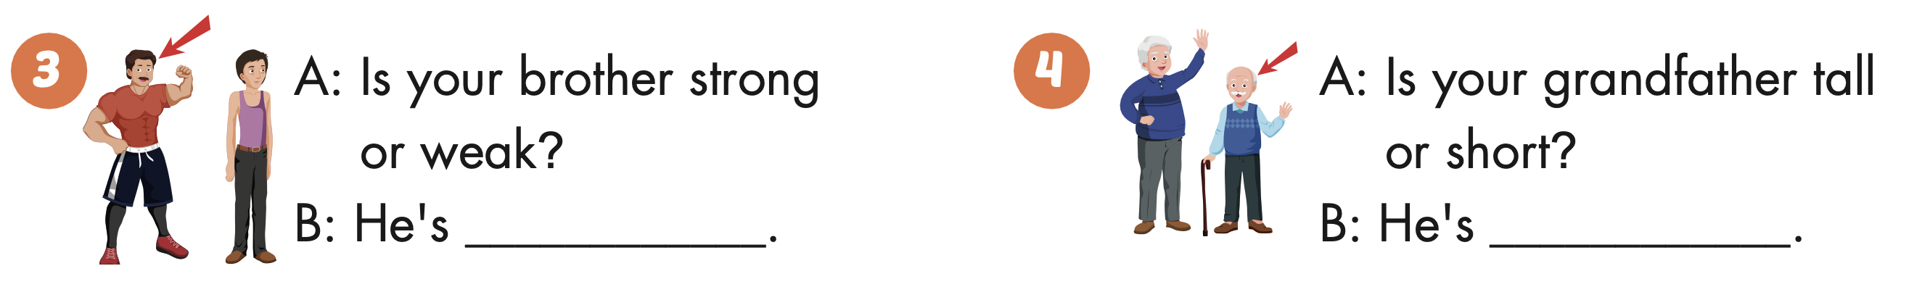
strong

Slide 44
short

Slide 45

Production

Slide 46

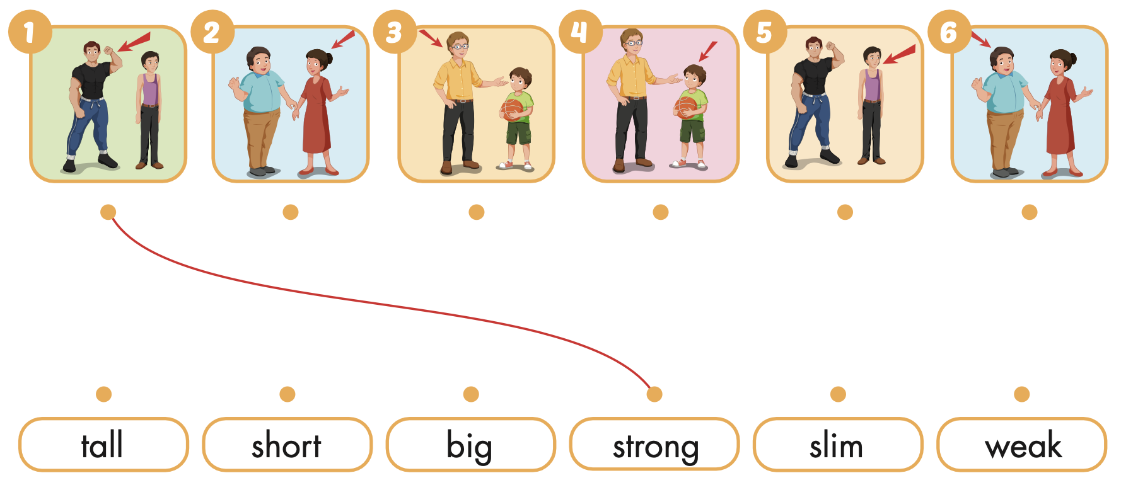
Extra Practice
WB, page 52

Slide 47

CONSOLIDATION

Slide 48
Today’s lesson
Vocabularies
tall, short, big, slim, strong, weak.
Structures/ Sentence patterns
Is your father big or slim? / He's slim. / Is your sister tall or short? / She's tall.

Slide 49
Homework
Practice the vocabularies and structure; and make sentences using them.
Do the exercises in Tiếng Anh 4 i-Learn Smart Start WB (page 52)
Do the exercises in Tiếng Anh 4 i-Learn Smart Start Notebook (page 34)
Prepare the next lesson (page 79 SB)
Play the consolidation games in Tiếng Anh 4 i-Learn Smart Start DHA App on www.eduhome.com.vn

