Slide 1

Unit 2: Family
Lesson 3.3
Page 32

Slide 2
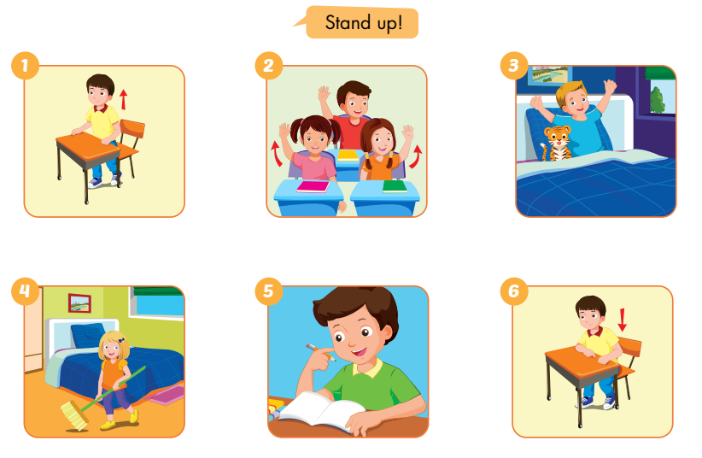
E
Point and say.
Notes:
E. Point and say.
Divide the class into two pairs.
Demonstrate the activity using the speech bubbles.
Have the student A point, have the student B say.
Swap roles and repeat.
Afterwards, have some pairs demonstrate the activity in front of the class.

Slide 3
E
2. Role-play.
Example:
Tina: This is my brother, Ben.
Mark: Hello, Ben. I’m Mark.
Ben: Hello, Mark.
Notes:
2. Role-play.
Divide the class into groups of three.
Demonstrate the activity using the example.
Ask them to role-play the activity.
Swap roles and repeat.
Afterwards, have some pairs demonstrate the activity in front of the class.

Slide 4
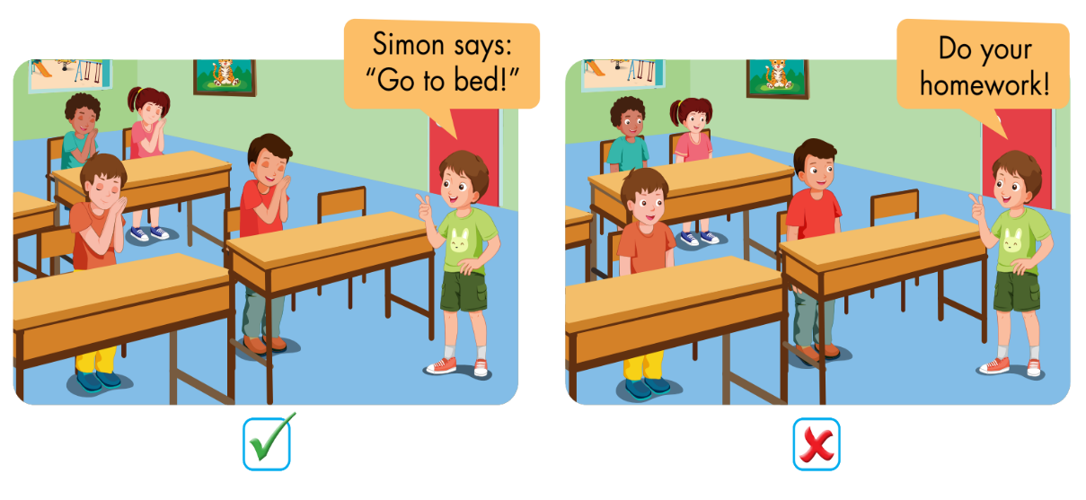
F
Play Simon says.
Notes:
F. Play Simon says.
Have students time to look and read at the examples.
Tell them they must only follow commands that start with “Simon says…”.
Model the activity in front of the class.
Demonstrate the game by giving the students different commands. If the command starts with “Simon says…”, students must do the action. If it doesn’t start with “Simon says”, students who do the action must sit down.
Invite one student to come to the front of the class to be “Simon”.
Ask them to swap roles and repeat with a new “Simon”.

