Slide 1

Unit 2: Family
Lesson 3
Page 31

Slide 2
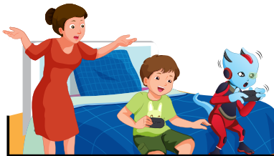

C. Listen and repeat
play /pleɪ/
pl
Sound
please /pliːz/

Slide 3

C.2. Chant.
/pl/, /pl/, /pl/,
/pl/, /pl/, /pl/,
play, please,
/pl/, /pl/, /pl/.

Slide 4


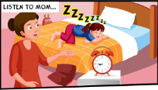
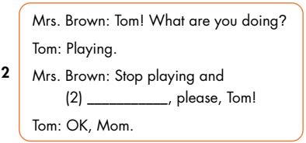
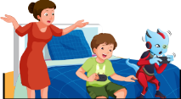
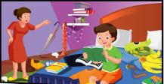
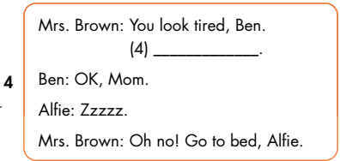
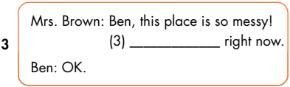
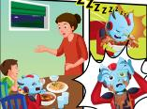
do your homework
Go to bed
clean your room

