Slide 1

Unit 2: Family
Lesson 3.1
Page 30

Slide 2


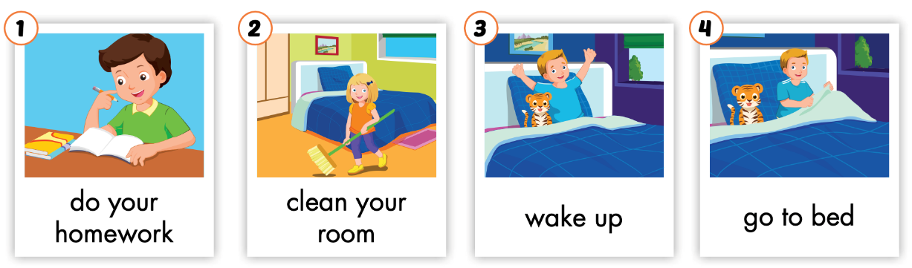
/du jər ˈhəʊmwɜːrk/
làm bài tập về nhà
/kliːn jər ruːm/
dọn phòng
/weɪk ʌp/
thức dậy
/ɡəʊ tə bed/
đi ngủ

Slide 3

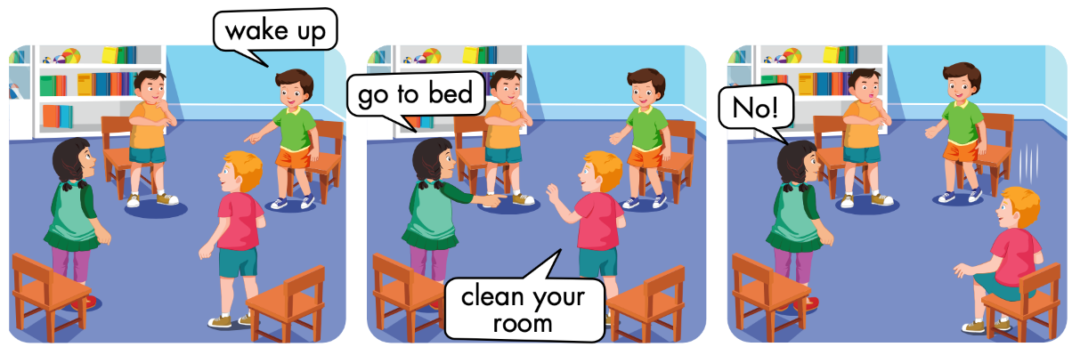

Slide 4

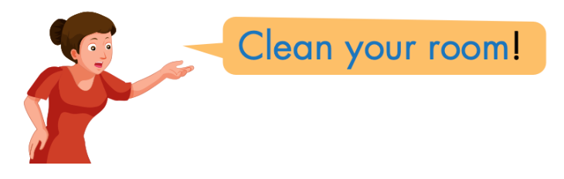
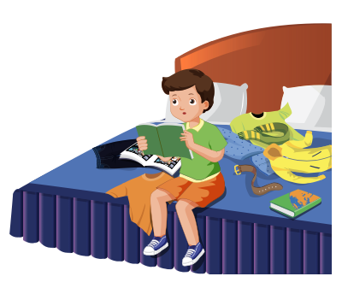
Click the icon to hear the sound.

Slide 5

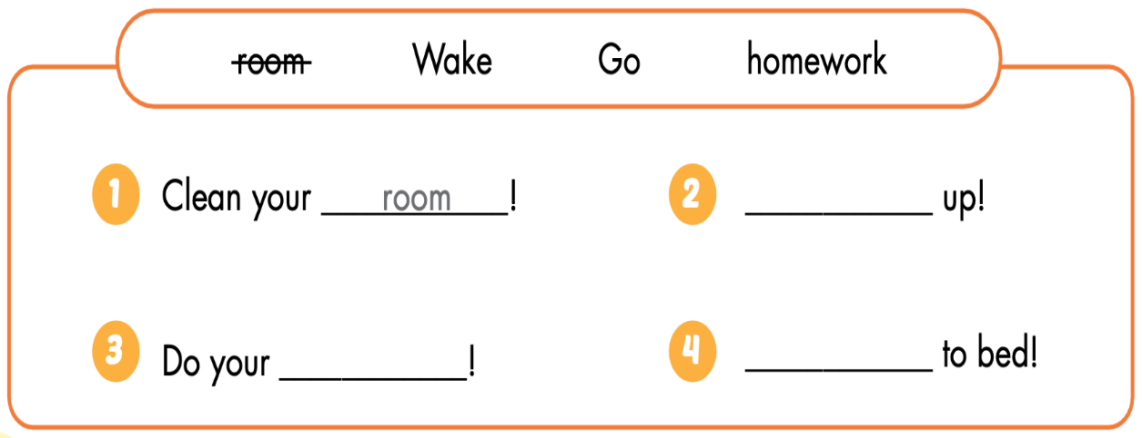
Wake
homework
Go

