Slide 1

Unit 2: Family
Lesson 2.1
Page 27

Slide 2


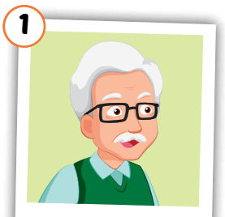
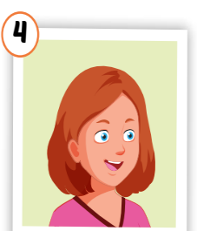
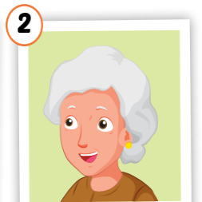
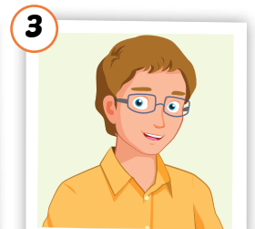
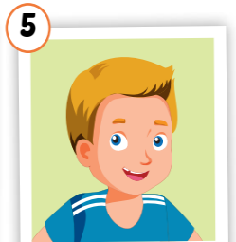
Click on each word to hear the sound.
grandfather
grandmother
uncle
aunt
cousin
/ˈɡrænfɑːðər/
ông nội, ông ngoại
/ˈɡrænmʌðər/
bà nội,
bà ngoại
/ˈʌŋkl/
chú, bác, cậu
/ænt/
cô, dì, mợ
/ˈkʌzn/
anh/chị/em họ

Slide 3
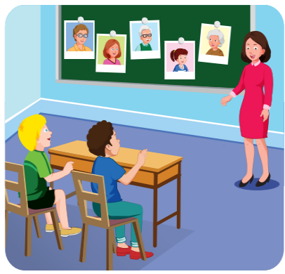
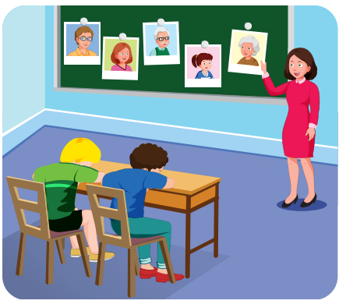
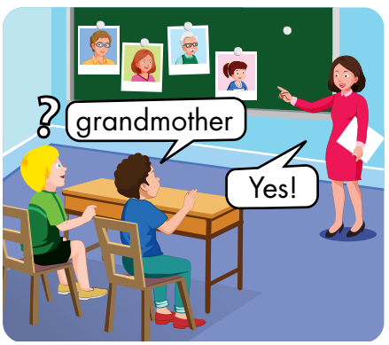

Slide 4




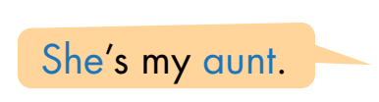



Slide 5

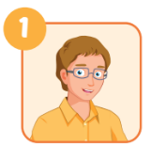
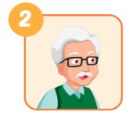
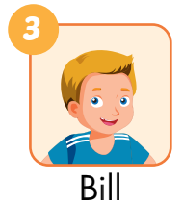
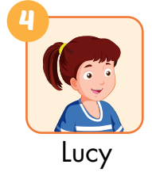
he
A: Who’s he? B: He’s my________.
A: Who’s ___________?
B: He’s _____________.
uncle
my grandfather
A: What’s his name? B: His name’s ______.
her name
A: What’s___________? B: Her___________.
Bill
name’s Lucy

