Slide 2


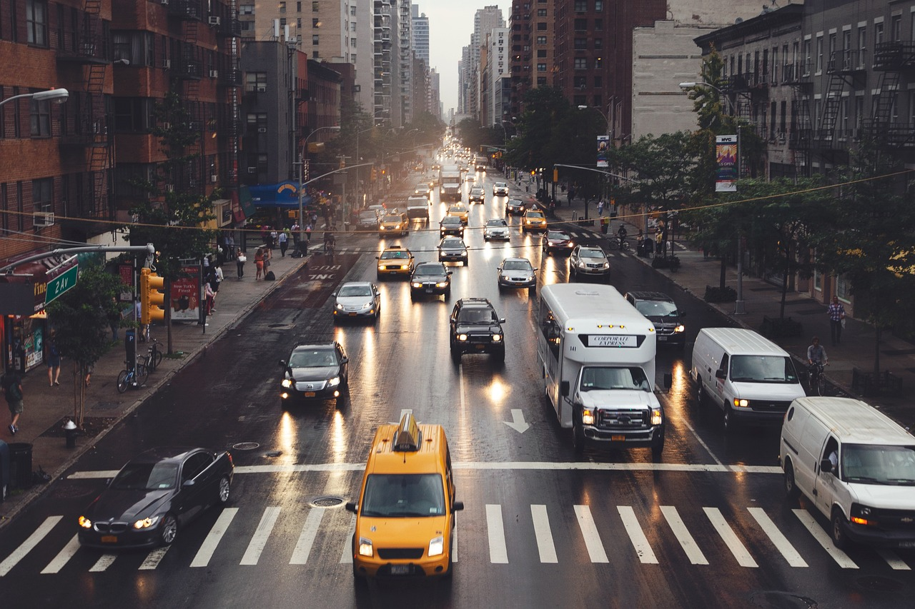
---------------
Unit
2
CITY LIFE
LESSON 1: GETTING STARTED
How is your city?

Slide 3

LESSON 1: GETTING STARTED
LESSON 1: GETTING STARTED
WARM-UP
Option 1: Think!
Option 2: City Debate
PRESENTATION
Vocabulary
Task 1: Listen and read.
Task 2: Read the conversation again and tick T or F.
Task 3: Match the words/ phrases with their pictures.
Task 4: Choose the correct answer A, B, C, or D.
PRACTICE
FURTHER PRACTICE
Task 5: Quiz: A lifestyle survey: City life or Village life?
CONSOLIDATION
Wrap-up
Homework

Slide 4
WARM-UP
OPTION 1
Answer the questions:
1/ Can you name some big cities in Viet Nam and in the world?
2/ Can you describe something you know about these cities?
(population, traffic, tourist attractions, ….)
THINK!

Slide 5
WARM-UP
OPTION 1
Answer the questions:
3/ Do you want to live there?
4/ Can you describe where you live? Is it a city or town?
5/ Do you like living there?
THINK!

Slide 6
WARM-UP
OPTION 2
- Work in teams.
- You have 2 minutes think about City advantages and disadvantages.
DEBATE
Advantages team | Disadvantages team

Slide 7
WARM-UP
OPTION 2
DEBATE TIME (2 minutes)
Advantages team | Disadvantages team

Slide 8
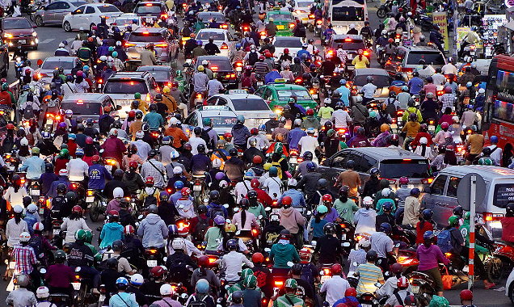

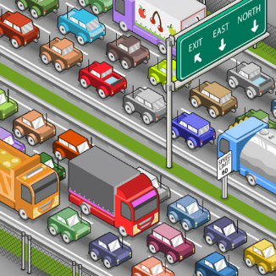
PRESENTATION
a large number of vehicles close together and unable to move or moving very slowly.
traffic jam (n)
/ˈtræfɪk ˌdʒæm/
kẹt xe

Slide 9


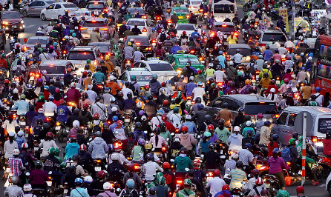
PRESENTATION
congested (adj)
/kənˈdʒestɪd/
tắc nghẽn (giao thông)

Slide 10
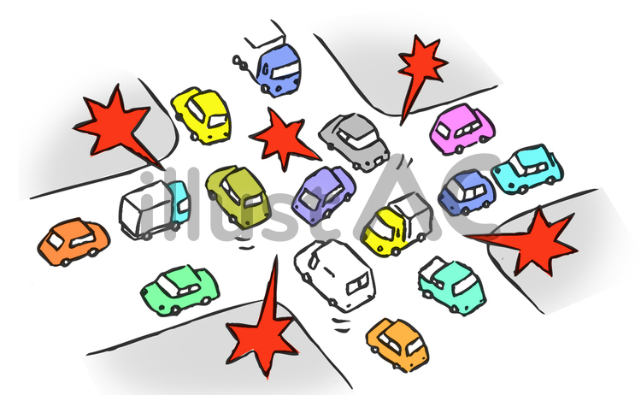
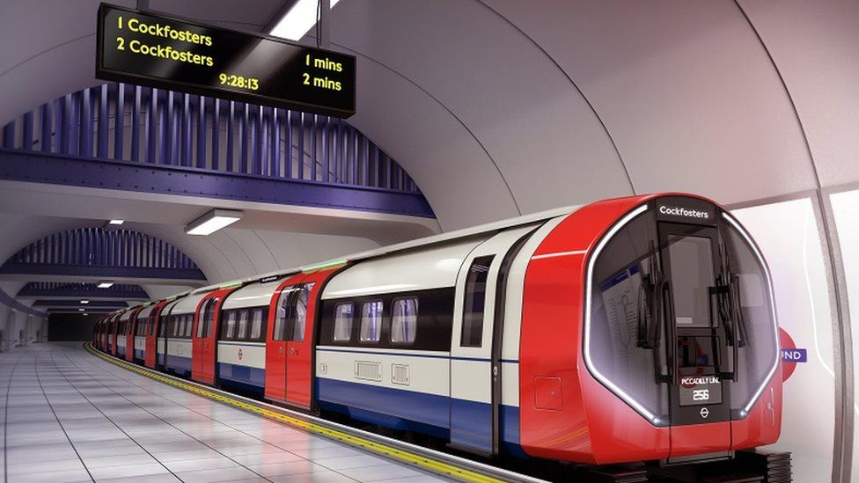
PRESENTATION
construction site (n)
/kənˈstrʌkʃn saɪt/
công trường xây dựng

Slide 11
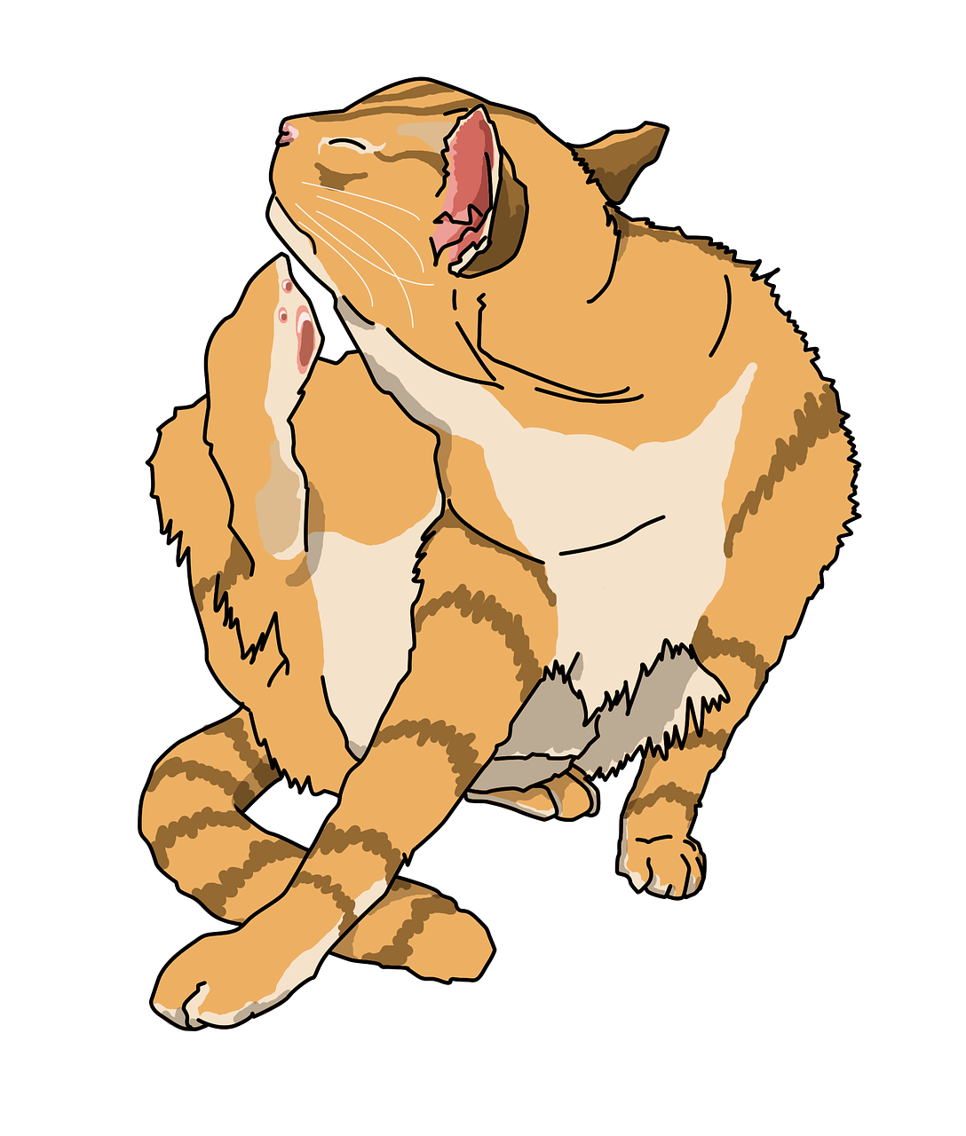
PRESENTATION
underground (n)
/ˌʌndəˈɡraʊnd/
hệ thống
tàu điện ngầm

Slide 12
PRESENTATION
itchy (adj)
/ˈɪtʃi/
ngứa, gây ngứa

Slide 13
PRESENTATION
downtown (n)
in or to the central part of a city
/ˌdaʊnˈtaʊn/
khu trung tâm thành phố, thị trấn

Slide 14
PRESENTATION
unreliable (adj)
not able
to be trusted
/ˌʌnrɪˈlaɪəbəl/
không đáng tin

Slide 15
PRESENTATION
grand (adj)
important and largein degree
/ɡrænd/
hoành tráng

Slide 16
PRESENTATION
pricey (adj)
expensive
/ˈpraɪsi/
đắt đỏ

Slide 17
PRESENTATION
New words | Pronunciation | Meaning
1. traffic jam (n) | /ˈtræfɪk ˌdʒæm/ | kẹt xe
2. congested (adj) | /kənˈdʒestɪd/ | tắc nghẽn (giao thông)
3. construction site (n) | /kənˈstrʌkʃn saɪt/ | công trường xây dựng
4. underground (n) | /ˌʌndəˈɡraʊnd/ | hệ thống tàu điện ngầm

Slide 18
PRESENTATION
New words | Pronunciation | Meaning
5. downtown (n) | /ˌdaʊnˈtaʊn/ | khu trung tâm thành phố, thị trấn
6. unreliable (adj) | /ˌʌnrɪˈlaɪəbəl/ | không đáng tin
7. grand (adj) | /ɡrænd/ | hoành tráng
8. pricey (adj) | /ˈpraɪsi/ | đắt đỏ

Slide 19
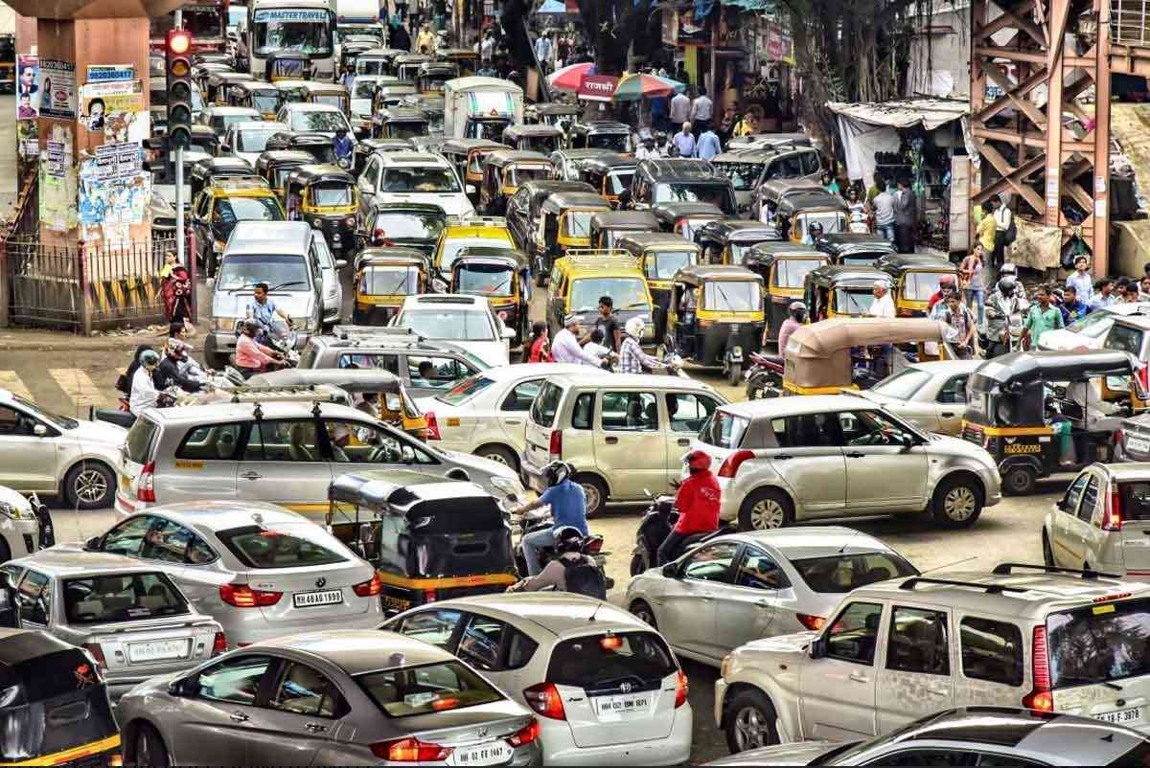
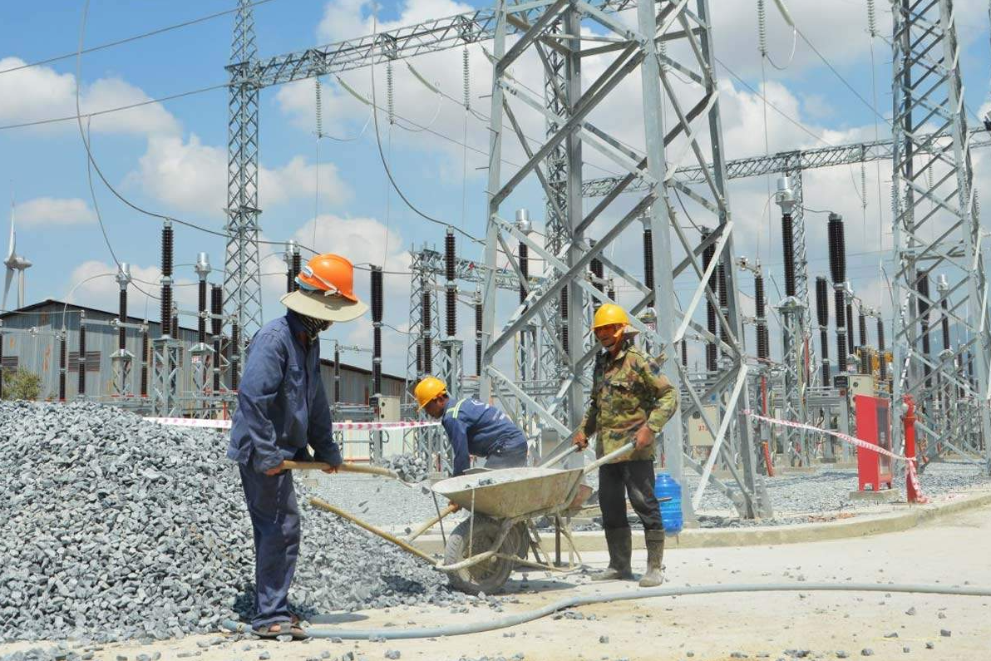
PRACTICE
Look at pictures on p.28
1. What do you see in each picture?
traffic jam / traffic congestion, …
2. Are the things in the pictures common in your home town?

Slide 20

PRACTICE
1
Listen and read.
Trang: Hi, Ben. Sorry I couldn’t get online earlier. I got stuck in a traffic jam and came home late.
Ben: No problem, Trang. Did you go by bus?
Trang: No. My dad picked me up. I rarely use the bus. It’s slow and packed with people.
Ben: I mostly get around by underground. It’s more reliable than the bus.
Trang: That’s great.
Ben: But traffic congestion is terrible in London. You know, the more crowded the city gets, the more congested the streets are.
Trang: Yeah … and the more polluted they may become. There’s a construction site in my neighbourhood. It’s dusty, so people easily get itchy eyes.
Ben: It must be noisy, too. The noise probably makes people feel stressed sometimes.
Trang: That’s right. But new buildings make the city look modern and attractive. Do you remember the grand building downtown?
Ben: Of course. How’s it now? When I left Viet Nam, they nearly finished it.
Trang: Well, it’s now a shopping mall. Teens like it because it’s modern and fun.
Ben: Do you often go there?
Trang: Sometimes. I watch movies there with my sister. I want to go there more often, but it’s a bit pricey.
Ben: It’s expensive here in London, too …

Slide 21
PRACTICE
Underline the words in the text that you think are related to the topic City life.

Slide 22

PRACTICE
2
Read the conversation again and tick T (true) or F (False).
 | T | F
1. The bus in Trang’s city is slow and crowded.
2. The underground system in Ben’s city is unreliable.
3. There is a dusty and noisy construction site near Trang’s house.
4. Trang thinks new buildings make the city look ugly.
5. Both Trang and Ben find shopping malls expensive.

Slide 23
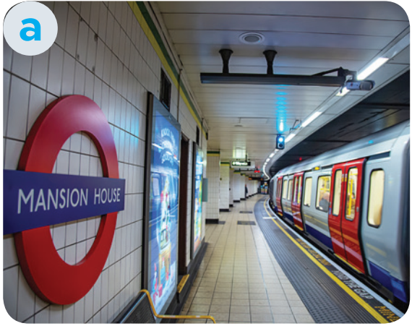
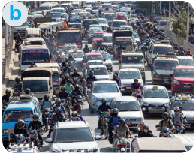
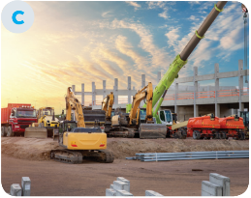
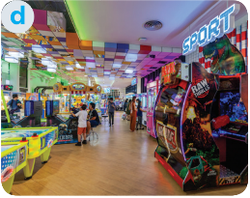
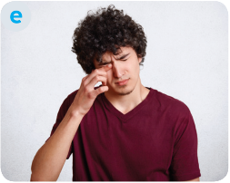
PRACTICE
3
Match the words/phrases with their pictures.
1. congested road
2. construction site
3. the underground
4. itchy eyes
5. entertainment centre

Slide 24


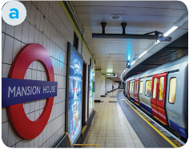

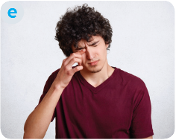
PRACTICE
3
Match the words/phrases with their pictures.
1. congested road
2. construction site
3. the underground
4. itchy eyes
5. entertainment centre

Slide 25
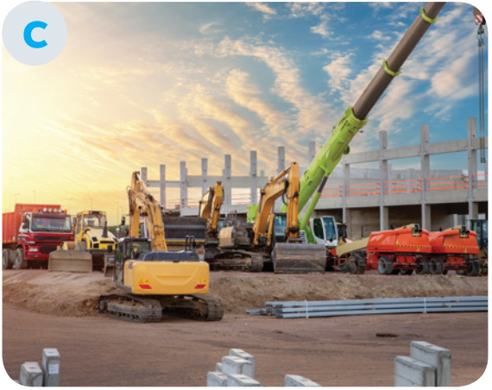




PRACTICE
3
3
Match the words/phrases with their pictures.
1. congested road
2. construction site
3. the underground
4. itchy eyes
5. entertainment centre

Slide 26




PRACTICE
3
Match the words/phrases with their pictures.
1. congested road
2. construction site
3. the underground
4. itchy eyes
5. entertainment centre

Slide 27



PRACTICE
3
Match the words/phrases with their pictures.
1. congested road
2. construction site
3. the underground
4. itchy eyes
5. entertainment centre

Slide 28
PRACTICE
Extra Activity: Work in groups. Each group makes sentences with the words/phrases.
1. congested road
2. construction site
3. the underground
4. itchy eyes
5. entertainment centre

Slide 29
PRACTICE
4
Choose the correct answer A, B, C, or D
1. I like getting around by ______. I hate the smell of car exhaust.
A. underground B. private car
C. taxi D. bus
2. Road dust may badly affect our ______.
A. stomach B. back C. eyes D. leg
3. There’s a ______ in my neighbourhood. It’s noisy and dusty.
A. building B. construction site
C. hospital D. lake

Slide 30
PRACTICE
4
Choose the correct answer A, B, C, or D
4. The road is narrow, so ______ often occurs at rush hour.
A. traffic light B. traffic flow
C. traffic congestion D. traffic safety
5. Many teens fancy spending their weekends in an entertainment ______.
A. industry B. value C. business D. centre

Slide 31
FURTHER PRACTICE
5
Quiz: A lifestyle survey: City life or Village life?
Complete the quiz. Then compare your choices with your friends’ and the teacher’s explanation. Which suits you more, life in the city or in a village?
You have 4 minutes to do this activity individually.

Slide 32
Compare your choices with your partner.
FURTHER PRACTICE
1. What kind of house do you want to live in? | 2. How do you like to get around?
A. A small and modern apartment. B. A house with a garden | A. By public transport. B. By motorbike or bicycle.
3. Where do you frequently enjoy visiting? | 4. How do you describe your favourite neighbourhood?
A. Shops, restaurants, cinemas, and art galleries. B. Local farmers’ markets. | A. Crowded and busy. B. Quiet and green.
5. How do you like to spend time outdoors?
A. Going for a walk or running in the park. B. Doing gardening or visiting next-door neighbours.

Slide 33
FURTHER PRACTICE
Compare your choices with your partner.
If you choose lots of A.
You will fit in the city.
If you choose lots of B.
The village is your better choice.

Slide 34
FURTHER PRACTICE
Show me more ideas about:
City Life | Village Life

Slide 35
PRODUCTION
EXTRA ACTIVITY
Work in groups and talk about the differences between living in the city and living in the countryside.

Slide 36

PRODUCTION
EXTRA ACTIVITY
 | Living in the city | Living in the countryside
Accommodation
Means of transport
Facilities
Neighbourhood
Outdoor activities

Slide 37

CONSOLIDATION
1
Wrap-up
What have we learnt in this lesson?
Gain an overview about the topic City life
Gain vocabulary to talk about life in the city

Slide 38

CONSOLIDATION
2
Homework
- Do exercises in the workbook.
- Prepare for the Project of the unit

Slide 39
CONSOLIDATION
MY FUTURE CITY
Name of the future city:
The population of the future city:
The type of houses people will live in:
The means of transportation that people will use:
The kinds of school and number of schools in the city:
The kinds and/or places of entertainment in the city:

Slide 40
Website: hoclieu.vn
Fanpage: facebook.com/www.tienganhglobalsuccess.vn/

