Slide 1

Warmly welcome to our class
English 6
Nguyen Binh Khiem Secondary School

Slide 2

WELCOME TO OUR CLASS
ENGLISH 6
Unit 4:
MY NEIGHBOURHOOD

Slide 3
Warm-up: Matching
B
A
1. Go straight
2. Turn left at
the traffic lights.
3. Go past the bus stop.
4. Take the first turning
on the left.
5. Go to the end of
the road.
6. Go along the street
7. It’s on your right
Nó ở bên phải của bạn
c. Đi thẳng
d. Đi đến cuối con đường
e. Rẽ trái ở cột đèn giao thông
f. Rẽ trái ở chổ rẽ đầu tiên
g. Băng qua tram xe buýt
h. Đi dọc theo con đường
1.C 2.e. 3.g 4.f 5. d 6. a 7.b
Notes:
3

Slide 4

UNIT 4: MY NEIGHBOURHOOD
LESSON 5
READING AND SPEAKING

Slide 5
UNIT 4: MY NEIGHBOURHOOD
LESSON 5
OBJECTIVES:
- develop reading skill for general and specific information;
- identify different features of a place; use what they have learnt to talk about a city.

Slide 6
I/ READING
* Vocabulary
- suburb (n):
Khu ngoại ô
= the countryside
play football, go camping, go fishing…
where can do these activities?
- Outdoor activity (n):
hoạt động ngoài trời
- backyard (n):
sân sau
(the yard behind the house)
- dislike (v)
(not) like
- incredibly (adv)
đáng kinh ngạc

Slide 7
* Checking words:
What and Where
suburb
dislike
incredibly
backyard
outdoor activity

Slide 8
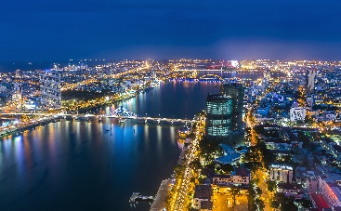
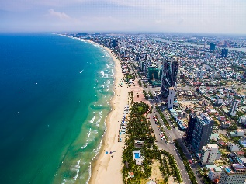
I/ READING:
*Read Khang’s blog.
MY NEIGHBOURHOOD
1.Where do you think Khang’s neighbourhood is?
2. What do you think about it?
3. What are there in the neighbourhood?
4. Do you like living there? Why?/ Why not?
In the countryside.
I think Khang’s neighbourhood is very nice and peaceful
There are a lot of trees, markets,...
Yes, I do. Because it is very peaceful.
→ You’re going to read Khang’s blog.

Slide 9


Read Khang’s blog. Look at the words in the box, then find them in the text and underline them. What do they mean?
http://www.myblog.com.vn/Khang
KHANG’S BLOG
Friday, December 23rd ...
MY NEIGHBOURHOOD
I live in the suburbs of Da Nang City. There are many things I like about my neighbourhood.
It’s great for outdoor activities because it has beautiful parks, sandy beaches and fine weather. There’s almost everything I need here: shops, restaurants, and markets. The people here are friendlier, and the food is better than in other places.
However, there are two things I dislike about it: there are many modern buildings and offices; and the streets are busy and crowded.
Posted by Khang at 4:55 PM

Slide 10

Read Khang’s blog again and fill the table with the information.
LIKES | DISLIKES
beautiful parks
modern buildings and offices
sandy beaches
busy and crowed streets
fine weather
shops, restaurant, markets
friendly people
good food

Slide 11

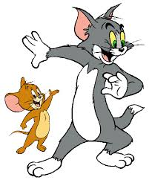
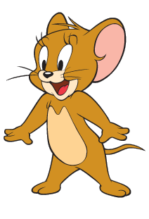
Read Khang’s blog again. Then answer the questions.
GAME : Lucky numbers
1
2
3
4
5
6

Slide 12
1.
Where is khang’s neighbourhood?
It is in the suburbs of Da Nang City.

Slide 13
2.
Why is his neighbourhood great for outdoor activities?
Because it has beautiful parks, sandy beaches and fine weather.

Slide 14
3.
What are the people in his neighbourhood like?
They are very friendly.

Slide 15
4.
How are the streets in his neighbourhood?
They are busy and crowed.

Slide 16

LUCKY NUMBER!

Slide 17
LUCKY NUMBER!

Slide 18
Read Khang’s blog again. Then answer the questions.
1.
Where is khang’s neighbourhood?
It is in the suburbs of Da Nang City.
2.
Why is his neighbourhood great for outdoor activities?
Because it has beautiful parks, sandy beaches and fine weather.
3.
What are the people in his neighbourhood like?
They are very friendly.
4.
How are the streets in his neighbourhood?
They are busy and crowed.

Slide 19

II. Speaking
Make notes about your neighbourhood.
Think about what you like / dislike about it.
LIKES | DISLIKES
- It’s great for outdoor activities
- The streets are busy and crowded during the day.
- There’s almost everything here:
- The people here are kind and friendly
- The food’s very good.

Slide 20

Work in pairs. Ask and answer about what you like and dislike about your neighbourhood.
Example:
A: Where do you live?
B: I live in the suburbs of Da Nang City.
A: What do you like about it?
B: The weather is fine. The people are friendly
and the food is good.
A: What do you dislike about it?
B: The streets are busy and crowded.

Slide 21

WRAP-UP:
- Learn new words.
Read about Khang’s neighbourhood.
Talk about your neighbourhood.

Slide 22
HOMEWORK:
- Learn by heart new words.
- Do Ex in the WB.
Prepare: Skills 2 (Write a paragraph about your neighborhood saying what you like or dislike.)

Slide 23


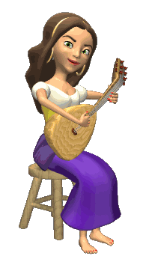


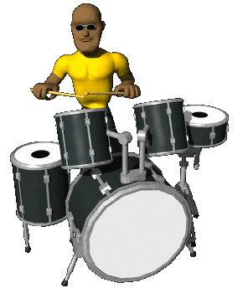





THANK YOU FOR ATTENTION!
GOOD BYE!
the end

