Slide 1
ENGLISH 9
Hello everyone !!!

Slide 2
WARM-UP
CHAIN GAME!!
1. Play in 2 teams
2. Each team play rock paper scissors to decide who will go first.
3. The winner say a sentence about their past experience then choose the second one in the other team. The second repeats and say their past experience and so on.
EXPERIENCES

Slide 3
WARM-UP
CHAIN GAME!!
4. The team can’t repeat the prior players’ answers in 10 seconds will lose the game.
EXPERIENCES

Slide 4
WARM-UP
Option 1
CHAIN GAME!!
EXAMPLE
Student 1 from team 1:
I had an unpleasant experience of a sports competition at school.
Student 2 from team 2:
She had an unpleasant experience of a sports competition at school and i accidentally felt while leaning to skate.
Student 3 from team 1:
She had an unpleasant experience of a sports competition at school. He accidentally felt while leaning to skate and i had a very good in the last summer camp…
EXPERIENCES

Slide 5
WARM-UP
Option 2
Chatting
Have you ever gone camping?
Have you ever travelled to a new place without parents like this?
Have you ever attended an army course/ joined any performances?
+ How do you feel about that experience?
+ What was that experience like?

Slide 6


Unit
5
OUR EXPERIENCES
LESSON 5: SKILLS 1
READING
SPEAKING

Slide 7

I. READING

Slide 8

1
Tick (√) the experiences you have had.
1. Joining a performance
2. Attending an army course
3. Travelling to a new place without parents

Slide 9

VOCABULARY

Slide 10
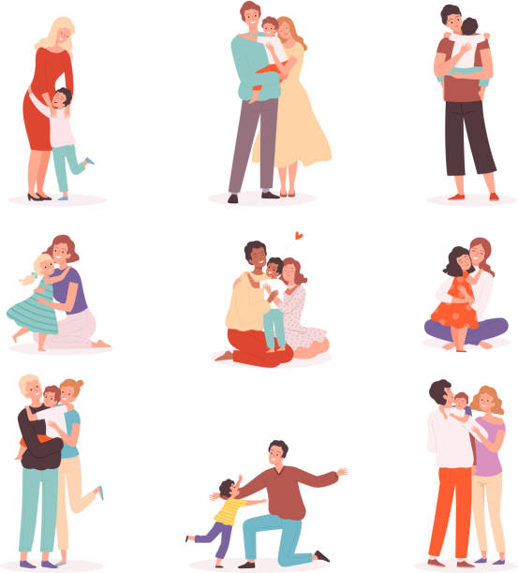

VOCABULARY
- touching (adj)
/ˈtʌtʃɪŋ/
gây xúc động

Slide 11
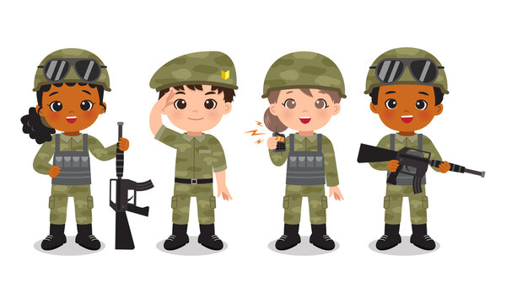
VOCABULARY
- soldier (n)
/ˈsəʊldʒə(r)/
người lính

Slide 12
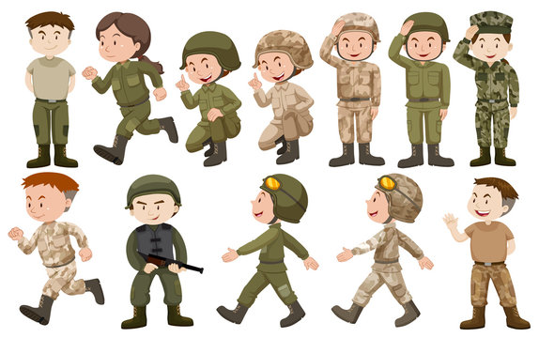
VOCABULARY
army-like (adj)
/ɑːmi- ‘laɪk/
như trong quân đội

Slide 13
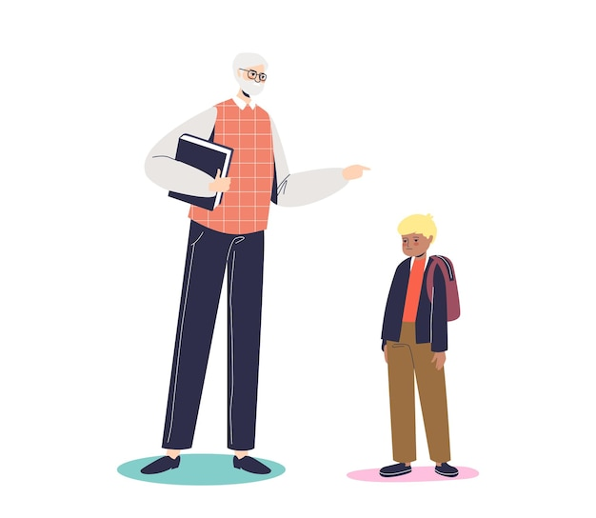
VOCABULARY
- strict (adj)
/strɪkt/
nghiêm khắc

Slide 14

VOCABULARY
- theme (n)
/θiːm/
chủ đề

Slide 15
Vocabulary
New words | Pronunciation | Meaning
1. touching (adj) | /ˈtʌtʃɪŋ/ | gây xúc động
2. soldier (n) | /ˈsəʊldʒə(r)/ | người lính
3. army-like (adj) | /ɑːmi- ‘laɪk/ | như trong quân đội
4. strict (adj) | /strɪkt/ | nghiêm khắc
5. theme (n) | /θiːm/ | chủ đề

Slide 16
* Checking vocab
What and Where
theme
army-like
soldier
touching
strict

Slide 17
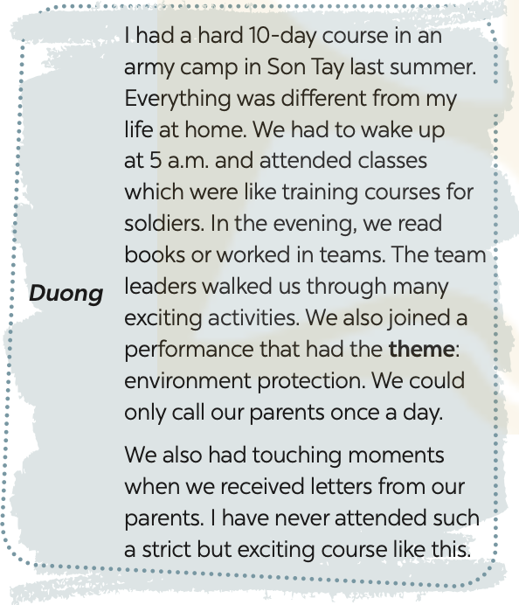
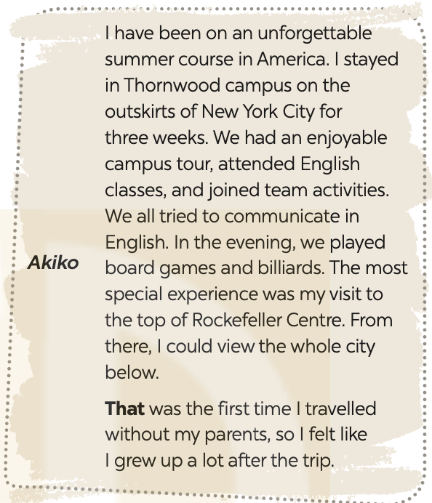

2
Read the texts and choose the correct answer A, B, C, or D.

Slide 18
2
Read the texts and choose the correct answer A, B, C, or D.
1. Duong and Akiko talked about ______.
A. their English summer courses B. experiences at summer courses
C. activities in summer D. their army training
2. What didn’t Duong do during his course?
A. Get up early. B. Work as a leader.
C. Receive letters from home. D. Work in teams.

Slide 19
2
Read the texts and choose the correct answer A, B, C, or D.
3. The word “theme” means ______.
A. Performance B. environment C. activity D. topic
4. The experience at Rockefeller Centre was ______ for Akiko.
A. unforgettable B. enjoyable C. special D. touching
5. The word “that” refers to ______.
A. travelling to America B. touring the Thornwood campus
C. visiting Rockefeller Centre D. viewing the city below

Slide 20
3
Read the texts again and tick Duong or Akiko.
Experiences | Duong | Akiko
1. attending an English course
2. attending an army-like course
3. joining a performance
4. touring a campus
5. receiving letters from home
✓
✓
✓
✓
✓

Slide 21

I. spEAkING

Slide 22
4
Match the questions in a with the answers in B. Share your answers with a classmate
A | B
1. What course did you attend? | a. It was in June.
2. When was that? | b. I felt that grew up a lot after that course.
3. What did you do? | c. I attended a course on soft skills with a group of young trainers.
4. What do you remember most about it? | d. We worked in groups on different projects. We also learned to solve problems. We had various experiences.
5. How did you feel? | e. I remember being so embarrassed at first. But the trainers and my peers were great and they helped me a lot.

Slide 23
Work in pairs. ask and answer about a course you have experienced. use the questions in 4 as cues. then report your partner’s answers to the class.
5
Example:
Minh attended a memorable summer course last year. It was a presentation skill course. He learnt how to organise the talk, and how to use visual aids. He also practised using gestures, and having eye contacts with the audience. He felt that the course was so impressive and memorable.

Slide 24

CONSOLIDATION
What have we learnt in this lesson?
Read about Duong and Akiko’s experiences in their last summer.
Talk about a course you have experienced.

Slide 25

Homework
Do exercises in the workbook
Write down your friend’s experiences in your notebooks.

Slide 26


Thank you!
Goodbye!

Slide 27
LESSON 5: SKILLS 1
LESSON 1: GETTING STARTED
WARM-UP
Chain game
Reading
Task 1: Write an activity next to each picture.
Task 2: Complete each sentence with an adjective in the box.
Task 3: Choose the correct answer A, B, C or D.
READING
SPEAKING
Speaking
Task 4: Listen and repeat the words. Pay attention to the sounds /j/ and /w/.
Task 5: Listen to the sentences. Underline the words with /j/ and circle the words with /w/. Practise the sentences.
CONSOLIDATION
Wrap-up
Homework

