Slide 1



Class : 9 A

Slide 2
WARM-UP
SENTENCE FORMING!!
OUR
EXPERIENCES
Play in 2 teams.
T says a verb in past participle form, and two teams uses that verb to say a sentence about his / her experience. If a team cannot make a sentence as required, it loses a turn.
The team with the most correct answers wins.
Example:
taken
→ I haven't taken part in the traditional dance performances yet.

Slide 3



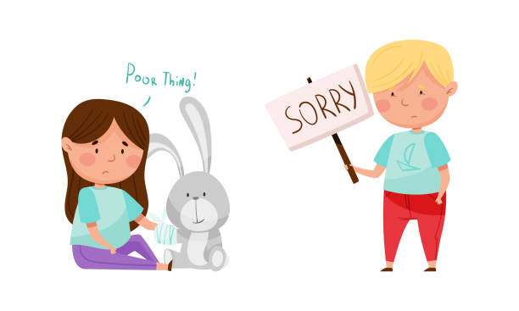
Unit
5
OUR EXPERIENCES
LESSON 4: COMMUNICATION

Slide 4

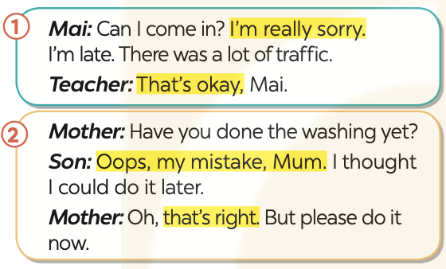
EVERYDAY ENGLISH
1
Listen and read the conversations. Pay attention to the highlighted parts.

Slide 5
Apologising and responding
(Xin lỗi và phản hồi)
Structures | Examples
Apolosizing | I’m really sorry… . Oops, my mistake.
Responding to apologies. | That’s okay. That’s right.

Slide 6

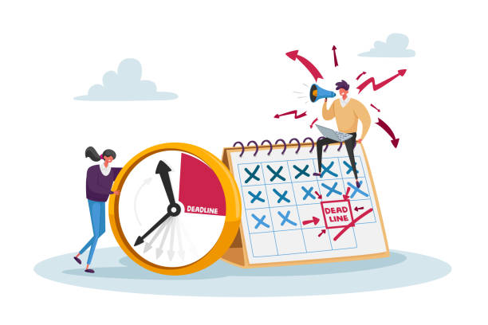
EVERYDAY ENGLISH
2
Work in pairs. Make similar conversations with the following situations.
1. You submit your project after the deadline.
2. You came home later than you promised your mum you would.

Slide 7
2
Work in pairs. Make similar conversations with the following situations.
1. You submit your project after the deadline.
Teacher: Have you submitted your project yet?
Student: Oops, my mistake. I thought I had more time. I'll make sure to be on time next time
Teacher: That's alright, but try to manage your time better in the future.

Slide 8
2
Work in pairs. Make similar conversations with the following situations.
2. You came home later than you promised your mum you would.
You: I'm really sorry. I came home later than I promised.
Mom: That's okay, but next time, make sure to inform me if you're going to be late.

Slide 9

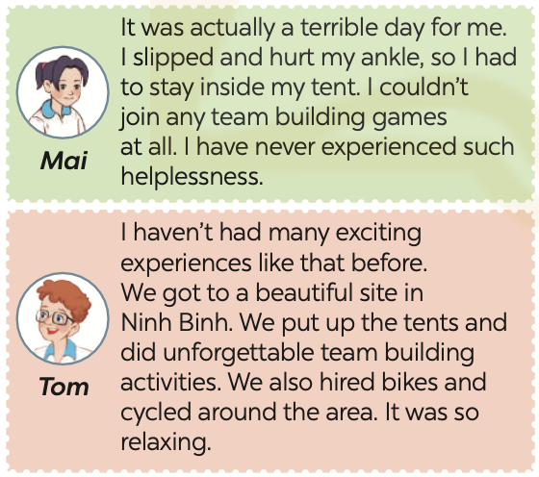
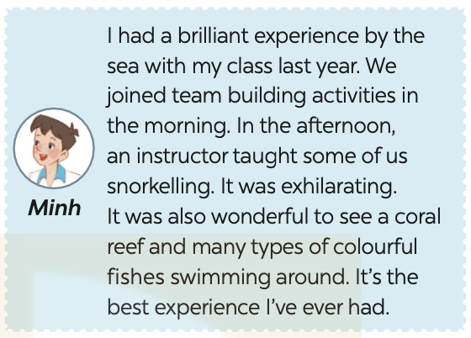
EXPERIENCES OF YOUR CLASS CAMPING DAY
3
Read the posts by three friends about their camping activities and match their names with the experiences.

Slide 10
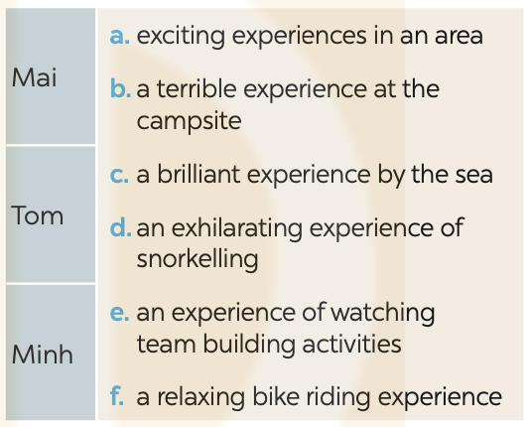
3
Read the posts by three friends about their camping activities and match their names with the experiences.

Slide 11
4
Work in pairs. ask and answer questions about the experiences of Mai, Tom, and Minh. you can use the questions below.
Where did he/she go?
What did he/she do?
How was his / her experience?
Has he / she ever had that experience before?

Slide 12
4
Work in pairs. ask and answer questions about the experiences of Mai, Tom, and Minh. you can use the questions below.
* Example:
A: Where did Mai go?
B: She went on a camping trip with her class.
A: What happened to her?
B: She slipped and hurt her ankle.
A: What did she do then?
B: She stayed inside the camp. She couldn’t join team building activities.
A: How did she feel?
B: She felt helpless. It was a terrible day for her.

Slide 13
5
Work in groups. take turns to ask and answer about one another’s experiences of a trip he / she has had. use similar questions to those in 4
* Example:
Linh: Mai, where did you go?
Mai: We went on a camping trip in Ninh Binh.
Linh: When was that?
Mai: Last year.
Linh: What happened then? / What did you do then?
Mai: We put up camps / tents, and joined team building activities.
Linh: How did you feel?
Mai: It was an amazing experience for me. I have never felt so excited like that.

Slide 14

CONSOLIDATION
What have we learnt in this lesson?
How to apologise and respond to apologises

Slide 15

Homework
Do exercises in the workbook.
Write down the results and feedback of the previous interviews.

Slide 16


Thank you!
Goodbye!

Slide 17
LESSON 4: COMMUNICATION
LESSON 1: GETTING STARTED
WARM-UP
Sentence forming
EVERYDAY ENGLISH
Task 1: Listen and read the conversations. Pay attention to the highlighted parts.
Task 2: Work in pairs. Make similar conversations with the following situations.
EVERYDAY ENGLISH
EXPERIENCES OF YOUR CLASS CAMPING DAY
Task 3: Choose the correct answer A, B, C, or D to complete each sentence.
Task 4: Write sentences about Mai’s experiences, using the information in the table.
Task 5: Work in groups. take turns to ask and answer about one another’s experiences of a trip he / she has had. Use similar questions to those in 4.
EXPERIENCES OF YOUR CLASS CAMPING DAY
CONSOLIDATION
Wrap-up
Homework

