Slide 1


Hello everyone !!!

Slide 2

* WARM UP: PELMANISM
* Example: do → done
1
2
WRITE
LIVE
3
4
DRINK
GO
5
6
EAT
SPEAK
7
8
DRUNK
WRITTEN
9
10
SPOKEN
LIVED
11
12
EATEN
GONE

Slide 3
* WARM UP: PELMANISM
* Example: do → done
WRITE
LIVE
DRINK
GO
EAT
SPEAK
WRITTEN
LIVED
DRUNK
GONE
EATEN
SPOKEN
V- P.P: Past participle

Slide 4



Unit
5
OUR EXPERIENCES
LESSON 3: A CLOSER LOOK 2
1

Slide 5
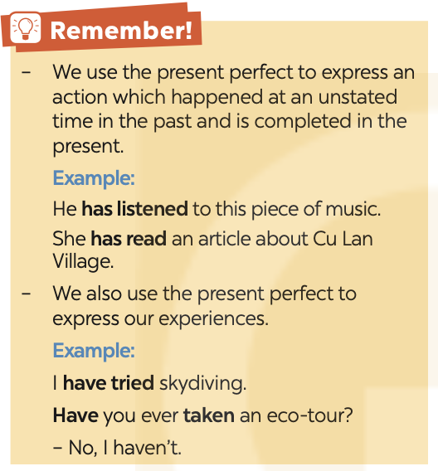
GRAMMAR: The present perfect
Form
S + have / has + Vp.p + … .
S + haven’t/ hassn’t + Vp.p + …
Have/ Has + S + Vp.p + … ?
P.P: Past participle

Slide 6
GRAMMAR: The present perfect
(Thì hiện tại hoàn thành)
Chúng ta dùng thì hiện tại hoàn thành để diễn tả một hành động đã xảy ra ở một thời điểm không xác định trong quá khứ và hoàn thành ở hiện tại.
He has listened to this piece of music.
She has read an article about Cu Lan Village.
Chúng ta cũng dùng thì hiện tại hoàn thành để diễn tả những trải nghiệm của mình.
I have tried skydiving.
Have you ever taken an eco-tour ? - No, I haven't.

Slide 7
GRAMMAR: The present perfect
 | Form
Dạng khẳng định | S + have / has + Vp.p + … .
Dạng phủ định | S + haven’t/ hassn’t + Vp.p + …
Dạng câu hỏi | Have/ Has + S + Vp.p + … ?
P.P: Past participle

Slide 8
Dấu hiệu nhận biết thì HTHT
before (trước đây)
ever (đã từng)
never (chưa từng, chưa bao giờ)
for + khoảng thời gian (trong khoảng)
since + mốc thời gian (từ khi)
just = recently = lately
yet (chưa): đứng cuối câu, dùng trong câu phủ định và nghi vấn
so far = until now = up to now (cho đến bây giờ)

Slide 9
PRACTICE
1
Write the correct forms of the verbs in the table.
Verbs | Past simple | Past participle
work join play be go do | worked | worked
joined
joined
played
played
was/were
been
went
gone
did
done

Slide 10
2
Complete the sentences with the correct forms of the verbs in the present perfect.
1. We (join) ___________ that project.
2. I (play) __________ a computer game at his house once.
3. She ______ never (work) ______ in such an unpleasant workplace.
4. He ______ never (be) ______ a class monitor.
5. They (go) __________ birdwatching several times.
have joined
have played
has
worked
has
been
have gone

Slide 11
3
Choose the correct answer A, B, C, or D to complete each sentence.
1. We ______ in our school’s sports competition once.
A. participate B. have participated
C. has participated D. are participating
2. Nam ______ any photos of his village for two years. A. has not taken B. have not taken
C. does not take D. is taking

Slide 12
3
Choose the correct answer A, B, C, or D to complete each sentence.
3. They _______ detective stories several times.
were reading B. read C. has read D. have read
4. I _______ never _______ that film before.
did; watched B. has; watched
C. have; watched D. was, watching
5. She _______ her cousin since she left school.
haven't met B. doesn't meet
C. hasn't met D. didn't meet

Slide 13
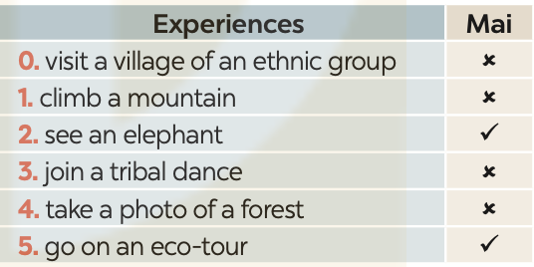
4
Write sentences about Mai’s experiences, using the information in the table.
Example:
Mai hasn’t visited a village of an ethnic group.

Slide 14
4
Write sentences about Mai’s experiences, using the information in the table.
1. Mai hasn’t climbed a mountain.
2. Mai has seen an elephant.
3. Mai hasn’t joined a tribal dance.
4. Mai has taken a photo of the forest.
5. Mai has gone on an eco-tour.

Slide 15
5
Work in pairs. ask and answer questions about your experiences using the present perfect
Example:
A: Have you visited a village of an ethnic group?
B: Yes, I have. / No, I haven’t.

Slide 16
* Production
Game : Lucky number
Find one incorrect word or phrase in the underlined words below and correct it.
1.Has you ever gone on a wildlife safari in Africa?
2.My friend haven't joined a guided city tour before.
3.Did you ever seen such a beautiful sunset like this?
4.Mrs Thu Ba has been explore the local markets recently.
5.She hasn't took part in the traditional dance performances yet.
6.Has he ever went scuba diving in the Caribbean?

Slide 17


Game: Lucky numbers
1
2
3
4
5
6
7
8
GA
GB
GA
2
4
6
8
10
12
14
GB
2
4
6
8
10
12
14
Go

Slide 18
* Production
Game : Lucky number
Find one incorrect word or phrase in the underlined words below and correct it.
1.Has you ever gone on a wildlife safari in Africa?
Has → Have

Slide 19
* Production
Game : Lucky number
Find one incorrect word or phrase in the underlined words below and correct it.
2. My friend haven't joined a guided city tour before.
haven't joined → has joined

Slide 20
* Production
Game : Lucky number
Find one incorrect word or phrase in the underlined words below and correct it.
3.Did you ever seen such a beautiful sunset like this?
Did → Have

Slide 21
* Production
Game : Lucky number
Find one incorrect word or phrase in the underlined words below and correct it.
4.Mrs Thu Ba has been explore the local markets recently.
Explore → explored

Slide 22
* Production
Game : Lucky number
Find one incorrect word or phrase in the underlined words below and correct it.
5.She hasn't took part in the traditional dance performances yet.
took part in → taken part in

Slide 23
* Production
Game : Lucky number
Find one incorrect word or phrase in the underlined words below and correct it.
6.Has he ever went scuba diving in the Caribbean?
Went → gone

Slide 24


UNLUCKY NUMBER

Slide 25



Slide 26

CONSOLIDATION
What have we learnt in this lesson?
How to use the present perfect tense

Slide 27

Homework
Do exercises in the Workbook.
Make 5 sentences in the present perfect tense.

Slide 28

Thank you!
Goodbye!

Slide 29
LESSON 3: A CLOSER LOOK 2
LESSON 1: GETTING STARTED
WARM-UP
Sentence puzzling
The present perfect
PRESENTATION
Task 1: Write the correct forms of the verbs in the table.
Task 2: Complete the sentences with the correct forms of the verbs in the present perfect.
Task 3: Choose the correct answer A, B, C, or D to complete each sentence.
Task 4: Write sentences about Mai’s experiences, using the information in the table.
PRACTICE
Task 5: Work in pairs. Ask and answer questions about your experiences using the present perfect.
PRODUCTION
CONSOLIDATION
Wrap-up
Homework

Slide 30
WARM-UP
Sentence puzzling!!
1. Work in 4 teams.
2. Unjumbled the given 4 sets of words to make 4 sentences.
3. The team with the most correct sentences in the fastest time is the winner.
OUR
EXPERIENCES

Slide 31
WARM-UP
Let’s check the sentences
1. Sarah has joined the camp since the beginning of summer.
2. She has gone to Paris with her family since last December.
3. They haven’t played for the school’s band for 4 months.
4. Have you done your homework yet? No, I have not.
OUR
EXPERIENCES
Notes:
Asking the sentences are in what tense?

